Slide 1

Presentation title
Designing Azure Compute and Storage Infrastructure for Advanced Performance
IT Innovation Series
Dan Stolts, Chief Technology Strategist
Twitter: @ITProGuru
Blog: http://ITProGuru
Speaker Name
#InnovateIT

Slide 2

Agenda
Scenario
Objectives
Technology overview
Lab environment and exercises

Slide 3
Scenario
Contoso, Inc. is still in
the process of evaluating recently added new features to Azure, such as Azure Resource Manager.
  Contoso has a number of large applications that use significant amounts of disk space
  for both read and write operations.
  Consequently, Contoso is interested in investigating how recently added features, such as new virtual machine scale units and premium storage, can provide both performance and cost benefits.
  You have been asked to investigate these features and create a sample Azure Resource Manager template to deploy a relatively high performance application.

Slide 4
Objectives
You will:
  Deploy a D2 virtual machine from a pre-configured template and
  compare it with a DS2 virtual machine that uses premium storage
  Learn about some of the more relevant capabilities within Azure and
  considerations that will allow you to design for cost-effective performance
  that matches the desired requirements
  Download an azuredeploy.json file from GitHub and modify it to deploy a
  virtual machine that uses premium storage, rather than standard storage
  Configure Iometer, and run a bench mark test

Slide 5
Technology overview

Slide 6
Resource groups
Container for multiple resources
Manage resources as a single unit
  Resources exist in one* resource group
  Resource groups can span regions
  Resource groups can span services
Role Based Access and Control
(RBAC) on groups or resources
Billing integrated tagging on
groups or resources
RESOURCE GROUPS
*and only one
Notes:
Overview of Resource Groups and how they are different from Service Groups (Classic)
Lots of ways you can use Resource Groups, Some examples: Per Project? Per Tier?
You can associate tags with the resource group which is integrated with Billing so it can be used as a custom identifier for your organization and billing

Slide 7




Azure VM families
Highest value
SSD storage,
faster CPUs
>64,000s of IOPS
Most memory,
fastest CPUs
Premium
storage
HIGHEST VALUE
LARGEST SCALE-UP
Notes:
New DV2 Vm family is not yet available, but announced at Azure Con…
New N family is not yet available, but announced at Azure Con
S nomenclature means you can connect to premium storage

Slide 8
Scale-up options
Highest value
Largest scale-up
A
D
G
N
DV2
Highest value
Most memory
fastest CPUs
>80,000 IOPs
Premium Storage
SSD Storage
Fast CPUs
GPU-enabled
virtual machines
New generation
of D family VMs
35% faster than D
Intel E5-2673 v3 CPUs
NVIDIA GPUs
Remote visualization
Compute-intensive + RDMA
Largest virtual machines
Fastest storage in the public cloud
Notes:
New DV2 Vm family is not yet available, but announced at Azure Con…
New N family is not yet available, but announced at Azure Con

Slide 9
Premium storage
Virtual machine
High bandwidth with low latency
Up to 32 TB of storage per Storage Account
64,000 IOPS per VM
5,000 IOPS per disk
~5 ms read/write (no cache)
Less than 1 ms read latency (cache)
Uncached
disk
Cached
disk
Local
disk
Disk provisioning
Disk provisioning
SSD provisioning
Cache miss
Cache hit
VM/network provisioning
Server SSD
Premium storage
blobs
Notes:
Premium Storage: High-Performance Storage for Azure Virtual Machine Workloads%
https://azure.microsoft.com/en-us/documentation/articles/storage-premium-storage-preview-portal/
You can use Premium Storage for Disks in one of two ways:
Create a new premium storage account first and then use it when creating the VM
Create a new DS-series or GS-series VM
While creating the VM, you can select a previously created Premium Storage account, create a new one, or let the Azure Portal to create a default premium account
Tip: To leverage the benefit of Premium Storage, create a Premium Storage account using an account type of Premium_LRS first. To do this, you can use the Microsoft Azure Preview Portal, Azure PowerShell, or the Service Management REST API
Azure uses the storage account as a container for your operating system (OS) and data disks
If you create an Azure DS-series or GS-series VM and select an Azure Premium Storage account, your operating system and data disks are stored in that storage account

Slide 10

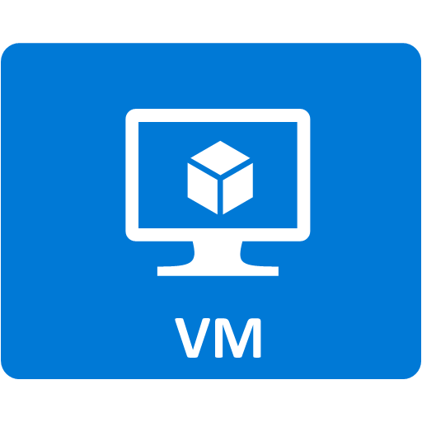
Azure scale unit (Azure Compute Cluster)
Definition
  A compute unit capable of supporting
  a defined range of VM sizes
  Each cloud service is bound to a
  single scale unit
  Each affinity group with one or more
  VM is bound to a single scale unit
Impact of resize
  VMs can only be resized to a size supported
  on scale unit where the VM is deployed
Scale unit
1
2
Scale unit
Notes:
Sizes for virtual machines at
https://azure.microsoft.com/en-us/documentation/articles/virtual-machines-size-specs/

Slide 11
Azure VM pricing tiers
Basic
  Scale Unit 1: A0-A4
  (original VM sizes)
  No load Balancing, no autoscale (can only scale between A0-A4)
    For small to medium applications or workloads
Standard
  Scale Unit 2: A0-A7
  (like SU1 but adds A5-A7)
  Scale Unit 3: A8/A9
  (“HPC” VMs, optimized networking with Infiniband)
  Scale Unit 4: A0-A7 and D1-D14 (D’s series with SSDs and better CPUs, and all A0-A7)
  Scale Unit 5: G1-G5
  (monster powerful VMs up to 32 core Xeon CPUs/448 GB RAM/6596 GB SSD storage/64 data disks)
Premium
  Available for DS and
  GS series VMs
Notes:
Basic: Shared…
Standard… good-great
Premium --- the best
Virtual Machines Pricing
https://azure.microsoft.com/en-us/pricing/details/virtual-machines/
New D-Series Virtual Machine Sizes
https://azure.microsoft.com/en-us/blog/new-d-series-virtual-machine-sizes/
Largest VM in the Cloud
https://azure.microsoft.com/en-us/blog/largest-vm-in-the-cloud/
How to choose scale unit
To ensure you get a SU that will meet your needs for scaling up, ensure the first VM deployed in that Cloud Service (or legacy Affinity Group) is in the upper range. So if you want SU2, deploy an S5 or above (S6 or S7) and you will be in SU2 at that point for all subsequent allocations. When you deploy a smaller size, like A2, you can get put into many different scale units. You won’t necessarily be in SU1.

Slide 12
Multiple storage accounts are often required!
To avoid throttling bottlenecks determine account and disk needs
Throttling is done per disk
  By family and by storage
Max of 20,000 IOPS (standard Storage Account)
Max of 35TB (Premium Storage Account
VM size | CPU cores | Max disk IOPS (per VM) | Max disk bandwidth (per VM) | Cache size (GB)
STANDARD_DS1 | 1 | 3,200 | 32 MB per second | 43
STANDARD_DS2 | 2 | 6,400 | 64 MB per second | 86
STANDARD_DS3 | 4 | 12,800 | 128 MB per second | 172
STANDARD_DS4 | 8 | 25,600 | 256 MB per second | 344
STANDARD_DS11 | 2 | 6,400 | 64 MB per second | 72
STANDARD_DS12 | 4 | 12,800 | 128 MB per second | 144
STANDARD_DS13 | 8 | 25,600 | 256 MB per second | 288
STANDARD_DS14 | 16 | 50,000 | 512 MB per second | 576
STANDARD_GS1 | 2 | 5000 | 125 MB per second | 264
STANDARD_GS2 | 4 | 10,000 | 250 MB per second | 528
STANDARD_GS3 | 8 | 20,000 | 500 MB per second | 1056
STANDARD_GS4 | 16 | 40,000 | 1,000 MB per second | 2112
STANDARD_GS5 | 32 | 80,000 | 2,000 MB per second | 4224
Storage disk type | P10 | P20 | P30
Disk size | 128 GiB | 512 GiB | 1024 GiB (1 TB)
IOPS per disk | 500 | 2300 | 5000
Throughput per disk | 100 MB per second | 150 MB per second | 200 MB per second
Notes:
Premium storage does not have 20k IOP limit but it does have 35TB storage capacity Limit

Slide 13
How many storage accounts?
It depends… what is the limiting factor (disk or VM)?
  EXAMPLE:
  5 VMs on P30 storage disk (5000 IOPS max). OR
  A single VM with 5 P30 disks striped = 25,000 IOPS
  So, in both cases 2 storage accounts are required to achieve 25,000 IOPS
  EXAMPLE:
  VMs capable of achieving 12,000 IOPS/disk. Assuming they do…
  (3 x 12,000=36,000)\20,000 = 2 storage accounts
  EXAMPLE:
  Maximum allowable disk capacity for premium storage accounts is 35 TB
  To accommodate the 64 1 TB disks allowed for a G5 VM, you would need
  2 storage accounts
  OR
=
12,000 IOPS/disk
=
Maximum: 35 TB

Slide 14
Azure storage types
  Block blobs, page blobs and disks, tables and queues, and files
 | Locally Redundant Storage (LRS) | Zone Redundant Storage (ZRS) | Geographically Redundant Storage (GRS) | Read-Access Geographically Redundant Storage (RA-GRS)
How it works | Makes multiple synchronous copies of your data within a single datacenter | Stores three copies of data across multiple datacenters within or across regions. For block blobs only | Same as LRS, plus multiple asynchronous copies to a second datacenter hundreds of miles away | Same as GRS, plus read access to the secondary datacenter
Total copies | 3 | 3 | 6 | 6
Why use it | For economical local storage or data governance compliance | An economical, higher durability option for block blob storage | For protection against a major datacenter outage or disaster | Provides read access to data during an outage, for maximum data availability and durability
Availability SLA | 99.9% read/write | 99.9% read/write | 99.9% read/write | 99.9% write 99.99% read
https://azure.microsoft.com/en-us/pricing/details/storage/
Notes:
How Azure pricing works
https://azure.microsoft.com/en-us/pricing/details/storage/

Slide 15
Temporary drive guidance
Never place critical unreplicated data
on temp drive!!
Use for SQL TempDB and Buffer Pool Extension on D-Series and G-Series VM sizes only (SSD temp disks)
  http://blogs.technet.com/b/dataplatforminsider/archive/2014/09/25/using-ssds-in-azure-vms-to-store-sql-server-tempdb-and-buffer-pool-extensions.aspx
Use scheduled tasks to configure temporary disk
Test scheduled tasks via resize
VM operation
Azure virtual machine
C:\
OS disk
D:\
temporary disk
E:\,F:\, etc.
data disks
Disk cache
Azure blob
Notes:
Virtual Machines Documentation
https://azure.microsoft.com/en-us/documentation/services/virtual-machines/

Slide 16
Temporary drive performance (D-Series)
Cores | VM sizes | Temp disk size (GB) | Max IOPS | Max read (MB/s) | Max write (MB/s)
1 | Standard_D1 | 50 | 3,000 | 48 | 24
2 | Standard_D2 Standard_D11 | 100 | 6,000 | 96 | 48
4 | Standard_D3 Standard_D12 | 200 | 12,000 | 192 | 96
8 | Standard_D4 Standard_D13 | 400 | 24,000 | 384 | 192
16 | Standard_D14 | 800 | 48,000 | 768 | 384
http://azure.microsoft.com/blog/2014/10/06/d-series-performance-expectations/
Notes:
TEMP DRIVE IS A LOCAL DRIVE so it is not tied to the 20K IOPs of a storage account, it does not go across the network to talk to the storage array
Azure Storage Scalability and Performance Targets
https://azure.microsoft.com/en-us/documentation/articles/storage-scalability-targets/

Slide 17
Key concepts – Service Manager
Hierarchy
Limits and locking
Subscription
Object | Limit | Locking
Subscription | 120 create/add operations in 5 minute window | N/A
Cloud service | 200 per subscription | ~3 minutes per update
Virtual machine | 50 per cloud service 2048 per virtual network | None
Virtual network | 100 per subscription | Single modification API
Storage account | 100 per subscription | None
Storage container | No limit | None
Storage blob | 40 per storage account | One blob per container per storage account at a time
Cloud service (200)
Virtual machine (50x200)
Virtual network (100)
Storage account (100)
Storage container
Storage blob (40x100)
http://azure.microsoft.com/en-us/documentation/articles/azure-subscription-service-limits/
Notes:
Only applies to Service Manager environment, no need to spend time on it … historical reasons only
Does not take into account premium storage

Slide 18
Know Your Limits – Resource Manager
Resource | Default Limit | Maximum Limit
Cores per subscription | 20¹ per Region | 10,000 per Region
Co-administrators | Unlimited | Unlimited
Storage accounts | 100 | 100²
Resource Groups | 800 | 800
Resource Manager API Reads | 15000 per hour | 15000 per hour
Resource Manager API Writes | 1200 per hour | 1200 per hour
Resource Manager API request size | 4,194,304 bytes | 4,194,304 bytes
VMs per Availability Set | 100 | 100
IOPS to a standard storage account | 20k | 20k
Notes:
1 can be increased easily with a support request on a per region basis
2 requires additional subscription

Slide 19
Large deployment guidance
Deploy VMs in blocks
  Block size: Minimum of Total VMs / 5 -or- 100
  Deploy one VM per cloud service; use common availability set in each cloud service
  Wait 5 minutes between starting each block of VMs to avoid throttling
Limit use of Get* APIs during deployment
  Limits possibility of throttling
  Back-off if any 503-ServiceUnavailable or 429-TooManyRequests errors are received
Use virtual network for connectivity
Custom image management
  If using a custom OS image then place up to 40 OS disks in a storage account
Notes:
Best Practices for Large Deployments of Azure Nodes with Microsoft HPC Pack
https://technet.microsoft.com/en-us/library/jj994092.aspx
Designing for Big Scale in Azure
http://blogs.msdn.com/b/kdot/archive/2014/10/09/designing-for-big-scale-in-azure.aspx

Slide 20
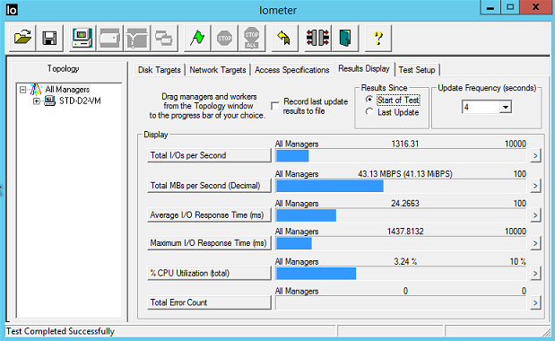
Iometer
An I/O subsystem measurement
and characterization tool for
single and clustered systems
Used as a benchmark and troubleshooting tool
Easily configured to replicate
the behavior of many popular applications
One commonly quoted measurement provided by
the tool is IOPS
Notes:
http://www.iometer.org/

Slide 21
Lab environment and exercises

Slide 22
Azure Boot Camp virtual machines
AZRCamp-Admin.contoso.com
(Windows 10; used for Azure Management)
AZRCamp-DC.contoso.com
(Windows Server 2012 R2; domain controller, DNS)
AZRCamp-Sync.contoso.com
(Used for synchronization in some labs)
AZRCamp-Edge
(Stand-alone Windows Server 2012 R2; RRAS)

Slide 23
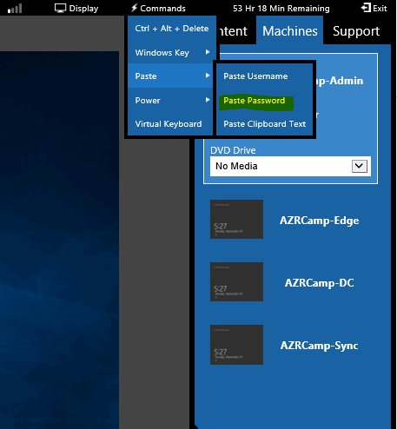
Lab environment
<insert lab url here>
Password = Passw0rd!

Slide 24
Prepare the Azure infrastructure
Lab02Start.ps1
  Create two Azure Resource Groups and determine two globally unique names for storage accounts
Deploy a D2 VM with standard storage
  4 striped disks
  Will be used to compare and contrast disk performance
  with a standard DS2 virtual machine that uses premium storage

Slide 25
Designing for appropriate workloads
Summary overview of Azure storage
and compute resource capabilities
  Basic vs. standard pricing tiers
  D and G series VMs
  Premium storage (DS and GS series)
Planning considerations for using
premium (or standard) storage
Notes:
Designing for appropriate workloads requires that performance benefits are relevant to the workloads and are cost-effective. Different applications will have different workloads. Some will be write-intensive, while others may be more read-intensive. And, the data that comprises the workloads can be vary from small to large. Within an Azure subscription, there is a cost associated with storage, compute, and other resources. Furthermore, software licensing models may be directly related to resources. For example, some database applications are licensed on a per CPU basis; the greater the number of CPUs, the greater the cost.
Windows Azure offers many choices for designing compute, storage, and other resources to provide an optimal fit for a particular workload or set of workloads. Designing resources for particular workloads requires an understanding, not only of the capabilities and cost associated with particular resources, but also the subscription and service limits, quotas, and constraints.

Slide 26
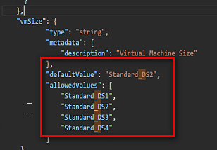
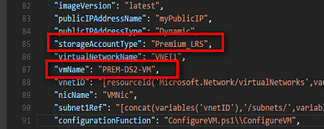
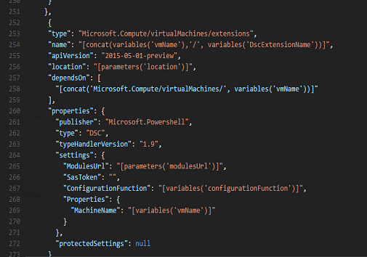
Deploy a VM with premium storage
Modify the
azuredeploy.json file

Slide 27
Compare standard and premium storage
Connect to STD-D2-VM
  Configure Iometer
  Run a disk performance test
Connect to PREM-D2-VM
  Configure Iometer
  Run a disk performance test
Compare disk performance data between VMs

Slide 28
Reset the Azure environment
Remove resource groups from Azure environment
.\RGCleanup.ps1

Slide 29
Conclusion

Slide 30
In review: Session objectives and takeaways
You now:
  Can deploy a D2 virtual machine from a pre-configured template and
  compare it with a DS2 virtual machine that uses premium storage
  Learn about some of the more relevant capabilities within Azure and
  considerations that will allow you to design for cost-effective performance
  that matches desired requirements
  Can download an azuredeploy.json file from GitHub and modify it to deploy
  a virtual machine that uses premium storage, rather than standard storage
  Can configure Iometer, and run a bench mark test

Slide 31
Resources
Register for another IT Innovation Series event
Further topics: Windows Server 2016, Windows 10 and more.
aka.ms/ITInnovation
Continue your learning
Download this presentation, access online training and demos, try Azure for free.
aka.ms/ITInnovationResources
Know someone who wants to learn more about
the Cloud?
Tell them to get started at the Microsoft Cloud Roadshow.
www.microsoftcloudroadshow.com

Slide 32

© 2015 Microsoft Corporation. All rights reserved. Microsoft, Windows and other product names are or may be registered trademarks and/or trademarks in the U.S. and/or other countries.
The information herein is for informational purposes only and represents the current view of Microsoft Corporation as of the date of this presentation. Because Microsoft must respond to changing market conditions, it should not be interpreted to be a commitment on the part of Microsoft, and Microsoft cannot guarantee the accuracy of any information provided after the date of this presentation. MICROSOFT MAKES NO WARRANTIES, EXPRESS, IMPLIED OR STATUTORY, AS TO THE INFORMATION IN THIS PRESENTATION.

