Slide 1

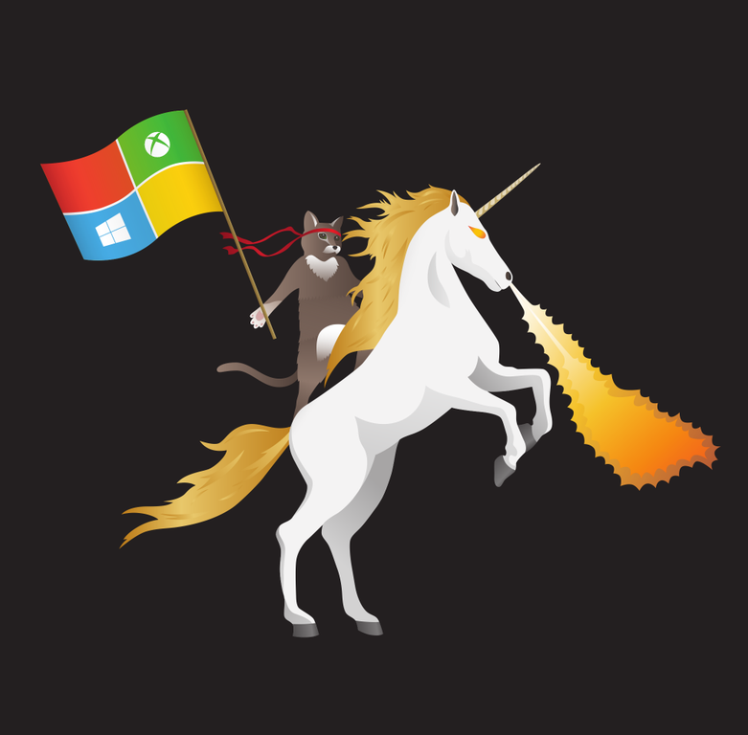




PowerShell and DSC Empowers DevOps and the Cloud
Dan Stolts (@ITProGuru)
Chief Technology Strategist
US DX North East – Audience
Blog: ITProGuru.com
dstolts@Microsoft.com
www.linkedin.com/in/danstolts
aka.ms/70-534-book
Specializations:
Cloud, Virtualization, Windows Server
@ITProGuru
Notes:
Title: PowerShell and DSC Empowers DevOps and the Cloud
Abstract: Dan Stolts from Microsoft and ITGuru.com comes with a full session on Desired State Configuration! DSC is a new management platform in Windows PowerShell that enables deploying and managing configuration data for software services and managing the environment in which these services run.
DSC provides a set of Windows PowerShell language extensions, new Windows PowerShell cmdlets, and resources that you can use to declaratively specify how you want your software environment to be configured. It also provides a means to maintain and manage existing configurations.Practical applications
Following are some example scenarios where you can use built-in DSC resources to configure and manage a set of computers (also known as target nodes) in an automated way:
Enabling or disabling server roles and features
Managing registry settings
Managing files and directories
Starting, stopping, and managing processes and services
Managing groups and user accounts
Deploying new software
Managing environment variables
Running Windows PowerShell scripts
Fixing a configuration that has drifted away from the desired state
Discovering the actual configuration state on a given node
Name of Presenter: Dan Stolts
Bio of Presenter (max 500 spaces): Dan Stolts “ITProGuru” is a technology expert who is a master of systems management and security. He is Chief Technology Strategist for Microsoft, owns several businesses and is a published author. Reach him on his primary blog http://itproguru.com or twitter @ITProGuru. He is proficient in many datacenter technologies (Windows Server, System Center, Virtualization, Cloud, Etc) and holds many certifications including MCT, MCITP, MCSE, TS, etc. Dan is currently specializing in system management, virtualization and cloud technologies. Dan is and has been a very active member of the user group community. Dan is an enthusiastic advocate of technology and is passionate about helping others. See more at: http://itproguru.com/about

Slide 2
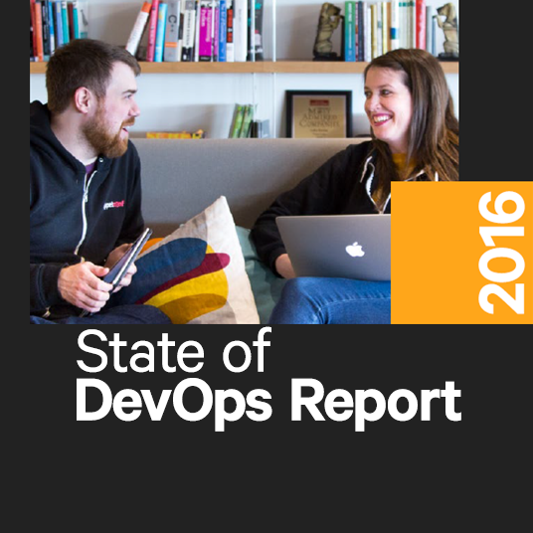
DevOps Benefits
Strong IT Performance is
a competitive advantage
200x more frequent deployments
Firms with high-performing
IT organizations were 2x as likely
to exceed their profitability, market share, and productivity goals
and with 2,555x
shorter lead time as compared to their lower-performing peers
Recover 24x faster from failures
DevOps Practices
improve IT
performance
and have a 3x lower change failure rate as compared to their lower-performing peers
Source: https://puppetlabs.com/
Notes:
Over the past 5 years, the State of DevOps report has surveyed more than 25,000 technical professionals world wide with companies of ALL sizes and verticals.
Employees in high-performing teams were 2.2x more likely to recommend their organization as a great place to work. (2016 – employee Net Promoter Score)

Slide 3

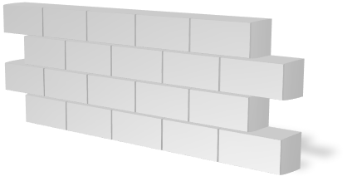




The consequences of inefficiency
40
%
… of implementations end up getting reworked because they don’t meet the users’ original requirements
IT drives business
success!
High IT performance correlates with strong business performance,
helps boost productivity,
market share and profit.
Outperforming
teams are
collaborate
54
%
extensively
more
likely to
41
%
… of development budgets for software, IT staff and external professional services will be consumed by poor requirements
with their
Collaboration blockers
counterparts
80
%
failure rate …
26.7%
No executive support
56.7%
Cultural inhibitors
43.3%
Fragmented processes
… for companies that try to adapt their existing tools for DevOps practices
Developers
IT Ops
%
Business
70
o
f
CIOs
Would
increase
risk
1 in
6
It takes on average 200 minutes to diagnose and repair a production issue
IT decision
makers is still
unfamiliar with
the term DevOps
to reduce
IT costs
and accelerate
business agility
3/4
of teams
DevOps was being initiated by
more development teams than IT Ops
teams by about a 40% to 33% margin
The average hourly cost of infrastructure failure is $100,000 per hour
A bug caught in production ends up costing
than if the same bug was found earlier in the development cycle
Responding to
ongoing needs for
efficiency and growth
100x more
have adopted
Agile methodologies
dual goals
Always keeping all
systems safe and secure
Notes:
In the real world, there are real consequences if you are unable to deliver high-quality software quickly or build the wrong thing to begin with:
40% of implementations end up getting reworked because they don’t meet the users’ original requirements
The average cost of one hour downtime of a customer-facing app is calculated at 100.000 dollars per hour – and this does not take into account the damage to reputation, which can be even greater.
Fixing such production issues takes on average 200 minutes per incident
Three quarters of development teams have adopted Agile methodologies today, enabling them to develop faster.
While this is a great number, it does not help if a development team is Agile but deployment still takes weeks or months because IT Ops is perceived as not being Agile
These are just 3 very high-level examples but all the data we have today points toward the same conclusion – this is about more than just frustration or minor delays. Lack of collaboration between dev and ops can have substantial impact on a company’s bottom line and success

Slide 4
List of DevOps Practices
Infrastructure as Code (IaC)
Continuous Integration
Automated Testing
Continuous Deployment
Release Management
App Performance Monitoring
Load Testing & Auto-Scale
Availability Monitoring
Change/Configuration Management
Feature Flags
Automated Environment De-Provisioning
Self Service Environments
Automated Recovery (Rollback & Roll-Forward)
Hypothesis Driven Development
  Testing in Production
  Fault Injection
  Usage Monitoring/User Telemetry
http://www.itproguy.com/devops-practices/

Slide 5
Why DSC VS GP? (Better than GP)
Declaring a DSC configuration is PowerShell based to help admins define configuration in the way they want.
    Reusability of Configuration Data
Can be used anywhere - on-premise, in a public or in a private Cloud environment.
Detects and fixes Configuration Drifts
Support for integration with other tools
Notes:
Declaring a DSC configuration is PowerShell based - You define configuration programmatically(script) which comes to admins naturally and help them define configuration in the way they want.
Reusability of Configuration Data - You can separate the configuration data from the logic of your configuration so that you can reuse your configuration data for different resources, nodes, and configurations, see http://technet.microsoft.com/en-us/library/dn249925.aspx
Can be used anywhere -DSC can be used on-premise, in a public or in a private Cloud environment. You just need either Windows Server 2012 R2 or Windows 8.1 and local administrator permissions to execute the DSC PowerShell scripts
Support for integration with other tools -You can integrate DSC with any Microsoft or non-Microsoft solutions as long as you can execute a PowerShell script on the target system. E.g. using DSC within the Windows Azure Pack portal in conjunction with SMA.

Slide 6
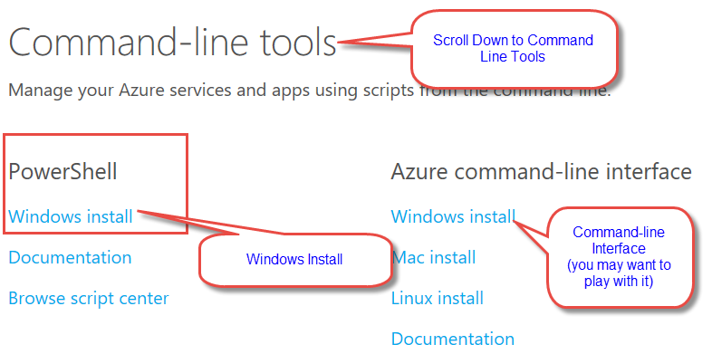
PowerShell Command-Line Tool for Azure
https://azure.microsoft.com/downloads/
Windows Install (under PowerShell)
CLI is there too if you want to play with it

Slide 7
Windows Management Framework 5.0
Windows Management Framework 5.0 includes updates to
  Windows PowerShell,
  Windows PowerShell Desired State Configuration (DSC),
  Windows Remote Management (WinRM),
  Windows Management Instrumentation (WMI).
Updates…
Just Enough Administration (JEA)
Creating Custom Types using PowerShell Classes
Improvements in PowerShell Script Debugging
Improvements in Desired State Configuration (DSC)
Audit PowerShell Usage using Transcription and Logging
Software Discovery, Install and Inventory with PackageManagement
PowerShell Module Discovery, Install and Inventory with PowerShellGet
PowerShell Script Discovery, Install and Management with PowerShellGet
New and updated cmdlets based on community feedback
Information Stream
Generate PowerShell Cmdlets based on OData Endpoint
Network Switch Management with PowerShell
Software Inventory Logging (SIL)
https://www.microsoft.com/en-us/download/details.aspx?id=50395

Slide 8
DSC Resource Kit – Anniversary Release
xActiveDirectory
xAdcsDeployment
xCertificate
xChrome
xComputerManagement
xDFS
xDhcpServer
xDnsServer
xDscDiagnostics
xDSCResourceDesigner
xExchange
xFailOverCluster
xFirefox
xNetworking
xPhp
xPSDesiredStateConfiguration
xRobocopy
xSqlPs
xSQLServer
xStorage
xTimeZone
xWebDeploy
xWindowsUpdate
To see a list of all released DSC Resource Kit modules, go to the PowerShell Gallery http://www.powershellgallery.com/
…
display all modules tagged as DSCResourceKit.
You can also enter a module’s name in the search box in the upper right corner of the PowerShell Gallery to find a specific module.
# To list all modules (WMF 5.0)of the DSC Resource Kit Find-Module -Tag DSCResourceKit
# To list all DSC resources (WMF 5.0) from all sources Find-DscResource
https://blogs.msdn.microsoft.com/powershell/2016/05/18/dsc-resource-kit-anniversary-release/

Slide 9
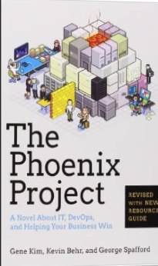
Tip: Must Read Book
Amazon…
The Phoenix Project: A Novel about IT, DevOps, and Helping Your Business Win Paperback
– October 16, 2014
The book is available on Audio Book; you can likely get it for free - if it’s your first time accepting a book from a friend. http://a.co/fJXE92A.
If you do not have an Audible Account, you get two free books when signing up for your free account.
This is the BEST IT Book I have ever read.

Slide 10
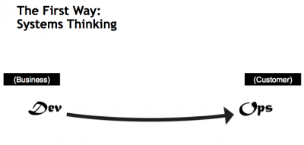
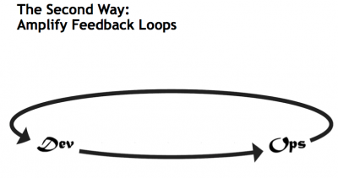
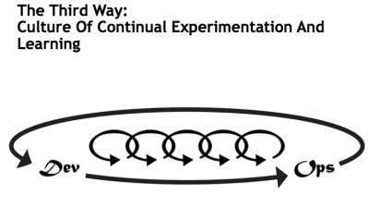
What is DevOps…
Infrastructure as Code (IaC)
Continuous Integration (CI)
Automated Testing
Application Performance Monitoring/Management (APM)
Continuous Deployment (CD)
Release Management
Configuration Management
DevOps Fundamentals
  Advanced Monitoring
  Capacity Management
  Feature Flags
  Self-Service Environments
Automated Recovery (Rollback & Roll-Forward)
Hypothesis Driven Development
  Testing in Production – partial user base
  Fault Injection
  Usage Monitoring/Telemetry
  A/B Testing (aka canary testing)
Gene Kim’s “3 ways”
The First Way emphasizes the performance of the entire system, as opposed to the performance of a specific silo of work or department — this as can be as large a division (e.g., Development or IT Operations) or as small as an individual contributor (e.g., a developer, system administrator).
The Second Way is about creating the right to left feedback loops. The goal of almost any process improvement initiative is to shorten and amplify feedback loops so necessary corrections can be continually made
The Third Way is about creating a culture that fosters two things: continual experimentation, taking risks and learning from failure; and understanding that repetition and practice is the prerequisite to mastery.
http://www.itproguy.com/devops-practices/
http://itrevolution.com/the-three-ways-principles-underpinning-devops/

Slide 11
Traditional vs modern dev-ops
Category | Traditional | Modern DevOps
Quality of code check-ins | Unknown | Validated through unit tests
Environment Creation/Configuration | Manual | Automated
Deployment Frequency | 1-2 months (or less frequent) | Deploy whenever needed, including several per day
App Deployment Process | Requires meetings and planning | Push-button deployment
Deployment validation | Manual | Automated
Monitoring | Minimal to none | Health and Performance monitoring
Dev and Ops relationship | Blame culture | Culture of trust

Slide 12
DSC – Definition
“Standard Space management to manage heterogeneous networks containing different types of Servers connected with Clients of different form factors.”
Servers
Windows/Linux etc.
Clients
Windows/iOS etc
Form Factors
PC/Servers/Tablet/Phones etc.

Slide 13
Why DSC?
Life with non-Registered (mobile) Devices
Different (including non-Windows) type of devices needs to be handled
Life in the Cloud…
Rapid change, at scale with, constant failures
Requirement
Need of an agent to “Make It So”
Want to compare Actual and Expected States easily
Need a language to express custom desired state easily
Need

Slide 14
What is “Make it so”?
With DSC we just define in configuration –
“Hey, you are a web browser, this is what you should look like.
Get to it, stay that way.”
Logic of making configuration in that way lies with ‘Local Configuration Manager’ on Client Machines.
  Making logic on client side enable us to control device specific behavior implementation

Slide 15
How DSC help?
One Stop Solution to Manage Enterprise
Option of correcting configuration drift when it occurs, or just report on configuration drift, to ley it know to admins that it has occurred
Cloud
BYOD - non-Win Devices
Laptop (VPNs)
Desktop/
Server

Slide 16
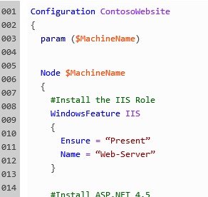
How DSC help?
One Stop Solution to Manage Enterprise
Allows you to describe the desired state of your environment by using this new power shell syntax
Option of correcting configuration drift when it occurs, or just report on configuration drift, to ley it know to admins that it has occurred
Cloud
BYOD - non-Win Devices
Laptop (VPNs)
Desktop/
Server

Slide 17

How DSC help?
One Stop Solution to Manage Enterprise
Allows you to describe the desired state of your environment by using this new power shell syntax
Option of correcting configuration drift when it occurs, or just report on configuration drift, to ley it know to admins that it has occurred
Cloud
BYOD - non-Win Devices
Laptop (VPNs)
Desktop/
Server

Slide 18
Where DSC can be used?
Install or remove server roles and features
Manage registry settings
Manage files and directories
Start, stop, and manage processes and services
Manage local groups and user accounts
Install and manage packages such as .msi and .exe
Manage environment variables
Discovering the actual configuration state on a given node
Fix a configuration that has drifted away from the desired state
Already Supported in GP

Slide 19
How DSC works?
Authorizing Phase
Staging Phase
“Make It So” Phase
3 Phase Model

Slide 20
How DSC works?
Authoring Phase
In this phase Admin creates the DSC configuration locally, through PowerShell or by third party languages/tools.
The output is one or more MOF (Management Object Format) files, the format which is consumable by DSC.
Notes:
Advanced task dependencies – talk about “Dependency Type” options enabled only for multi-machine job when Dependencies is clicked in the Task tab.
Studio Help -> Contents -> “Working With Jobs” -> “Key Concepts for WTT Jobs” -> Parameters

Slide 21
How DSC works?
DC /
Pull Server
Authoring Phase
Staging Phase
In this phase DSC data (MOF files) is staged for Deployment –
Push Model – On DC
Pull Model – Dedicated Web Server (IIS)
Notes:
Advanced task dependencies – talk about “Dependency Type” options enabled only for multi-machine job when Dependencies is clicked in the Task tab.
Studio Help -> Contents -> “Working With Jobs” -> “Key Concepts for WTT Jobs” -> Parameters

Slide 22
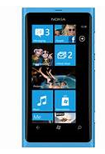
How DSC works?
DSC data is either pulled or pushed to the “Local Configuration Store” and contains the current, previous and the desired (DSC) state configuration.
DC /
Pull Server
Authoring Phase
Staging Phase
“Make it So” Phase
The configuration then gets parsed and the relevant (WMI) provider implements the change and “makes it so”.
Enterprise
Notes:
Advanced task dependencies – talk about “Dependency Type” options enabled only for multi-machine job when Dependencies is clicked in the Task tab.
Studio Help -> Contents -> “Working With Jobs” -> “Key Concepts for WTT Jobs” -> Parameters

Slide 23
How DSC works?
DSC data is either pulled or pushed to the “Local Configuration Store” and contains the current, previous and the desired (DSC) state configuration.
DC /
Pull Server
Authoring Phase
Staging Phase
“Make it So” Phase
The configuration then gets parsed and the relevant (WMI) provider implements the change and “makes it so”.
Enterprise
Notes:
Advanced task dependencies – talk about “Dependency Type” options enabled only for multi-machine job when Dependencies is clicked in the Task tab.
Studio Help -> Contents -> “Working With Jobs” -> “Key Concepts for WTT Jobs” -> Parameters

Slide 24
Power Shell Extension
Support type definitions for eg . Configuration types
New language/constructs specific to authoring of the Configuration scripts.
Eg.
configuration MyWebsite
{
node ("WebServer1", "WebServer2")
{
WindowsFeature IIS
{
Ensure = "Present"
Name = "Web-Server“
}
}
}

Slide 25
DSC Push Model
Authoring Phase
Staging Phase
“Make it So” Phase
Local Configuration Store
Configuration Staging Area
(Contains DSC data)
Parser and Dispatcher
Imperative Providers

Slide 26
DSC Pull Model
Authoring Phase
Staging Phase
“Make it So” Phase
Local Configuration Store
Pull Server
(Contains DSC data and Modules)
Parser and Dispatcher
Imperative Providers

Slide 27
When to use which model?
Recommended
Pull Model | Push Model
Suitable for new enterprises where network is dynamic in nature | Suitable for legacy enterprises where network is static in nature
Scalable Solution – Dedicated server ensure that response can be scaled specially in case of Cloud where VMs can be created on demand | All files resides in DC, increased DSC activity may increase load on already burdened DC.
Non-Windows Devices – Pull Server being just webserver, all devices can pull configuration from Web URL. | No current support for non-Windows Device

Slide 28
  As Dan the developer,
  I can easily
  author a DSC script
  reusing DSC resources
  from a public or private gallery,
  so that I can quickly and easily write
  DSC scripts
  with very little custom code.

Slide 29
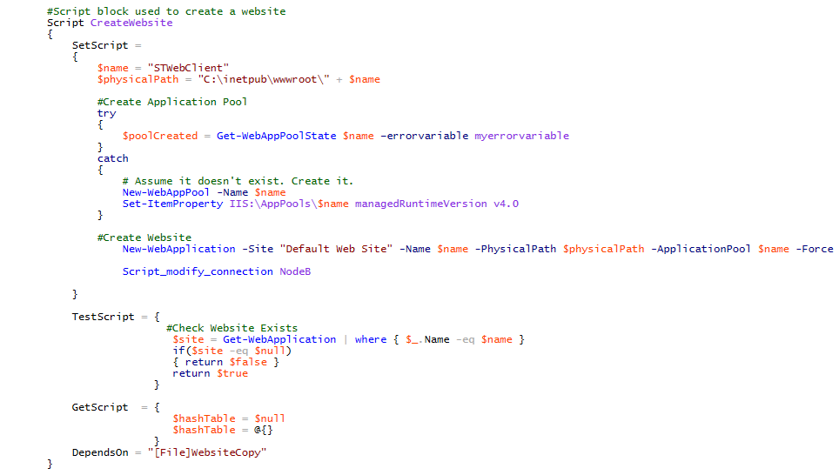
Author a DSC script
WITHOUT DSC Resource

Slide 30
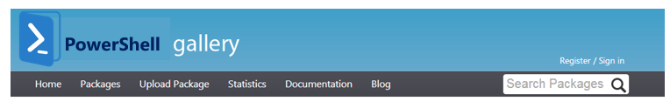
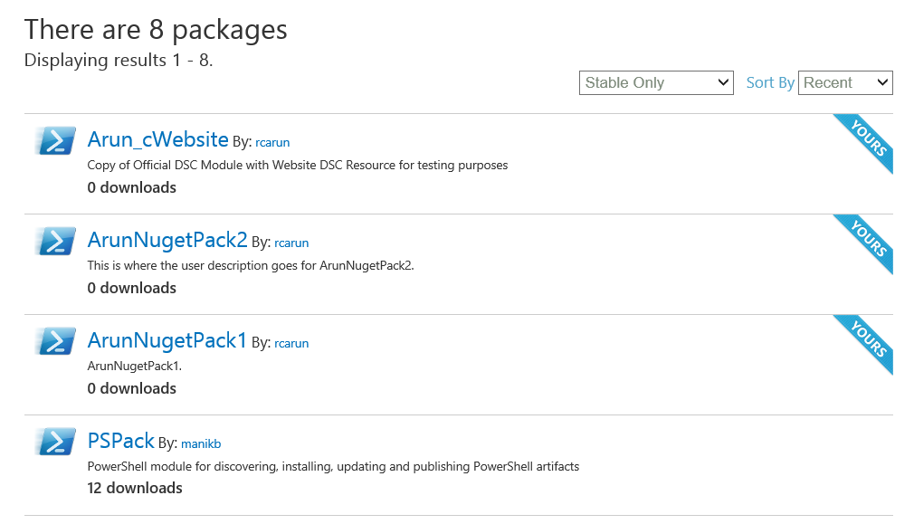
… reusing DSC resource/s - I
I can Find DSC resources from Gallery by Search Term/Name/Tag
I have a rich set of resources to use from Day 1 that replace my RM actions [see next slide]

Slide 31
Rich set of DSC resources replacing RM actions
No. | RM Tool | Tag | RM Action | RM Customer Usage | Analog DSC Resource
1 | Application Pool | IIS | Create/Config/Start/Remove App Pool | 1. Very Frequent | IISWebConfiguration
2 | Web Application | IIS | Create/Configure/Remove Web Application | 1. Very Frequent | WebDeploy
3 | Website | IIS | Create/Configure/Remove/Start/Stop/Restart Website | 1. Very Frequent | Website
4 | Database Deployer | SQL | Create/Drop Database | 1. Very Frequent | SQLQuery
5 | Database Deployer | SQL | Execute SQL Script | 1. Very Frequent | SQLQuery
6 | Windows | System | Common Windows IO | 1. Very Frequent | File
7 | XCopy Deployer | System | Copy File or Folder | 1. Very Frequent | File
8 | MSI Deployer | System | Deploy MSI | 1. Very Frequent | Package
9 | Virtual Directory | IIS | Create/Configure/Remove Virtual Directory | 2. Frequent | IISWebConfiguration
10 | Web Application | IIS | Remove Web Application | 2. Frequent | WebDeploy
11 | File | System | Create/Delete File or Folder | 2. Frequent | File
12 | Command Line Runner | System | Run Command Line [as User] | 2. Frequent | Process
13 | Windows Services Manager | System | Create/Start/Stop/Config/Restart Service | 2. Frequent | Service
14 | MTM Automated Tests Manager | Test | Run Tests | 2. Frequent | ?

Slide 32
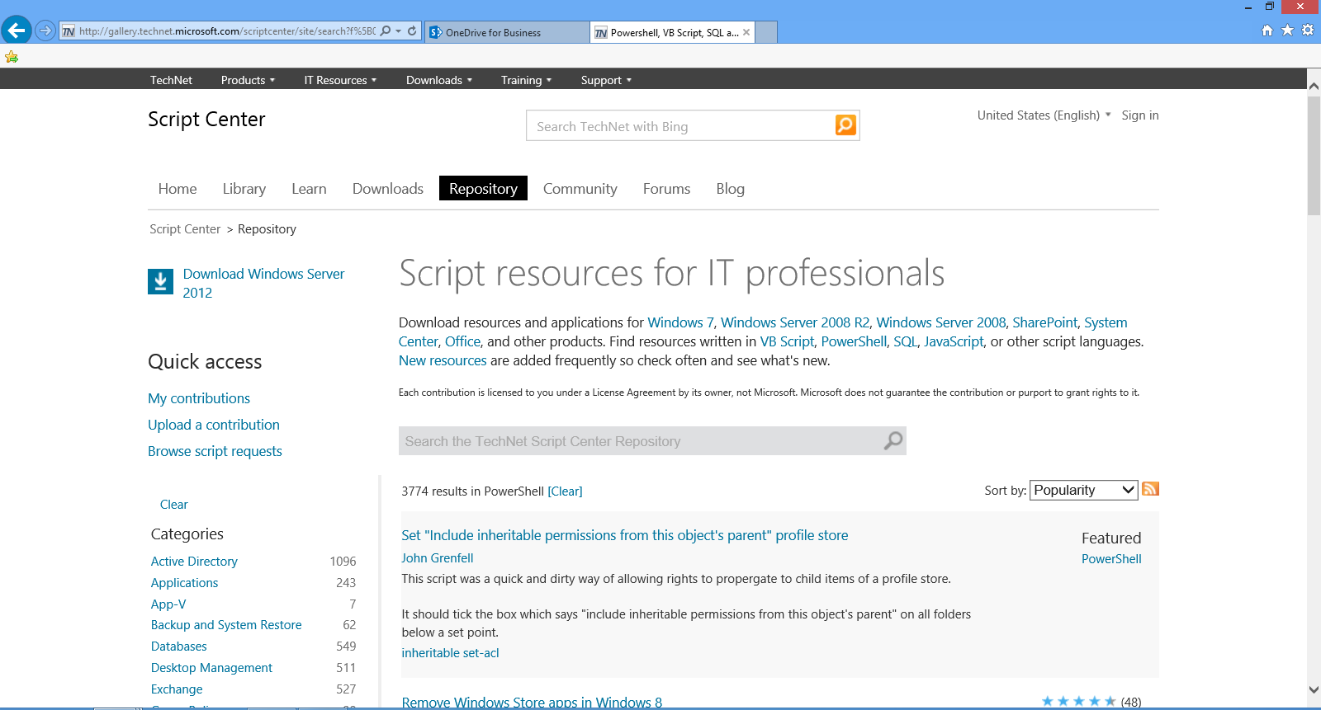
Existing PS Modules/DSC resources ported to gallery
I can port PS modules & DSC resources from Technet Script center to the gallery.

Slide 33
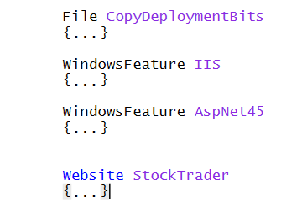
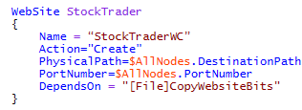
reusing DSC resource/s - II
WITH DSC Resource
I can install multiple resources & modules that my DSC script depends on before deploying to a node in push mode.

Slide 34
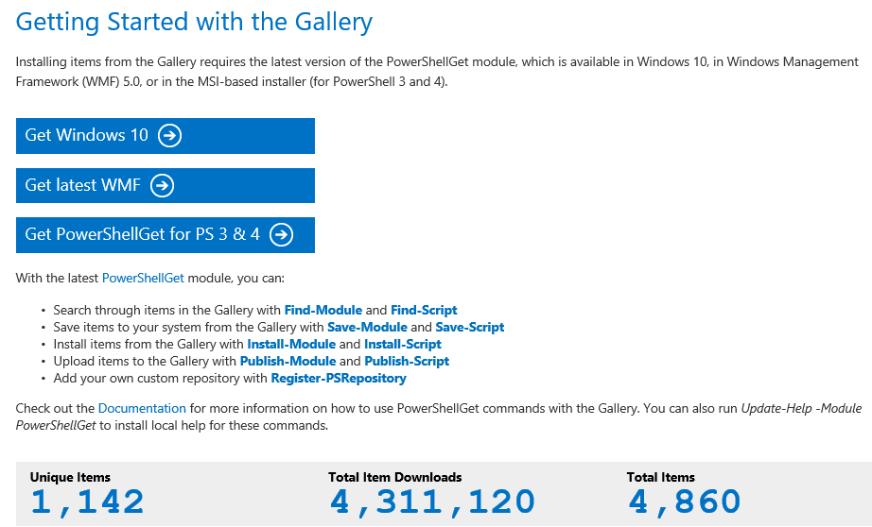
PowerShell Gallery
http://www.powershellgallery.com/

Slide 35
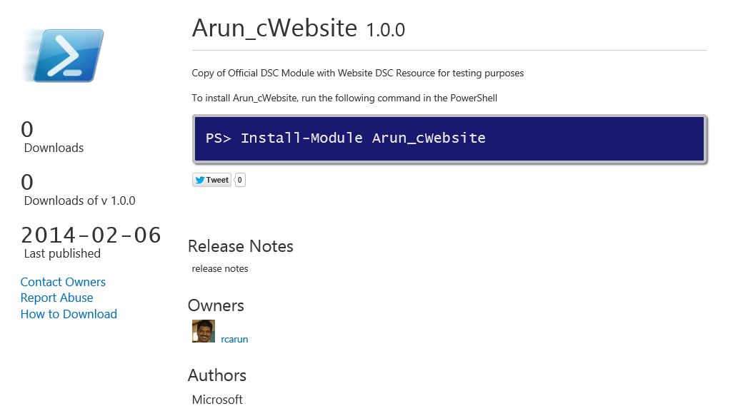
… from a public or private gallery - I
I can install DSC resources from the Gallery

Slide 36
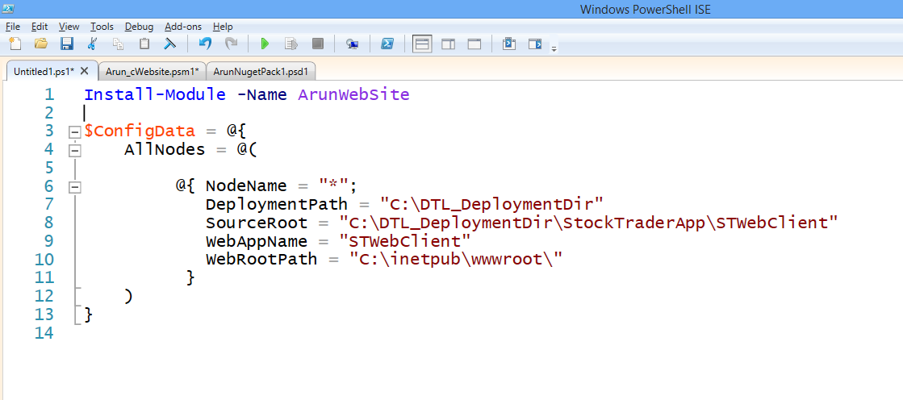
… from a public or private gallery - II
I can choose the URI of the public/private gallery or the path [like a build drop path] that I want to install the module from.

Slide 37
… from a public or private gallery - III
User can choose to not install module from the public/private gallery but to directly copy all the required bits directly from a build drop path.

Slide 38
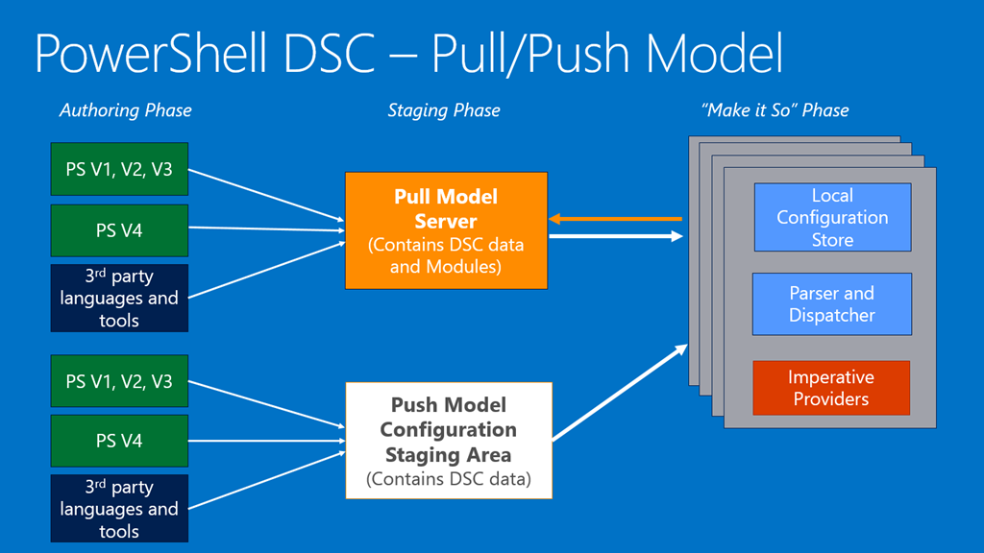

Slide 39
Deep dive into Script Authoring phase
Generate MOFs
using Modules+Script+StaticConfig
along with app bits
DSC Pull Server
Checkin Modules+Script+ StaticConfig
along with app source
Source Control
Build
Nodes
Author DSC script
Azure VMs
Copy “Package”
Azure VMs
DTL Push Server
Uses modules from different sources
Private Gallery
Public Gallery
Self-Authored
P0 – MOFs need to be machine agnostic.
P1 – MOFs need to be tag/role based.
OR
P0 – Pull needs to have DSC files and generate MOFs in the nodes.

Slide 40
Deep dive into Script Authoring phase
Generate MOFs
using Modules+Script+StaticConfig
along with app bits
DSC Pull Server
Checkin Modules+Script+ StaticConfig
along with app source
Source Control
Build
Nodes
Author DSC script
Azure VMs
Copy “Package”
Azure VMs
DTL Push Server
Uses modules from different sources
Private Gallery
Public Gallery
Self-Authored
Apply Dynamic Config?
[“Property Bags”]

Slide 41

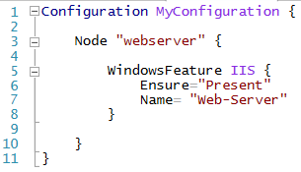
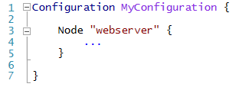
What does a Script look like?
“MyConfiguration.webserver”
Configuration Block…
Within a Configuration block, you can do anything that you normally could in a PowerShell function
Resource Block… (AKA: Compilation Job)
Node block…
https://azure.microsoft.com/en-us/documentation/articles/automation-dsc-overview/

Slide 42
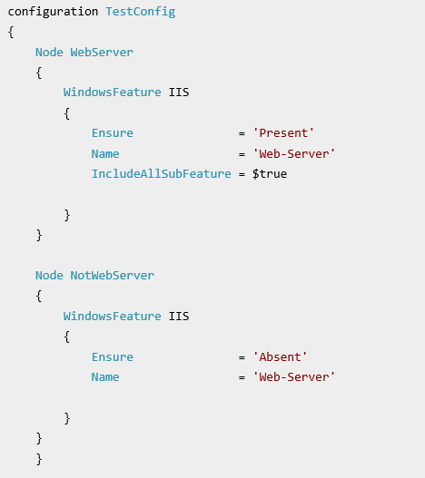
DSC configuration
Step-by-Step
Prerequisites
An Azure Automation account. see Azure Run As Account.
An Azure Resource Manager VM (not Classic) running Windows Server 2008 R2 or later. see Create your first Windows virtual machine in the Azure portal
Prerequisites (above)
Create Test Config
Importing a configuration into Azure Automation
Viewing Configuration
Compile Configuration (MOF file)
Viewing a compilation
Viewing Node Configuration
Onboard Azure ARM VM for Mgmt
Assign Node Configuration
Save the file as TestConfig.ps1.
https://azure.microsoft.com/en-us/documentation/articles/automation-dsc-getting-started/

Slide 43
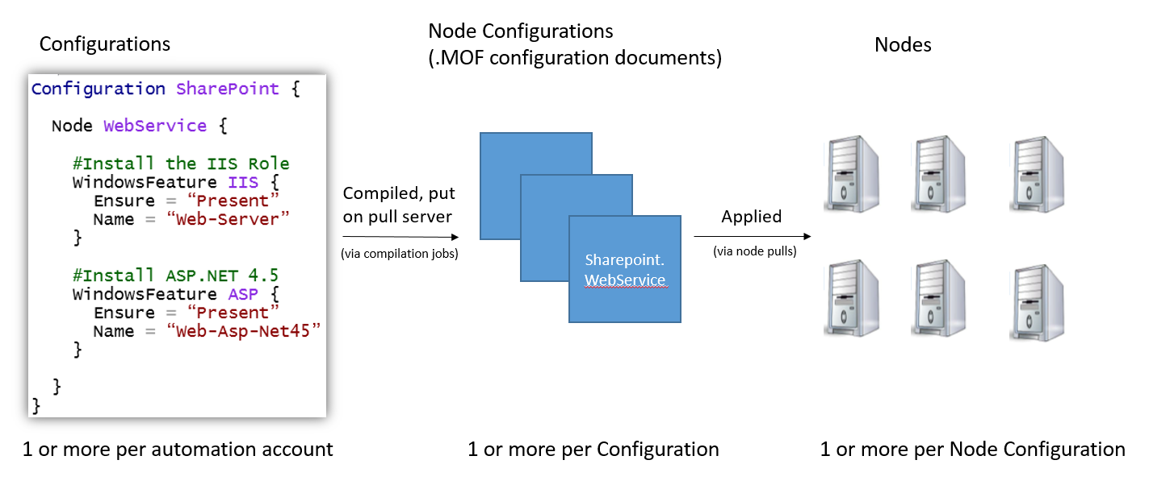
Azure Automation DSC LifeCycle

Slide 44








Session VS VM (or VDI)
Single OS
All Workloads
OS, Apps, Config, Mgmt
EACH Workload
OS
OS
OS
OS
Apps
Apps
Apps
Apps
Massive VM Overhead
(Disk, Disk IO, Memory, CPU, OS, Licenses, Density, The works)
OS
OS
OS
OS
Apps
Apps
Apps
Apps
OS
OS
OS
OS
workloads
Apps
Apps
Apps
Apps
OS
OS
OS
OS
Apps
Apps
Apps
Apps
Application(s)
Application(s)
Operating
System
Operating
System
Parent OS
Hardware Virtualization
Hardware Virtualization
Hardware / Hypervisor Level
Session Based Computing
VM or VDI Based Computing

Slide 45


Containers
Single OS
All Workloads
OS
EACH Platform
App
App
App
App
App
App
App
App
App
App
App
App
App
App
App
App
App
App
App
App
App
App
App
App
All Advantages of VM & Session
Isolation, Little overhead
workloads
App
App
App
App
App
App
App
App
Container / Image
App
App
App
App
Container Engine
App
App
Linux VM
Container / Image
Container
Container
Application(s)
Container Engine
Container Engine
Operating
System
Operating
System
Parent OS
Hardware Virtualization
Hardware Virtualization
Hardware / Hypervisor Level
Container Based Density Advantages
Container Based Computing VM Isolation

Slide 46



Container Run-time On-Premises
Windows Server
Container(s)
Docker Container
Hyper-V
Container(s)
Docker Engine
Host
Operating
System
Virtual
machine(s)
Linux
Hyper-V Hypervisor
Physical
Server
Windows Host
Operating System

Slide 47

Container Run-time Cloud
Windows Coming
Docker Container (Linux Now)
Windows Server
Container(s)
Hyper-V
Container(s)
Azure
Container(s)
ACS … Containers As A Service
Docker Compatible
Virtual
machine(s)
Docker Engine
Hyper-V Hypervisor
Linux
Windows
Windows
Hyper-V Hypervisor
Cloud
Provider
Windows Host
Operating System

Slide 48





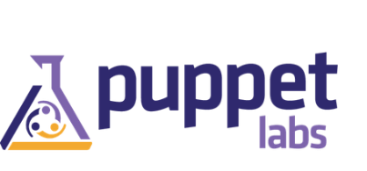
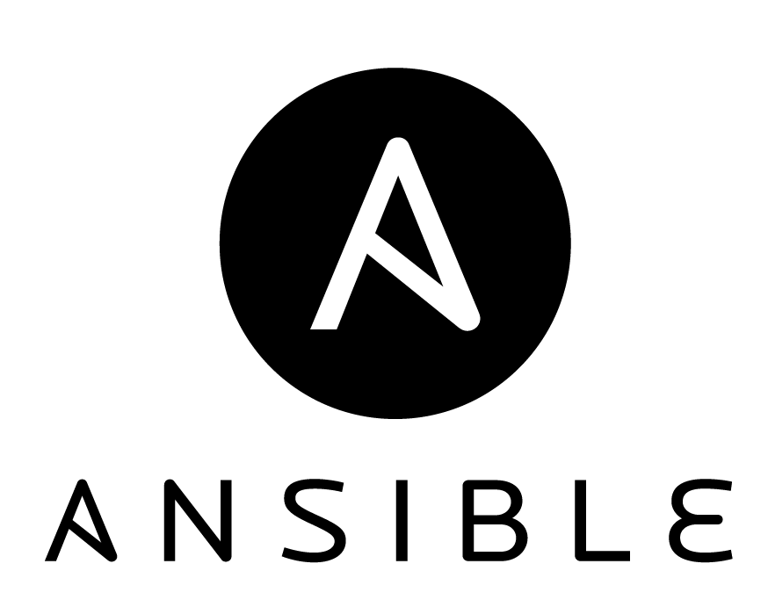
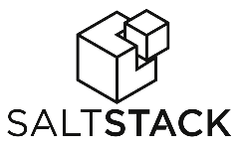









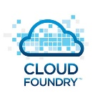

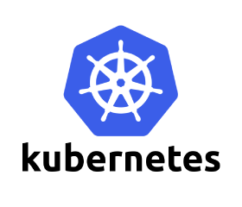
























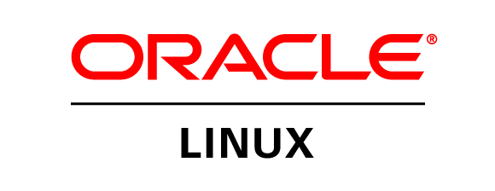


Azure is an open cloud
DevOps
Clients
Management
Applications
Orchestration
PaaS
App Frameworks
& Tools
Databases &
Middleware
Infrastructure

Slide 49
Free Resources for DevOps Practices
Optimize your
DevOps practices & tools:
  Get started on your DevOps journey: aka.ms/devops
Download the Forrester Infrastructure-as-Code whitepaper:
  Complexity kills. Automate with Infra as code: aka.ms/iac_tlp
Accelerate your application
delivery lifecycle
Technical resources for Practitioners:
  Get access to free online training, evals and HOLs: aka.ms/devopsmva
Join the Community conversations:
  Use #TalkDevOps on Twitter

Slide 50
Resources
Group Policy vs DSC
http://sdmsoftware.com/group-policy-blog/group-policy/group-policy-vs-desired-state-configuration-vs/
DSC Blog
http://blogs.msdn.com/b/powershell/archive/tags/desired+state+configuration/

Slide 51
What’s Next?
Preview of Windows Server Containers
Preview of Hyper-V Containers
How can you stay up to date?
  Follow me on Twitter @ITProGuru
  Follow my Blog http://ITProGuru.com
  Windows Container’s site https://msdn.microsoft.com/virtualization/windowscontainers
    http://aka.ms/windowscontainers

