Slide 1

Presentation title
Designing identity solutions with Azure Active Directory
IT Innovation Series
Dan Stolts, Chief Technology Strategist
Twitter: @ITProGuru
Blog: http://ITProGuru
Speaker Name
#InnovateIT

Slide 2

Agenda
Scenario
Objectives
Technology overview
Lab environment and exercises

Slide 3
Scenario
Contoso, Inc. has been using Azure primarily to provide Infrastructure as a Service and Platform as a Service. It has not been leveraging any security
and identity services, such as Azure Active Directory, that are also available in Azure
  One of the management challenges that Contoso is facing is caused by its increasing reliance on applications that are built, hosted, and maintained
  by 3rd-party vendors, commonly known as Software as a Service (SaaS) applications. For example, Contoso recently migrated from an on-premises Customer Relationship Management (CRM) solution to a cloud-based solution. This is just one example among many SaaS applications that Contoso is increasingly reliant on.
  These SaaS applications have provided significant benefits to Contoso in the form of reduced costs and greater agility in managing public relations through social media. However, there has been a management cost. Managing account passwords for sanctioned SaaS applications is proving difficult. Additionally, there is an increasing and unauthorized use of consumer SaaS applications. The extent of this use is unknown at the present time.
  Management has asked you to explore how Azure AD might benefit the organization by providing single sign capabilities for SaaS applications. Additionally, you have a mandate to explore how Cloud App Discovery, which is part of Azure Active Directory Premium, can assist Contoso in discovering consumer cloud applications that are currently in use and
  that can be potentially integrated with Azure AD single sign-on.

Slide 4
Objectives
This lab is intended for IT professionals who need to design and manage Azure Active Directory solutions
You will:
  Install and configure Azure AD Connect
  Use Azure AD Connect to integrate Azure AD with your on-premises AD
  Use Azure AD to authenticate with SaaS services
  Perform Cloud AD Discovery of which SaaS services are being used

Slide 5
Technology overview

Slide 6
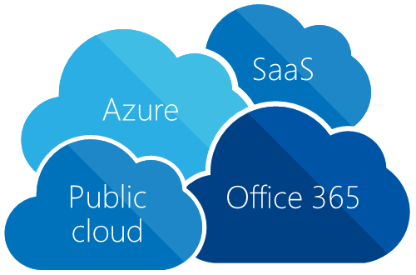

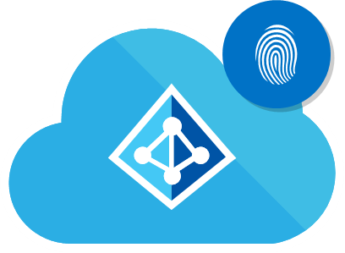
Identity as the control plane
Simple connection
Self-service
Single
sign-on
Windows Server
active directory
Username
Other directories
************
On-premises
Microsoft Azure AD
Cloud
Notes:
Microsoft has a solution for this
[Click] Traditional identity and access management solutions providing sing-sign on to on-premises applications and directory services such as Active Directory and others are used from the vast majority of organizations and huge investments were made to deploy and maintain them. These solutions are perfect for the on-premises world.
[Click] There are new pressing requirements to provide the same experience to cloud applications hosted in any public cloud.
[Click] Azure Active Directory can be the solution to this new challenge by extending the reach of on-premises identities to the cloud in a secure and efficient way.
[Click] In order to do that, one simple connection is needed from on-premises directories to Azure AD.
[Click] and everything else will be handled by Azure AD. Secure single sign-on to thousands of SaaS applications hosted in any cloud by using the same credentials that exist on-premises
[Click] And we don’t forget the users. Azure AD provides Self-service capabilities and easy access to all the application, consumer or business, they need.
in the cloud but on-premises too (Application Proxy)
Azure Active Directory
https://azure.microsoft.com/en-us/services/active-directory/
Active Directory Federation Services (AD FS) & Azure Active Directory Sync (DirSync) Resources
http://simon-may.com/adfs-dirsync-waad-resources/

Slide 7
What is Azure Active Directory?
A comprehensive identity and access
management cloud solution
  It combines directory services, advanced identity
  governance, application access management and
  a rich standards-based platform for developers
Available in 3 editions:
Free
Basic
Premium

Slide 8

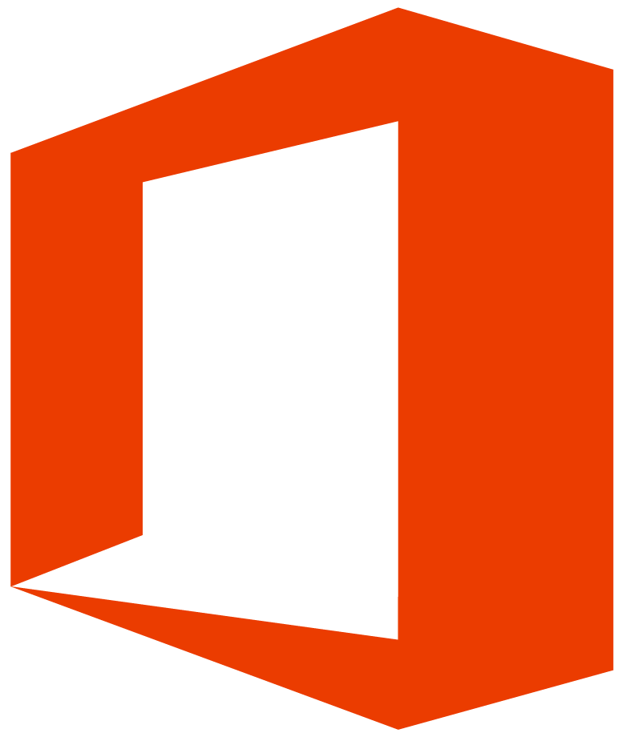

Your directory on the cloud
Azure Active
Directory Connect
and Connect Health
HR Apps
Connect and sync on-premises directories with Azure
Azure Active
Directory
MIN
Other
directories
(PowerShell / SQL (ODBC / LDAP v3
/ Web Services (SOAP, JAVA, REST)

Slide 9
Your directory on the cloud
Version 2
HR Apps
Connect and sync on-premises directories with Azure
Azure Active
Directory
MIN
Other
directories
Azure Active Directory Connect
and Connect Health
(PowerShell / SQL (ODBC / LDAP v3
/ Web Services (SOAP, JAVA, REST)

Slide 10
Making hybrid identity simple
DirSync
Azure Active Directory Connect
Azure Active Directory Connect
Consolidated deployment assistant for your identity bridge components
All currently available sync engines
will be replaced by the sync engine included in the Connect tool
Assisted deployment of ADFS is available through Azure Active Directory Connect
ADFS is an optional component
for authentication in hybrid implementation
  Password sync can replace ADFS
  for more scenarios
Azure Active Directory Sync
Sync Engine
FIM + Azure Active Directory Connector
ADFS
ADFS
Notes:
Active Directory Federation Services (AD FS) & Azure Active Directory Sync (DirSync) Resources
http://simon-may.com/adfs-dirsync-waad-resources/

Slide 11

Delivering a seamless user authentication experience
Identity Synchronization with password (hash) sync
User attributes are synchronized using identity synchronization services including a password hash, authentication is completed against Azure Active Directory
Identity Synchronization
User attributes are synchronized using identity synchronization tools, authentication is passed back through federation and completed against Windows Server Active Directory
AD FS
Notes:
Authentication Scenarios for Azure AD
https://azure.microsoft.com/en-us/documentation/articles/active-directory-authentication-scenarios/

Slide 12
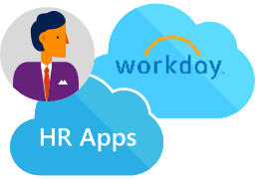
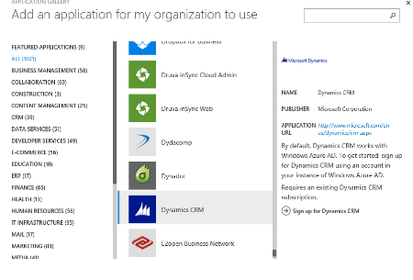

Your directory on the cloud
Connect and sync on-premises directories with Azure
2400+ pre-integrated popular SaaS apps
+
Other directories
SaaS apps

Slide 13
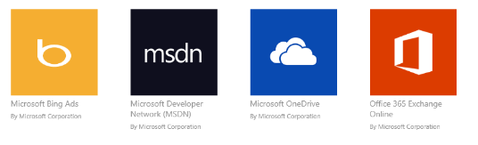
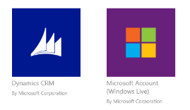
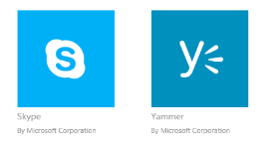

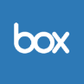




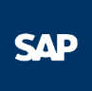
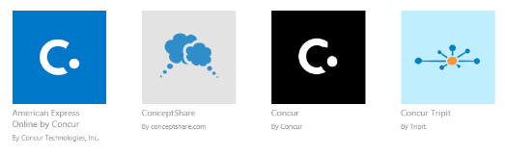
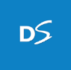

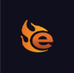
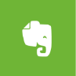
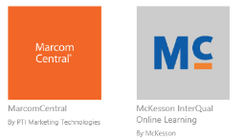
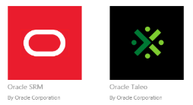
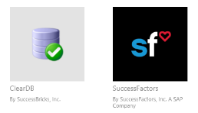

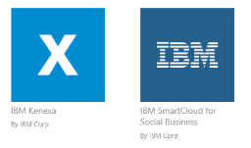

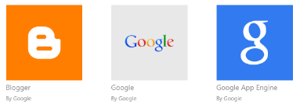
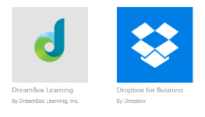




Pre-integrated SaaS apps in the application gallery
Microsoft Bing Ads
By Microsoft Corp
Microsoft Developer Network (MSDN)
By Microsoft Corp
Microsoft OneDrive
By Microsoft Corp
Office 365 Exchange
By Microsoft Corp
Dynamics CRM
By Microsoft Corp
Microsoft Account (Windows Live)
By Microsoft Corp
Skype
By Microsoft Corp
Yammer
By Microsoft Corp
ServiceNow
By ServiceNow
Box
By Box
Salesforce
By Salesforce.com
Citrix GoToMeeting
By Citrix
NASDAQ Online
By the NASDAQ CMX Group, Inc.
SAP Business Objectives BI OnDemand
By SAP
Concur
By Concur
Concur Tripit
By Tripit
DocuSign
By DocuSign, Inc.
Red Hat OpenShift
By Red Hat, Inc.
Egnyte
By Egnyte, Inc.
Evernote
By Evernote Corp.
MarcomCentral
By PTI Marketing Tech
McKesson InterQual Online Learning
By McKesson
Oracle SRM
By Oracle Corp.
Oracle Taleo
By Oracle Corp.
ClearDB
By SuccessBricks, Inc.
SuccessFactors
By SuccessFactors, Inc. a SAP company
American Express OPEN Small Business
By American Express
IBM Kenexa
By IBM Corp.
IBM SmartCloud for Social Business
By IBM Corp
Workday
By Workday
Blogger
By Google
Google
By Google
Google app Engine
By Google
DreamBox Learning
By DreamBox Learning
Dropbox for Business
By Dropbox
Facebook
By Facebook
AT&T Business Direct
By AT&T
Twitter
By Twitter
Amazon Web Services
By Amazon
Netflix
By Netflix. Inc.
Notes:
2400+ apps are supported (Oct 2014)
Azure Active Directory application gallery: Federated SaaS apps
http://social.technet.microsoft.com/wiki/contents/articles/20235.azure-active-directory-application-gallery-federated-saas-apps.aspx

Slide 14
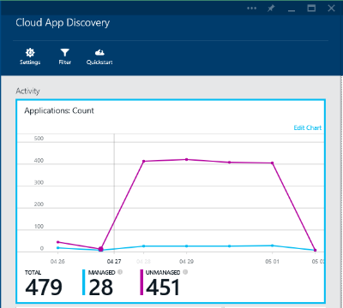
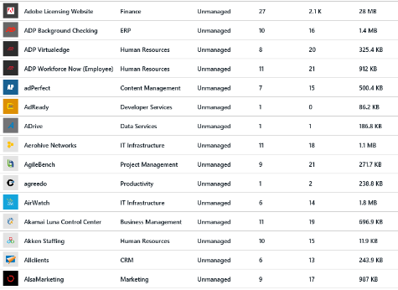
Reveal shadow IT:
Discover all SaaS apps in use within your organization
Microsoft Azure Active Directory
Cloud App Discovery
Comprehensive reporting
  SaaS app category
  Number of users
  Utilization volume
Source: Help Net Security 2014
Notes:
Cloud App Discovery
https://appdiscovery.azure.com/

Slide 15
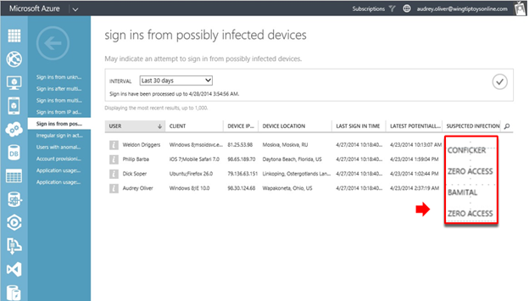
Azure AD Access & Usage Reports

Slide 16
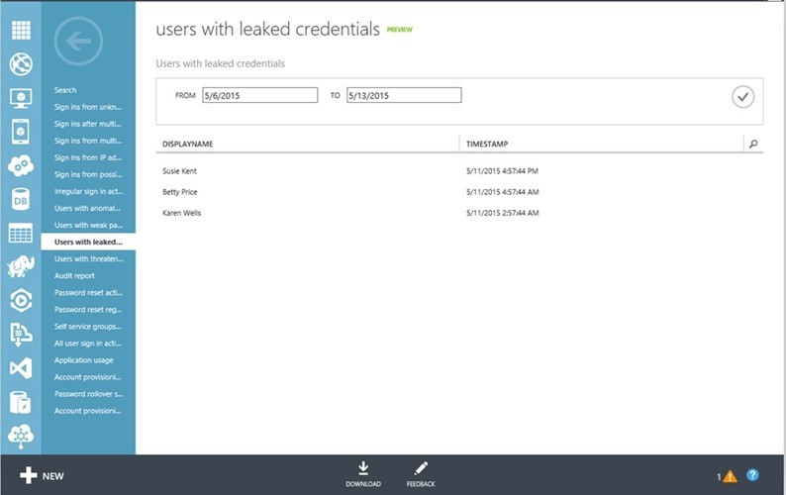
Azure AD Access & Usage Reports

Slide 17
Other Cloud Capabilities
Customer approval for support activities
Administrator activity APIs
Security and anomaly reporting APIs
Email detonation chambers and URL rewriting
Multi-factor authentication everywhere
Privileged identity management
Encryption for data at rest and in-transit
Ecryption key management services
The list will continue to grow...

Slide 18
Lab environment and exercises

Slide 19
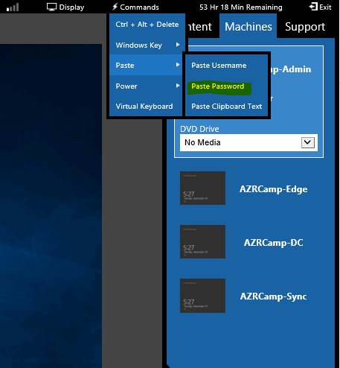
Lab environment
Lab URL:
  <insert url here>
Password:
  Passw0rd!

Slide 20
Azure Boot Camp virtual machines
AZRCamp-Admin.contoso.com
  (Windows 10; used for Azure Management)
AZRCamp-DC.contoso.com
  (Windows Server 2012 R2; domain controller, DNS)
AZRCamp-Sync.contoso.com
  (Used for synchronization in some labs)
AZRCamp-Edge
  (Stand-alone Windows Server 2012 R2; RRAS)
Azure

Slide 21
Installing and configuring Azure AD Sync
Create a DirSync Account in Azure AD
Install Azure AD Connect
Confirm Azure AD Connect Synchronization

Slide 22
Establishing single sign-on with a
3rd-party provider and Azure AD
Add 3rd-party providers to Azure AD
Test 3rd-party single sign-on

Slide 23
Cloud App Discovery
Enable Azure AD Premium Trial
Enable Azure Cloud App Discovery
Configure Cloud App Discovery & generate data
Explore the Cloud App Discovery report

Slide 24
Reset the Azure environment
Remove resource groups from Azure environment
.\RGCleanup.ps1

Slide 25
Conclusion

Slide 26
In review: Session objectives & takeaways
You now know how to:
  Install and configure Azure AD Connect
  Use Azure AD Connect to integrate Azure AD with your on-premises AD
  Use Azure AD to authenticate with SaaS services
  Perform Cloud AD Discovery of which SaaS services are being used

Slide 27
Demo

Slide 28
Resources
Register for another IT Innovation Series event
Further topics: Windows Server 2016, Windows 10 and more.
aka.ms/ITInnovation
Continue your learning
Download this presentation, access online training and demos, try Azure for free.
aka.ms/ITInnovationResources
Know someone who wants to learn more about
the Cloud?
Tell them to get started at the Microsoft Cloud Roadshow.
www.microsoftcloudroadshow.com

Slide 29

© 2015 Microsoft Corporation. All rights reserved. Microsoft, Windows and other product names are or may be registered trademarks and/or trademarks in the U.S. and/or other countries.
The information herein is for informational purposes only and represents the current view of Microsoft Corporation as of the date of this presentation. Because Microsoft must respond to changing market conditions, it should not be interpreted to be a commitment on the part of Microsoft, and Microsoft cannot guarantee the accuracy of any information provided after the date of this presentation. MICROSOFT MAKES NO WARRANTIES, EXPRESS, IMPLIED OR STATUTORY, AS TO THE INFORMATION IN THIS PRESENTATION.

