Slide 1

Presentation title
Designing Azure network
infrastructure for advanced security
IT Innovation Series
Dan Stolts, Chief Technology Strategist
Twitter: @ITProGuru
Blog: http://ITProGuru
Speaker Name
#InnovateIT

Slide 2

Agenda
Scenario
Objectives
Technology overview
Lab environment and exercises

Slide 3
Scenario
Contoso, Inc. has asked you
to continue to investigate the advantages of deploying IaaS using Azure Resource Manager
  A significant is the security of applications
  that reside in Azure. Contoso would like
  to see its best practices reflected in the configuration of the Azure networking to
  help ensure the integrity and confidentiality
  of its data. In particular, Contoso in interested in learning how Azure Resource Manager templates may be used to quickly deploy
  an infrastructure that uses VPN to provide connectivity to manage resources and at
  the same time uses Network Security
  Groups to control access.
Notes:
Network security Groups and Azure Resource manager templates

Slide 4
Objectives
You will:
  Analyze JSON objects that make it possible to deploy network configurations
  Complete a partially finished template to deploy Network Security Groups

Slide 5
Technology overview

Slide 6

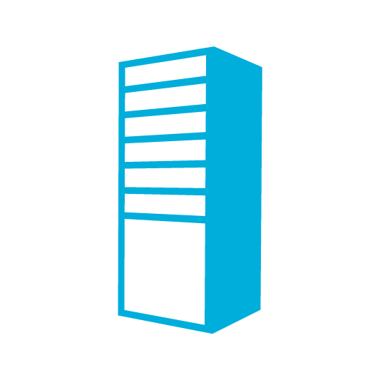


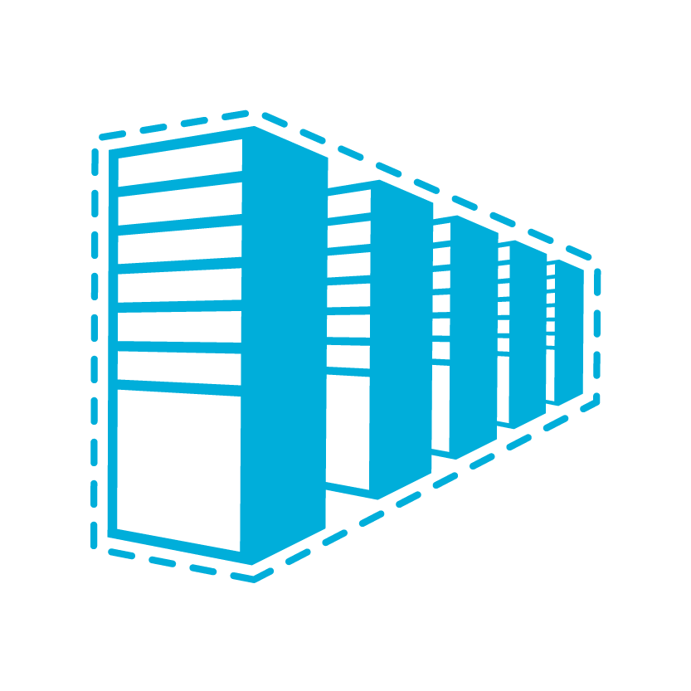

Azure Virtual Network
Bring your own network
Logical isolation with control
over network
Create subnets with your private
or public IP address spaces
Bring your own DNS or use
Azure-provided DNS
Secure VMs with Network
Security Groups
Run highly available internal services behind internal load balancer
INTERNET
DIRECT INTERNET
CONNECTIVITY
ON-PREMISES
VIRTUAL NETWORK
AZURE INFRA
ROUTER
NETWORK SECURITY GROUP
WEB FIREWALL
DNS
WEB
SERVER
AD
FE SUBNET
LOAD BALANCER
AZURE INTERNAL LB
APP SERVERS
DB SERVERS
BE SUBNET
Notes:
You can completely build your own network
Azure Virtual Network
https://azure.microsoft.com/en-us/services/virtual-network/
Virtual Network Documentation
https://azure.microsoft.com/en-us/documentation/services/virtual-network/

Slide 7

Internet IP addresses and load balancing
Public IP addresses in Azure
  Can be used for instance (VM) level access or
  load balancing
Instance-level IP
  Internet IP assigned exclusively to single VM
  Entire port range accessible by default
  Primarily for targeting a specific VM
Load balanced IP (VIP)
  Internet IP load balanced among one or
  more VM instances
  Allows port redirection
  Primarily for load balanced, highly available,
  or auto-scale scenarios
INTERNET
INTERNET
151.2.3.4 (VIP)
LB
131.3.3.3
(INSTANCE-LEVEL IP)
131.3.4.4
(INSTANCE-LEVEL IP)
VM1
VM2
IP1
IP2
Notes:
Instance Level Public IP Overview
https://azure.microsoft.com/en-us/documentation/articles/virtual-networks-instance-level-public-ip/

Slide 8
Reserved IPs can move!
Retain your IP addresses
IPs on existing services can
be reserved
IPs can be moved between services in seconds
INTERNET
RESERVED IP
AZURE LOAD BALANCER
RESERVED IP MOVES
CLOUD SERVICE 1
CLOUD SERVICE 2
Notes:
Reserved IP addresses for Cloud Services & Virtual Machines
https://azure.microsoft.com/en-us/blog/reserved-ip-addresses/
Azure Datacenter IP Address Ranges
https://msdn.microsoft.com/en-us/library/azure/dn175718.aspx

Slide 9
DNS names for public IP
FQDN access to a
virtual machine
Available for virtual machines and web/worker roles
Automatic DNS registration/
de-registration during
scale-up, scale-down
INTERNET
WEBROLE.0.CONTOSO.CLOUDAPP.NET 130.26.10.80
WEBROLE.0.CONTOSO.CLOUDAPP.NET 130.26.10.80
CONTOSO APP WITH 2 VIRTUAL MACHINES
VM INSTANCE 1
VM INSTANCE 2
Notes:
Azure DNS
https://azure.microsoft.com/en-us/services/dns/

Slide 10
User Defined Routes (UDR)
Control traffic flow in your network with custom routes
Attach route tables to subnets
Specify next hop for
any address prefix
Set 0/0 route to force
tunnel all traffic to
on-premises or appliance
INTERNET
UDR
SYSTEM ROUTE
“IP FORWARDING”
FRONTEND SUBNET
BACKEND SUBNET
SYSTEM ROUTE
VM/APPLIANCE
UDR
“IP FORWARDING”
Notes:
User Defined Routes and IP Forwarding
https://azure.microsoft.com/en-us/documentation/articles/virtual-networks-udr-overview/

Slide 11



Multiple NICs in Azure VMs
Up to 16 NICs per VM
NSG and routes on all NICs
Can separate frontend, backend, and management
VIRTUAL NETWORK
VIRTUAL MACHINE
NIC2
NIC1
DEFAULT
10.3.3.33
10.2.2.22
10.1.1.11
VIP 133.44.55.66
INTERNET
BACKEND
SUBNET
MGMT
SUBNET
FRONTEND
SUBNET
Notes:
Multiple VM NICs and Network Virtual Appliances in Azure
https://azure.microsoft.com/en-us/blog/multiple-vm-nics-and-network-virtual-appliances-in-azure/
Create a Multi-NIC VM with a Public IP in Azure
http://blogs.msdn.com/b/rslaten/archive/2014/11/18/create-a-multi-nic-vm-with-a-public-ip-in-azure.aspx
Create a VM with multiple NICs
https://azure.microsoft.com/en-us/documentation/articles/virtual-networks-multiple-nics/

Slide 12
Connectivity

Slide 13
Picking the right connectivity model
INTERNET / VPN GATEWAYS
EXCHANGE PROVIDER
NETWORK SERVICE PROVIDER
Connect via an encrypted link over
public internet
Peer at an ExpressRoute location, an Exchange provider facility
Connection from WAN provided
by network service provider
Azure becomes another site on the customer’s WAN
MICROSOFT
CLOUD
PUBLIC
INTERNET
PUBLIC
INTERNET
MICROSOFT
CLOUD
CUSTOMER
SITE 3
CUSTOMER
SITE 2
MICROSOFT
CLOUD
WAN
CUSTOMER
SITE 1
PUBLIC
INTERNET
CUSTOMER
SITE
CUSTOMER
SITE
EXPRESSROUTE
PARTNER LOCATION
INTERNET-BASED CONNECTIVITY
EXPRESSROUTE –
PROVIDES CUSTOMER CHOICE AND INCLUDES ACCESS TO ALL MICROSOFT CLOUD SERVICES
Notes:
About VPN Devices and Gateways for Virtual Network Connectivity
https://msdn.microsoft.com/en-us/library/azure/jj156075.aspx
ExpressRoute
https://azure.microsoft.com/en-us/services/expressroute/
ExpressRoute Pricing
https://azure.microsoft.com/en-us/pricing/details/expressroute/
New Networking features and partnerships for Enterprise scenarios
https://azure.microsoft.com/en-us/blog/networking-enterprise/

Slide 14
VPN Gateways for Virtual Network
ExpressRoute gateway or VPN gateway needed
to access a virtual network
Introducing a new Standard Gateway
  Supports ExpressRoute and VPN coexistence
  Improved throughput for ExpressRoute
VIRTUAL NETWORK GATEWAY SKU | EXPRESSROUTE GW THROUGHPUT | VPN GW EXPRESSROUTE COEXISTENCE | VPN GW THROUGHPUT | VPN GW MAX IPSEC TUNNELS | COST (USD) / HOUR
BASIC | 500 MBPS | NO | 100 MBPS | 10 | $0.04
STANDARD | 1000 MBPS | YES | 100 MBPS | 10 | $0.19
PERFORMANCE | 2000 MBPS | YES | 200 MBPS | 30 | $0.49
NOTE THAT EXPRESSROUTE TRAFFIC FOR AZURE PUBLIC SERVICES, O365, AND SKYPE FOR BUSINESS
DOES NOT GO THROUGH A VIRTUAL NETWORK GATEWAY
Notes:
Azure Standard VPN Gateway
https://azure.microsoft.com/en-us/updates/azure-standard-vpn-gateway/

Slide 15
Q. How do I securely connect my on-premises environment to the cloud?
A. Azure Virtual Network easily extends your on-premises network through site-to-site and point-to-site VPN, much the way you’d set up and connect to a remote branch office. Dedicated fiber connections are available using Azure ExpressRoute.
Azure
Customer Site
Site-to-Site VPN
VPN
Point-to-Site VPN
Computers
Behind Firewall
Resources
Azure Network Security Whitepaper
http://azure.microsoft.com/trust
Remote Workers

Slide 16
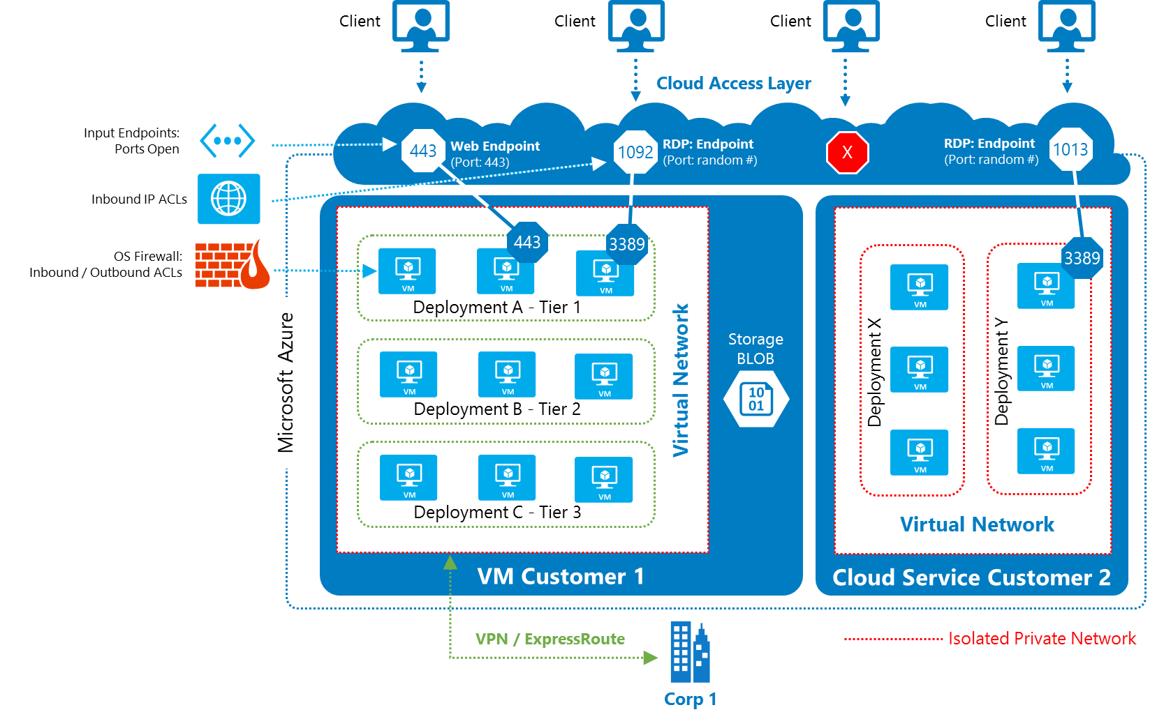
Isolation
Deployment network: Each deployment can be isolated from the other deployments at the network level. Multiple VMs within a deployment can communicate with each other through private IP addresses.
Virtual network: Each virtual network is isolated from the other virtual networks. Multiple deployments inside the same subscription can be placed on the same virtual network, and then communicate with each other through private IP addresses

Slide 17
Cloud Access Layer:
Define Security Groups OR Endpoint ACLs to control open inbound traffic
3rd Party Firewalls also available
External public ports with sensitive data should be encrypted using SSL
Notes:
Network administrators can manage these isolated private networks in a way similar to the management of on-premises private networks.
The mechanisms for administrators to manage network security on their Azure private networks are in the Azure Cloud Access Layer, which is comparable to the edge of a corporate network that faces the Internet. The Cloud Access Layer includes a firewall, load-balancer, and network address translation (NAT) functionality managed by the customer administrator.

Slide 18
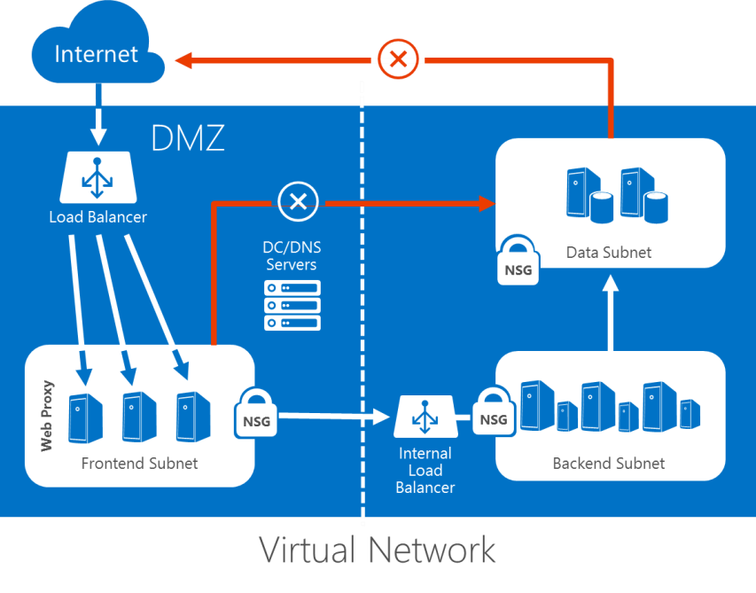
Isolating VMs within a virtual network for defense-in-depth
The administrator can segment intranet traffic at the network layer within a Virtual Network by using Network Security Groups.
Network Security Groups can be applied to a subnet in a Virtual Network.

Slide 19
Cloud Services security

Slide 20
Cloud Services: Layered security, protection, and isolation
INTERNET
CLOUD SERVICES
AND
VIRTUAL MACHINES
VIRTUAL
NETWORK
ISOLATION
VM
FIREWALL
NSG
ACLS
DDOS
PROTECTION
ON-PREMISES
Notes:
Cloud basics - Security in the cloud
http://www.microsoft.com/industry/government/guides/cloud_computing/3-security.aspx
Microsoft Azure Trust Center: Security
https://azure.microsoft.com/en-us/support/trust-center/security/

Slide 21
Network Security Groups
Segment network to meet
security needs
Prioritized set of rules
  Default rules: 65,000 and above
Applied at the VM and/or subnet
Applies to internal and external traffic
Default tags: Virtual Network,
Internet, Azure load balancer
API audit logs
ON PREMISES 10.0/16
INTERNET
EXPRESS
ROUTE
AND VPNs
✓
✗
✗
✓
✓
✓
VPN GW
BACKEND
10.3/16
MID-TIER
10.2/16
FRONTEND
10.1/16
VIRTUAL NETWORK
✗
Notes:
Network Security Groups
https://azure.microsoft.com/en-us/blog/network-security-groups/
What is a Network Security Group (NSG)?
https://azure.microsoft.com/en-us/documentation/articles/virtual-networks-nsg/

Slide 22
Lab environment and exercises

Slide 23
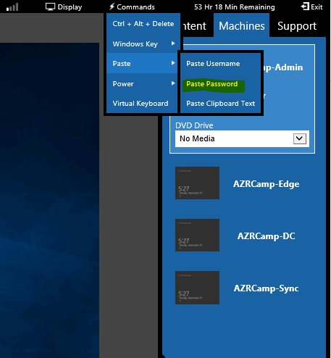
Lab environment
<insert lab url here>
Password = Passw0rd!

Slide 24
Azure Boot Camp virtual machines
AZRCamp-Admin.contoso.com
(Windows 10; used for Azure Management)
AZRCamp-DC.contoso.com
(Windows Server 2012 R2; domain controller, DNS)
AZRCamp-Sync.contoso.com
(Used for synchronization in some labs)
AZRCamp-Edge
(Stand-alone Windows Server 2012 R2; RRAS)

Slide 25
Environment – lab end state
INTERNET
✓
Allow port 80 inbound
PREMISE – MANAGEMENT NETWORK
(192.168.10.0/24)
FE_NSG
FE1 (app IIS)
✓
Optional: Allow port 80 outbound*
Allow
port 1688 outbound
✓
FE SUBNET
(10.0.0.0/24)
✓
Allow
all inbound
Allow port 23*
✓
✓
Allow
3389*
GATEWAY SUBNET (10.0.200.0/28)
✓
BE1 (app)
*All traffic (inbound
and outbound) denied unless explicitly allowed
AZURE
VNET: 10.0.0.0/16
BE SUBNET
(10.0.1.0/24)
BE_NSG

Slide 26
Prepare the lab environment
Deploy the Azure VM and network infrastructure necessary for the lab
  Alternative #1: PowerShell
  Alternative #2: GitHub
.\Lab03Start.ps1

Slide 27
Analyze ARM template
Open azuredeploy.json in Visual Studio code
Examine Azure networking resources deployment
in ARM template
  Virtual Network resource
  Public IP addresses resource
  Network gateway resources

Slide 28
Complete site-to-site VPN configuration
Configure local VPN device for site-to-site
VPN connection
  Configure AZRCAMP-EDGE to connect to the Azure VPN gateway

Slide 29
Configure Network Security Groups (NSG) by using ARM templates
Verify connectivity to virtual machines
Deploy Network Security Groups by
using an ARM template
Troubleshoot template deployment
Verify NSG rules

Slide 30
Reset the Azure environment
Remove resource groups from Azure environment
.\RGCleanup.ps1

Slide 31
Conclusion

Slide 32
In review: Session objectives and takeaways
You now:
  Analyzed JSON objects that make it possible to deploy network configurations
  Completed a partially finished template to deploy Network Security Groups

Slide 33
Resources
Register for another IT Innovation Series event
Further topics: Windows Server 2016, Windows 10 and more.
aka.ms/ITInnovation
Continue your learning
Download this presentation, access online training and demos, try Azure for free.
aka.ms/ITInnovationResources
Know someone who wants to learn more about
the Cloud?
Tell them to get started at the Microsoft Cloud Roadshow.
www.microsoftcloudroadshow.com

Slide 34

© 2015 Microsoft Corporation. All rights reserved. Microsoft, Windows and other product names are or may be registered trademarks and/or trademarks in the U.S. and/or other countries.
The information herein is for informational purposes only and represents the current view of Microsoft Corporation as of the date of this presentation. Because Microsoft must respond to changing market conditions, it should not be interpreted to be a commitment on the part of Microsoft, and Microsoft cannot guarantee the accuracy of any information provided after the date of this presentation. MICROSOFT MAKES NO WARRANTIES, EXPRESS, IMPLIED OR STATUTORY, AS TO THE INFORMATION IN THIS PRESENTATION.

