Slide 1

Presentation title
Technology Landscape in a Cloud First World
IT Innovation Series
Dan Stolts, Chief Technology Strategist
Twitter: @ITProGuru
Blog: http://ITProGuru
Speaker Name
#InnovateIT

Slide 2
Story..
A Cab/Taxi Company
Founded 2009
Launch 2010
How was this company’s success possible?
Notes:
A startup business launched in 2010 that would ultimately change the way we travel the streets of the world when we do not have our cars. This company grew to be a global powerhouse in less than 5 years! I have no doubt everyone in this room has either used them or at least heard of them and understand what they do and how they can help you when in need. This company is now, a mere 5 years after launch, a $50 BILLION business. The company started out as UberCab and shortly thereafter changed their name to simply Uber. That’s an impressive feat for sure. But consider this... Uber is one of the largest Taxi companies in the world but they do not own a single Car! But wait, their’s more. What happens when cars can drive themselves? How many MORE people will want to take advantage of this opportunity to generate revenue with their car. Sure they have more than their fair share of controversy. We are not going to dig into that.
How was this possible? The cloud and a vision! What does this have to do with Security? I will answer that in a couple minutes.
First let’s look at another story

Slide 3
Another SHORT Story…
A Software Company
Everything.
Everything can change in a very short period of time and we in the IT business need to be able to change to keep up with it.
Notes:
A not so small software company who had a reputation for being a bully, slow and stale. A company that lost it’s ability to “innovate”. With some 190,000 employees many thought the company had become irrelevant and many more expected that this would be the inevitable outcome for the companies long term outlook. Just over 5 years ago, on February 1, 2010 the company launched a new product that would not only change the fate of the organization but change the we the world thinks about cloud computing. The product was then called Windows Azure. Others were already in the cloud business but focusing on Virtual Machines in the sky. Microsoft started out with a new and very different model and 5 years later is the biggest cloud provider in the world. This technology so fundamentally changed the company that it is no longer a software company. It is now a Services and Devices company and if you reach any trade magazine or newspaper today you will read about them being considered the leading innovator of our time.
What does this have to do with security? Everything. Everything can change in a very short period of time and we in the IT and security business need to be able to change with it.

Slide 4
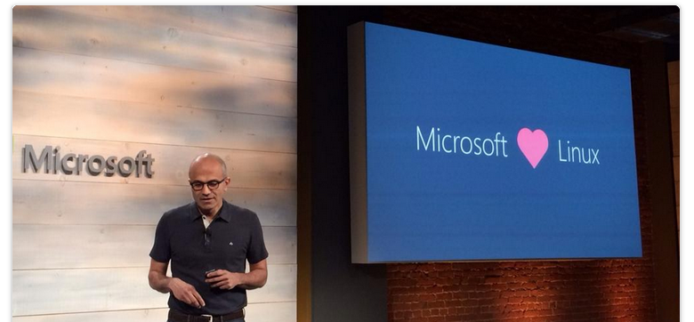
CEO Satya Nadella: “Microsoft Loves Linux”
Notes:
I can sum up most of the changes at Microsoft of late with a short story about a couple very basic changes made by our new CEO Satya Nadella.
Just a couple years ago when Steve Ballmer was running the company Microsoft focused on MONEY. Today, everything has changed. Now the company focuses on Technology and more specifically how Microsoft can help our customers solve their business problems. See, two years ago,
Microsoft employees were stack ranked…
This caused employees to be competitive with others even on the same team. Individuals were measured on how well they performed relative to peers. Businesses were evaluated on how well they did relative to other business units within Microsoft.
Today, everyone is evaluated on three fundamental metrics
How well you do your job
How your contributions are leveraged by others
How you leverage others contributions.
In this model, each person and business MUST help others and let others help them.
Additionally, Satya requires all business units to develop services to support all of our customers key platforms. In fact, Linux in particular is so far behind the curve in what is possible that as an organization the product groups are developing for Linux integration first then back porting to windows instead of the reverse.
These changes and others, have helped Microsoft’s stock more than double since Satya took over less than 2 years ago. It is amazing how fast such a large company could completely turn around with GREAT LEADERSHIP!
The days of Microsoft simply being a software or license vehicle are long gone. The job of the sales team is not to sell you a license, it is to help you identify and resolve problems.

Slide 5


Agenda
8:30AM Registration / Welcome / Lab Setup
9:00-9:30AM Introduction – Datacenter and IT role changes in a cloud first world
9:30-10:30AM Deploy Azure Resources using ARM Templates
10:30-12:00AM Designing Azure compute and storage infrastructure for advanced performance
12:00PM Lunch served
12:45-1:45PM Designing Azure Networking Infrastructure for advanced security
1:45-2:30PM Designing identity solutions with Azure Active Directory
2:30-2:45PM Wrap up / Evaluations / Raffle
2:45-4:30PM Instructor-led / Hands-on labs

Slide 6

Important Links
Questions at TechNet Events Forum
http://aka.ms/tne
Get the Slides and Resources
http://ITProGuru.com/resources

Slide 7
A leader in Gartner magic quadrants
x86 server virtualization¹
Microsoft only leader in all four magic quadrants
Public cloud storage services²
Cloud infrastructure as a service³
Enterprise application platform as a service⁴
[1] Gartner “x86 Server Virtualization Infrastructure,” by Thomas J. Bittman, Michael Warrilow, July 14 2015; [2] Gartner “Public Cloud Storage Services,” by Arun Chandrasekaran, Raj Bala June 25, 2015; [3] Gartner “Magic Quadrant for Cloud Infrastructure as a Service,” by Lydia Leong, Douglas Toombs, Bob Gill, May 18, 2015; [4] Gartner “Enterprise Application Platform as a Service,” by Yefim V. Natis, Massimo Pezzini, Kimihiko Iijima, Anne Thomas, Rob Dunie , March 24, 2015.
Gartner does not endorse any vendor, product or service depicted in its research publications, and does not advise technology users to select only those vendors with the highest ratings or other designation. Gartner research publications consist of the opinions of Gartner's research organization and should not be construed as statements of fact. Gartner disclaims all warranties, expressed or implied, with respect to this research, including any warranties of merchantability or fitness for a particular purpose.

Slide 8



Provide Business Units The Service(s) and Solutions They Need
Or Else…
Who’s Job is it to solve Business Problems?
Who understands how Technology can be used to Solve Business Problems?
CEO
CFO
CIO
CXO
Managers
You!
Your Business Unit Will…
You WILL …
Lose Money
Not Hit Their Numbers
Go Around You!
Find a Solution
Host it in the cloud
Stray from policy and procedures
Miss Opportunity
Lose Control
Lose Visibility
Lose Management
Still be RESPONSIBLE if the $%^&* hits the fan!!!
Lose your SANITY? Your JOB?
AKA: Shadow IT
Only YOU Can Stop Shadow IT

Slide 9
New Pulse of IT
Get Smart, Be Strategic; Solve Business Problems
How can you deliver services faster?
How can you help the company continue expansion?
How can you increase customer satisfaction or retention?
What are current pain points for…
  Customers? Partners? Employees?
What new services (cloud, mobile) might your company be able to benefit from?
Projects on a shelf for lack of infrastructure or money?
What are Business Unit Challenges?
Your Vision + New Cloud/Mobile/Tech Solutions = Success!

Slide 10






















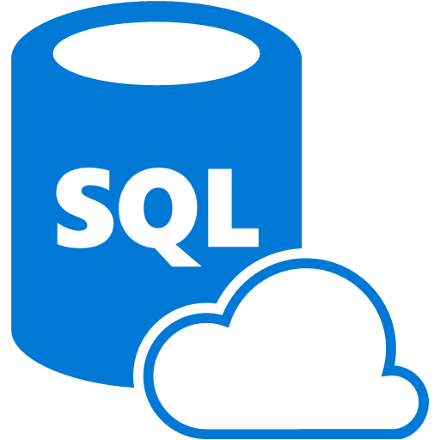





























Platform Services
Security & Management
Compute
Web and Mobile
Developer Services
Hybrid
Operations
Cloud
Services
Service
Fabric
Web Apps
API
Apps
API
Management
Visual Studio
Azure SDK
Portal
Azure AD
Connect Health
Batch
Remote App
Mobile
Apps
Logic
Apps
Notification
Hubs
Team Project
Application
Insights
Active
Directory
AD Privileged
Identity
Management
Multi-Factor
Authentication
Integration
Analytics & IoT
Data
Backup
Storage
Queues
Biztalk
Services
Automation
HDInsight
Machine
Learning
SQL
Database
SQL Data
Warehouse
Operational
Insights
Hybrid
Connections
Service
Bus
Key Vault
Data
Factory
Event
Hubs
Redis
Cache
Search
Import/Export
Store /
Marketplace
Media & CDN
Site
Recovery
Stream
Analytics
Mobile
Engagement
DocumentDB
Tables
VM Image Gallery
& VM Depot
Media
Services
Content Delivery
Network (CDN)
StorSimple
Infrastructure Services
Compute
Storage
Networking
Virtual Machines
Containers
BLOB Storage
Azure Files
Premium Storage
Virtual Network
Load Balancer
DNS
Express
Route
Traffic Manager
VPN Gateway
Application Gateway
Datacenter Infrastructure (24 Regions, 19 Online)
Notes:
Why this Slide:
It shows we have a very broad platform. It about BOTH IaaS and PaaS, that these work together. It shows that we continue to lead in world class IT capabilities and that there’s really nothing missing.
Key Points:
We have already seen how the Azure Platform is IaaS + Pass – but I want you to understand that this is a huge number of capabilities – IT building blocks if you will.
Every one of these blocks you provision anytime, self-service anywhere in the world 24x7. You pay for what you use, you can get more or less anytime and you can fully automate everything…
DON’T spent too much time on this slide – you are going to DEMO (aren’t you!!!)… DON’T go through each block…
Transition to NEXT Slide: Make the build go backwards to show JUST IaaS and then you will go to the demo to show it.

Slide 11
IoT 2010
Alarm clock
Refrigerator
Automobile
VoIP phone
Computer
Printer
Media player
Microwave
HOME
WORKPLACE
HOME
Coffee maker
Smart scale
Oven
Cell phone
HVAC
Vending
Security
Television

Slide 12
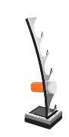
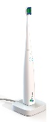

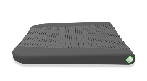




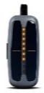

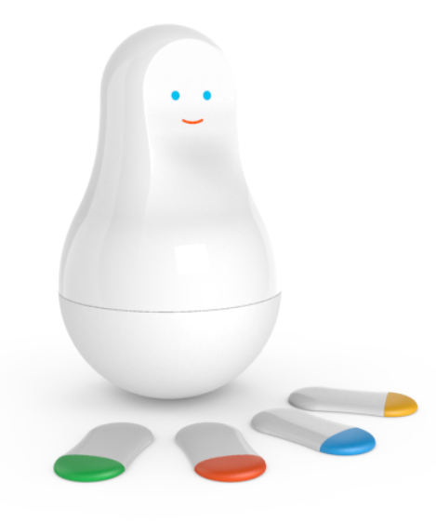





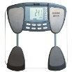





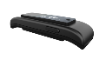



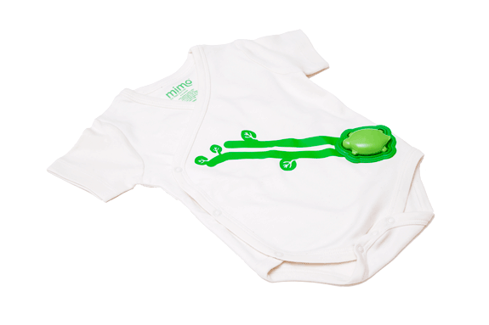
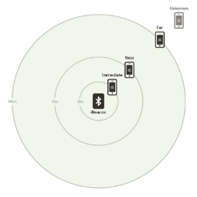
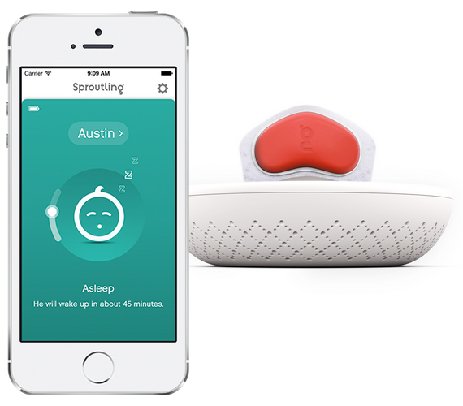


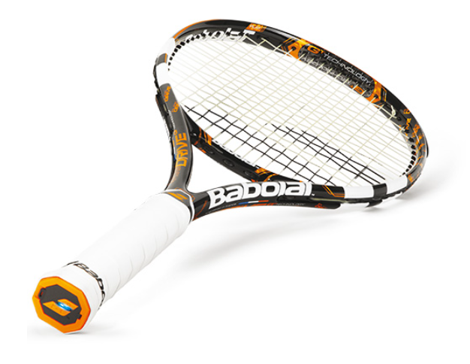







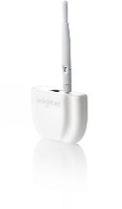




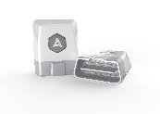
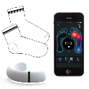









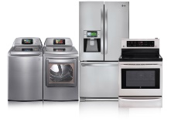

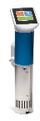
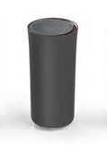

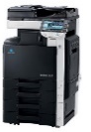
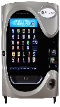
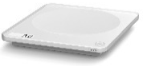

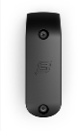
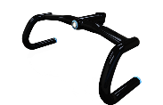
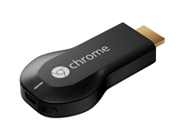






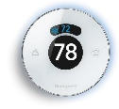
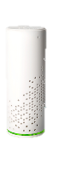

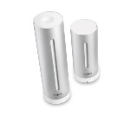


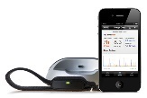







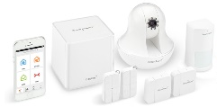
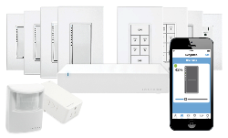

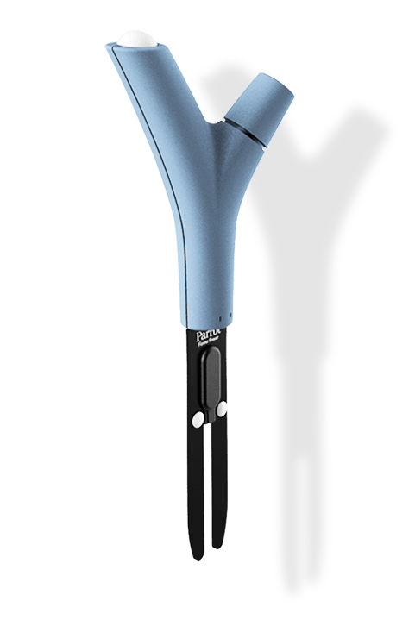

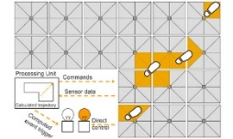
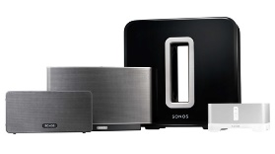






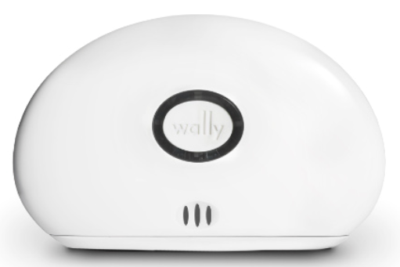

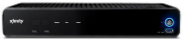
IoT 2015
Devices, sensors, and actuators with the ability to collect and share data
Medication adherence
Health monitoring
Pet tracking
Behavior modification
Object tracking
Child and elder
monitoring
Sports
and fitness
Indoor
navigation
Trip tracking and car health
Smart lighting
Beacons
and proximity
COMMUTE
COMMUTE
HOME
WORKPLACE
HOME
Smart appliances
Food and nutrition tracking
Identity
Office equipment
Smart vending machines
Bike ride stats and protection
Air conditioning and temperature control
Sleep tracking
Environmental sensors
Information capture
Control
Home security
Home automation
Leak detection
Garden, lawn and plant care
New devices and sensors
Entertainment systems
Notes:
Notes:
The “things” are devices, sensors, or actuators with the ability to collect and share data as well as impact the physical world around us.
The concept of the Internet of Things is not new – it has been around for over 20 years.
Among the many examples of IoT devices are inventory management sensors; health care monitoring systems; point-of-sale terminals; home energy meters; power monitors; security monitors; vehicle trackers; home appliance monitors; and public transit monitors.
Many kinds of scensors temperature, movement, gps location,

Slide 13
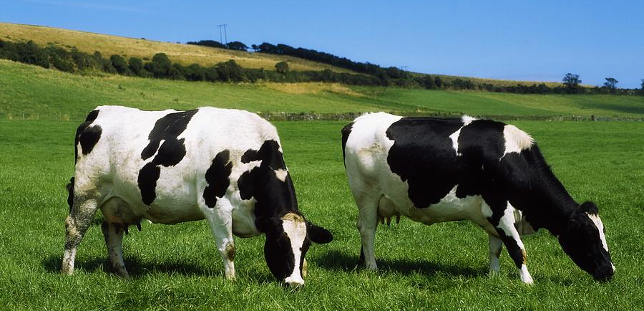

The connected cow: Using IoT to transform cattle production
CHALLENGE
SOLUTION
BENEFITS
Fujitsu is the world’s fourth-largest IT services provider with approximately 162,000 employees in more than 100 countries and holds about 97,000 patents worldwide. Fujitsu wanted to help dairy farmers increase production, improve data insights and transform their business by optimizing the timing of artificial insemination (AI). It also wanted to decrease loss through early detection of health issues.
Fujitsu learned from public research that a cow produces more estrus (goes into heat) 16 hours after the number of steps increases significantly. The company created an innovative solution which uses a rugged pedometer with a five-year battery to measure the number of footsteps a cow takes, then sends that data to the cloud for analysis to determine optimum AI timing and even affect calf gender. In addition, the patterns of steps can detect disease in cattle. Alerts are delivered to the farmer’s cell phone.
Improves calf production up to 31%, with an average of 12%
Modernizes data access with mobile phone alerts, reducing labor costs for monitoring cows
Transforms herd management by allowing farmers to increase chances of producing a male or female calf
Reduces loss by detecting 8-10 different kinds of diseases in cattle
FUJITSU

Slide 14











Large Scale Technology Trends
Transforming access to people and information
Mobile
Social
Cloud
Big Data
Millennials
will make up
  Over 80% of new apps were distributed or deployed on clouds in 2012.
  Digital content grew to
By 2016, smartphones and tablets will put power in the pockets of a billion global consumers
  2.7ZB in 2012, up 48% from 2011, rocketing
  toward 8ZB by 2015.
75% of
the American workforce by 2025
The world’s mobile
worker population
will reach
  70%
  of organizations
  are either using or
  investigating cloud computing solutions
  65%
  of companies
  are deploying at least one social software tool.
  80%
  growth of unstructured data is predicted over the next five years.
1.3 billion over 37% of the total workforce by 2015

Slide 15
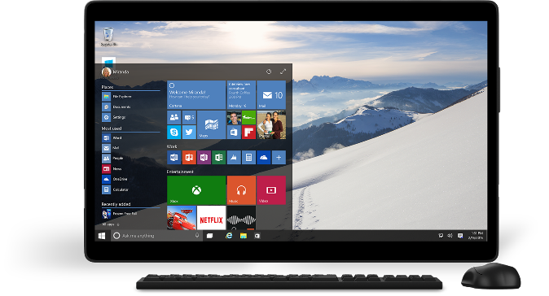
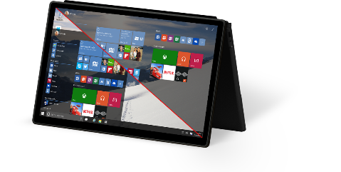
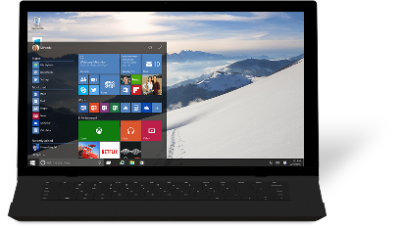
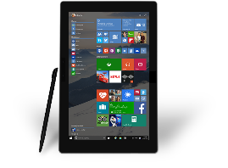
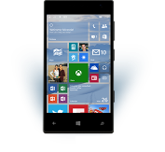


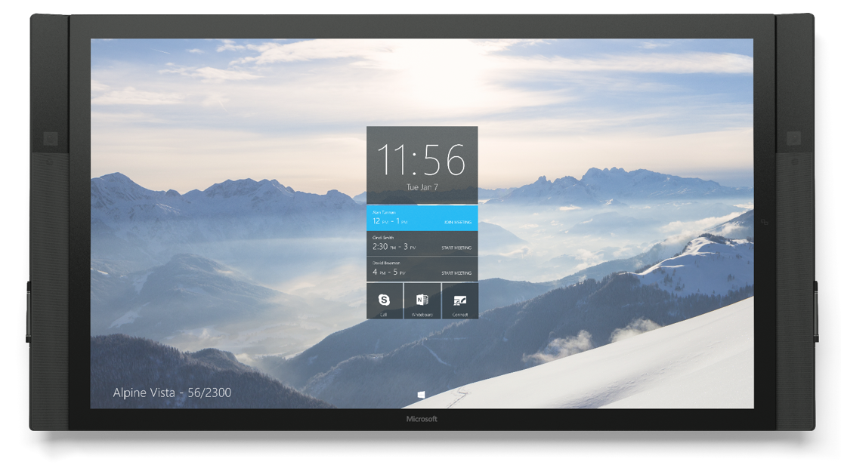
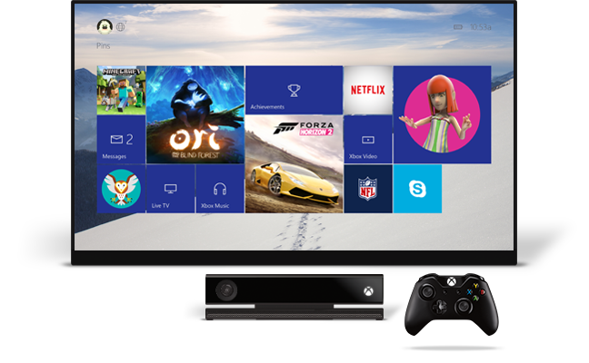
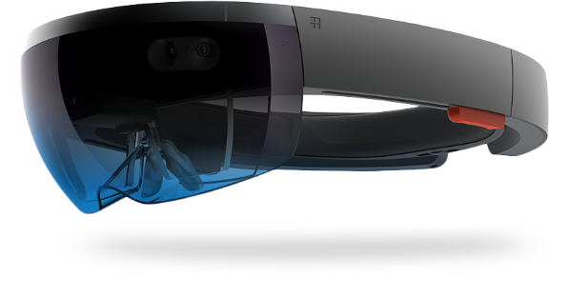
One converged Windows platform
Rapidly Growing Ecosystem
Notes:
With Windows 10 we’re bringing our entire family of experiences together from headless IoT devices to the phone, to tablets, PCs, up to the amazing new Surface Hub and beyond into the world of holograms.
One Platform, One Development Platform, One Store, One development Model, One Commerce Platform, One Universal App Model.
Windows Universal apps will enable the UI to scale seamlessly from phone to tablet and beyond – providing a familiar and productive experience regardless of the device type.
Finally -- for enterprises -- One platform means One Management paradigm and Security model across all devices. All devices can be managed with group policy and managed through MDM.
Let’s look at the innovation we’re bringing for business in Windows 10.

Slide 16


Security in a cloud first world!

Slide 17
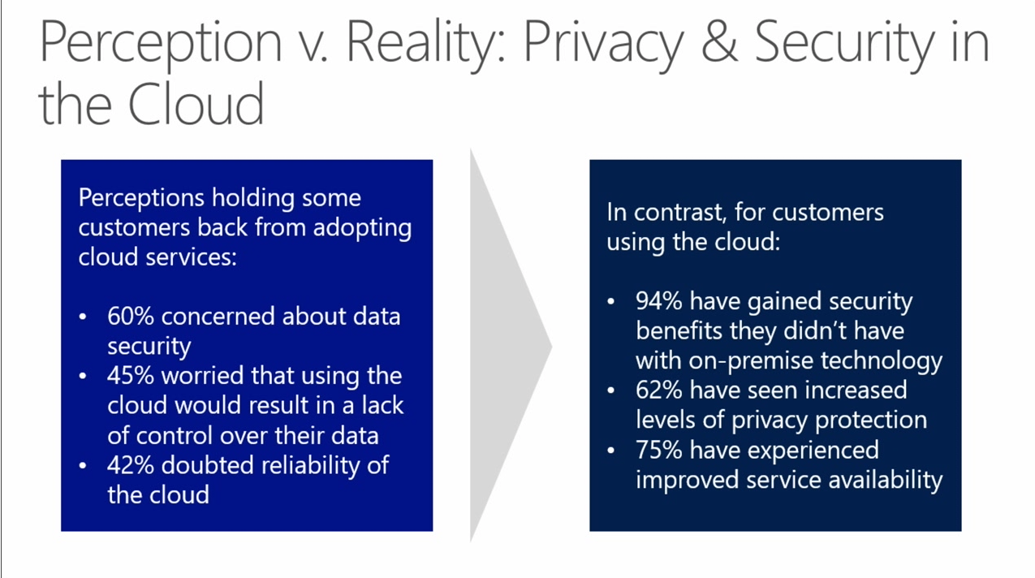

Slide 18
The Security Development Lifecycle (SDL)
Start
Goals
Protect Microsoft Customers
  Reduce the number
  of vulnerabilities
  Reduce the severity
  of vulnerabilities
  Make exploitation harder
Best Practices & Learning
Product Development
Incident Response
(MSRC)
Training, Requirements, and Design
Final Security Review
Implementation
Release
Key Principles
Secure by Design
  Eliminate security issues early
  Prescriptive, yet practical
  Proactive – not just
  “looking for bugs”
Beta Testing
Internal Testing
Verification
Notes:
You have to have tools and repeatable processes to make sure vulnerabilities in your systems are very hard to exploit.
Part of the ISO 270034 standard
We in IT must demand not only your cloud provider but also your other partners and suppliers are following best practices!!!

Slide 19


International Standard for Development – ISO 27034-1
Preparation
Development
Transition
Utilization
Training
Requirements
Design
Implementation
Verification
Release
Response
1.
Core Security
Training
2.
Establish Security
and Privacy Requirements
Make sure not only your cloud provider but also your other partners are following these best practices!!!
5.
Establish Design Requirements
8.
Use
Approved Tools
11.
Perform Dynamic Analysis
14.
Create an
Incident
Response Plan
17.
Execute
Incident
Response Plan
3.
Create
Quality Gates/
Bug Bars
6.
Perform Attack Surface Analysis/ Reduction
9.
Deprecate Unsafe Functions
12.
Perform
Fuzz Testing
15.
Certify Release
and Archive
4.
Perform Security
and Privacy Risk Assessments
7.
Use Threat
Modeling
10.
Perform Static Analysis
13.
Conduct Attack Surface Review
16.
Certify Release
and Archive
ISO/IEC 27034-1: 2011 “Annex A” provides example alignment of an existing process
based on Microsoft Simplified SDL to the framework and structures of ISO 27034.

Slide 20
Your cloud provider is your partner
Responsibility
On-Prem
IaaS
PaaS
SaaS
Customer management of risk
Data Classification | End Point Devices
Data classification
and accountability
Client & end-point
protection
Identity & access
management
Shared management of risk
Identity & access management
Application
level controls
Network controls
Provider management of risk
Physical | Networking
Host Security
Physical Security
Cloud Customer
Cloud Provider

Slide 21
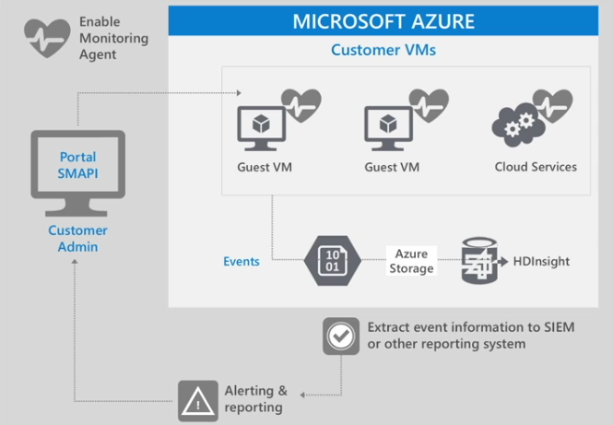
Monitoring
Azure
Performs monitoring and alerting on security events for the platform
Enable security data collection via Monitoring Agent or Windows Event Forwarding
Your Job
Configure monitoring
Export events to SQL Database, HDInsights or a SIEM for analysis
Monitor alerts a& reports
Respond to alerts

Slide 22
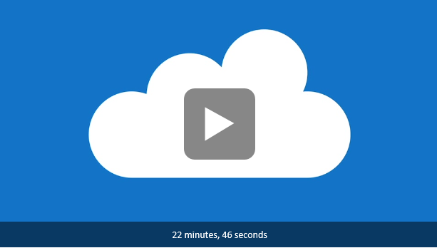
Resources - Security Overview
https://channel9.msdn.com/events/Microsoft-Azure/AzureCon-2015/ACON211

Slide 23
More Resources
Azure Platform security and compliance
https://channel9.msdn.com/events/Microsoft-Azure/AzureCon-2015/ACON211
AzureCon 2015 https://channel9.msdn.com/events/Microsoft-Azure/AzureCon-2015
Security in a Cloud Enabled World on Microsoft Virtual Academy http://MicrosoftVirtualAcademy.com
  About 6 hours of detailed information on working and integrating security best practices as you move resources into the cloud.
Security in a Cloud Enabled World Poster & Whitepaper http://aka.ms/securecustomer
Azure Trust Center https://azure.microsoft.com/en-us/support/trust-center/
Cyber Trust Blog blogs.microsoft.com/cybertrust
Security Intelligence Report www.microsoft.com/sir
Security Development Lifecycle www.microsoft.com/sdl
Protecting your datacenter and cloud from emerging threats
http://blogs.technet.com/b/windowsserver/archive/2015/05/05/protecting-your-datacenter-and-cloud-from-emerging-threats.aspx

Slide 24
Questions…
?
?
?
?
?
?
?
?
?
?
?
?
?
?
?
?
?
?
?
?
?

Slide 25
Thank you

