Slide 1
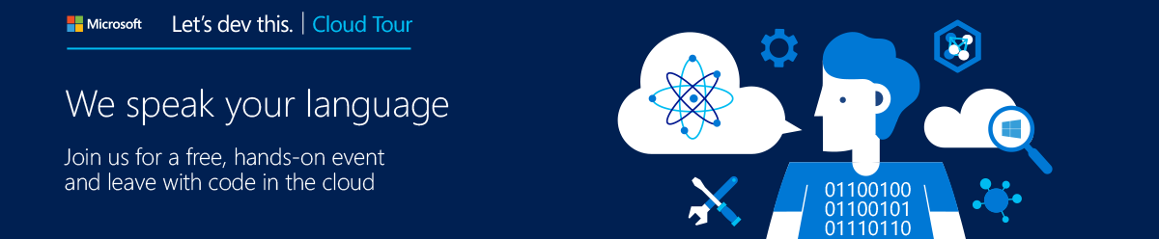




Let’s dev this. Cloud Tour
The Cloud for Modern Business
Microsoft All Star Cast
Dan Stolts
Chief Technology Strategist
Build a powerful, enterprise-grade cloud platform using the NEW features of Visual Studio 2015 & Microsoft Azure
Maria Naggaga
Technology Evangelist
Jason Keicher
Developer Technology Specialist
Ashish Sharma
Developer Technology Specialist
Notes:
Build a powerful, enterprise-grade cloud platform using the NEW features of Visual Studio 2015 & Microsoft Azure
Please join us for this interactive, full-day training session led by Microsoft experts, created specifically for developers like you.
What am I going to learn?
At this event, you will learn about the latest release of Visual Studio 2015 and Microsoft Azure’s features and services – including Microsoft Azure Virtual Machines, Websites, and Visual Studio’s IntelliTest – that can help you build and move a variety of apps to the cloud. You’ll see how to build websites, mobile applications, and enterprise-class applications.
We’ll give you a free Microsoft Azure pass since you’ll spend most of the day in a hands-on lab environment.
Topics we’ll cover:
Intro to Microsoft Azure & Visual Studio 2015 - Hello Azure! In this talk, you'll learn about Microsoft Azure’s broad service offerings. All the pieces – including Compute, Data, App and Network Services – combine to provide one powerful enterprise-grade cloud platform you can trust. We’ll also broadly cover some of the new features in Visual Studio 2015 and VSO/TFS 2015.
Microsoft Azure App Services with Visual Studio 2015 - Microsoft Azure App Services provide a powerful way to create Web, Mobile, API and Logic applications. In this module, you will learn the basics of these services and try them in the associated hands-on labs. We’ll throw in some of the exciting new features of Visual Studio including the redesigned IntelliTrace for debugging and the brand new IntelliTest that will help you enhance quality while improving productivity.
Identity & Access - Learn about ADAL Library, O365 Library, OData Services, .NET & Java.
IaaS - Need some extra servers? We've got them. Microsoft Azure Virtual Machines provide both Windows and Linux guest operating systems.
Data - Microsoft Azure has many ways to fulfill your storage needs. Covering SQL, Azure HD Insight, Data Warehousing and Data Lakes, this module provides a solid drilldown into the choices available. Learn how to build web apps using DocumentDB and Azure SQL.
Build a powerful, enterprise-grade cloud platform using the NEW features of Visual Studio 2015 & Microsoft Azure
Date: Oct 15, 2015 8:30 AM - 5:00 PM
Microsoft Office - New York City
11 Times Square,
New York , NY 10036
See map and/or driving directions
Please join us for this interactive, full-day training session led by Microsoft experts, created specifically for developers like you.
What am I going to learn?
At this event, you will learn about the latest release of Visual Studio 2015 and Microsoft Azure’s features and services – including Microsoft Azure Virtual Machines, Websites, and Visual Studio’s IntelliTest – that can help you build and move a variety of apps to the cloud. You’ll see how to build websites, mobile applications, and enterprise-class applications.
We’ll give you a free Microsoft Azure pass since you’ll spend most of the day in a hands-on lab environment.
Topics we’ll cover:
Intro to Microsoft Azure & Visual Studio 2015 - Hello Azure! In this talk, you'll learn about Microsoft Azure’s broad service offerings. All the pieces – including Compute, Data, App and Network Services – combine to provide one powerful enterprise-grade cloud platform you can trust. We’ll also broadly cover some of the new features in Visual Studio 2015 and VSO/TFS 2015.
Microsoft Azure App Services with Visual Studio 2015 - Microsoft Azure App Services provide a powerful way to create Web, Mobile, API and Logic applications. In this module, you will learn the basics of these services and try them in the associated hands-on labs. We’ll throw in some of the exciting new features of Visual Studio including the redesigned IntelliTrace for debugging and the brand new IntelliTest that will help you enhance quality while improving productivity.
Identity & Access - Learn about ADAL Library, O365 Library, OData Services, .NET & Java.
IaaS - Need some extra servers? We've got them. Microsoft Azure Virtual Machines provide both Windows and Linux guest operating systems.
Data - Microsoft Azure has many ways to fulfill your storage needs. Covering SQL, Azure HD Insight, Data Warehousing and Data Lakes, this module provides a solid drilldown into the choices available. Learn how to build web apps using DocumentDB and Azure SQL.

Slide 2
Agenda / Timeline
Subject to change without notice :)
Time | Session | Leader
08:30 – 09:00 | Registration & Breakfast | Maria
09:00 – 10:00 | Keynote: Getting to Know Azure | Dan & Maria
10:00 – 10:15 | BREAK & Lab | All
10:15 – 11:00 | App Service | Jason
11:00-11:45 | Identity and Access | Maria
11:45 – 13:30 | Lunch & Labs | All
13:30 – 14:15 | IaaS | Dan
14:15 – 15:00 | Data Services | Ashish
15:00 – 15:15 | BREAK & Lab | All
15:15 – 16:45 | Hands on Labs | All
16:45 – 17:00 | Wrap up, Eval & Prizes | Maria

Slide 3
Why the cloud?

Slide 4
Why the cloud?
Rapidly setup environments to drive business priorities
Scale to meet peak demands
Increase daily activities, efficiency and reduced cost.
Speed
Scale
Economics

Slide 5
Why the cloud?
  Hosting models
  Business model
  On Premises
  Infrastructure
  (as a Service)
  Platform
  (as a Service)
  Software
  (as a Service)
  Applications
Applications
  You manage
Applications
Applications
  You scale, make resilient and manage
  You scale, make
  resilient & manage
Data
Data
Data
Data
Runtime
Runtime
Runtime
Runtime
  Scale, resilience and
  management by vendor
Middleware
Middleware
Middleware
  Scale, resilience and
  management by vendor
Middleware
O/S
O/S
O/S
O/S
Virtualization
Virtualization
  Managed by vendor
Virtualization
Virtualization
Servers
Servers
Servers
Servers
Storage
Storage
Storage
Storage
Moving between stacks …
Migrating Apps and Workloads?
Networking
Networking
Networking
Networking

Slide 6
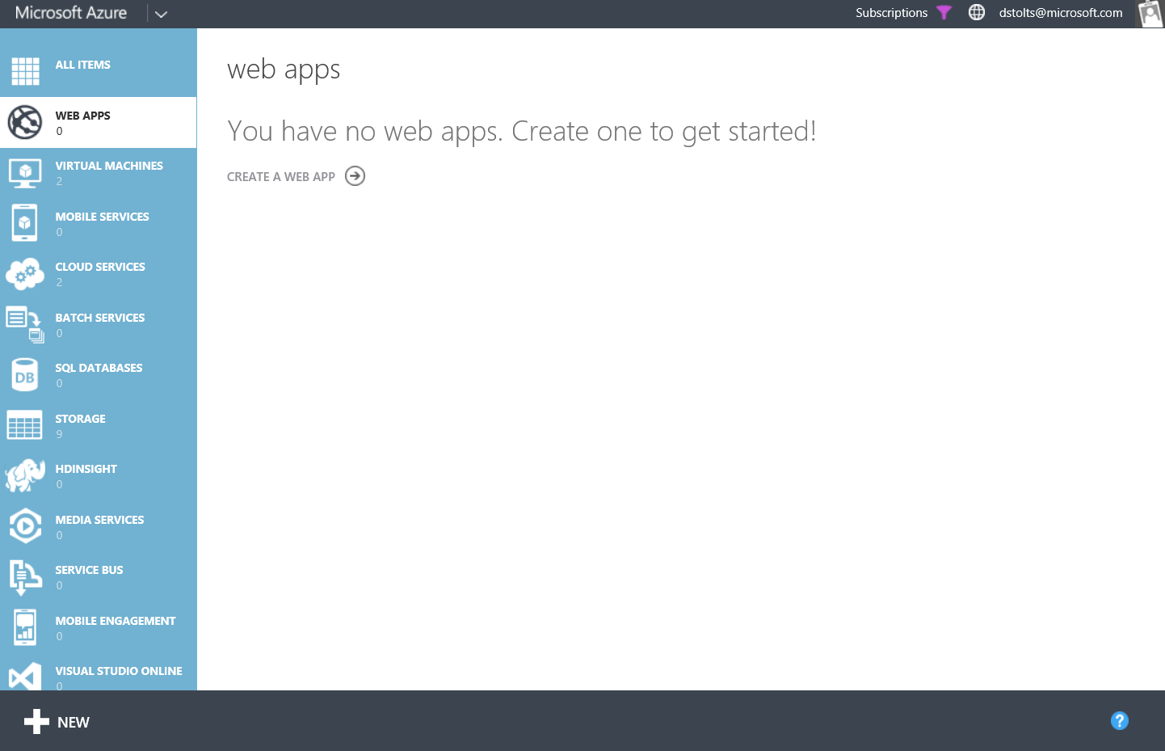
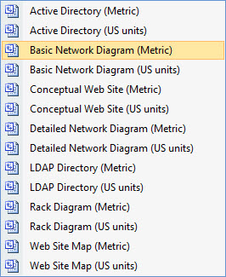
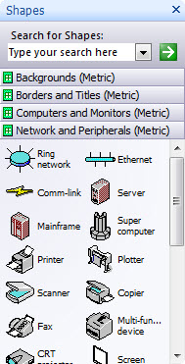
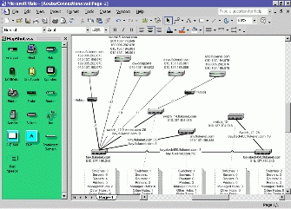
Azure

Slide 7





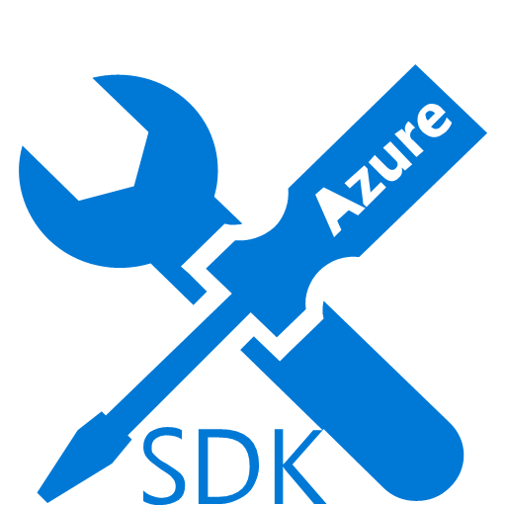
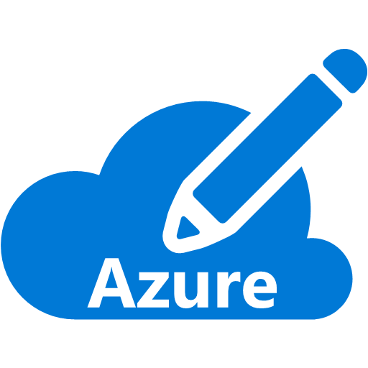















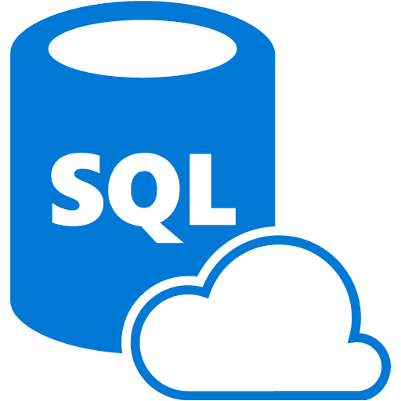





























Platform Services
Security & Management
Compute
Web and Mobile
Developer Services
Hybrid
Operations
Cloud
Services
Service
Fabric
Web Apps
API
Apps
API
Management
Visual Studio
Azure SDK
Portal
Azure AD
Connect Health
Batch
Remote App
Mobile
Apps
Logic
Apps
Notification
Hubs
Team Project
Application
Insights
Active
Directory
AD Privileged
Identity
Management
Multi-Factor
Authentication
Integration
Analytics & IoT
Data
Backup
Storage
Queues
Biztalk
Services
Automation
HDInsight
Machine
Learning
SQL
Database
SQL Data
Warehouse
Operational
Insights
Hybrid
Connections
Service
Bus
Key Vault
Data
Factory
Event
Hubs
Redis
Cache
Search
Import/Export
Store /
Marketplace
Media & CDN
Site
Recovery
Stream
Analytics
Mobile
Engagement
DocumentDB
Tables
VM Image Gallery
& VM Depot
Media
Services
Content Delivery
Network (CDN)
StorSimple
Infrastructure Services
Compute
Storage
Networking
Virtual Machines
Containers
BLOB Storage
Azure Files
Premium Storage
Virtual Network
Load Balancer
DNS
Express
Route
Traffic Manager
VPN Gateway
Application Gateway
Datacenter Infrastructure (24 Regions, 23 Online)

Slide 8
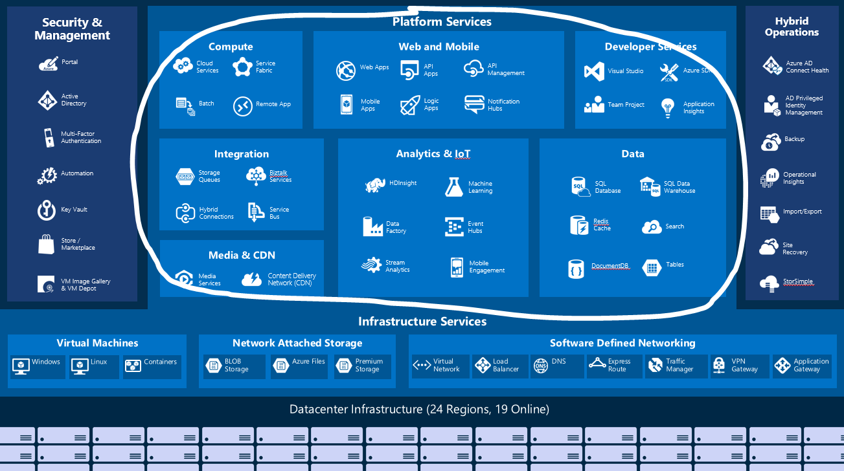
New Business
Applications
25%
Custom apps
50%
App operations
10%
New business apps
15%
Packaged apps
Move up the stack – to PaaS – as much a cultural shift as a technology shift
Azure handles resilience, servicing, management
Shift to Optimization from deployment/ops

Slide 9

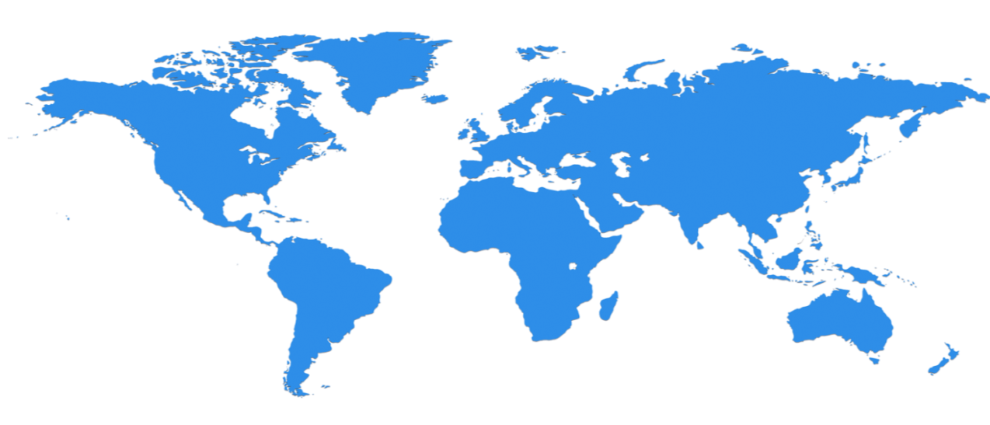

Huge infrastructure scale is the enabler
24 Regions Worldwide, 19 ONLINE…huge capacity around the world…growing every year
North Central US
Illinois
North Europe
Ireland
West Europe
Netherlands
Central US
Iowa
Canada Central
Toronto
Canada East
Quebec City
US Gov
Iowa
China North *
Beijing
China South *
Shanghai
Japan East
Saitama
West US
California
East US
Virginia
India Central
Pune
Japan West
Osaka
South Central US
Texas
East US 2
Virginia
US Gov
Virginia
India South
Chennai
India West
Mumbai
East Asia
Hong Kong
SE Asia
Singapore
Australia East
New South Wales
Brazil South
Sao Paulo
Australia South East
Victoria
  100+ datacenters
  Top 3 networks in the world
  2x AWS, 6x Google DC Regions
  G Series – Largest VM in World, 32 cores, 448GB Ram, SSD…
Operational
Announced/Not Operational
  * Operated by 21Vianet
Notes:
Why this Slide:
This is SUCH a big investment – it’s a game for only very few. It’s not new for us – we have been doing this for our own services and our consumer/web properties for 20+ years
Key Points:
Where are we – EVERYWHERE…!
How big is this - $15+ B and counting – this is serious, we continue to bet big and you can count on us
Talk about DC innovation – DC Efficiency and Gen 5 data centers.
Scale – at this scale you do get efficiencies – the main one being POWER
Remember our “strategy” – we will be in the major places, but not everywhere – we have Azure Stack/Hosters for that.
Transition to NEXT Slide: This is the physical infrastructure that Azure sits on, now lets talk about Azure the PLATFORM

Slide 10
>57%
More than
1,000,000
>300k
Fortune 500 using Azure
Active websites
SQL Databases in Azure
>60
>300
>1.65
TRILLION
storage objects
MILLION
AAD users
>3
MILLION
requests/sec
>13
BILLION
MILLION
authentication/wk
Developers registered with Visual Studio Online

Slide 11




















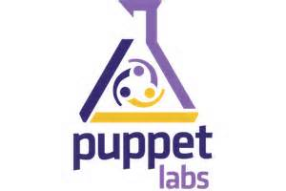












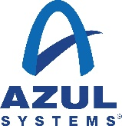




















Partners

Slide 12
Portal
Storage
ASP.NET MVC 5.1
Virtual Machines
SMB File System
Traffic Mgr
Disk Optimized
Memory Optimized
IBIZA
Azure Redis Cache
Hadoop 2.2
Powershell and DSC
Static IP
Resource Manager
99.95% SLA
Puppet Chef Docker
Event Hub
2014
Subnet Routing
Backup
Capture / Deploy
.NET 4.5
Web Apps
SQL Database
Powershell Automation
BD’s up to 500GB
Cordova
API Management
.NET Support
Autoscale
Active GEO replication
Node.JS project support
Self Service Site Recovery
Java Support
Remote Apps
Visual Studio & .NET
Networking
ASP.NET Web API 2.1
Web Jobs
Point-to-site VPN
Xamarin
Mobile Services
Remote Debug
VSO Open Api’s
Offline Sync
Dynamic Routing
HDInsight
AD support
VSO GA
VM Management
Kindle Support
Autoscale
Remote Debugging
Site Recovery
YARN support
.NET Foundation

Slide 13
How we differentiate with Azure
Hyper-scale
Enterprise Grade
Hybrid

Slide 14

Why should you care? Why are you here?
How does this relate to your Business?
Who in your company is SMART about Technology?
Who’s Job is it to solve business problems?
CEO?
CFO?
Directors/Managers?
Department Heads?
YOU?
Notes:
Who is smart and empowered, what I mean by this is smart about technology and cloud services and leveraging them to solve business problems. Empowered meaning you have the ability to implement change.

Slide 15
New Pulse of IT
Be Strategic; Solve Business Problems
How can you deliver services faster?
How can you help the company continue expansion?
How can you increase customer satisfaction or retention?
What are current pain points for…
  Customers? Partners? Employees?
What new services (cloud, mobile) might your company be able to benefit from?
What projects are on a shelf for lack of resources?
Your Vision + New Cloud Solution = Success!

Slide 16


The connected cow: Using IoT to transform cattle production
CHALLENGE
SOLUTION
BENEFITS
Fujitsu is the world’s fourth-largest IT services provider with approximately 162,000 employees in more than 100 countries and holds about 97,000 patents worldwide. Fujitsu wanted to help dairy farmers increase production, improve data insights and transform their business by optimizing the timing of artificial insemination (AI). It also wanted to decrease loss through early detection of health issues.
Fujitsu learned from public research that a cow produces more estrus (goes into heat) 16 hours after the number of steps increases significantly. The company created an innovative solution which uses a rugged pedometer with a five-year battery to measure the number of footsteps a cow takes, then sends that data to the cloud for analysis to determine optimum AI timing and even affect calf gender. In addition, the patterns of steps can detect disease in cattle. Alerts are delivered to the farmer’s cell phone.
Improves calf production up to 31%, with an average of 12%
Modernizes data access with mobile phone alerts, reducing labor costs for monitoring cows
Transforms herd management by allowing farmers to increase chances of producing a male or female calf
Reduces loss by detecting 8-10 different kinds of diseases in cattle
FUJITSU

Slide 17
IoT 2010
Alarm clock
Refrigerator
Automobile
VoIP phone
Computer
Printer
Media player
Microwave
HOME
WORKPLACE
HOME
Coffee maker
Smart scale
Oven
Cell phone
HVAC
Vending
Security
Television

Slide 18
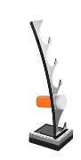
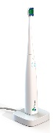
























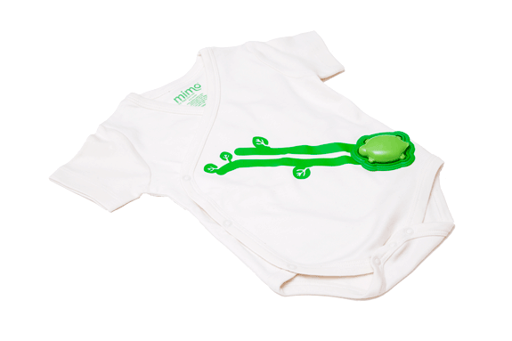
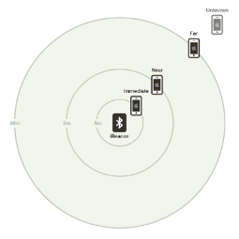
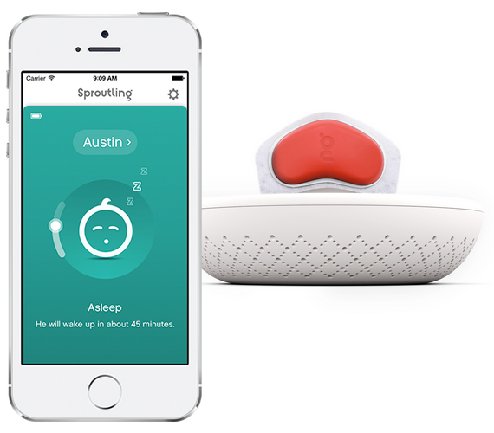




























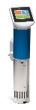


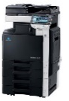
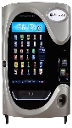


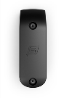






















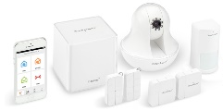
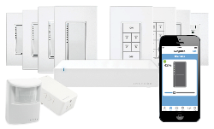

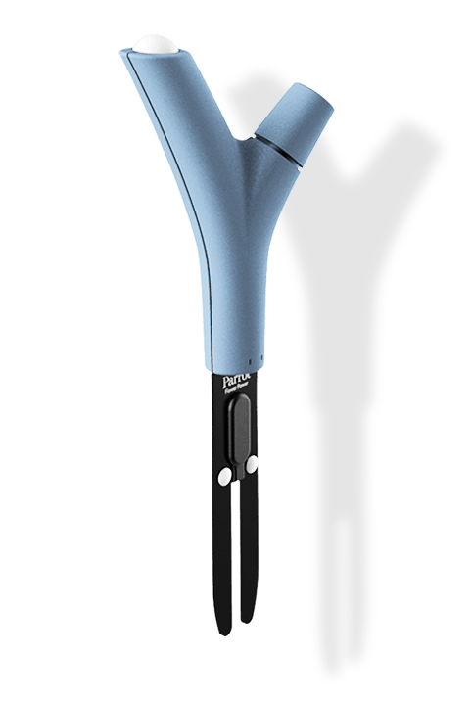

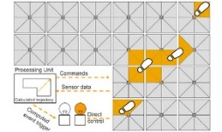
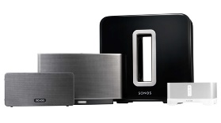






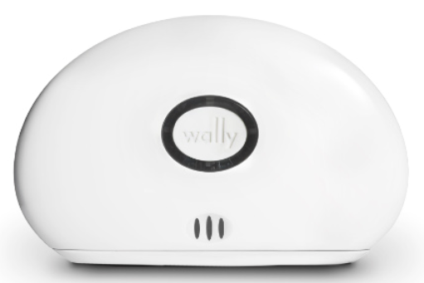

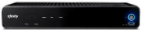
IoT 2015
Medication adherence
Health monitoring
Pet tracking
Behavior modification
Object tracking
Child and elder
monitoring
Sports
and fitness
Indoor
navigation
Trip tracking and car health
Smart lighting
Beacons
and proximity
COMMUTE
COMMUTE
HOME
WORKPLACE
HOME
Smart appliances
Food and nutrition tracking
Identity
Office equipment
Smart vending machines
Bike ride stats and protection
Air conditioning and temperature control
Sleep tracking
Environmental sensors
Information capture
Control
Home security
Home automation
Leak detection
Garden, lawn and plant care
New devices and sensors
Entertainment systems

Slide 19
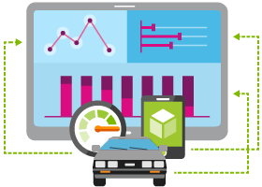

Internet of Things
  Event Hubs
  Notification Hubs
  Stream Analytics
  Machine Learning
  HDInsight
  Power BI for Office 365
With Microsoft Azure IoT services, you can monitor assets to improve efficiencies, drive operational performance to enable innovation, and leverage advance data analytics to transform your company with new business models and revenue streams.
Notes:
Speaking Notes
Azure Mobile Services is a Backend-as-a-Service
Instead of you having to design, build, test, deploy, manage, and upgrade your whole backend, we do it for you
Features of Mobile Services
Storage – SQL DB
Authentication – built in support for social providers w/ ability to custom auth
Backend logic – data validation, logical flows, etc
Push Notifications – across all major mobile platforms
Scheduler – backend job processing

Slide 20
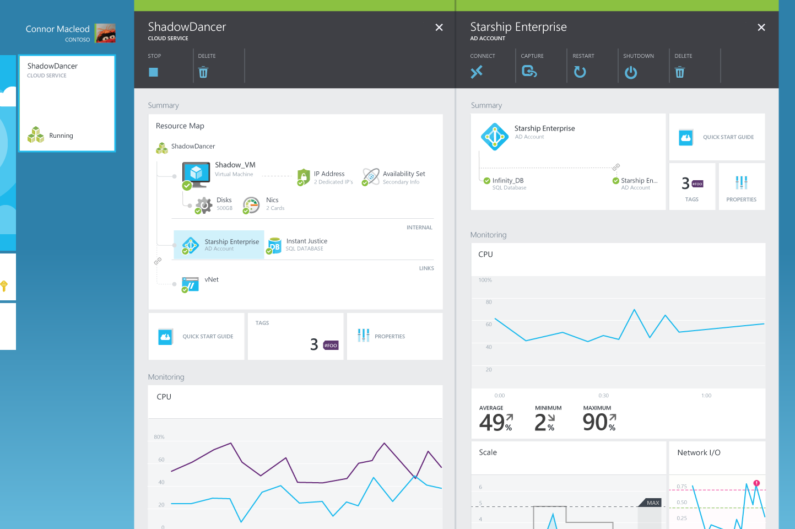
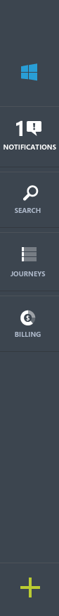
Hybrid consistency
CUSTOMER DATACENTER
CONSISTENT
PLATFORM
MICROSOFT
AZURE
SERVICE PROVIDER
Common OS and Hypervisor
Common management API/UX
Common programming model

Slide 21

Connect every on-premises server to the cloud
Azure
StorSimple
Backup
Hyper-V Disaster Recovery
VMWare Disaster Recovery
SQL Server Always On
Active Directory
Orchestration as a Service
ExpressRoute Networking
On-Premises Datacenter

Slide 22



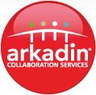










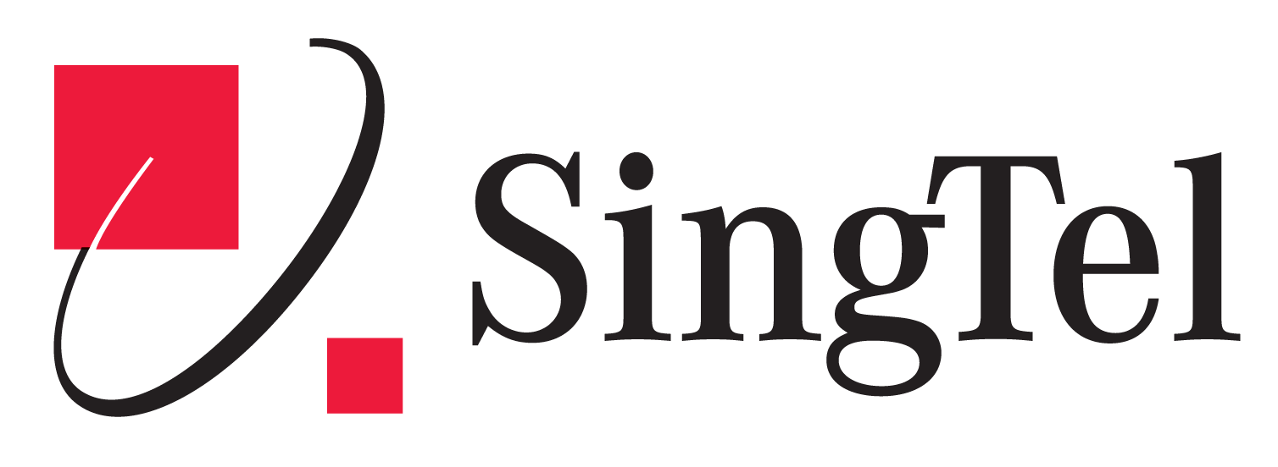





















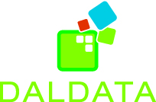

























Cloud OS Network hosting and service providers

Slide 23









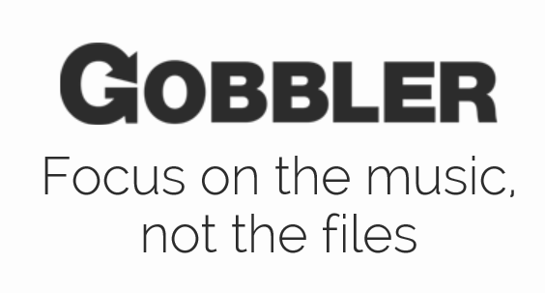



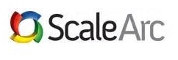
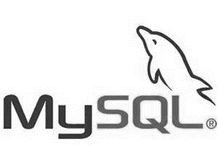
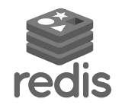







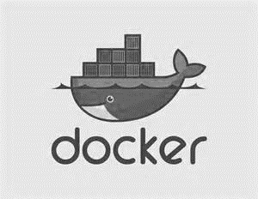
Support for Open Source
Languages
CMS
Devices
Databases / Apps
Operating
systems
Management

Slide 24
Virtual Machines
Getting started
Select image
and VM size
New disk persisted in storage
Management portal
Windows Server
Boot VM from new disk
>_
Linux
Scripting
(Windows, Linux and Mac)
Blob
Storage
General Purpose
Basic
Standard
Optimized Compute
Performance Optimized
Network Optimized
REST API
Cloud
Comprehensive
Networking

Slide 25
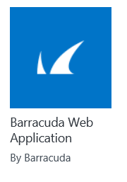
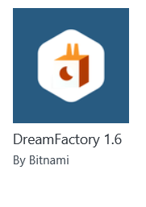
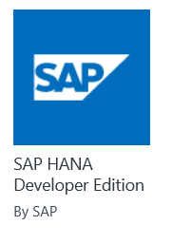
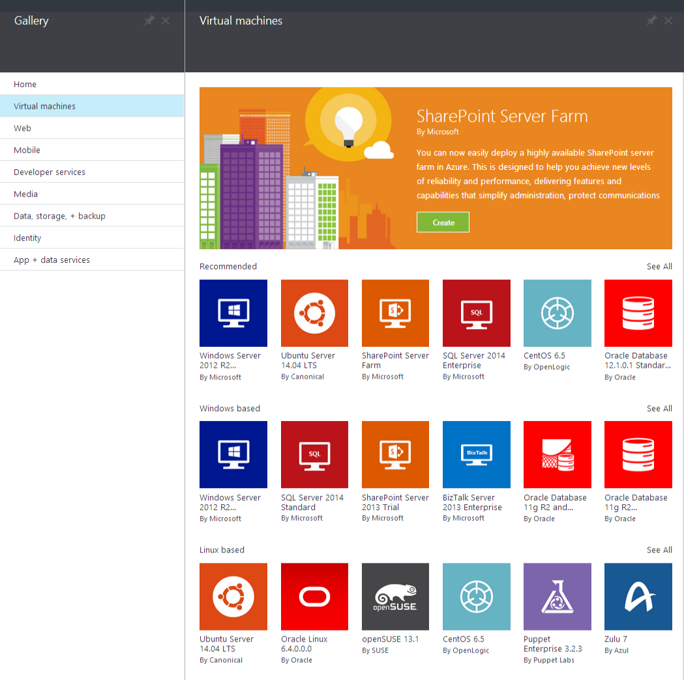
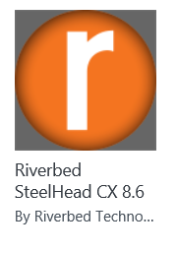
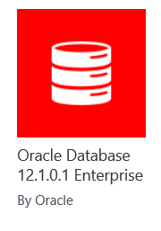
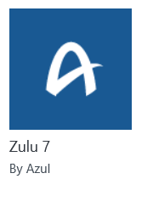
Microsoft Azure
Certified

Slide 26

Microsoft Azure Site Recovery
Orchestrated disaster recovery to a second site or to Azure
Microsoft Azure
Site Recovery
Microsoft Azure
Site Recovery
Communication Channel
Communication and Replication
Replication channel:
Hyper-V Replica
Windows Server
Primary Site
Recovery Site
Windows Server
Primary Site
Windows Server
Automated VM protection and replication
Remote health monitoring
Customizable recovery plans
No-impact recovery plan testing
Orchestrated recovery when needed

Slide 27
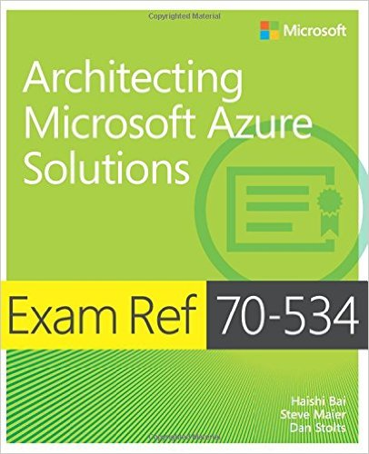

Azure Certification Jump Start
70-534 Architecting Microsoft Azure Solutions
All Attendees Go Home With The Book & Autograph!!!
Brought to you By:
@ITProGuru
Microsoft
8:00 Registration, Breakfast and Networking
8:30 Sharp: 70-534 Introduction
Exam Tips and Tricks
Design Microsoft Azure infrastructure and networking (15–20%)
Secure resources (15–20%)
Design an advanced application (15–20%)
Lunch & Labs
Design websites (15–20%)
Design an application storage and data access strategy (15–20%)
Design a management, monitoring, and business continuity strategy (15–20%)
Field Experiences
5:00pm Book Signing – Authors Dan Stolts
5:00pm Social Hour w/ Dan Stolts and Friends
Registration Required: Site TBD $50 Fee covers materials and food
http://www.amazon.com/dp/0735697442/ref=rdr_ext_tmb
Jan ?? 2016 – Microsoft NYC - ITProGuru.com/Join
Notes:
http://aka.ms/70-534 – Once it goes live..
Learn what you need to know to become a certified Azure Solutions Architect. We will go through the lessons found in the book 70-534 Architecting Microsoft Azure Solutions. We will wrap things up with our speakers (and authors of the book) doing a book signing so bring your copy of the book.
70-534 Introduction
Exam Tips and Tricks
Design an advanced application (15–20%)
Design websites (15–20%)
Design a management, monitoring, and business continuity strategy (15–20%)
Design Microsoft Azure infrastructure and networking (15–20%)
Secure resources (15–20%)
Design an application storage and data access strategy (15–20%)
Field Experiences
Book Signing – Authors Dan Stolts, Steve Maier

Slide 28
Trust through Transparency
$
Monthly SLAs
ISO 27001 Cloud Security Alliance (STAR)
Industry standards
Regulatory compliance
Trust center
Yearly audits
Independently verified
Real-time status
Service dashboard
HIPAA Business Associate Agreement (BAA)

Slide 29




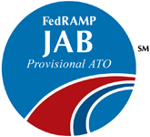
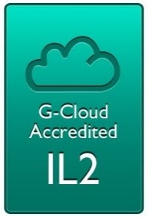

Compliance: aka.ms/AzureCompliance
Notes:
Speaker notes:
Azure meets a broad set of international and industry-specific compliance standards, such as ISO 27001, HIPAA, FedRAMP, SOC 1 and SOC 2, as well as country-specific standards including Australia IRAP, UK G-Cloud, and Singapore MTCS.
Azure cloud services, with independently verified compliance, give you the foundation to achieve compliance for the infrastructure and applications you run in Azure.
Azure is subjected to rigorous audits by independent organizations and the results are available to you as a part of Microsoft's commitment to transparency.
Microsoft was also the first to adopt the uniform international code of practice for cloud privacy, ISO/IEC 27018, which governs the processing of personal information by cloud service providers.

Slide 30

Titanfall
→ Game sessions hosted using Azure
→ Hosted using >100,000 Azure Virtual Machines
Notes:
Points to land:
Imagine what you could do…
→ 360,000 concurrent cores
→ Have EA tell the story
→ Assume we don't run out of capacity

Slide 31

SQL Database
Fully managed SQL Server database technology as a service
  Ideal for simple and complex applications
  Enterprise-ready with automatic support for HA
Secondary
Replica
Primary
Secondary
Replica
Secondary
Replica
Notes:
Speaker notes:
How is HA achieved? At any one time, three database replicas are running—one primary replica and two or more secondary replicas. If the hardware fails on the primary replica, Azure SQL Database detects the failure and fails over to the secondary replica. In case of a physical loss of a replica, a new replica is automatically created. So there are always at minimum two physical, transitionally consistent copies of your data in the datacenter.

Slide 32
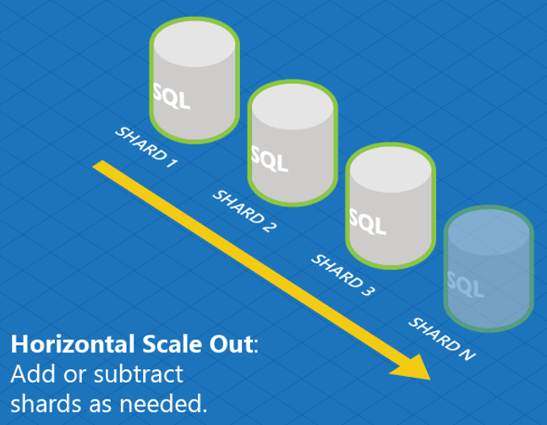



SQL Database
  Designed to scale out elastically with demand
  Robust Failover and Disaster Recovery capabilities
Cross Datacenter Failover
Notes:
Speaker notes:
Azure SQL Database Elastic Scale capabilities simplify the process of scaling out (and in) a cloud application’s data tier by streamlining development and management. Based on industry-standard sharding practices, Elastic Scale offers functionality to help you build and maintain applications that can span a few databases or thousands.
On top of the built-in systems that enable HA of your database, Azure SQL Database offers additional business continuity features:
The active geo-replication support enables you to initiate/control any failovers – allowing you to shift the primary database to any of your secondary regions.
The built-in backup and restore capabilities offered by Azure SQL Database provide great functionality for recovering from disaster and human error (oops mistakes).

Slide 33

Big Data Insights
Microsoft Azure HDInsight
Microsoft instance of Hadoop distribution running as service
Support existing ecosystem from Hive, Pig, etc
Includes HBase and Storm
Extended to support Excel and BI tooling
Integration with diverse sources of data
Notes:
Speaker notes.
HDInsight is Microsoft instance of Apache Hadoop distribution running as a service in Azure cloud that you can spin up in minutes. It’s architected to handle any amount of data, scaling from terabytes to petabytes on demand.
Supports existing ecosystem such as Hive to explore your data or to create reusable batch processing jobs. Includes Pig to implement complex processing logic.
Uncover business insights by processing and analyzing structured or semi-structured data from web clickstreams, social media, server logs, devices and sensors, and more.
Because it's integrated with Excel, HDInsight lets you visualize and analyze your Hadoop data in compelling new ways in a tool familiar to your business users.
Includes NoSQL transactional capabilities with Apache Hbase. Provides real-time stream processing capabilities with Apache Storm
Leverage existing skills for configuration, submission, and monitoring of Hadoop jobs using languages you know such as Java, C#, PowerShell, .Net SDK

Slide 34

Big Data Insights
Microsoft Azure Machine Learning
Democratized platform for Machine Learning
Fully-managed cloud service for building predictive
analytics solutions
Elastic, pay as you go with low operating costs
Extend with Power BI, HDInsight and cloud hosted data
Extensible, supports R and Python
Notes:
Speaker notes:
Democratized; Azure Machine Learning lets the masses and scientists alike learn, experiment, mashup and create high quality powerful algorithms.
Visually compose ML workflow through a web browser with no software to install and without learning multiple tools from data acquisition, cleaning and prep, machine learning, and experimentation.
Fully-managed cloud service for building predictive analytics solutions, helps overcome the challenges most businesses have in deploying and using machine learning.
Enables data scientists and developers to efficiently embed predictive analytics into their applications.
Azure ML is supports today’s Data scientists’ choice of language R and can bring their existing assets in R and integrate them seamlessly into Azure ML workflows.

Slide 35




Hybrid Identity
Virtual
Machines
Virtual
Network
Connect hybrid infrastructure services with a single identity
Authenticate apps in virtual machines using
on-premises identities
Bring mature, enterprise adopted AD to apps in cloud
Enable hybrid scenarios through Virtual Network private secure connection to on-premises
Connect Office 365 and other SaaS Apps to on-premises identities
Windows Server
Active Directory DS
Windows Server
Active Directory ADFS
Windows Azure
Active Directory
LOB & custom apps
Windows Server
Active Directory
Internet
End Users
On-premises
Windows Azure
SaaS Apps
Notes:
Extend and Synch. – Connect Hybrid Infrastructure Services with a Single Identity
The next scenario we’ll discuss is in the context of Office 365 and Windows Server Active Directory, which is used by 90% of enterprises worldwide. You’ll see how Active Directory in Virtual Machines can bring hybrid scenarios to life. This is possible not only when you run Active Directory and its components – such as federation services and DirSync - in Windows Azure Virtual Machines. For your SharePoint farms, with SQL Server apps talking back to on-premises, you’ll also want to connect back to your corporate identity store this way.
When you sign up for Office 365, you get virtually anywhere access to familiar Office tools, plus enterprise-grade email, conferencing, and a lot more. If you’re like most customers, you might want to synch on-premises identity with Office 365. By simply running Active Directory in Virtual Machines, synching with ADFS on-premises and connecting through Virtual Network, you can set up single sign-on capabilities.
This model also applies for applications running in Windows Azure Virtual Machines. When those applications need to authenticate with on-premises identities, you just connect to on-premises Active Directory to federate identities. With Windows Azure Infrastructure Services, it’s easy to build hybrid environments that take advantage of what you already have, while enabling new capabilities in the cloud.

Slide 36
AAD Multi-Factor
Strong multi-factor authentication
Real-Time Fraud Alert
PIN option
Security
Reporting and logging for auditing
Enables compliance with NIST 800-63 Level 3, HIPAA,
PCI DSS, and other regulatory requirements

Slide 37
You
Microsoft Azure Active Directory
Synchronize your corporate
and 3rd party identities
Integration with O365
Support modern protocols
  OAuth 2.0
  OpenID Connect
  WS-Fed
  SAML 2.0
Identity and Access Mgmt Permissions
  Users
  Groups
  Applications
Microsoft Azure AD
3rd party clouds/hosting
PCs and devices

Slide 38


Azure Media Services
Olympics NBC Sports
On Demand Media Services
Video-on-demand
  Ingest
  Encode
  Package
  Encrypt
  Delivery
Live Streaming Support
Office 365 Integration
Azure Media Player
Live video encoding and streaming
Web + Mobile
100 million viewers
2.1 million concurrent HD viewers during the
USA vs. Canada hockey match
Notes:
Speaker notes:
Deliver video content or stream video to audiences large or small to any device(Web or Mobile) anywhere reliably and in scale.
Helps you create versatile media workflows for ingesting, encoding, protecting and streaming content to audiences on-demand or broadcast live.
Powerful and extensible platform with broad set of first and third-party capabilities to support complete end-to-end media workflows.
Integration with Office 365 empowers organizations of all sizes helps to use videos to enhance sharing, collaboration and communication.
Azure Media Player, an automated online player solution, supports all the usual industry standards like HTML5 video, Media Source Extensions and rights management through Encrypted Media Extensions. The focus here is on open standards, but on older browsers, the player can fall back on Flash or Silverlight.

Slide 39
Azure Data Factory
Compose and orchestrate
Connect to data of diverse shapes and location
Orchestrate processing to produce trusted data
Manage from single pane of glass
Manage a network of data pipelines
See lineage and impact analysis
Set data production policy
Retry, concurrency, late data handling
Identify and debug errors
Automatic dataset health alerts
Troubleshoot complex pipelines
AZURE DATA FACTORY
Manage and monitor
Data and operational lineage
Coordination and scheduling
Policy
DATA PIPELINES
Activity
Activity

Slide 40

Azure Stream Analytics
Event producers
Collection
Ingestor (broker)
Transformation
Long-term storage
Presentation and action
Stream Analytics
Web/thick client
dashboards
Applications
Service bus
Legacy IOT
(custom protocols)
Event hubs
Azure DBs
Stream
processing
Search and query
Devices
Cloud gateways
(web APIs)
Azure storage
IP-capable devices
(Windows/Linux)
Storage
adapters
HDInsight
Data analytics (Excel)
Low-power devices (RTOS)
Field
gateways
Devices to take action

Slide 41
Microsoft Azure Service Fabric
A platform for reliable, hyperscale, microservice-based applications
Microservices
Service Fabric
Container Orchestration & lifecycle management
Application Programming Models
High Availability
Hybrid Operations
Data Partitioning
Health Monitoring
Self-healing
Simple programming models
High Density
Rolling Upgrades
Low Latency
Placement Constraints
Replication & Failover
Stateful services
Fast startup & shutdown
Load balancing
Hyper-Scale
Automated Rollback
Management
Communication
Reliability
Hosting
Subsystem
Testability
Windows
Server
Linux
Windows
Server
Linux
Azure
Hosted Clouds
Federation
Windows
Server
Linux
Private Clouds
Transport
Notes:
Hyperscale – Platform made to build a small model of your service that is meant to scale without having to re-visit the model
Reliable – Built in such a way that you can make changes to the service without introducing downtime.
Reliability Subsystem –
failover manager – Monitors the health of every micro service running in the cluster, identifies machine failures, brings up new nodes
Cluster manager – Lifecycle management, handles upgrades of the system
Naming system – Micro services are defined by a unique name that needs to be resolved across the cluster as it scales; resolution is abstracted away by the platform
Image store – As you provision code and affect state, this is replicated across the cluster using the image store.

Slide 42
Key Scenarios to Get Started with Microsoft Azure

Slide 43

Key Scenarios to get started with Microsoft Azure
Full Dev/Test environments
Build
Production
Visual Studio Online
Master branch
GIT / TFS
Staging
Check-in
Test branch
Dev/Test
Developers
Notes:
Speaker notes:
Create full Dev, Test, Staging and Production environments in minutes
Availability of Visual Studio Online(VSO) integration with build option available
Validate web app changes in a staging or test deployment slot before swapping it with the production slot
Swap to get your "last known good site" instantaneously if there is a problem with a new deployment in production
Swapping to production from staging as opposed to direct deployment eliminates downtime
Dev, Test, Staging and Production deployment workflow can be automated when pre-swap validation isn’t needed

Slide 44


Key Scenarios to get started with Microsoft Azure
Microsoft SQL Server
VM
Microsoft SQL Server
VM
Microsoft Azure
Lift and Shift
  Application VM
  Storage
Corporate
Network
  Application VM
  Archive
  key data inexpensively
  PDF
  JPG
  VIDEO
  DB
  DOCX
Notes:
Speaker notes:
Lift and Shift
Take existing work loads and run them in a certified instance. Emphasize image mobility and Azure Files to help move applications that require SMB shared folders very easily to Azure.
Storage
Archive key data in inexpensive cloud storage. Mention corporate finance databases, industry compliance documents and other key data can be inexpensively archived to Azure storage.

Slide 45

Key Scenarios to get started with Microsoft Azure
HDInsight
Visualization
and reporting
tools
Input
Process
Results
Output
Iterative exploration - Process key data into business intelligence using Hadoop
Notes:
Speaker notes:
Iterative exploration
The source data files(log files, email messages, tweets, and more) are loaded into the cluster, processed by one or more queries within HDInsight, and the output is consumed by the chosen reporting and visualization tools. The cycle repeats using the same data until useful insights have been found, or it becomes clear that there is no useful information available from the data—in which case you might choose to restart the process with a different source dataset.

Slide 46










Key Scenarios to get started with Microsoft Azure
Identity as a Service
SaaS
Active Directory
Active Directory
Synchronize and
consolidate
identities
Custom
LOB apps
ISV/CSV
apps
Azure App Service and Non-MS cloud-based apps
PCs and devices
Notes:
Speaker notes:
Identity as a Service; Control and protect your apps, data and services in Azure together with assets in non-MS cloud using a single AD account.
Consolidate all your identities using one account for single sign-on to any cloud and on-premises services, using your favorite device, including iOS, Mac OS X, Android, and Windows devices.
As a developer you must also need to understand implications of extending your credentials in on-premises Active Directory to Azure Active Directory to protect your assets in on-premises and in the cloud.

Slide 47







On-premises /
Hosting Services
IIS/SQL Server Based
Web Apps
Microsoft
SQL
Server
IIS
Non-IIS Open Source
Web Apps
Microsoft Azure
MySql
Web Apps - Take your web apps to the cloud using inexpensive and FAST App Service Web Apps
Key Scenarios to get started with Microsoft Azure
Notes:
Speaker notes:
You can easily move your existing IIS based web apps including SQL Server databases to Azure App Service easily with a migration tool provided by Microsoft called Azure App Service Migration Assistant.
If your open source web app’s framework is supported on App Service, the languages and frameworks needed by your application are configured for you automatically. Migrate an existing application or create a new one from the Application Gallery.
Consider using Azure Cloud Services or IaaS Virtual Machines if you are unable to migrate your application via Migration Assistant or your open source web app’s framework isn’t supported on App Service.
Other notes:
Windows Server 2003 will reach end of support on July 14th 2015. If you are currently hosting your websites on an IIS server that is Windows Server 2003, Web Apps is a low-risk, low-cost, and low-friction way to keep your websites online, and Web Apps Migration Assistant can help automate the migration process for you.
Moving to Web Apps require less time and IT expertise to configure and secure your apps compared to apps running in VM environment.
Web Apps require no maintenance effort on your part to patch, update, and manage underlying VM environment.

Slide 48
Activate your MSDN Benefits…
+
3 VMs for 16 hrs a day
80 VMs for 20 hour load test
Up to 100 web sites + DB
Up to
$150
33%^{off}
25%^{off}
89
per Month
Dev/Test VMs
Other Dev/Test
Countries

Slide 49

Visual Studio Online
Code
Insights
Agile
Deploy
Build
Test
Full Portal Integration
Not just for Microsoft shops

Slide 50
Demo: Azure Portals

Slide 51
Get started today at http://azure.microsoft.com

Slide 53
Let’s dev this | Cloud Tour Event Wrap-Up
Are you leaving money on the table? Learn more about the Visual Studio promo SKU’s from your local Developer Tools Specialist? Promo ends on 12/31/15 so ask TODAY!
Is your organization ready to deliver apps to all of your customers? Take Microsoft’s FREE Self-Assessment tool to gauge your readiness with real time results including guidance on which areas you should focus on next:
http://aka.ms/devopassessmenttool
For a online copy of the Fundamentals of Azure book, please download here:
aka.ms/fundofazurebook
© 2015 Microsoft Corporation. All rights reserved. Microsoft, Windows, Windows Vista and other product names are or may be registered trademarks and/or trademarks in the U.S. and/or other countries.
The information herein is for informational purposes only and represents the current view of Microsoft Corporation as of the date of this presentation. Because Microsoft must respond to changing market
conditions, it should not be interpreted to be a commitment on the part of Microsoft, and Microsoft cannot guarantee the accuracy of any information provided after the date of this presentation.
MICROSOFT MAKES NO WARRANTIES, EXPRESS, IMPLIED OR STATUTORY, AS TO THE INFORMATION IN THIS PRESENTATION.

Slide 54
Let’s dev this | Cloud Tour Attendee Evaluation
Please take a few minutes to answer our short survey BEFORE you leave the event today!
To receive the evaluation link for this event, text MICROSOFT DEVNYC to 878787. You agree that Microsoft can send you an automated message to this mobile phone.
If unable to access the evaluation through the QR code on your name badge, please find the evaluation here:
aka.ms/Cloud_NYC
For a online copy of the Fundamentals of Azure book, please download here:
aka.ms/FundOfAzureBook
Provide the email you used to register for this event, select the attendee evaluation and complete the evaluation.
Thank you for your feedback!
© 2015 Microsoft Corporation. All rights reserved. Microsoft, Windows, Windows Vista and other product names are or may be registered trademarks and/or trademarks in the U.S. and/or other countries.
The information herein is for informational purposes only and represents the current view of Microsoft Corporation as of the date of this presentation. Because Microsoft must respond to changing market
conditions, it should not be interpreted to be a commitment on the part of Microsoft, and Microsoft cannot guarantee the accuracy of any information provided after the date of this presentation.
MICROSOFT MAKES NO WARRANTIES, EXPRESS, IMPLIED OR STATUTORY, AS TO THE INFORMATION IN THIS PRESENTATION.

