Slide 1
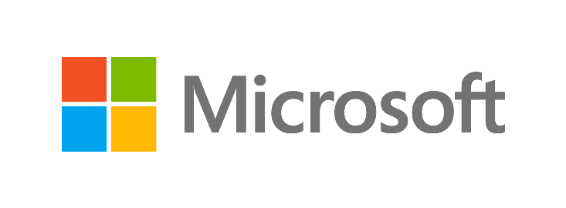

Learn. Give. Inspire.
Charitable Giving Campaign
Exclusively for VTUG members
For every download of
Window Server 2012 R2 or Hyper-V 2012 R2
Microsoft will donate USD $2 to the
American Cancer Society organization
aka.ms/VTUG-Give
October 18 – November 18, 2013

Slide 2
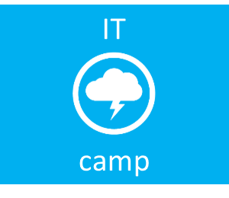

Windows Server 2012 R2
Launch!
Download http://aka.ms/VTUG-win2012r2
Virtualization
Cloud
System Center
Management
Infrastructure
Security
Dan Stolts, MCT, MCSA, MCITP, MCSE…
Microsoft – Chief Technology Strategist
http://ITProGuru.com
@itproguru
CT, MA, ME, NH, VT, NY (upstate)
http://blogs.technet.com/DanStolts
Join Event Calendar - http://NEITPro.com
@ITProGuru
More Jobs ☺
  Owner - Bay State Integrated Technology, Inc. (www.BayStateTechnology.com)
  President - Boston User Groups (www.BostonUserGroups.org)
  Cubmaster/Leader – Cub Scouts Pack 14, Lakeville, MA {LakevillePack14.com)
  Founder/Chairman - Virtualization Group Boston (www.VirtG.com)
  Founder/President – North East Leaders (www.NELeaders.com)
HOL Guides: http://itproguru.com/hol/
Free Server in the Cloud - http://aka.ms/IaaS

Slide 3
Agenda
Trends
Windows Server: At the heart of the Cloud OS
Customer challenges and opportunities
Windows Server momentum
Windows Server 2012 R2 capability overview
Why choose Windows Server 2012 R2
Next steps

Slide 4

Transformational trends
Cloud
computing
New social
and app patterns
Compute
Storage
Network
Consumerization
of IT
Data
explosion

Slide 5

The Cloud OS
Modern platform for the world’s apps
CUSTOMER
Transforms
the datacenter
Empowers
people-centric IT
1
CONSISTENT
PLATFORM
WINDOWS AZURE
SERVICE PROVIDER
Unlocks insights
on any data
Enables
modern apps
DEVELOPMENT
MANAGEMENT
DATA
IDENTITY
VIRTUALIZATION

Slide 6
First-party cloud experience
Windows Server
Windows Azure

Slide 7
Bringing our learnings to your datacenter
Windows Server
High performance
storage on industry-
standard hardware.
Highly available, file-based storage.
Storage spaces with automatic tiering.
Shared VHDX guest clustering.
Multi-tenant environments
with isolation.
Resource metering.
High-density web sites and VMs.
Software-defined networking.
Hyper-V network virtualization with
multi-tenant, site-to-site gateway network QoS.
Policy based automation.
Cluster aware updates
Dynamic optimization.
Application
and web.
NUMA-aware scalability.
Support for open standards and
multiple languages.
Windows Azure
And many others….

Slide 8
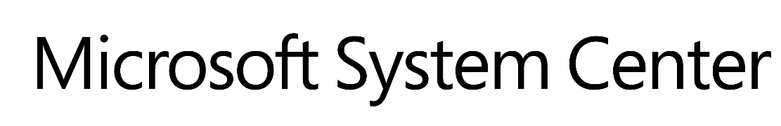
Customer challenges and opportunities
Opportunities:
Datacenter solution with lower infrastructure costs and OPEX savings from increased operational efficiencies.
Datacenter solution with support for modern,
self-service applications and automation of repeatable tasks.
Datacenter solution with high level of cross-platform interoperability.
Datacenter solution that unifies device environment and protects corporate data.
Challenges:
“Keeping the lights on” mandate reduces agility to address app owners’ needs.
Complexities due to diverse
datacenter infrastructure.
Flat or shrinking IT budgets even as
business expectations increase.
End user pressure to enable access to corporate information from a variety of devices.
Efficient datacenter operations
across entire customer base.
Need to offer differentiated services to customers.
Datacenter solution with lower infrastructure costs and OPEX savings from increased operational efficiencies.
Datacenter solution with support for modern,
self-service applications and automation of repeatable tasks.
Datacenter solution with high level of cross-platform interoperability.
Datacenter solution that unifies device environment and protects corporate data.
Notes:
8

Slide 9




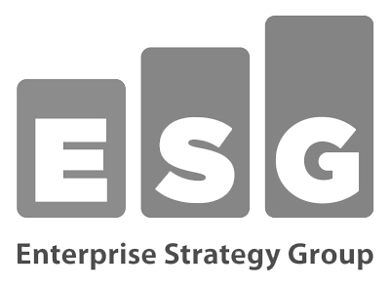

Windows Server 2012 momentum
  “I expect to reduce storage costs by 10 times and
  server costs by 50 percent.”
  —Dan Smith, Deputy CIO, Marquette University
“Windows Server 2012 is built deep in the cloud...
You end up with a solution set that has the capability of doing the kinds of compute scenarios that customers will want to do in the next few years...we think it's a great product.“
—Al Gillen, IDC
  “We decided to avoid paying VMware $1.75M (U.S.) in licenses and go with Windows Server 2012 and Hyper-V to build a private cloud model for our regional datacenters.”
  —Studio Moderna, Slovenia
  “…Preconceived notions about Microsoft versus VMware for the virtualization layer need to be re-examined.”
  “We could potentially save more than $300,000 annually in software licensing costs by switching to Hyper-V.”
  —Karen MacMahon, Team Leader for Virtualization, talking about their success with Windows Server 2012 VDI capabilities
The 2012 CRN Tech Innovator and Enterprise App Awards (Windows Server 2012 gets Virtualization and Editor’s choice)
  “I‘ve been a huge advocate for VMware. With Windows Server 2012 and the latest version of Hyper-V, all of that changes.”
  —Justin Apps, Head of Enterprise Architecture, about how they improved identity and access management with Windows
  Server 2012
  “Consolidate SQL 2012 OLTP and Exchange 2013 application workloads using Windows Server 2012 Hyper-V with confidence.”
  —ESG report on Hyper-V performance and scale with SQL
  and Exchange, Feb 2013

Slide 10


Windows Server 2012 R2: Overview
Windows Server 2012 R2 capabilities
Server virtualization
Storage
Networking
New levels of performance
and cross-platform support
High performance and resiliency at a fraction of the cost
Hybrid networking with breakthrough levels of flexibility and performance
Server management and automation
Web and application platform
Access and information protection
Virtual desktop infrastructure
Increased management efficiency for a diverse datacenter
Modern apps built and deployed to scale on-premises and in the cloud
Consistent and flexible user access to corporate resources while protecting data
Great performance, easy to deploy and cost-effective

Slide 11
LOOK!
Storage Spaces
Thin Provisioning
Virtual Storage Stack on Physical Server!

Slide 12
Try It Yourself!!!
RDP Now!
CampRD.cloudapp.net:3389
User: contoso\vtug
Pass: guru

Slide 13
Learn. Give. Inspire.
Charitable Giving Campaign
Exclusively for VTUG members
For every download of
Window Server 2012 R2 or Hyper-V 2012 R2
Microsoft will donate USD $2 to the
American Cancer Society organization
aka.ms/VTUG-Give
October 18 – November 18, 2013

Slide 14
Server virtualization
Windows Server 2012 R2 delivers
IT demands
Support for demanding, critical business workloads
Increased flexibility
to move resources
and workloads
Leverage existing cross-platform investments
New levels of performance and cross-platform support
Best-in-class performance
for Microsoft workloads
Industry-leading 64 TB
VHDX virtual disk with dynamic resize
High-performance live migrations with compression or RDMA offload
Industry-first shared-nothing live migration
Flexible guest clustering options including shared
VHDX files
Multi-node Hyper-V Replica with configurable replication frequency
Full Dynamic Memory support for Linux
Linux integration
services included in
key standard distributions
Enterprise-class scale
and performance.
Virtual machine mobility.
First-class citizen guest support for Linux.

Slide 15


High-performance live migration
Accelerate live migration performance with compression or RDMA-capable network adapters
For <10GBit network connectivity, live migration compression delivers superior performance – 2x acceleration for most workloads
For >10GBit networks, Remote direct memory access (RDMA) offload delivers the highest performance with low CPU utilization and transfer speeds of up to 56Gb/s
Windows Server 2012 R2 supports RoCE, iWARP and Infiniband RDMA solutions
Compute
Network
RDMA delivers low latency CPU
and network utilization.
Virtual
machine
Virtual
machine
Fast network connection
Network
adapter
20GB Connection
Network
adapter
GbE (Gigabit Ethernet) network connectivity
Server running
Hyper-V
Server running
Hyper-V
Live migration with RDMA

Slide 16
Workload mobility
Shared-nothing live migration
Benefits:
Increase flexibility of virtual
machine placement.
Increase administrator efficiency.
Reduce downtime for migrations across cluster boundaries.
Live migration
MEMORY
MEMORY
Memory content
Configuration data
Modified memory pages
Virtual
machine
Virtual
machine
SOURCE
Hyper-V
IP connection
DESTINATION
Hyper-V
SOURCE
device
DESTINATION
device
Reads and writes go to the source VHD.
Reads and writes go to the source VHD. Live Migration begins.
Disk contents are copied to new destination VHD.
Disk writes are mirrored;
outstanding changes are replicated.
Live Migration continues.
Live migration completes.

Slide 17
Dynamic Memory
Dynamic Memory
Reallocates memory automatically among running virtual machines
New in R2: Support for Linux VHD’s
MAXIMUM
MEMORY
Memory in use
MAXIMUM
MEMORY
Memory in use
MINIMUM MEMORY
Administrator can increase maximum memory without a restart
Windows Server 2012 improvements
Minimum memory
Hyper‑V smart paging
Memory ballooning
Runtime configuration
Virtual
Machine 1
Hyper-V
Physical
memory
pool
Physical
memory
pool
Physical
memory
pool

Slide 18
Dynamic Memory
Benefits
Higher consolidation numbers
Improved reliability of Hyper‑V operations
Ability to increase maximum memory configuration with minimal downtime
VM1
VM2
VMn
Maximum
memory
Maximum
memory
Maximum
memory
Startup increases memory in use
Minimum
memory
Memory in use after startup
Minimum
memory
Minimum
memory
  Hyper‑V
Paging file provides additional memory for startup
Memory reclaimed after startup
Physical
memory
pool
Physical
memory
pool
Physical
memory
pool
Physical
memory
pool
Virtual machine starting with
Hyper‑V smart paging
Removing paged memory after virtual machine restart

Slide 19
Storage
Windows Server 2012 R2 delivers
IT demands
Less expensive, enterprise-class
storage solution
Guaranteed high levels of Service Level Agreement (SLA)
Efficient management of storage resources
High performance and resiliency at a fraction of the cost
Storage spaces for inbox storage virtualization with automatic tiering
RDMA hardware offloading significantly improving scale for SMB traffic
SMB transparent failover for < 25ms failover time
Fine-grained, per-share SMB scale-out
Windows Azure Hyper-V Recovery Manager
Online VHDX resize
Storage QoS
Unified storage management
Windows Azure Backup
High-performance storage on industry-standard hardware.
Continuous application availability and robust recovery.
Comprehensive storage management and backup.

Slide 20
Storage tiering
  Inbox storage virtualization solution with automatic tiering
  Improved storage cost-performance with
  industry-standard hardware
  Use solid-state drives (SSD) and hard-disk drives (HDD) in tiered storage space
  Can “pin” high priority files
  to the SSD tier
Storage Spaces
Solid State Drives
Hot data
Storage tiering
Cold data
Hard Disk Drives

Slide 21
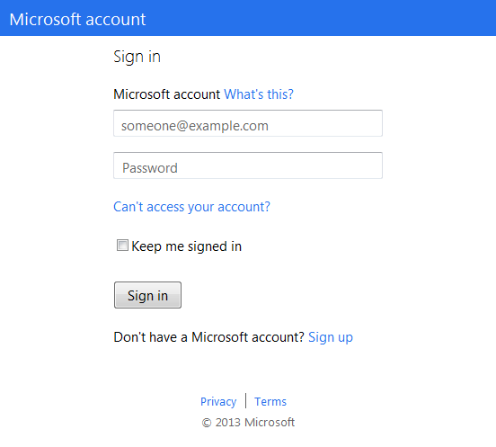


Windows Azure Hyper-V Recovery Manager
Datacenter A
Health Monitoring
System Center
Virtual Machine
Manager
AD
Configure
SQL
Sign up
Exch
Create
recovery plan
Hyper-V Replica replicates changes
Create a recovery plan
System Center
Virtual Machine
Manager
AD
Orchestrates recovery plan for VMs or services in the event of an outage
SQL
Exch
Datacenter B

Slide 22
Windows Azure Backup
Scenario 1
Scenario 2
  Only a few servers that need protection.
  Currently no back up solution or replacing a competing product.
  Use the Windows Server backup tools.
  Currently using System Center Data
  Protection Manager.
Windows Server
Protected Server
DPM Server

Slide 23
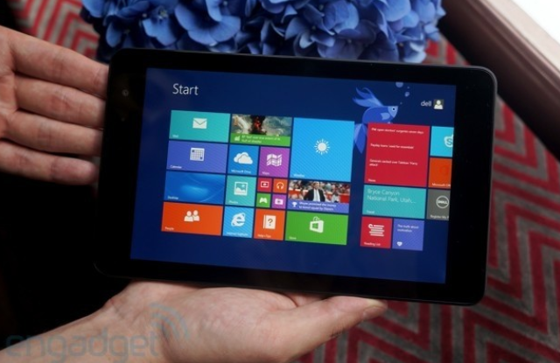
Scan your badge for a chance to win!
A Dell Venue 8 Pro
(ARV $299 USD)
We will also keep you up to date on upcoming events (including Windows Server 2012 Launch, TechNet & IT-Camps)
To view our full privacy policy visit Privacy.Microsoft.com

Slide 24
Networking
Windows Server 2012 R2 delivers
IT demands
Simplified use of network resources in
a multi-tenant, cross-premises environment
Continuously available and resilient network infrastructure
Greater control and more extensibility
Hybrid networking with breakthrough levels of flexibility and performance
Hyper-V Network Virtualization and multi-tenant site-to-site VPN gateway inbox
Standards-based switch configuration
Single root I/O virtualization with support for live migration and HA
NIC teaming with increased load-balancing performance
Resource metering
Virtual IP address management
QoS management
DNS traffic management
Software-defined network infrastructure.
High-performance networking.
Improved manageability and diagnostics.

Slide 25
Software-defined networking
  Features
  In-box multi-tenant edge gateway for seamless connectivity between physical & virtual networks
  Isolated virtual networks running on
  shared network infrastructure
Standards-based automated network
switch configuration
Partner ecosystem support
  Benefits
  Open, extensible and standards-based solution
  Delivers flexibility, automation and control
  Seamlessly bridges on-premises and off-premises networks, physical and virtual
  Simplifies BYOIP scenarios and customer onboarding to service provider clouds
192.168.0.0/24
192.168.0.0/24
Blue company
Red company
Site-to-site connectivity
Site-to-site connectivity
Multi-tenant VPN gateway
http://contosoweb.red.com
14.1.1.100
http://contosoweb.blue.com
14.1.1.100
NVGRE
Service provider cloud

Slide 26
NIC teaming
  Provides network fault tolerance and continuous availability when network adapters fail by teaming multiple
  network interfaces
  New in R2: enhanced LBFO performance
  Vendor agnostic and shipped inbox
  Provides local or remote management through Windows PowerShell or UI
  Enables teams of up to
  32 network adapters
  Aggregates bandwidth from
  multiple network adapters
  Includes multiple nodes: switch dependent and independent
Operating system
Virtual
adapters
Teamed network adapter
Teamed network adapter
NIC Teaming
Physical adapters

Slide 27
Virtual IP address management
  Provides network fault tolerance and continuous availability when network adapters fail by teaming multiple
  network interfaces.
  New in R2: Enhanced LBFO performance.
  Vendor agnostic and shipped inbox.
  Provides local or remote management through Windows PowerShell or UI.
  Enables teams of up to 32
  network adapters.
  Aggregates bandwidth from multiple network adapters.
  Includes multiple nodes: switch dependent and independent.
  Inbox feature for integrated management of IP addresses, domain names, and device identities
  New in R2: virtualized IP address
  space management
  Tightly integrates with Microsoft DNS
  and DHCP servers
  Provides custom IP address space display, reporting, and management
  Audits server configuration changes
  and tracks IP address use
  Migrates IP address data from spreadsheets or other tools
IPAM distributed architecture
Domain
copr.woodbridge.com
Domain
europe.corp.woodbridge.com
IPAM Server (UK)
DHCP, DNS, DC, and NPS servers
IPAM server (Redmond)
  Site: UK
  Branch office
Domain
fareast.corp.woodbridge.com
DHCP, DNS, DC, and NPS servers
IPAM Server (Hyderabad)
DHCP, DNS, DC, and NPS servers
IPAM Server (Bangalore)
DHCP, DNS, DC, and NPS servers
  Site: Redmond
  Head office
  Site: Hyderabad
  Branch office
  Site: Bangalore
  Branch office

Slide 28
Server management and automation
Windows Server 2012 R2 delivers
IT demands
Consistent management of diverse datacenter resources
Efficient, local and remote management of server resources
Cost-effective management of
more tasks
Increased management efficiency for a diverse datacenter
Windows Management Framework
Standards-based switch management
Server Manager
Windows Server
Essentials Experience
Windows PowerShell 4.0
Intellisense integrated scripting environment
Desired State Configuration
Standards-based management.
Simplified multi-server management.
Robust automation.

Slide 29
Windows Management Framework
Maximize the value of using the Windows Management Framework
IT Pro
Tool Developer
Solution Provider
Standard APIs: MI Client, Windows PowerShell, Open Data Protocol (OData)
Standard protocols: WS-Management, REST, HTTP, PSRP
Windows Management Framework
Standard models: Common Information Model (CIM) schema,
Storage Management Initiative Specification (SMI-S)
Disk
Storage
Operating System
Devices
Managed objects

Slide 30
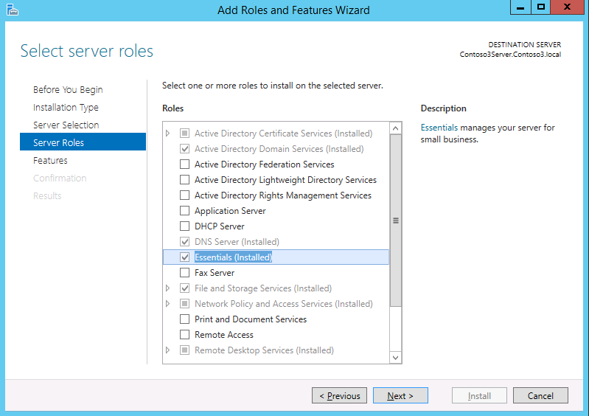
Windows Server Essentials Experience
Essentials functionalities are enabled via a dedicated server role in Windows Server Standard and Windows Server Datacenter.
Familiar and seamless deployment experience that sets up the most fundamental roles for the primary server.
Optional unattended deployment and configuration using PowerShell.

Slide 31
Windows PowerShell 4.0
Key features
Broader coverage
Rich management through more than 3,000 cmdlets
Windows PowerShell Web Access
Higher performance
On-the-fly compilation—scripts run up to
six times faster
Performance improvements
Greater resiliency
Robust session connectivity
Disconnected sessions
Session configuration files
Job scheduling
Windows PowerShell Workflow
More intuitive
Integrated scripting environment 3.0:
IntelliSense | Code Snippets
Syntax simplification
Cmdlet discovery and module auto-loading
Updatable help
Script-sharing

Slide 32


Web and application platform
Windows Server 2012 R2 delivers
IT demands
DEVELOPER
Broaden the reach
of your applications
Increase performance and efficiency of applications and websites
Reuse your IT development skills
and knowledge
Modern apps built and deployed to scale on-premises
and in the cloud
Programming symmetry
Virtual machine portability
Hybrid applications
NUMA-aware scalability
IIS CPU throttling
Centralized SSL
certificate support
ASP.NET integration
Support for
multiple languages
Support for open
source software
Flexibility to build
on-premises and
in the cloud.
Scalable and elastic application and web platform.
Open web platform.

Slide 33
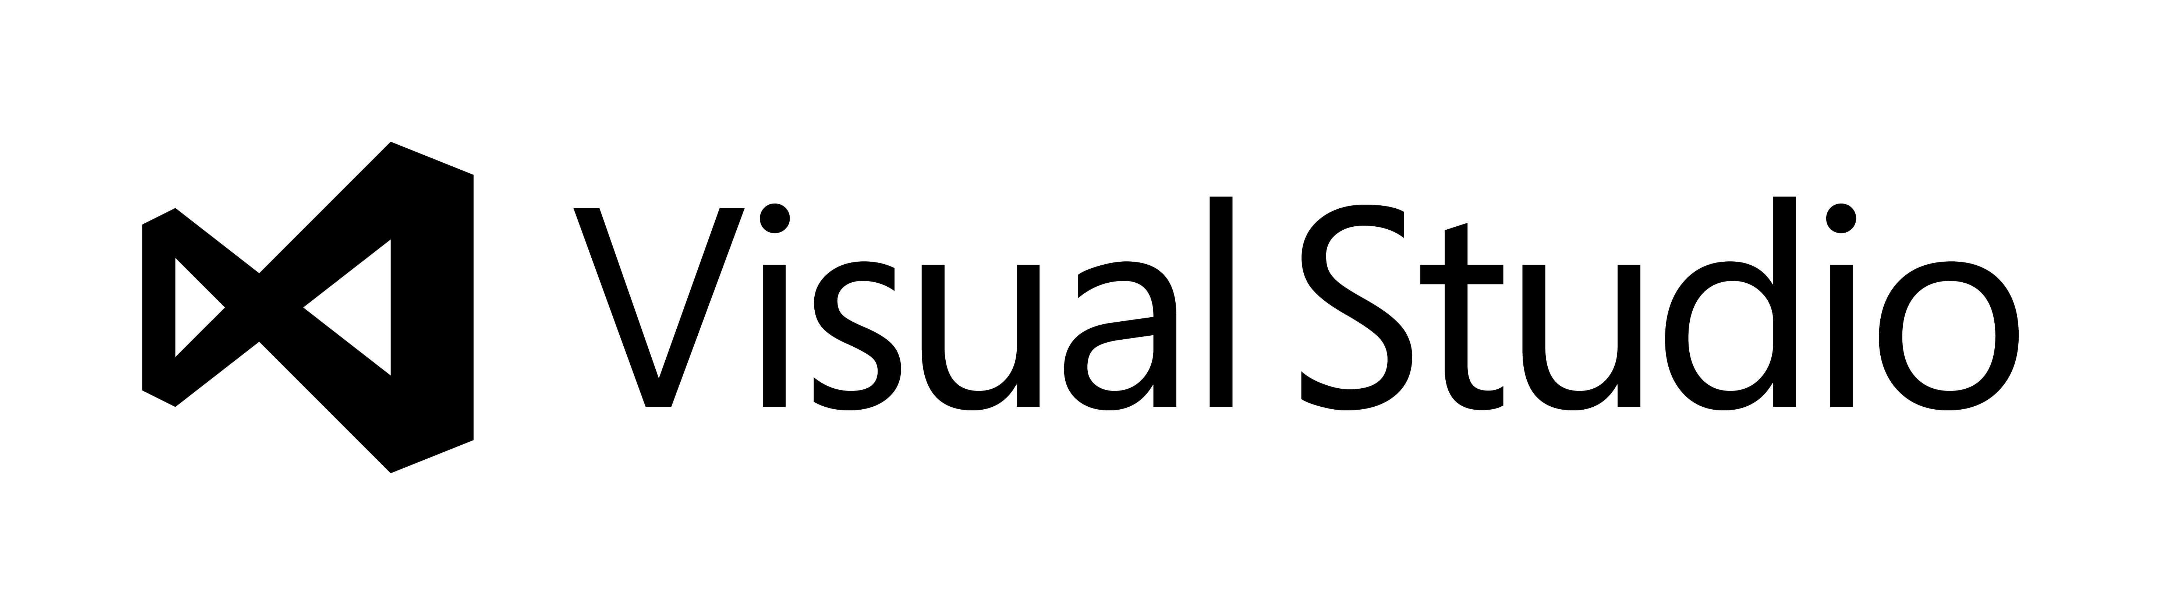
Programming symmetry
  Create cloud-based or hybrid applications
  Windows Azure SDK
  Same development tools between Windows Server and Windows Azure
  Common workflows and rules across
  web, application, and datacenter tiers
  Application-to-application contracts
  that support HTML5
  I/O operations that use isolated storage.
Windows Azure applications
Your code
Your code
Operating system
Operating system
Web role instance 1
Web role instance 2
Your code
Your code
Windows Server 2012
Windows Server 2012
Hyper-V or hardware
Hyper-V or hardware
On-premises applications

Slide 34
NUMA-aware scalability
Previous Internet Information Services versions on NUMA hardware
  Starts scaling NEGATIVELY when the number of cores increases beyond the point where memory synchronization outweighs the benefits of any additional cores
  Non-Uniform Memory Architecture
  Processors can access local memory faster than remote memory
  A significant percentage of new servers have NUMA
  Designed for scale-up
Internet Information Services in Windows Server 2012 R2 on NUMA hardware
  Scales POSITIVELY with increasing cores, allowing organizations to benefit from their NUMA hardware investments

Slide 35

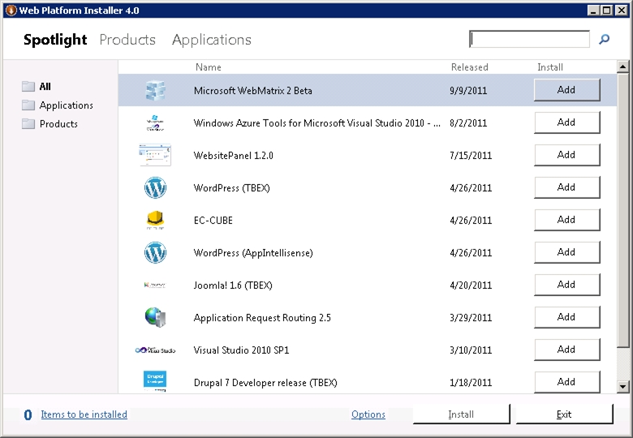
Support for open source software
Web platform installer
Automates installation of the most popular ASP.NET and PHP apps through Windows Web App Gallery.
Simplifies discovery and acquisition of the Microsoft web stack.
Supported on Windows Server 2012 R2.
Windows Web App Gallery Atom feed is consumed by the
App Gallery itself, Web Platform Installer, Internet Information Services Manager, and participating hosting control panels.
Windows
Web App Gallery
Atom feed
Internet Information Services
Hosting control panel
Web Platform Installer tool
Developers follow three steps to submit
an application to Windows Web App Gallery.
Adhere to
gallery
principles
Add support
to app
package
Submit
app

Slide 36
Access and information protection
Windows Server 2012 R2 delivers
IT demands
Controlled access to corporate data from user’s device of choice
Common user identity to access on-premises and cloud resources
Protect corporate data and maintain regulatory compliance
Consistent and flexible user access to corporate resources while protecting data
Workplace Join
Web Application Proxy
Automatic VPN connections
Work Folders
Windows Server
Active Directory
Windows Azure
Active Directory
Active Directory
Federation Services
Dynamic Access Control
Active Directory Rights Management Services
Multi-factor authentication
Always-on remote access from trusted devices.
Seamless, single sign-on access to application
and data.
Policy-based access
and audit of corporate information.

Slide 37

Controlled access to corporate data
Users are provided with
a common identity when accessing cloud-based resources.
Active Directory
Other cloud based apps and identity stores.
When a user registers their device it becomes known and “trusted” to provide device level authentication. IT can then publish access to resources based on registration plus the users identity.
Application Server
Windows Server Remote Access
IT can use Windows Server Remote Access to provide seamless application access and automatic VPN connections with conditional access based on user and device validation.
Active
Directory
BYOD Devices
Users can access corporate applications and data wherever they are.

Slide 38
Virtual desktop infrastructure
Windows Server 2012 R2 delivers
IT demands
Simplified roll-out and administration of a
VDI environment
Reduced time and cost to deploy virtual desktops and applications
Consistent Windows experience across devices
Great performance, easy to deploy and cost-effective
Wizard-based, automatic setup and deployment
Unified administration of published applications
and desktops
User profile disk
Support for multiple, lower cost storage options
Read-write VDI storage de-duplication for increased VM density
and reduced cost
RemoteFX for WAN
RemoteFX
Adaptive Graphics
Support for physical
and software GPU
Efficient VDI management.
Best value for VDI.
Rich user experience.

Slide 39
Personalization with user profile disk
  Benefits
  What should I deploy?
  Available with pooled virtual machine collections and remote desktop session host collections
  Stores all user settings and data
  Contains roaming user profile, Folder Redirection cache, and user environment virtualization
  Roams with user within collection
  Appears as a local disk and improves application compatibility
User profile disk.
With every virtual machine pool and remote desktop session host collection.
User environment virtualization.
To apply roam settings
across collections.
Folder redirection.
To apply roaming user data across collections.
To centralize user data backup.
  User profile disk with pooled
  virtual machine collections.
  User profile disk with remote desktop session host collections.

Slide 40
Storage de-duplication for VDI
Hyper-V VDI
SMB
Scale-out file server
Dedup
Cluster shared volumes

Slide 41
RemoteFX over WAN
  Hardware and software GPUs
  Rich multimedia
  USB redirection
Corporate LAN
Hardware & software GPUs,
Rich multimedia, USB redirection.
Internet or WAN
Multitouch, WAN acceleration
Single sign-on.
  Multitouch
  WAN acceleration
  Single sign-on

Slide 42
Why choose Windows Server 2012 R2
Enterprise-class
Simple and
cost-effective
Application
focused
User
centric
Best-in-class performance and scale for Microsoft workloads
Industry-leading support for
64-node clusters and 8,000 VMs per cluster
64 TB VHDX virtual disk with online resize for dynamically growing and shrinking the VHDX file
Hyper-V Network Virtualization and multi-tenant VPN gateway for inbox software-defined networking (SDN) solution
SMB traffic offload to RDMA-capable NICs for dramatic performance improvements
Flexible guest clustering options for file and block storage with shared VHDX files that preserve dynamic memory, live migration and storage live migration for guest VM
Windows Azure Backup for reliable and cost-effective backup to the cloud
VDI storage de-duplication
Complete VM portability between Windows Server and Windows Azure without the need for VM conversion
Same development model between Windows Server and Windows Azure
Common development tools between Windows Server and Windows Azure for a rich and complete environment to build applications on-premises and for the cloud
Always-on remote access to corporate information from trusted devices
Consistent, inbox Windows experience for remote users virtually anywhere on any device
Unified application and device management with common identity on-premises and in the cloud
Granular, policy-based data protection and regulatory compliance

Slide 43





BizSpark
Software
  3 years free software/Development Tools
  Windows Azure Credits $200 first month/$150 thereafter
Support
  Professional technical and product support
  Unique offers from Network Partners
  Visibility
  Profile, Offers and Events
  Connection to the ecosystem
  Opportunities for showcase, visibility (events, social media)
Is your startup:
Developing Software?
Privately held?
Less than 5 years old?
Making less than US $1M in annual revenue?
http://aka.ms/BizSparkNow

Slide 44
Learn. Give. Inspire.
Charitable Giving Campaign
Exclusively for VTUG members
For every download of
Window Server 2012 R2 or Hyper-V 2012 R2
Microsoft will donate USD $2 to the
American Cancer Society organization
aka.ms/VTUG-Give
October 18 – November 18, 2013

Slide 45
Next steps: Cloud optimize your business with Windows Server 2012 R2
Download and evaluate Windows Server 2012 R2 http://aka.ms/VTUG-Win2012r2
Check out blog post series http://aka.ms/2012r2-01
Check out blogs http://itproguru.com ; http://blogs.technet.com/server-cloud
Build Free Server in the Cloud http://aka.ms/VTUG-Cloud Step-By-Step: http://aka.ms/azRocks
Refer to additional Windows Server 2012 R2 resources
http://www.microsoft.com/en-us/server-cloud/windows-server/windows-server-2012-r2.aspx
Windows Server 2012 R2 on TechNet
  http://www.Microsoft.com/technet

Slide 46

© 2013 Microsoft Corporation. All rights reserved. Microsoft, Windows, Windows Vista and other product names are or may be registered trademarks and/or trademarks in the U.S. and/or other countries.
The information herein is for informational purposes only and represents the current view of Microsoft Corporation as of the date of this presentation. Because Microsoft must respond to changing market conditions, it should not be interpreted to be a commitment on the part of Microsoft, and Microsoft cannot guarantee the accuracy of any information provided after the date of this presentation. MICROSOFT MAKES NO WARRANTIES, EXPRESS, IMPLIED OR STATUTORY, AS TO THE INFORMATION IN THIS PRESENTATION.

Slide 47
Windows Server 2012 R2: Cloud optimize your business http://aka.ms/2012r2-02
Enterprise-class
Simple and cost-effective
Application focused
User centric
Live migration with RDMA
Multi-node Hyper-V Replica
Shared VHDX guest clustering
Enhanced Linux integration services
Hyper-V network virtualization
Multi-tenant VPN gateway
Low-cost, highly available file-based storage
Storage Spaces with automatic tiering
Storage de-duplication for VDI
Work Folders
Top Windows Server 2012 R2 features

Slide 48
Appendix

