Slide 1

Upgrading Windows Server 2008 to Windows Server 2012
Speaker Name
Title
Email
Microsoft Corporation
Notes:
For questions concerning this deck, contact Blain Barton at blainbar@Microsoft.com
For the Hyper-V section contact Tommy Patterson at topatter@Microsoft.com

Slide 2
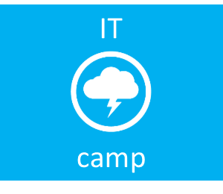

Upgrading Windows Server 2008 to Windows Server 2012
Virtualization
Cloud
System Center
Management
Infrastructure
Security
Dan Stolts, MCT, MCSA, MCITP, MCSE…
Microsoft – Chief Technology Strategist
http://ITProGuru.com
@itproguru
CT, MA, ME, NH, VT, NY (upstate)
http://blogs.technet.com/DanStolts
More Jobs ☺
  Owner - Bay State Integrated Technology, Inc. (www.BayStateTechnology.com)
  President - Boston User Groups (www.BostonUserGroups.org)
  Leader – Cub Scouts Pack 14, Lakeville, MA {LakevillePack14.com)
  Founder/Chairman - Virtualization Group Boston (www.VirtG.com)
  Founder – North East IT Professionals (meetup.com/NEITPro)
@ITProGuru

Slide 3
Agenda
Why Upgrade to Windows Server 2012?
Operating System Hardware and Disk Space Requirements
Supported Windows Clients and Servers
Supported In-Place Upgrade Paths
Functional Levels, Operation Master Roles, Active Directory Considerations
Migration Tools for Windows Server 2012
Hyper-V and Virtual Machines Considerations
Summary
Overview of upgrading Windows Server 2008 R2 SP1 to Windows Server 2012.
Notes:
Why Upgrade to Windows Server 2012?
Operating System Hardware and Disk Space Requirements
Supported Windows Clients and Servers
Supported In-Place Upgrade Paths
Functional Levels, Operation Master Roles, Active Directory Considerations
Migration Tools for Windows Server 2012
Hyper-V and Virtual Machines Considerations
Summary

Slide 4
Why Upgrade to Windows Server 2012?
Notes:
Windows Server 2012 is at the heart of the Cloud OS and delivers on the promises of a modern data center to bring you the economics, agility and innovation of cloud both on your premises and off.
We’ve seen hundreds of thousands of downloads of the pre-release versions, thousands of engineers worked on this product – and we couldn’t be more stoked to share it with you.
Let’s take a closer look at how Windows Server 2012 can deliver technical value to you–

Slide 5



Why Upgrade to Windows Server 2012?
TOP BENEFITS OF WINDOWS SERVER 2012
Comprehensive cloud platform
Complete, built-in virtualization platform
Enterprise-class scale and performance, so you can virtualize every application
Ability to achieve business continuity with inbox disaster recovery solutions
Best-in-class hybrid cloud experience with a common set of technologies
Cost savings and increased efficiencies
Reduced storage costs with Storage Spaces and other storage enhancements
Increased server/administrator ratio through Windows PowerShell and multimachine management
Increased uptime with Cluster-Aware Updating and transparent failover
Support for a modern work style
Virtual Desktop Infrastructure (VDI): simplified management and reduced cost of implementations
Optimized branch office wide area network (WAN) bandwidth use
Ability for remote users to more securely access internal resources without a virtual private network (VPN)
Notes:
First, let’s take a look at WHY you would want to go to Windows Server 2012? It really provides value in 3 key areas –
Complete virtualization platform: Delivers a fully isolated, multi-tenant environment that includes tools to guarantee SLAs, enable chargebacks, and support self-service delivery.
Improved scalability and performance: Delivers a high-density, scalable environment that can be adapted to perform at the optimal level based on customer needs.
Connecting to cloud services: Uses a common identity and management framework for security-enhanced and reliable cross-premises connectivity.
WS2012 delivers new levels of cost savings and efficiencies though performance and reliability on industry-standard hardware, maximizing uptime and minimizing failures and downtime.
Flexible storage: Provides diverse storage choices that deliver performance, efficiency, and innovation while taking advantage of industry-standard hardware.
Continuous availability: Provides cost-effective and highly available IT services, designed to protect against a wide range of failure scenarios and help both prevent downtime and speed recovery when needed.
Management efficiency: With automation of a broader set of management tasks, simplifies deployment of major workloads and provides the path toward full lights-out automation.
WS2012 enables flexible access to data and applications while simplifying management and maintaining security, control, and compliance.
Access from virtually anywhere, any device: Enables seamless, flexible access to a virtualized work environment from virtually anywhere, including branch locations and public connectivity services.
Full Windows experience, anywhere: Enables a personalized and rich user experience on popular devices, while adapting to different network conditions quickly and responsively.
Enhanced data security and compliance: Offers central audit and access policies that enable granular access to data and corporate resources, based on strong identity, data classification, and simplified administration for remote access.

Slide 6
Operating System Hardware and Disk Space Requirements

Slide 7
Expanded Processor & Memory Support
System | Resource | Maximum Number |  | Improvement Factor
 |  | Windows Server 2008 R2 | Windows Server 2012
Host | Logical processors on hardware | 64 | 320 | 5x
 | Physical Memory | 1 TB | 4 TB | 4x
 | Virtual processors per host | 512 | 2,048 | 4x
Virtual Machine | Virtual processors per virtual machine | 4 | 64 | 16x
 | Memory per virtual machine | 64 GB | 1 TB | 16x
 | Active virtual machines per server | 384 | 1,024 | 2.7x
Cluster | Nodes | 16 | 64 | 4x
 | Virtual machines | 1,000 | 8,000 | 8x
Notes:
Features in Hyper-V in Windows Server 2012 that support the virtualization of high-performance, scale-up workloads include:
Increased hardware support for the virtualization host. Hyper-V in Windows Server 2012 RC supports running on a host system with up to 320 logical processors and 4 terabytes of memory, providing greater compatibility with very large server systems.
• Support for large virtual machines. Hyper-V in Windows Server 2012 supports configuration of virtual machines with up to 64 virtual processors and 1 TB of memory.
Use of NUMA to speed up the performance of virtual machines. Non-Uniform Memory Access (NUMA) is a computer architecture used in multiprocessor systems in which the time required for a processor to access memory depends on the memory’s location relative to the processor. NUMA provides the affinity to prefer local memory access over remote memory access. By projecting a virtual NUMA topology onto large virtual machines,
Hyper-V in Windows Server 2012 enables the guest operating system and applications such as Microsoft SQL Server to use their existing thread scheduler and memory allocation optimizations, which provides better performance and scalability of demanding workloads.

Slide 8
Supported Windows Clients and Servers

Slide 9
Supported Windows Clients and Servers
Below are supported domain members that work with domain controllers that run Windows Server 2012:
Client operating systems:
Windows 8, Windows 7, Windows Vista, Windows XP
Server operating systems:
Windows Server 2012
Windows Server 2008 R2
Windows Server 2008
Windows Server 2003 R2
Windows Server 2003
Note: Most Windows Server 2012 roles are backward compatible with other Windows Server 2008 Active Directory
Notes:
The following Windows client and Windows Server operating systems are supported for domain member computers with domain controllers that run Windows Server 2012:
Client operating systems: Windows 8, Windows 7, Windows Vista, Windows XP
Server operating systems: Windows Server 2012, Windows Server 2008 R2, Windows Server 2008, Windows Server 2003 R2, Windows Server 2003
Note: Most Windows Server 2012 roles are backward compatible with other Windows Server 2008 Active Directory

Slide 10
Supported In-Place Upgrade Paths

Slide 11
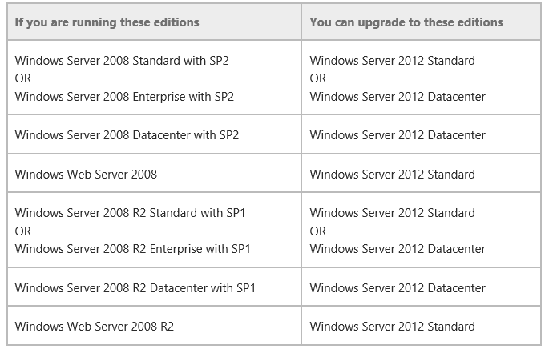
Upgrading in-place to Windows Server 2012
YES – You can upgrade domain controllers that run 64-bit versions of Windows Server 2008 or Windows Server 2008 R2 to Windows Server 2012.
NO - You cannot upgrade domain controllers that run Windows Server 2003 or 32-bit versions of Windows Server 2008… Migrate Instead
Notes:
Domain controllers that run 64-bit versions of Windows Server 2008 or Windows Server 2008 R2 can be upgraded to Windows Server 2012.
You cannot upgrade domain controllers that run Windows Server 2003 or 32-bit versions of Windows Server 2008. To replace them, install domain controllers that run Windows Server 2012 in the domain, and then remove the domain controllers that Windows Server 2003.
Note - Most Windows Server 2012 roles are backward compatible with other Windows Server 2008 Active Directory

Slide 12
Functional Levels Considerations

Slide 13
Functional Levels Considerations
Windows Server 2012 requires a Windows Server 2003 forest functional level or higher.
Before you can add a DC that runs Windows Server 2012 to an existing AD forest, the forest functional level must be Windows Server 2003 or higher.
If the forest functional level is Windows 2000, the installation is blocked.
Notes:
Windows Server 2012 requires a Windows Server 2003 forest functional level. That is, before you can add a domain controller that runs Windows Server 2012 to an existing Active Directory forest, the forest functional level must be Windows Server 2003 or higher.
This means that domain controllers that run Windows Server 2008 R2, Windows Server 2008, or Windows Server 2003 can operate in the same forest, but domain controllers that run Windows 2000 Server are not supported and will block installation of a domain controller that runs Windows Server 2012. If the forest functional level is Windows 2000, the installation is also blocked.
The only supported path from running Windows 2000 domain controllers to running Windows Server 2012 domain controllers is:
Install domain controllers that run Windows Server 2003 or later. These domain controllers can be deployed on an evaluation version of Windows Server. This step also requires running adprep.exe as a prerequisite.
Remove the Windows 2000 domain controllers.
Raise the forest functional level to Windows Server 2003 or higher.
Install domain controllers that run Windows Serer 2012.
Remove domain controllers that run earlier versions of Windows Server.
The new Windows Server 2012 domain functional level enables one new feature: the KDC support for claims, compound authentication, and Kerberos armoring KDC administrative template policy has two settings (Always provide claims and Fail unarmored authentication requests) that require Windows Server 2012 domain functional level. For more information, see Support for claims, compound authentication, and Kerberos armoring.
The Windows Server 2012 forest functional level does not provide any new features, but it ensures that any new domain created in the forest will automatically operate at the Windows Server 2012 domain functional level. The Windows Server 2012 domain functional level does not provide other new features beyond KDC support for claims, compound authentication, and Kerberos armoring. But it ensures that any domain controller in the domain runs Windows Server 2012. For more information about other features that are available at different functional levels, see Understanding Active Directory Domain Services (AD DS) Functional Levels.

Slide 14
Operation Master Roles Considerations

Slide 15
Operation Master Roles Considerations
Some new features in Windows Server 2012 that affect operations master roles:
    The PDC emulator must be running Windows Server 2012 to support cloning virtual domain controllers.
    The Relative Identifier (RID) Master has new RID issuance and monitoring functionality. The improvements include better event logging and more appropriate limits.
    New security principals are created when the PDC emulator runs Windows Server 2012.
Notes:
Some new features in 2012 that affect operations master roles:
The PDC emulator must be running Windows Server 2012 to support cloning virtual domain controllers. There are additional prerequisites for cloning DCs. For more information, see Active Directory Domain Services (AD DS) Virtualization.
New security principals are created when the PDC emulator runs Windows Server 2012.
Security principals are a foundation for controlling access to securable resources.
The RID Master has new RID issuance and monitoring functionality. The improvements include better event logging, more appropriate limits, and the ability to - in an emergency - increase the overall RID pool allocation by one bit. For more information, see Managing RID Issuance.
The relative identifier (RID) operations master allocates blocks of RIDs to each domain controller in the domain. Whenever a domain controller creates a new security principal, such as a user, group, or computer object, it assigns the object a unique security identifier (SID).
This SID consists of a domain SID, which is the same for all security principals created in the domain, and a RID, which uniquely identifies each security principal created in the domain.
Note Though they are not operations master roles, another change in AD DS installation is that the DNS server role and the global catalog are installed by default on all domain controllers that run Windows Server 2012.

Slide 16
Active Directory Considerations – New Features

Slide 17
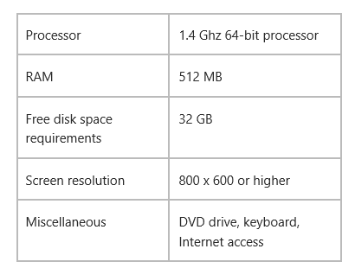
Operating System Requirements + Domain Disk Requirements
Minimum OS Requirements
Disk Space Requirements – NTDS.DIT
  The drive that hosts the Active Directory database (NTDS.DIT) must have free disk space that represents at least 20% of the NTDS.DIT file before you begin the operating system upgrade.
  If there is insufficient free disk space on the volume, the upgrade can fail and the upgrade compatibility report returns an error indicating insufficient free disk space.
Notes:
This section covers disk space requirements only for upgrading domain controllers from Windows Server 2008 or Windows Server 2008 R2 to Windows Server 2012. For more information about disk space requirements for upgrading domain controllers to earlier versions of Windows Server, see Disk space requirements for upgrading to Windows Server 2008 or Disk space requirements for upgrading to Windows Server 2008 R2.
On domain controllers that you plan to upgrade to Windows Server 2012, make sure that the drive that hosts the Active Directory database (NTDS.DIT) has free disk space that represents at least 20% of the NTDS.DIT file before you begin the operating system upgrade. If there is insufficient free disk space on the volume, the upgrade can fail and the upgrade compatibility report returns an error indicating insufficient free disk space:
In this case, you can try an offline defragmentation of the Active Directory database to recapture additional space, and then retry the upgrade. For more information, see Compact the Directory Database File (Offline Defragmentation).

Slide 18
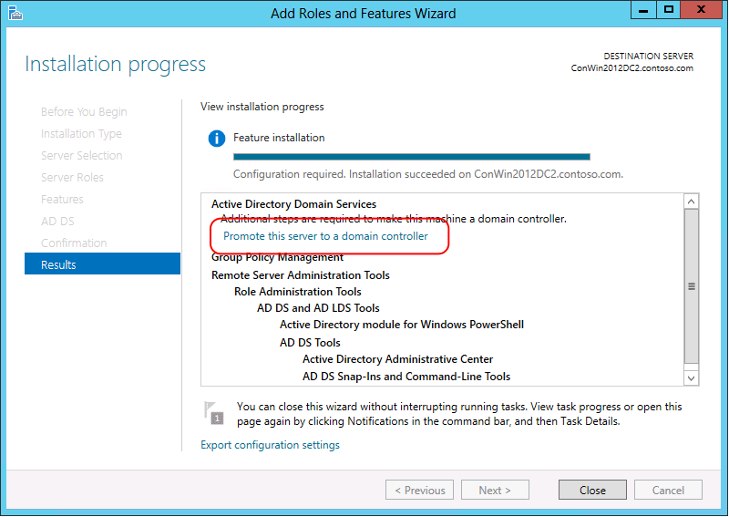
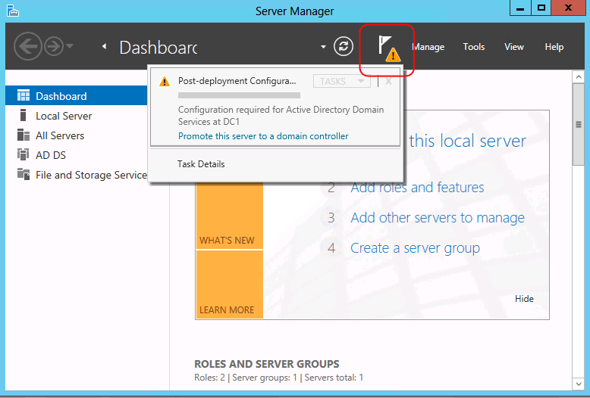
Active Directory Domain Services Installation
CUI-based command-line installations are performed by using the ADDSDeployment Module in Windows PowerShell.
GUI-based promotions are performed in Server Manager using a completely new Active Directory Domain Services Configuration Wizard.
Notes:
In Windows Server 2003 through Windows Server 2008 R2, you ran the x86 or X64 version of the Adprep.exe command-line tool before running the Active Directory Installation Wizard, Dcpromo.exe, and Dcpromo.exe had optional variants to install from media or for unattended installation.
In Windows Server 2012, command-line installations are performed by using the ADDSDeployment Module in Windows PowerShell. GUI-based promotions are performed in Server Manager using a completely new Active Directory Domain Services Configuration Wizard.

Slide 19
Active Directory Domain Services Install – Continued…
To simplify the installation process, ADPREP has been integrated into the AD DS installation and runs automatically as needed.
Prerequisite checks in the AD DS Installation Wizard identify potential errors before the installation begins.
The wizard also exports a Windows PowerShell script that contains all the options that were specified during the graphical installation.
Notes:
To simplify the installation process, ADPREP has been integrated into the AD Domain Services installation and runs automatically as needed. The Windows PowerShell–based AD DS Configuration Wizard automatically targets the schema and infrastructure master roles in the domains where Windows Server 2012 DCs are being added, then remotely runs the required ADPREP commands on the relevant domain controllers.
Prerequisite checks in the AD DS Installation Wizard identify potential errors before the installation begins. Error conditions can be corrected to eliminate concerns from a partially complete upgrade. The wizard also exports a Windows PowerShell script that contains all the options that were specified during the graphical installation.
Taken together, the AD DS installation changes in Windows Server 2012 simplify the DC role installation process and reduce the likelihood of administrative errors, especially when you are deploying multiple domain controllers across global regions and domains.
More detailed information on GUI and Windows PowerShell-based installations, including command line syntax and step-by-step wizard instructions, see Install Active Directory Domain Services. For administrators that want to control the introduction of schema changes in an Active Directory forest independent of the installation of Windows Server 2012 DCs in an existing forest, Adprep.exe commands can still be run at an elevated.

Slide 20
Active Directory – Tool changes
There are some tool changes related to AD DS:
Deprecation of Adprep32.exe
There is only one version of Adprep.exe
It can be ran as needed on 64-bit domain controllers that run Windows Server 2008 or later. The system determines this.
Deprecation of Dcpromo.exe
It can still be run with an answer file and through PowerShell.
Notes:
There’s only one version of Adprep.exe and it can be run as needed on 64-bit domain controllers that run Windows Server 2008 or later. Adprep32.exe can still be ran remotely, and must be run remotely if that targeted operations master role is hosted on a 32-bit operating system or Windows Server 2003.
Deprecation of Dcpromo.exe
Dcpromo is deprecated although in Windows Server 2012 only it can still be run with an answer file to give organizations time to transition existing automation to the new Windows PowerShell installation options.
Bonus -
LMHash is disabled on user accounts
Secure defaults in Security templates on Windows Server 2008, Windows Server 2008 R2 and Windows Server 2012 enable the NoLMHash policy which is disabled in the security templates of Windows 2000 and Windows Server 2003 DCs. Disable the NoLMHash policy for LMHash-dependent clients as required,

Slide 21
Overview of Migration Tools

Slide 22
Migration Tools for Windows Server 2012
After you register the tools, then you can begin the migration process.
Here’s a list of resources for Migration -
  Migrate Active Directory Federation Services Role Services to WS 2012
  Migrate Health Registration Authority to Windows Server 2012
  Migrate Hyper-V to Windows Server 2012
  Migrate IP Configuration to Windows Server 2012
  Migrating Network Policy Server to Windows Server 2012
  Migrate Print and Document Services to Windows Server 2012
  Migrate Remote Access to Windows Server 2012
  Migrate Windows Server Update Services to Windows Server 2012
Notes:
You can migrate from:
Windows Server 2003 SP2 (x86 or x64)
Windows Server 2003 SP2 (x86 or x64)
Windows Server 2003 SP2 (x86 or x64)
Windows Server 2008 (Full installation)
Windows Server 2008 R2 (Full installation or Core)
Windows Server 2012 (Full installation or Core)
The migration tools will allow you to migrate a variety of roles and services.
Migrate Active Directory Federation Services Role Services to Windows Server 2012
Migrate Health Registration Authority to Windows Server 2012
Migrate Hyper-V to Windows Server 2012
Migrate IP Configuration to Windows Server 2012
Migrating Network Policy Server to Windows Server 2012
Migrate Print and Document Services to Windows Server 2012
Migrate Remote Access to Windows Server 2012
Migrate Windows Server Update Services to Windows Server 2012
As you can see these tools are extremely powerful. Before you can start to use these tools you first have to install the tools. To install the tools you will follow this basic procedure:
Installing Windows Server Migration Tools on destination servers that run Windows Server 2012.
Creating deployment folders on destination servers that run Windows Server 2012
Copying deployment folders from destination servers to source servers.
Registering Windows Server Migration Tools on source servers.
Install the Windows Server 2012 Migration Tools
You can install the Server Migration tools either via PowerShell or the Add Roles and Features wizard on your destination server. To install the tools a core server you will have to use PowerShell. The following cmdlet will install the migration tools on Server1. Make sure you are in an administrative tools session:
Install-WindowsFeature Migration –ComputerName Server1
Creating and Copy Deployment Folders for the to Source Servers
After you have installed the tools on your Windows Server 2012 you will then create a folder with the tools and then copy them down to your source servers. When you install the migration tools you get the full set of tools for all the supported source servers. So you will have tools for Windows Server 2003 x86 and tools for Windows Server 2008 R2. So when you create your deployment folder you will have to know what your source servers are so you can install the proper tools. Once you know the source server OS, then complete the following procedure from an administrative cmd prompt:
Navigate to the ServerMigrationTools directory located in the system32 folder: cd %Windir%\System32\ServerMigrationTools\
To create a deployment folder in the d:\deploy directory for the x64 version of Windows Server 2003 run the following command:
SmigDeploy.exe /package /architecture amd64 /os WS03 /path d:\deploy
This will create a folder in the deployment path directory that will follow this structure. SMT_<Operating System>_<Architecture> For the above example the folder name would be SMT_WS03_amd64
This contains the tools for your source operating system. For the other operating system choices look to this article for the full list of commands: Install, Use, and Remove Windows Server Migration Tools
Copy the directory you just created to the source servers to a local directory.
Register Server Migration Tools
Once the tools have been copied to the source servers from the destination servers, you will then need to register them. Prior to registering them there you may need to install some pre-requisites on the servers. They will differ based the source servers OS. Here is a list for more details take a look here:
Windows Server 2008 R2 source server
Verify that the source server has sufficient disk space (at least 23 MB) to store the Windows Server Migration Tools deployment folder.
Windows Server 2008 source server
Verify that the source server has sufficient disk space (at least 23 MB) to store the Windows Server Migration Tools deployment folder.
Install Windows PowerShell by using Server Manager or by running the Server Manager command prompt tool, ServerManagerCmd.exe. For more information about how to add features to the server by using ServerManagerCmd.exe, see Overview of Server Manager Commands in the Windows Server 2008 Server Manager Help.
Windows Server 2003 or Windows Server 2003 R2 source server
Verify that the source server has sufficient disk space (at least 25 MB) to store the Windows Server Migration Tools deployment folder.
Download and install Microsoft .NET Framework 2.0. Microsoft .NET Framework 2.0 is available for download from the Microsoft Web site.
Download and install Windows PowerShell 1.0, or a later version. Windows PowerShell 1.0 is available for download from the Microsoft Web site.
When your ready to register tools, you just need to open an administrative console on your source server, navigate to the directory you copied the tools into and run the following command:
.\Smigdeploy.exe
After you register the tools, then you can begin the migration process. This process will vary depending the roles you are trying to migrate and for detail directions take a look here:
Migrate Active Directory Federation Services Role Services to Windows Server 2012
Migrate Health Registration Authority to Windows Server 2012
Migrate Hyper-V to Windows Server 2012
Migrate IP Configuration to Windows Server 2012
Migrating Network Policy Server to Windows Server 2012
Migrate Print and Document Services to Windows Server 2012
Migrate Remote Access to Windows Server 2012
Migrate Windows Server Update Services to Windows Server 2012
Remove the Server Migration Tools
When your done with the migration tools you easily remove the tools. On you destination Windows Server 2012 systems, you can remove them via the remove roles and features tools or with this PowerShell command, the command would remove the tools from server1:
Uninstall-WindowsFeature Migration –ComputerName server1
On your destination servers you will need to first unregister the tools. Navigate to your migration tools directory and run the following command from and administrative command prompt:
SmigDeploy.exe /unregister
After you have unregister the tools you can then simply delete the folder and the contents.

Slide 23
Hyper-V and Virtual Machines Considerations

Slide 24
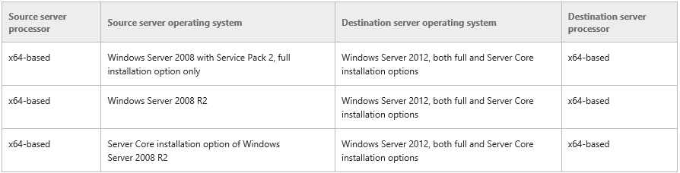
Hyper-V Migration Compatibility Scenarios
Standard, Enterprise, and Datacenter editions of Windows Server running Hyper-V are supported as either source or destination servers.
The stand-alone product “Microsoft Hyper-V Server” is not supported
Notes:
Standard, Enterprise, and Datacenter editions of Windows Server running Hyper-V are supported as either source or destination servers.

Slide 25
Migrating from one Hyper-V to another
The best way to upgrade your Hyper-V infrastructure is to simply blow away the current operating system, then install Server 2012 fresh on the hardware.
The following steps will describe the migration process of your virtual machines without upgrading the OS in place.
Here are some really important file locations we need to take note of:
      • VM Config (XML) files
      • VM Data (VHD) files
      • VM Snapshot (XML) pointer files
It’s wise to remove, revert, or apply all snapshots prior to proceeding (depending on the individual sizes for bandwidth considerations during the copy process) however it is not required.
Notes:
The best way to upgrade your Hyper-V infrastructure is to simply blow away the current operating system, then install Server 2012 fresh on the hardware.
The following steps will describe the migration process of your virtual machines without upgrading the OS in place.
Here are some really important file locations we need to take note of:
• VM Config (XML) files
• VM Data (VHD) files
• VM Snapshot (XML) pointer files
The best way to upgrade your Hyper-V infrastructure is to simply blow away the current operating system, then install Server 2012 fresh on the hardware.
The following steps will describe the migration process of your virtual machines without upgrading the OS in place.
Here are some really important file locations we need to take note of:
• VM Config (XML) files
• VM Data (VHD) files
• VM Snapshot (XML) pointer files
It’s wise to remove, revert, or apply (depending on the individual scenarios) all snapshots prior to proceeding. however it is not required.

Slide 26
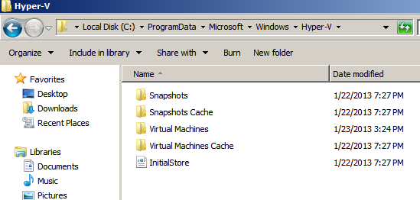
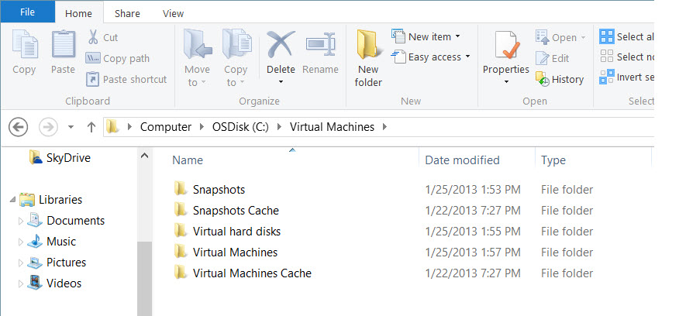
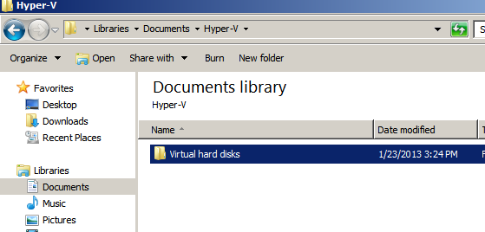
Consolidating Folder Locations
Hyper-V in Windows 2012 has a simplified the folder structure
Backup the 2008R2 VMs , consolidate the folders on Windows Server 2012
Move our “Virtual Machines” folder to a LUN or external disk
ProgramData\Microsoft\Windows\Hyper-V
Create your folders on WS2012 then move the file to the locations
2008 R2 Default Locations
Config and Snapshot Subfolders
Hard Disk Subfolders
%Profile%\Documents\Hyper-V\Virtual hard disks
Notes:
Since in-place upgrades of server operating systems is not something many administrators like to do for various good reasons, a simpler way to upgrade the Hyper-V infrastructure is to simply blow away the current operating system, then install Server 2012 fresh on the hardware. The following steps will describe the process of upgrading the infrastructure without upgrading the OS in place. Before getting started there are some really important file locations we need to take note of:
• VM Config (XML) files
• VM Data (VHD) files
• VM Snapshot (XML) pointer files
It is wise to remove, revert, or apply(depending the individual scenarios) all snapshots prior to proceeding. however it is not required.
Notice first that by default in 2008R2, the VM Config and Snapshot files are located in a separate place from the Disk files.
(ProgramData\Microsoft\Windows\Hyper-V)
Important Talking Points:
Move the default VM location prior to rolling out in prod. Still tied to userprofile by default, which is a bad thing.
Backup the VMs before moving files, record the original file locations somewhere in case of reverting.
VMs should be shutdown prior to moving files.
The Virtual Disk files are located in by default in another folder (%Profile%\Documents\Hyper-V\Virtual hard disks), hopefully in production these files are located on centralized or some physical disks other than the profile directory.
We are now assuming that a Windows Server 2012 instance is available for us with Hyper-V enabled. If you have not prepared the server yet you can follow along the lab guides found here to get started, skipping the steps for booting to a VHD of course. So what we want to do is consolidate the folders shown above to a LUN or separate disk than the operating system, then copy them to the target server or mount the LUN that includes the contents, so that effectively we end up with this collection of subfolders together available on our target Hyper-V system.

Slide 27
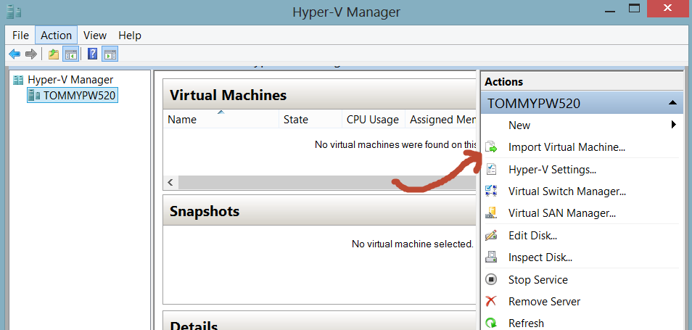
Improved VM Import
The New VM Import feature:
    Performs configuration validation during import process
    No need to export first! Can manually copy VM files between hosts and then import them
    Improved Import wizard – Validates Configurations During Import Process
Launch Hyper-V Manager
Select Import Virtual Machine
Notes:
Note – your attendees will be doing this in the labs. Highly recommended to create identically Virtual Switch names of that from the source environment prior to moving forward with Import Process. Not required, but makes life easier.
The process used for importing VMs onto Hyper-V hosts has been improved in Windows Server 2012. The goal of these improvements is to help prevent configuration problems from happening that can prevent the import process from completing successfully.
In Hyper-V on Windows Server 2008 R2, when you imported a VM onto a host, the VM and all its files were copied to the host, but they weren’t checked for possible configuration problems. However, Hyper-V on Windows Server 2012 now validates the configuration of VM files when they are imported to identify potential problems and, if possible, resolve them. The import wizard detects and fixes more than 40 types of incompatibilities.
This new wizard also creates a temporary copy of the VM configuration file as an added safety step.
With Windows Server 2008 R2 to import a VM to a different host, you first needed to export it. To export the VM, you first needed to turn it off. This caused administrators to schedule downtime prior to exporting the VM. Now, with Windows Server 2012, you can simply copy the VM’s files manually to the new host, and then, on the new Windows Server 2012 host, just run through the Import Virtual Machine wizard, point to the newly copied VM, and it’s imported!

Slide 28
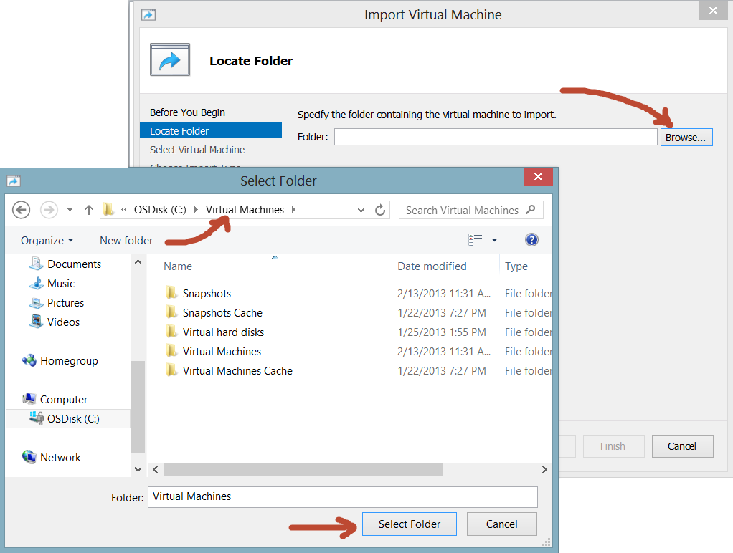
The Import Process (GUI Based)
Browse to the location where the Virtual Machine files reside, Click on Select Folder, Click Next
Notes:
Browse to the location where the Virtual Machine files reside, Click on Select Folder, Click Next

Slide 29
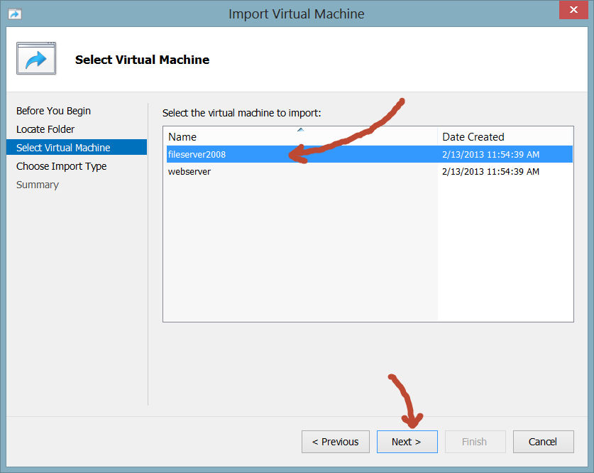
The Import Process (GUI Based)
All Virtual Machines available for Import will show up for selection, highlight the VM to be imported and click Next
Notes:
All Virtual Machines available for Import will show up for selection, highlight the VM to be imported and click Next…

Slide 30
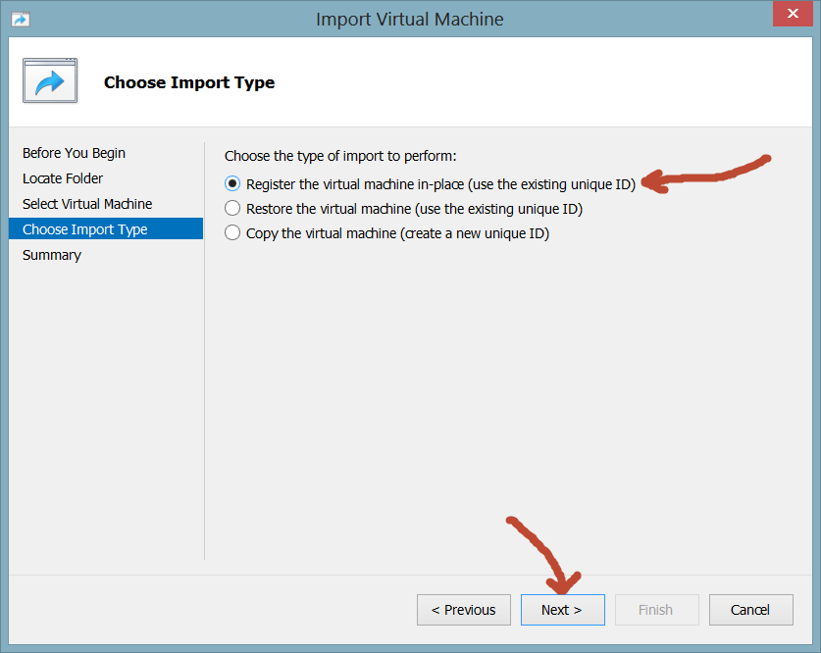
Register, Restore, or Copy?
Register – Assumes that all files exist in this consolidated folder and that the files will continue forward residing in this folder
Restore – Registers the VM configuration files in their current location and copies the other necessary files to new location
Copy – Copies all VM files to a new location for the VM to continue forward running in the new location
Notes:
Register – Assumes that all files exist in this consolidated folder and that the files will continue forward residing in this folder
Restore – Registers the VM configuration files in their current location and copies the other necessary files to new location
Copy – Copies all VM files to a new location for the VM to continue forward running in the new location
Note: The Copy method will require duplicate disk space as the files are copied to a new directory, there is no cleanup of the old files when completed, so only choose this option if disk space is available.

Slide 31
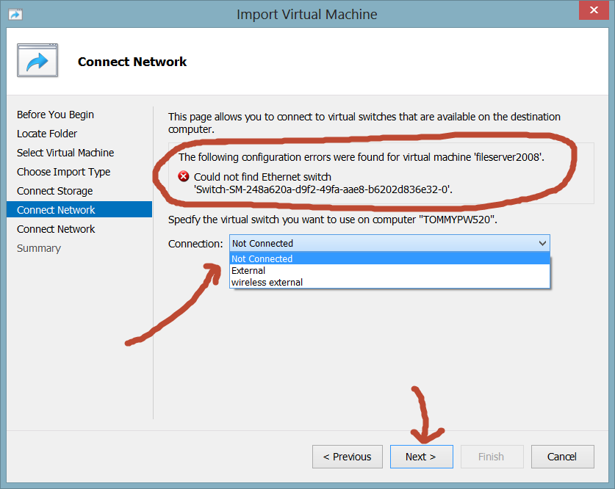
Selecting the Virtual Switch(Network)
Select the proper Virtual Switch for this Virtual Machine’s network card
Multiple virtual NICs will continue to prompt for the proper switches until all have been allocated
Notes:
Select the proper Virtual Switch for this Virtual Machine’s network card
Multiple virtual NICs will continue to prompt for the proper switches until all have been allocated

Slide 32
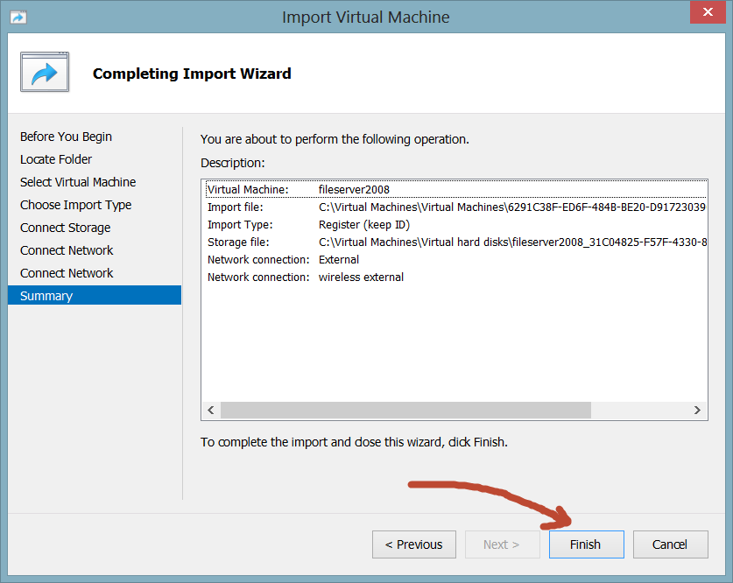
Complete the Import Process
Summary Page is presented, click Finish
Notes:
Summary Page is presented, click Finish.

Slide 33
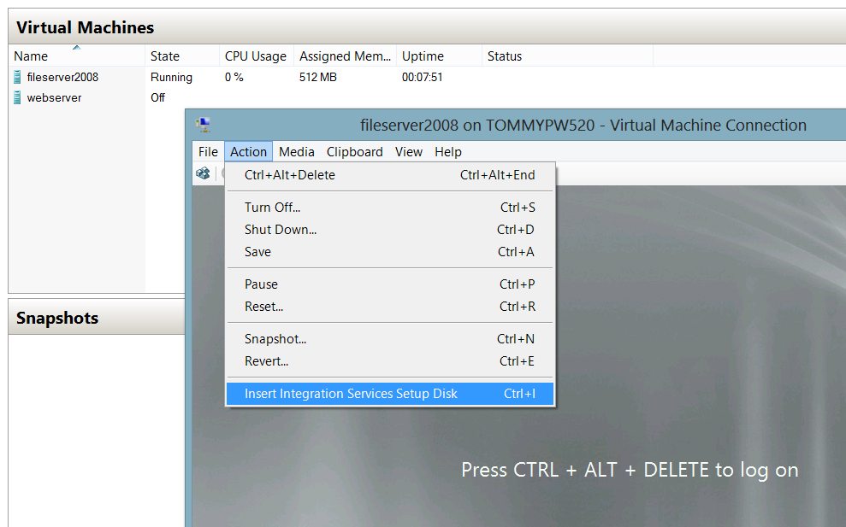
Import Completed
Virtual Machines are now ready to start up for the first time.
Action Items:
Boot the VM
Connect to the Console
Upgrade the Integration Services
Note: Windows Server 2012 guest machines do not require Integration Services upgrades.
Notes:
The Virtual Machines are now displayed. Check the settings then boot them up. Remember to run the Integration Services upgrade in each VM that is not Server 2012 based. Windows Server 2012 already has the proper drivers for Hyper-V. Integration Services are the drivers and required files to let the operating system of the guest understand how to best talk to the Hypervisor.
Once connected to the Console of the VM click on Action then select Insert Integration Services Setup Disk. Once logged into the operating system, open the attached CDROM from within Windows Explorer and run through the upgrade.

Slide 34
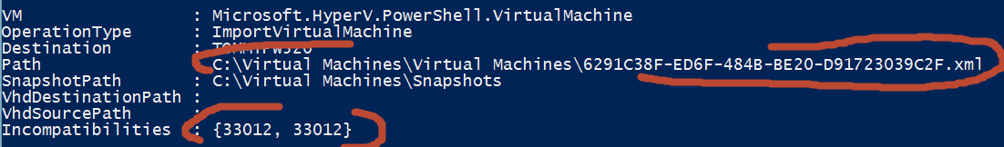
Importing the VMs via PowerShell
First make sure the Hyper-V module is loaded:
Import-Module Hyper-V
Change directory to Virtual Machines
dir -Recurse *.xml | Compare-VM
$results = Compare-VM -Path 'C:\Virtual Machines\Virtual Machines\6291C38F-ED6F-484B-BE20-D91723039C2F.xml'
$results.Incompatibilities[0].Source | Connect-VMNetworkAdapter -SwitchName "External"
$results.Incompatibilities[1].Source | Connect-VMNetworkAdapter -SwitchName "wireless external"
Import-VM -CompatibilityReport $results
Name State CPUUsage(%) MemoryAssigned(M) Uptime Status
---- ----- ----------- ----------------- ------ ------
fileserver2008 Off 0 0 00:00:00 Operating normally
Notes:
First make sure the Hyper-V module is loaded:
Import-Module Hyper-V
Change directory to Virtual Machines
dir -Recurse *.xml | Compare-VM
$results = Compare-VM -Path 'C:\Virtual Machines\Virtual Machines\6291C38F-ED6F-484B-BE20-D91723039C2F.xml'
$results.Incompatibilities[0].Source | Connect-VMNetworkAdapter -SwitchName "External"
$results.Incompatibilities[1].Source | Connect-VMNetworkAdapter -SwitchName "wireless external"
Import-VM -CompatibilityReport $results
Name State CPUUsage(%) MemoryAssigned(M) Uptime Status
---- ----- ----------- ----------------- ------ ------
fileserver2008 Off 0 0 00:00:00 Operating normally

Slide 35
Cluster Migration Considerations
Build a new cluster.
Migrate the VMs via the Migration Tool.
All new features going forward will support Live Migration.

Slide 36
Summary
Ensure you have the proper hardware and enough room for the NTDS.DIT before you upgrade
You cannot upgrade Windows Server 2003 or Windows Server 2008 32-bit to Windows Server 2012
Out of the 4 editions, only the AD DS role is supported on Windows Server 2012 Standard and Datacenter Editions
Make sure and review the considerations around the Functional Levels, Operation Master Roles, Active Directory, Hyper-V and Virtual Machines when upgrading
For more resources around upgrading to Windows Server 2012, visit http://technet.microsoft.com/en-us/library/hh994618.aspx
This presentation provides an overview of upgrading Windows Server 2008 R2 SP1 to Windows Server 2012.
Notes:
Ensure you have the proper hardware and enough room for the NTDS.DIT before you upgrade.
You cannot upgrade Windows Server 2003 or Windows Server 2008 32-bit to Windows Server 2012.
Out of the 4 editions, only the AD Domain Services role is supported on Windows Server 2012 Standard and Datacenter Editions.
Make sure and review the considerations around the Functional Levels, Operation master Roles, Active Directory, Hyper-V and Virtual Machines when upgrading.
For more resources around upgrading to Windows Server 2012, visit http://technet.microsoft.com/en-us/library/hh994618.aspx

Slide 37

Get the evaluation, get certified, and get trained
Get the evaluation
Microsoft Server and Cloud Platform:
http://aka.ms/msproducts
Get certified
Microsoft Learning:
http://aka.ms/itproexpert
Get trained
Microsoft Virtual Academy:
http://aka.ms/go-mva

Slide 38
© 2012 Microsoft Corporation. All rights reserved. Microsoft, Windows, and other product names are or may be registered trademarks and/or trademarks in the U.S. and/or other countries. The information herein is for informational purposes only and represents the current view of Microsoft Corporation as of the date of this presentation. Because Microsoft must respond to changing market conditions, it should not be interpreted to be a commitment on the part of Microsoft, and Microsoft cannot guarantee the accuracy of any information provided after the date of this presentation. MICROSOFT MAKES NO WARRANTIES, EXPRESS, IMPLIED OR STATUTORY, AS TO THE INFORMATION IN THIS PRESENTATION.

