Slide 1
Windows 8 Deployment

Slide 2










Deployment
deployment tools
deployment challenges
meeting challenges
deployment products
Notes:
Deployment
Key Messages:
Deployment can be challenging
Automation and a wizard-guided user interface are the keys to addressing these challenges
Microsoft provides the tools that can help organizations deploy Windows 8 and applications with less effort
Operating system deployment presents a number of challenges for organizations, not only for Windows 8 but for all operating systems.
Process automation and wizard-guided user interfaces reduce the effort and risk associated with deploying and managing operating systems and applications.
Microsoft provides the tools that can help you deploy Windows 8 and applications with less effort.

Slide 3





Challenges
configuration settings
content management
compliance standards
preserve user settings and files
configuration standards
configuration drift
Notes:
Challenges
Key Messages:
Deployment creates a number of challenges
Keeping up with configuration changes requires a lot of effort and time
Ensuring compliance with configuration standards can be difficult
Users interject additional problems with device management
Windows deployment can presents a number of challenges for IT professionals and the organizations for which they work. These challenges are usually reflected in increased effort, complexity, inefficiency, and ineffectiveness.
Management of operating system, device driver, operating system language pack, and application content often results in out-of-date operating system images or a larger number of operating system images to manage.
Preserving user settings and files represents a deployment risk for existing users. During the migration process to existing computers, user settings and files need to be preserved. One of the largest user complaints is the loss of configuration settings and files during a refresh of their devices with a new operating system and applications.
Changing device-configuration standards makes it difficult to keep devices compliant. As compliance, security, and organizational standards change, the operating system images and configuration settings must change to adhere to these standards.
As users install applications and make changes to the standard configuration of the operating system and applications, configuration drift occurs. At a minimum, these changes cause configuration drift from standards, but often can result in the user device being inoperable.

Slide 4



Meeting Challenges
Automation
Wizard-guided user interface
Centralized management
Notes:
Meeting Challenges
Key Messages:
Automation is essential to meeting deployment challenges
Wizard-guided user interfaces help reduce configuration errors and deployment risk
Centralized management of deployment content and processes
[CLICK]
Automation is essential to meeting deployment challenges. Automation helps prevent configuration issues by reducing the number of manually performed steps and avoiding inadvertent human-induced errors. Automation also provides a repeatable process that helps ensure configuration consistency. Automation improves the efficiency and effectiveness of IT professionals, allowing them to do more with the same amount of time and effort.
[CLICK]
Wizards help users and IT professionals provide configuration information with minimal effort and less potential for errors. Wizards guide users and IT professionals through the deployment process and prompt them for configuration settings that are essential to performing a successful deployment.
[CLICK]
Centralized administration helps ensure deployment consistency across the organization. Centralizing administration also helps reduce the work of managing deployments because any changes in the deployment content or processes are propagated throughout the organization. When coupled with automation and wizards, centralized administration can make IT professionals more effective and efficient than without these advantages.

Slide 5




Deployment Products and Tools
  Windows Assessment and Deployment Kit
  (Windows ADK)
  Microsoft Deployment Toolkit (MDT)
  Internet Explorer
  Administrator Kit (IEAK)
  System Center 2012 Configuration Manager
Notes:
Deployment Products and Tools
Key Messages:
Microsoft provides the products, tools, and technologies to make deployments easier and repeatable
Windows Assessment and Deployment Kit (Windows ADK)
Internet Explorer Administration Kit (IEAK)
Microsoft Deployment Toolkit (MDT)
Microsoft provides the products, tools, and technologies to perform successful deployments. Many of these deployment aids are available for free and can help organizations deploy Windows 8 and applications with less effort and risk. These same products, tools, and technologies help IT professionals be more efficient and effective at performing their job functions so that they can do more with the same level of effort.
The Windows ADK is a collection of tools that help in the assessment and deployment of Windows 8. The Windows ADK will be discussed in more detail later in this session.
The IEAK helps customize Internet Explorer branding and configuration settings. The IEAK will be discussed in more detail later in this session.
The MDT helps manage deployment content in preparation for deployment, then collects deployment information through wizards at the time of deployment. The MDT allows you to control the level of information required at deployment time. The MDT also allows you to perform fully automated deployments that require no deployment information at the time of deployment. The MDT can be used by itself or in conjunction with System Center 2012 Configuration Manager and System Center Configuration Manager 2007. The MDT will be discussed in more detail later in this session.

Slide 6




Windows ADK Overview
Windows Assessment and Deployment Toolkit
Work On Your
Own Device
Assessment and
Deployment Tools
Required by MDT
Required by System
Center 2012
Configuration Manager
Windows ADK Components
Deployment and Imaging
Windows Preinstallation Environment
User State Migration Tool
Volume Activation Management Tool
Windows Performance Toolkit
Windows Assessment Toolkit
Windows Assessment Services
Notes:
Windows ADK Overview
Key Messages:
Collection of assessment and deployment tools to aid in the deployment of Windows 8
Required for any automated Windows 8 operating system deployment using the MDT and/or the Operating System Deployment (OSD) feature in System Center 2012 Configuration Manager
Keep the discussion brief as this is not the primary focus of the session
The Windows ADK is a collection of assessment and deployment tools that aid in the deployment of Windows 8.
These tools are required for any automated Windows 8 operating system deployment using the MDT and/or the OSD feature in System Center 2012 Configuration Manager.
Each of the tools in the Windows ADK will be discussed in separate slides.

Slide 7

Deployment And Imaging
Key Tools:
DISM
Sysprep
Windows SIM
Customize
and deploy Windows Images
Can be standalone
Recommend using with MDT and System Center 2012 Configuration Manager
Required by MDT and System Center 2012 Configuration Manager
Text/Pic
Notes:
Deployment and Imaging
Key Messages:
Contains the tools that you need to customize, deploy, and service Windows images
These tools stand alone but are recommended to be used with the MDT and System Center 2012 Configuration Manager to provide automation and wizard-driven interfaces
These tools are leveraged by the MDT and System Center 2012 Configuration Manager
Contains a number of command-line tools that assist in the deployment and imaging of Windows and Windows Preinstallation Environment (Windows PE)
First, let's take a look at the Deployment and Imaging component of the Windows ADK. This component contains the tools that you need to customize, deploy, and service Windows images. These tools can stand alone but are recommended to be used with the MDT and System Center 2012 Configuration Manager. The tools in the Deployment and Imaging component of the Windows ADK are required by the MDT and System Center 2012 Configuration Manager.
Let's take a look at a few of the key tools in the Deployment and Imaging component. Deployment Image Servicing and Management (DISM) is a command-line tool that mounts and services Windows images before deployment. You can use DISM image-management commands to mount, and get information about, Windows image (.wim) files or virtual hard disks (VHD) and to capture, split, and otherwise manage .wim files. DISM replaces the ImageX tool for image management.
The System Preparation (Sysprep) tool prepares a computer for delivery to a customer by configuring it to create a new computer security identifier (SID) when the computer is restarted. In addition, the Sysprep tool removes user-specific and computer-specific settings and data that must not be copied to a destination computer.
Windows System Image Manager (Windows SIM) creates unattended Windows Setup answer files. You can create an answer file by using information from a .wim file and a catalog (.clg) file. Component settings are added to an appropriate configuration settings in the answer file. You can also add packages to be installed during Windows Setup.
Windows Recovery Environment (Windows RE) is a recovery environment that can repair common causes of unbootable operating systems automatically.
There are a number of other command-line tools that assist in the deployment and imaging of Windows, boot configuration, and Windows PE configuration.

Slide 8

Windows Preinstallation Environment
Minimal operating system
Assist in deployment
Based on Windows 8
Used by MDT and System Center 2012 Configuration Manager
Notes:
Windows Preinstallation Environment
Key Messages:
Windows PE is a minimal operating system based on the Windows operating system used to assist in deployment
Windows PE 4.0 is based on the Windows 8 operating system
Windows PE is used by both the MDT and System Center 2012 Configuration Manager
Keep the discussion brief as this is not the primary focus of the session
Now let's look at the next component of the Windows ADK, Windows PE. Windows PE is a minimal operating system designed to prepare a computer for Windows installation by starting a computer that has no operating system. During deployment of Windows, Windows PE can be used to partition and format hard drives, copy disk images to a computer, and initiate Windows Setup from a network share.
Windows PE is available as a standalone product to customers who have the appropriate licensing agreement, and is an integrated component of many Windows technologies, including Windows Setup and Windows Deployment Services.
Windows PE 4.0 is based on the Windows 8 operating system.
Windows PE is used by both the MDT and System Center 2012 Configuration Manager.
Customized Windows PE images can be created using the tools provided with Windows PE. MDT and System Center 2012 Configuration Manager can also create customized Windows PE images.

Slide 9
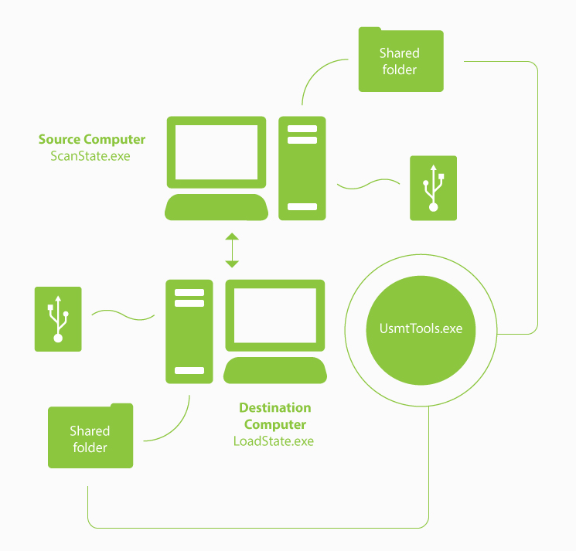

User State Migration Tool
Migrate user profiles and files
Required by MDT and System Center 2012 Configuration Manager
Command line tools
  ScanState.exe
  LoadState.exe
  UsmtUtils.exe
Notes:
User State Migration Tool
Key Messages:
Migrates user profiles from existing Windows operating systems to Windows 8
The USMT is used by both the MDT and System Center 2012 Configuration Manager to migrate user state
Includes command-line tools and configuration files for performing the migration process
Keep the discussion brief as this is not the primary focus of the session
The User State Migration Tool (USMT) migrates user profiles and files from existing Windows operating systems to Windows 8. It captures the user state from the existing operating system and subsequently restores the user state to Windows 8.
The USMT includes three command-line tools (ScanState.exe, LoadState.exe, and UsmtUtils.exe).
The ScanState.exe tool captures user state from the existing operating system (such as Windows XP, Window Vista, Windows 7, or Windows 8).The captured user state can be stored locally, on a removable drive, or on a network shared folder. The ScanState.exe tool can also estimate the amount of disk storage required by the migrated user state.
The LoadState.exe tool restores the captured user state from the location where it is stored by the ScanState.exe tool.
The UsmtUtils.exe tool performs user state migration–related functions, such as extracting files from a compressed migration store or removing hard-link stores that cannot be otherwise deleted due to a sharing lock.
Includes three .xml files that configure the user state capture and restore process (MigApp.xml, MigDocs.xml, and MigUser.xml). In addition, the Config.xml file specifies files or configuration settings to exclude from the migration. You can create custom .xml files to support specialized migration needs.
The USMT is used both by the MDT and System Center 2012 Configuration Manager to migrate user state. At the appropriate time during the deployment process, the ScanState.exe and LoadState.exe command-line tools automatically run to migrate user state.

Slide 10

Volume Activation Management Tool
Automate and centrally manage
Windows, Office, other products
Enterprise environments
Manage volume activation
Multiple Activation Keys (MAKs)
Windows Key Management Service (KMS)
Notes:
Volume Activation Management Tool
Key Messages:
Helps automate and centrally manage volume and retail-activation processes for Windows, Microsoft Office, and other Microsoft products
Manages volume activation using Multiple Activation Keys (MAKs) or the Windows Key Management Service (KMS)
Typically deployed in enterprise environments
Keep the discussion brief as this is not the primary focus of the session
Now let's look at the Volume Activation Management Tool (VAMT). The VAMT enables network administrators and other IT professionals to automate and centrally manage the volume and retail-activation processes of Windows, Microsoft Office, and select other Microsoft products.
The VAMT can manage volume activation using MAKs or KMS and is typically deployed in enterprise environments.
The VAMT is a standard Microsoft Management Console (MMC) snap-in that requires MMC 3.0. The tool can be installed on any computer that runs Windows 8, Windows 7, Windows Server 2012, or Windows Server 2008 R2.

Slide 11
Windows Performance Toolkit
Profiles Windows and applications
Performance monitoring tools
Windows Performance Recorder (WPR)
Windows Performance Analyzer (WPA)
Notes:
Windows Performance Toolkit
Key Messages:
Includes performance monitoring tools that produce performance profiles
Produces performance profiles for Windows operating systems and applications
Includes the Windows Performance Recorder (WPR) and the Windows Performance Analyzer (WPA)
Keep the discussion brief as this is not the primary focus of the session
[CLICK]
The Windows Performance Toolkit consists of performance monitoring tools that produce in-depth [CLICK] performance profiles of Windows operating systems and applications.
[CLICK]
The WPR is a powerful recording tool that creates Event Tracing for Windows (ETW) recordings. You can run the WPR from the WPR user interface or from the command line. The WPR provides built-in profiles that you can use to select the events that are to be recorded. Alternatively, you can author custom profiles in XML.
[CLICK]
The WPA is a powerful analysis tool that combines a very flexible user interface with extensive graphing capabilities and data tables that can be pivoted and that have full text search capabilities. The WPA allows you to explore the root cause of any identified performance issues.

Slide 12






Windows Assessment Toolkit
Assess existing Windows
operating system
Assess performance,
reliability, and functionality
Recommend improvements
Notes:
Windows Assessment Toolkit
Key Messages:
Determines the quality of a running operating system
Assesses the performance, reliability, and functionality
Includes all the tools needed to assess computers and determine how to make any necessary improvements
Keep the discussion brief as this is not the primary focus of the session
Another component in the Windows ADK is the Windows Assessment Toolkit.
[CLICK]
The Windows Assessment Toolkit helps you determine the quality of a running operating system or a set of components with regard to [CLICK] performance, reliability, and functionality.
[CLICK]
The toolkit includes the tools that you need to assess a local computer, review the results, diagnose problems, and determine how to make improvements.
Assessments can be performed using the Windows Assessment Console or command-line tools.

Slide 13

Windows Assessment Services
Test framework for running assessments
Used in lab environments
Measure performance, reliability,
and functionality
Notes:
Windows Assessment Services
Key Messages:
Provides a test framework for running assessments that measure performance, reliability, and functionality on multiple computers
Windows Assessment Services - Client (Windows ASC) is used to configure and monitor the assessment
Keep the discussion brief as this is not the primary focus of the session
The final component in the Windows ADK is the Windows Assessment Services component.
[CLICK]
Windows Assessment Services is a test framework used to automate running assessments that measure performance, reliability and functionality on multiple computers in a lab environment.
It helps you eliminate fragmented, error-prone, expensive, pre-deployment test processes, and enables you to replace multiple steps and inconsistent tools with just one tool.
[CLICK]
Windows ASC is the graphical user interface that interacts with Windows Assessment Services. This enables you to manage settings and assets, such as which lab computers to test, which images should be applied to those computers, and which assessments should be run on the test computers.
[CLICK]
You can use Windows ASC to monitor the progress of a running job and to view and compare the results that were produced. Additional benefits include the ability to import results into a central database for consolidated report generation.

Slide 14







Internet Explorer Administration Kit
Work On Your
Own Device
Deploy and Manage
Custom Installations
Brand Internet
Explorer
Configure Internet
Explorer Settings
Notes:
Internet Explorer Administration Kit
Key Messages:
The Internet Explorer Administration Kit (IEAK) is used to deploy and manage custom installations of Internet Explorer
Provides the ability to deploy branded versions of Internet Explorer
Provides the ability to configure Internet Explorer settings
Keep the discussion brief as this is not the primary focus of the session
Now let's take a look at the next tool that you can use in deployments, the Internet Explorer Administration Kit (IEAK). The IEAK is used to deploy custom installations of Internet Explorer and is a free tool provided by Microsoft.
The IEAK provides the ability to deploy branded versions of Internet Explorer, specific to the needs of the organization.
The IEAK also provides the ability to deploy Internet Explorer with specific configuration settings that comply with baseline configuration standards.
Internet Explorer customizations are saved in a custom browser package for deployment to targeted users and devices.

Slide 15


Brand Internet Explorer
Branding:
Customized Graphics, Favorite Icons, Autorun Splash Screen
System Integrators and OEMs
Notes:
Brand Internet Explorer
Key Messages:
Branding can include customized graphics, icons for the Favorites list, and autorun splash screen
System integrators and original equipment manufacturers (OEMs) might want to provide branded versions of Internet Explorer to customers
Keep the discussion brief as this is not the primary focus of the session
Internet Explorer branding allows you to change the browser toolbar button, the icons for the Favorites list, and the autorun splash screen (if the customized version of Internet Explorer is distributed by CD or DVD).
The primary audience for branding is system integrators and OEMs. These organizations might want to provide branded versions of Internet Explorer to customers. This branding includes customized graphics and text within Internet Explorer.
The customized branding is saved in a custom browser package that is included as part of the Internet Explorer deployment files.

Slide 16


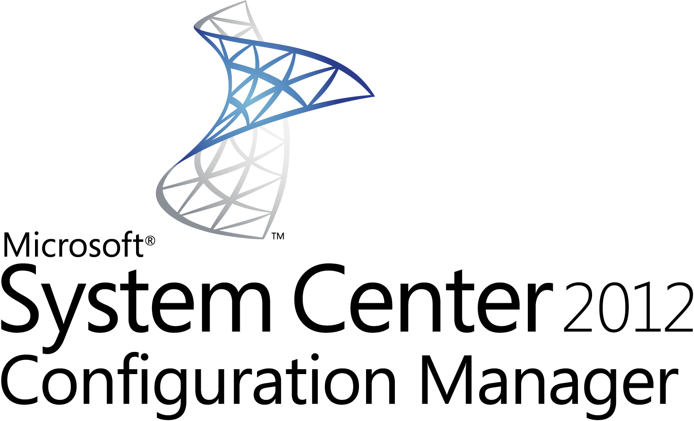

Configure Internet Explorer Settings
Myriad of settings
Managed devices
Group Policy settings
Adhere to baselines
Text/Pic
Notes:
Configure Internet Explorer Settings
Key Messages:
Internet Explorer has many configuration settings
Organizations want to preset these configuration settings as a part of their baselines
Managed devices can be configured using Group Policy settings or System Center 2012 Configuration Manager
Keep the discussion brief as this is not the primary focus of the session
Internet Explorer has a number of configuration settings that need to be managed. Organizations want to preset these configuration settings as a part of their established configuration baseline standards.
The configuration settings are saved in a custom browser package that is included as part of the Internet Explorer deployment files.
For managed devices, it is recommended that these configuration settings be managed using Group Policy settings. The IEAK is good for providing initial configuration settings during deployment, but Group Policy can help ensure that the configuration settings stay in compliance with regulatory agency and organizational configuration baseline standards.
The Internet Explorer configuration settings can also be automatically managed and monitored using System Center 2012 Configuration Manager. These products could be used in conjunction to automatically detect configuration baseline drift and automatically perform remediation to bring the configuration settings back into compliance.

Slide 17







Deploying Windows 8 Using the MDT
Automates
Deployment
Wizard-driven
Deployment
Partially or
Fully Automated
With or without
System Center 2012
Configuration Manager
Wizard-driven
Management
Notes:
Deploying Windows 8 Using the MDT
Key Messages:
The MDT helps automate the deployment and ongoing management of Windows 8 and applications
The MDT provides wizard-driven management of deployment content
The MDT provides a wizard-driven collection of deployment information
The MDT supports partially automated and fully automated deployments
The MDT works with or without System Center 2012 Configuration Manager
Now let's turn our attention to the Microsoft Deployment Toolkit. The MDT helps automate the deployment and ongoing management of Windows 8. It leverages and automates the tools in the Windows ADK to deploy Windows 8 and applications.
The MDT reduces the effort and complexity of managing deployment content through all phases of the IT lifecycle. The MDT provides wizards that help in the initial creation of deployment content.
The MDT also reduces the effort and complexity of performing deployments. The MDT provides wizard-driven deployment that helps reduce the risk of configuration errors at the time of deployment.
The MDT performs highly automated deployments that allow you to control the type of information that you wish to provide at the time of deployment. You can configure MDT deployment wizards to prompt for only the necessary information and provide only those deployment settings that you wish to control. For example, you can configure the MDT deployment wizards to prompt for the computer name at the time of deployment, while using configuration settings that you configured prior to deployment for the remainder of the configuration settings.
The MDT can also perform fully automated deployments that require no user interaction at the time of deployment. The MDT allows you to configure all the deployment configuration settings and then automatically initiate the deployment process using Windows Deployment Services.
The MDT works with or without System Center 2012 Configuration Manager. For organizations that have System Center 2012 Configuration Manager, the MDT leverages that investment to provide improved automation and management. For organizations without System Center 2012 Configuration Manager, the MDT provides the ability to perform the same level of automation and improved efficiency and effectiveness.

Slide 18
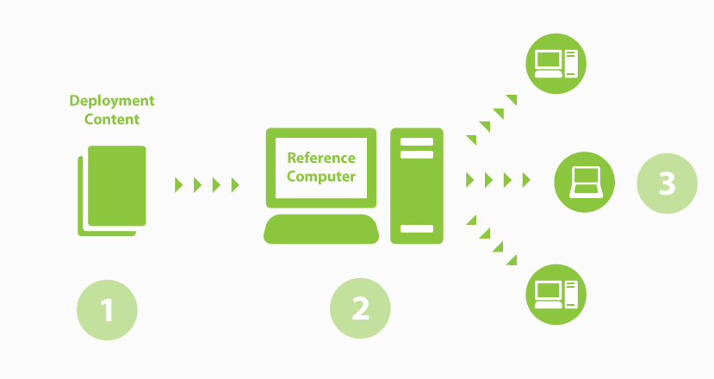

Overview of MDT Deployment
Microsoft Deployment Toolkit
Industry best practices
Configuration settings
Reference computer
Target computer
Notes:
Overview of MDT Deployment
Key Messages:
The MDT supports industry best practices for operating system and application deployment
Reference computers act as the template for the targeted computers
The MDT manages the configuration settings and then updates the unattended installation files based on those configuration settings at the time of deployment
Images of the reference computers are deployed to the targeted computers
Let's see how the MDT works. The deployment process and guidance provided by the MDT are based on industry best-practice recommendations for operating system and application deployment. This helps ensure that deployments are performed efficiently and with minimal risk.
You use the MDT to configure the deployment configuration settings that you wish to provide prior to deployment. This allows you to dramatically reduce the level of information that is required to be provided at the time of deployment and helps minimize configuration errors and deployment risk.
The MDT uses reference computers as the template for the targeted computers. As a part of the deployment process, a reference computer is created for each unique image that you wish to create. This process is more efficient and provides improved flexibility than the traditional "cloning" methods.
The captured operating system image of the reference computer is deployed to the targeted computers. At the time of deployment, the MDT can optionally collect additional deployment configuration settings that allow you to provide computer-specific settings. For fully automated deployments, no additional configuration settings are required at the time of deployment.

Slide 19
Selecting the Right Deployment Method
LTI - Light Touch Installation
UDI – User-Driven Installation
ZTI – Zero Touch Installation
Partially and fully automated deployments
Without System Center 2012 Configuration Manager
Just-in-time configuration setting
  Partially and fully automated deployments
  With System Center 2012 Configuration Manager
  Just-in-time configuration settings
  Fully automated deployments
  With System Center 2012 Configuration Manager
  Configuration settings in advance
ZTI and UDI use common processes
Notes:
Selecting the Right Deployment Method
Key Messages:
The MDT provides different deployment methods
Lite Touch Installation (LTI) can perform partially and fully automated deployments for environments without System Center 2012 Configuration Manager
User-Driven Installation (UDI) can perform partially and fully automated deployments for environments with System Center 2012 Configuration Manager
Zero Touch Installation (ZTI) performs fully automated deployments for environments with System Center 2012 Configuration Manager
ZTI and UDI use common processes for deployment
The MDT provides different deployment methods: Lite Touch Installation (LTI), User-Driven Installation (UDI), and Zero Touch Installation (ZTI). Each method enables highly automated deployment of Windows operating systems and applications. The more you automate the deployment, the more you reduce deployment risk and the possibilities for configuration errors.
LTI can perform partially and fully automated deployments for environments without System Center 2012 Configuration Manager. This allows you to determine the deployment configuration settings that you wish to provide prior to deployment and at the time of deployment. We will talk more about LTI later in this session.
UDI can perform partially and fully automated deployments for environments with System Center 2012 Configuration Manager. This also allows you to determine the type of deployment configuration settings you wish to provide prior to deployment and at the time of deployment. We will talk more about UDI later in this session.
ZTI performs fully automated deployments for environments with System Center 2012 Configuration Manager. This allows you to provide all the configuration settings in advance and eliminate the need for any user or deployment technician interaction at the time of deployment. We will talk more about ZTI later in this session.
ZTI and UDI use common processes for performing deployments. The same System Center 2012 Configuration Manager task-sequence templates are used for both UDI and ZTI. The primary difference between a task sequence created for UDI and a task sequence created for ZTI is that the task sequence runs a wizard for UDI and skips that step for ZTI. You can change a task sequence for use by UDI or ZTI by changing that one step within the task sequence.

Slide 20

Demo: Deploying Windows 8 Using LTI

Slide 21
Demo: Deploying Windows 8 Using ZTI

Slide 22





Summary
Challenging
Reduce effort
Reduce complexity
Reduce Risk
Any size organization
Notes:
Summary
Key Messages:
Operating system deployment can be challenging
The MDT reduces the effort and complexity for deploying Windows 8 and applications
The MDT reduces deployment risk
The MDT can be used by organizations of any size
The Windows ADK provides the basic tools for all deployments
As we've seen, Windows operating system deployment presents a number of challenges.
However, the MDT can help reduce the effort and complexity of performing Windows 8 deployments. The MDT can also help deploy applications that are specifically designed to be deployed as though they were part of the operating system image.
The MDT helps reduce deployment risk by providing highly automated deployment processes and wizard-driven user interfaces. The highly automated processes are based one best-practice recommendations and help eliminate any configuration errors that might be introduced through manual configuration methods. The wizard-driven user interfaces help you know exactly the right information you need to provide to successfully complete Windows 8 and corresponding application deployment.
The MDT can be used by organizations of any size. For organizations without System Center 2012 Configuration Manager, the LTI deployment method allows you to leverage all the benefits of the MDT. For organizations with System Center 2012 Configuration Manager, the UDI and ZTI deployment methods allow you to leverage your existing investment and streamline Windows 8 and application deployment.
At the heart of all of these tools is the Windows ADK. It provides the essentials that are required to automate Windows 8 operating system deployment.

Slide 23
What’s Next
  Evaluate Windows 8
  Evaluate MDT
Notes:
What’s Next
Key Messages:
Evaluate Windows 8
Evaluate the MDT
What are the next steps? First, evaluate Windows 8. See how Windows 8 can help your organization achieve higher levels of productivity for all users and devices.
Second, evaluate the MDT. Learn how to leverage the automation and ease of configuration provided by the MDT to make wide-scale deployment of Windows 8 and your applications easier than ever before.

Slide 24



© 2012 Microsoft Corporation. All rights reserved. Microsoft, Windows, Windows Vista and other product names are or may be registered trademarks and/or trademarks in the U.S. and/or other countries.
The information herein is for informational purposes only and represents the current view of Microsoft Corporation as of the date of this presentation. Because Microsoft must respond to changing market conditions, it should not be interpreted to be a commitment on the part of Microsoft, and Microsoft cannot guarantee the accuracy of any information provided after the date of this presentation. MICROSOFT MAKES NO WARRANTIES, EXPRESS, IMPLIED OR STATUTORY, AS TO THE INFORMATION IN THIS PRESENTATION.

