Slide 1
Overview System Center 2012 SP1
IT Camps

Slide 2
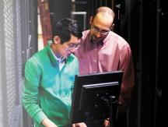
System Center 2012 Capabilities
Tools
Deploy
App Controller
Configure
Service Model
Migrate
IaaS
Self Service
Portal
Process
Automation
IT Service Management
Application Owner
“Service Consumer”
Service Provider “Datacenter Admin”
Virtual
Inventory
Monitor
Protect
Physical
Business Requirements
Process
Tools
Infra

Slide 3
System Center 2012 SP1
Windows Server 2012
Productive Infrastructure
Predictable Applications
Your Cloud
Notes:
Well before we actually delve into the details of the capabilities that we have I would like to sort of segment this talk into three capabilities.
First I will talk about the capabilities that we are using as a part of Windows Server 2012 which make your infrastructure far more productive than it ever has been in the past. We’ll then talk about predictable applications and how you do application monitoring inside your datacenter as well as and then we subsequently talk about how you set up and manage your private cloud.

Slide 4
Updates in SP1
Windows Server 2012
Windows Server 2008 R2
SP1
System Center 2012
Microsoft
Hyper-V Server 2012
Manages
Microsoft
Hyper-V Server 2008 R2
Windows Server
SQL Server
2008 R2
2008 R2
2012
2012
6+
5+
Notes:
So let’s go straight into productive infrastructure.
So what exactly is System Center 2012 SP1, well before there was System Center 2012 SP1 there was System Center 2012 which was used to manage Windows Server 2008 R2 as well as Microsoft Hyper-V Server 2008 R2 as well as versions of Citrix Xen Server and VMware.
System Center 2012 SP1 runs on Windows Server 2012 and is used to manage both Windows Server 2012 as well as Windows Server 2008 R2. and in addition it ups the support that we have for Citrix Xen Server 6.0 and for VMWare up to VMWare 5.1.

Slide 5
Productive Infrastructure
Notes:
So let’s talk about productive infrastructure.

Slide 6
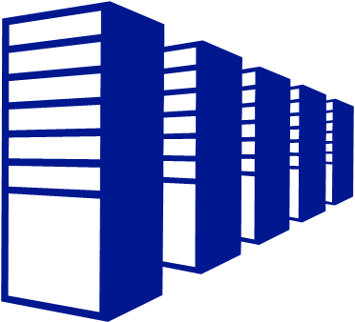
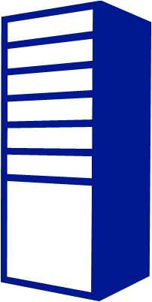
Windows Server 2012 Scale
System | Resource | Maximum number Windows Server 2012 | Improvement factor
Cluster | Hosts | 64 | 4×
 | Virtual machines | 8,000 | 8×
Host | Logical processors on hardware | 320 | 5×
 | Physical memory | 4 TB | 4×
 | Virtual processors per host | 2,048 | 4×
Virtual Machine | Virtual processors per virtual machine | 64 | 16×
 | Memory per virtual machine | 1 TB | 16×
 | Active virtual machines | 1,024 | 2.7×
Notes:
So if you look at what we have achieved with Windows Server 2012 this slide shows you the dramatic improvements we have made to the scale in terms of the number of hosts that we can have in a single cluster, in terms of the number of virtual machines that you can have in a single cluster, the amount of physical memory that we support in a single hyper-v host, the number of virtual processors that we support per host, the amount of active virtual machines that we can have on a physical host and as you can see, compared to the previous release of Hyper-V there have been significant enhancements to what a customer can now support inside the datacenter. Our goal truly was to make sure that you as a customer can now virtualize virtually every workload inside your datacenter. That was the intent in the design philosophy behind Windows Server 2012 and the numbers here reflect the maximum scale that you potentially reach today in being able to virtualize your workloads. In support of the enhanced scale that we have in Windows Server 2012 in System Center 2012 we have had to make enhancements to support this new scale.
6

Slide 7
Infrastructure Enhancements (VMM)
System Center 2012 | System Center 2012 SP1
Hyper-V 2K8 R2 boot from VHD Configure physical Hyper-V cluster Out of band management Online patch orchestration of Hyper-V | Host profiles and configuration management Bigger Clusters (16 → 64 nodes) Bigger hosts (64 →320 cores, 1TB -> 4 TB) Larger VMs (64 vCPU’s, 1 TB RAM)
Software Defined Networking | Isolated tenant networks IP virtualization Manage Switch Extensions Logical Switch
Discovery of arrays , pools , LUNs Classification of storage resources On demand assignment of storage to a service and clusters | SMB3.0 and NAS support Live storage migration Multiple Live Migrations
Notes:
And this next slide shows the enhancements that we have made in the context of virtual machine manager content of System Center 2012 SP1. and just as a comparison on this slide I show you first what is available first in System Center 2012 and the enhancements that we’ve added in SP1 to support Windows Server 2012. so as you can see, you know the size of the clusters goes from 16 to 24, your VM size and topology increases dramatically. Now the second part of this table which is really where I’d like to focus your attention on which is software defined networking. Prior to Windows Server 2012 and System Center 2012 SP1 we had a fairly simple model of networking that existed. And with Windows Server 2012 we have really made a huge investment in enabling software defined networking for you inside the datacenter. And what software defined networking really means is that for you as a customer to be able to set up and manage networks on the fly using your administrative pools and software. In case of our stack the tool that we use to manage your software defined networking stack is the Virtual Machine Manager component of System Center 2012 SP1. with the release of SP1 you can now create isolated tenant networks on the fly using Hyper-V network utilization, this allows you to create isolated networks without having to rely on VLANs which are challenging to configure and have scale limitations in terms of the number of VLANs that you can have in your datacenter. Using VMM you can now manage all the extensions that partners are developing for the extensible switch for Hyper-V in Windows Server 2012. This makes it really convenient for you as customers to deploy and manage these extensions.
In addition we heard from customers that when you have a large number of Hyper-V hosts and each of these Hyper-V hosts has an instance of a Hyper-V switch, customers are looking for an easier way to manage all the policy and configuration items on these individual virtual switches. So with System Center 2012 SP1 we introduced the concept of a logical switch which takes all the individual switch instances which exist on the Hyper-V host and binds them together as one logical entity, allowing you to define policy elements and configuration elements across all those individual Hyper-V switches increase them as one logical entity. This also makes it really simple if you want to deploy multiple switch extensions across all these individual Hyper-V switch instances. All you need to define is a logical switch, add the switch extensions to that logical switch, and VMM will take care of managing and deploying the life cycle of these switch extensions across all these Hyper-V switch extensions.
From a perspective of storage Windows Server 2012 lowers the total cost of ownership from a storage perspective by enabling Hyper-V to store and run the VMs off of a SMB3.0 share. And the VMM component in System Center 2012 SP1 enables you to configure and manage the deployment off of these Hyper-V shares and Hyper-V hosts. In addition we support live storage migration and support utilization of multiple live migrations as are supported by the Windows Server 2012 Hyper-V platform.

Slide 8
Hyper-V Network Virtualization
Blue VM
Red VM
Blue Network
Red Network
Virtualization
Physical
Server
Physical
Network
Hyper-V Network Virtualization
Run multiple virtual networks on a physical network
Each virtual network has illusion it is running as a physical network
Realized via Windows Server and VMM
Server Virtualization
Run multiple virtual servers on a physical server
Each VM has illusion it is running as a physical server
Notes:
So Hyper-V network virtualization is a new capability in Windows Server 2012 where the network environment is virtualized in much of the same way as a server environment is virtualized in virtual machines. So with the virtual machines you can run multiple VMs on the same physical server so with network virtualization you can have multiple networks that are each independent with their own address base completely isolated from each other all on the same physical network. This is done through isolation in the Hyper-V switch and on the network the packets are encapsulated and on the network using a portal called NBGRE.

Slide 9
Logical Switch
VM
VM
VM
VM
VM
VM
VM
VM
VM
VM
VM
VM
VM
VM
VM
VM
VM
VM
VM
VM
…on Host 1
…on Host 2
…on Host 3
…on Host n
Logical Switch
Virtual Switch
Virtual Switch
Virtual Switch
Virtual Switch
Virtual Switch
Virtual Switch
Virtual Switch
Single management entity spanning hosts
Manage extensions across hosts
Apply policy and configuration across hosts
Virtual Switch
Extension1
Extension1
Extension1
Extension1
Extension1
Extension1
Extension1
Extension1
Extension1
Extension2
Extension2
Extension2
Extension2
Extension2
Extension2
Extension2
Extension2
Extension2
Extension3
Extension3
Extension3
Extension3
Extension3
Extension3
Extension3
Extension3
Extension3
Physical Network

Slide 10
Virtual Switch
VM
VM
VM
VM
VM
VM
VM
VM
VM
VM
VM
VM
VM
VM
VM
VM
VM
VM
VM
VM
…on Host 1
…on Host 2
…on Host 3
…on Host n
Virtual Switch
Virtual Switch
Virtual Switch
Virtual Switch
Extension1
Extension1
Extension1
Extension1
Extension2
Extension2
Extension2
Extension2
Extension3
Extension3
Extension3
Extension3
Physical Network

Slide 11
Demo
Network Isolation with Hyper-V Network Virtualization
Notes:
In this demo I’m going to show you how simple it is to actually create an isolated network, the demo is going to be done from the perspective of an administrator who’s actually creating these networks but from a customer standpoint using the SPF capability and exposing this to a portal a hoster could expose the creation of the isolated networks as excel service experience to their customers as well.
This screen is from the System Center 2012 SP1 virtual machine manager console. And you can see in the VMs and services tab I have a new node called VM networks. Let’s see how easy it is to actually create a VM network. So I create a VM network, create PinkCola, and there is one physical network on which I want to create this which is called the PA network. I’m going to isolate using Hyper-V network virtualization, both for Hyper-V 4 and then I’m going to add VM subnets, let’s call it the PinkCola corp network and I’m going to define the network for PinkCola 10.0.0.24 let’s make is a large network so moving on, and effectively with a few clicks of the button I now have a new isolated network over which I can actually create a network pool. I can define the network starting addresses, I can define if there is a gateway that’s required, I can specify the DNS, I can specify Win Servers and there you have it. Within these few clicks of the button as you can see now on the same underlying physical network I actually have three different networks and as you can see here the BlueCola network and the RedCola network have overlapping IP address, yet by virtue of the fact that we’re using Hyper-V network virtualization these two networks, the machines that are connected to these two networks will not be able to see traffic that is not destined that is destined for the other network. So this is how easy it is for you as customers to be able to create and manage these isolated networks inside your datacenter.

Slide 12
Backup Enhancements
Windows Server 2012
Cloud
CSV 2.0
Remote SMB
Data Deduplication
VM Mobility
…
Backup to Windows Azure
Notes:
From a fabric infrastructure perspective we have also made enhancements to the backup capability that exists in System Center 2012 SP1. So the data protection management component of System Center 2012 now supports backing up CSV 2.0, backing up remote SMB shares, utilizing data deduplication, and handles the mobility of virtual machines as they traverse each of the individual Hyper-V host instances.
In addition in data protection manager we have made investments so that you can now back up your data into Windows Azure and this allows you as a customer to utilize the storage that exists in your Windows Azure storage accounts as storage which you can use to back up your data using DPM. And at this point of time I’d like to show you a brief demo of how you can actually back up your data into Windows Azure.

Slide 13
Predictable Applications
Notes:
Even though traditionally System Center has been a very powerful tool for customers to use inside the datacenter for customers to use inside the infrastructure at the end of the day customers are deploying infrastructures you can actually deploy applications onto that infrastructure. In System Center 2012 SP1 we have made enhancement investments so application owners can actually determine how their applications are performing as seen from the perspective of the customer who’s consuming the application.

Slide 14
Developer Operations
Web Test + Target URL + Schedule
Web Test
Visual Studio 2012
Operations Manager
Global Service Monitor
Results + Intellitrace
Workitem +
Results + Intellitrace
!
Call Web App
Production Application
On-Premise
Results
Notes:
In this section I’m going to talk to you a little bit about how customers can actually use the capabilities available in System Center SP1 in particular with a capability called global service monitor and operations manager to determine how their applications are performing. Now in normal, as a developer inside the enterprise the developer knows best how to test their applications, they develop a series of for web based applications they may develop a series of web tests that they feed into Operations Manager, Operations Manager can integrate with a service that we have running in the cloud called Global Service Monitor. Global Service Monitor allows us to run these web tests and target your target server from multiple points of presence in the world. You have worldwide audiences and you want to make sure an application is accessible and is performing for all your customers across the world. With Global Service Monitor we know afford you the opportunity to target your web based application from multiple points of presence in the world with the targeted web tests that are authored by the developer or IT pro. Using the points of presence we actually call the application the results are returned to Global Service Monitor and in case there is any performance or accessibility problems with the production application that information is fed from the Global Service Monitor and goes back to the Operations Manager where you can do all the regular operations you can do by creating alerts and subsequently administering and root causing what caused the problem with that particular application. This makes it really convenient and easy for you as application owners to determine the performance of your application as it is being faced by the customers of the application from an outside in perspective. With the detailed results the integration that we have with Visual Studio 2012 we can then go all the way back and open a ticket or work item in Visual Studio 2012 so the developer can actually go into all the details of the ticket and look at the problem and try and root cause and solve the problem for that particular issue.

Slide 15
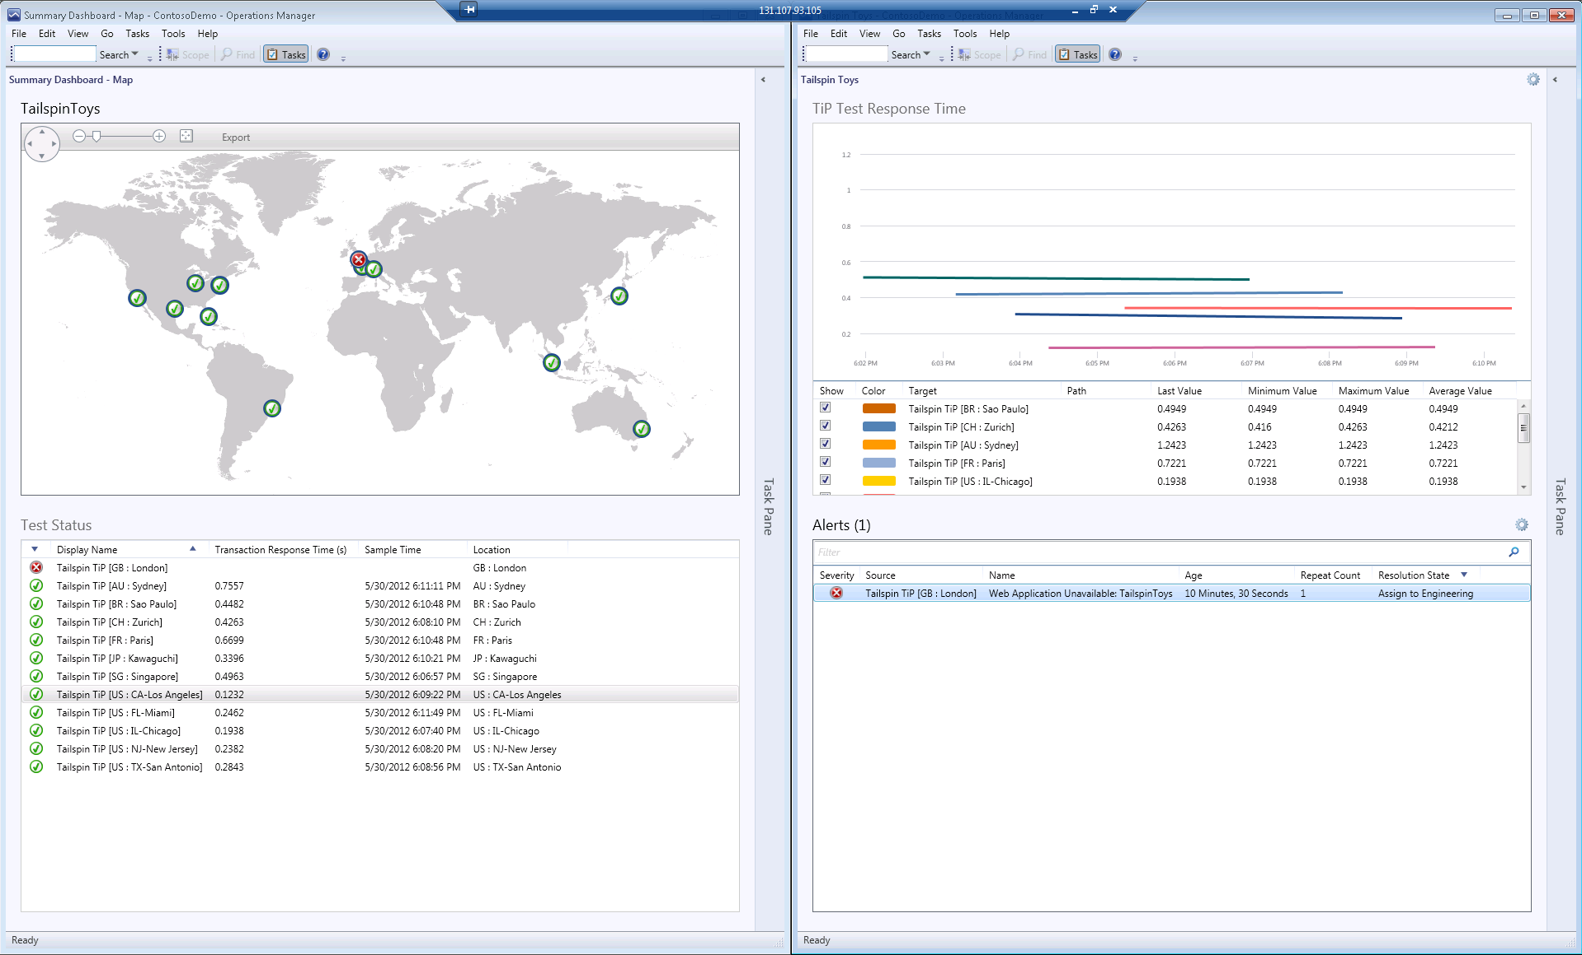
Global Service Monitor
Response Times
Points of Presence
Alerts
Test Status
Notes:
This screen shot shows you a view of the Global Service Monitor as seen from the console, as you can see here these are the various points of presence in the world where your application is being targeted and as you can see here that for the target access for London there seems to be a problem for this particular application. And then from a customer standpoint you can dig in deeper as to why the particular access from London does not happen to be working for that application. So this makes it really easy for you as application owners to get an all up view about how your application is performing from a customer standpoint in your data centers.

Slide 16
Your Cloud
Notes:
Now let’s talk a little bit about the cloud and the cloud is all about providing self service experiences to your customers.

Slide 17
Multi-Tenant Isolation
Tenant A
Tenant B
Tenant A Users
Tenant A Admin
Tenant B Users
Tenant B Admin
Tenant A Self-Service User Roles
VM Networks, Templates, VHDs, Allowed Actions
Tenant A
Tenant Admin User Role
Tenant B Self-Service User Roles
VM Networks, Templates, VHDs, Allowed Actions
Tenant B
Tenant Admin User Role
Tenant A Production (Quota)
Tenant A Dev (Quota)
Tenant A Test (Quota)
Tenant B Production (Quota)
Tenant B Dev (Quota)
Tenant B Test (Quota)
Service Provider
SERVICE PROVIDER FOUNDATION
SPF Database
REST API
AUTHENTICATION & AUTHORIZATION
AGGREGATION, TENANT MANAGEMENT, STAMP MANAGEMENT
RESOURCES, ACTIONS
ORCHESTRATION & PROCESS
Stamps
Tenants
User Roles
Production Cloud
Gold Cloud
Dev Cloud
Test Cloud
European Cloud
Synced User Roles
Synced User Roles
Synced User Roles
VMM 1
VMM 2
VMM3
Notes:
Today we are seeing a lot of customers not only on the infrastructure that they are developing inside the datacenters but are relying more and more on service providers and hosters to provide them this capacity as needed. In System Center 2012 SP1 we have made significant enhancements in investments so that service providers and hosters can use the capabilities that we provided as a part of System Center 2012 and System Center 2012 SP1 and using shared infrastructure provide isolated environment Service Provider Foundation provides a REST based API over one or more virtual machine manager servers and provides customers with the ability to access their capacity across these multiple VMM servers using a REST interface. You can have multiple tenants, tenant A and tenant B in this case who can access their capacity which may be sitting on shared infrastructure on VMM but are isolated from the perspective of each of these tenants.

Slide 18
Hybrid Cloud
Enterprise Customer
App Controller
Public Cloud
(Windows Azure)
Private Cloud
Service
Provider Cloud
Notes:
So you’ll see here that an enterprise customer using App Controller can manage their capacity on the private cloud, manage their capacity on the Service Provider Cloud as well as manage any capacity that they may have acquired from a public cloud.

Slide 19
What is App Controller?
System Center component
Self Service for application administrators
Application focus
Manage applications not resources
Public and private clouds
Virtual Machine Manager
Service providers (SP1)
Windows Azure subscriptions
Notes:
So what is App Controller? So it is a System Center component so if you have System Center that means you do own App Controller so it’s a self service for application administrators and they basically can manager their virtual machines and services whether it’s in public or private cloud and both basically service providers and virtual and the on premise powered by windows Server 2012 and System Center Virtual Machine Manager and of course then also in the public cloud domain with Windows Azure so you should be able to manage resources on this.

Slide 20
Managing Services in Multiple Clouds
System Center 2012 - App Controller
Private
Private
Public
Public
On Premises
Service Provider Foundation
Windows Azure
Virtual Machine Manager
Virtual Machine Manager
Hyper-V
VMware
Xen
Hyper-V
VMware
Xen
Notes:
Now let’s look at the kind of the high level view of the App Controller so you can think about more from the perspective of how it sits is basically you have your on premise systems basically with Windows Server 2012 you have Virtual Machine Manger running on top and on your hoster environment you have a service provider foundation which runs on top of Virtual Machine Manager. And in your public environment you can think of Windows Azure and some of you may be familiar with Amazon but in this case it’s Windows Azure all of these have, so the on premise as well as the hosters would have what we call different hyper visor support. So we support Hyper-V, we support VMWare, we support Xen, those are the hyper visors we support. Now, on top of these systems basically, typically you have different clouds that are there and then different services and VMs that are part of these clouds within these connections. And System Center App Controller what it does is give you a single pane of view on top of these systems. And actually we’ll go into these systems right now and see how you can actually see all these systems and in one pane of glass.

Slide 21
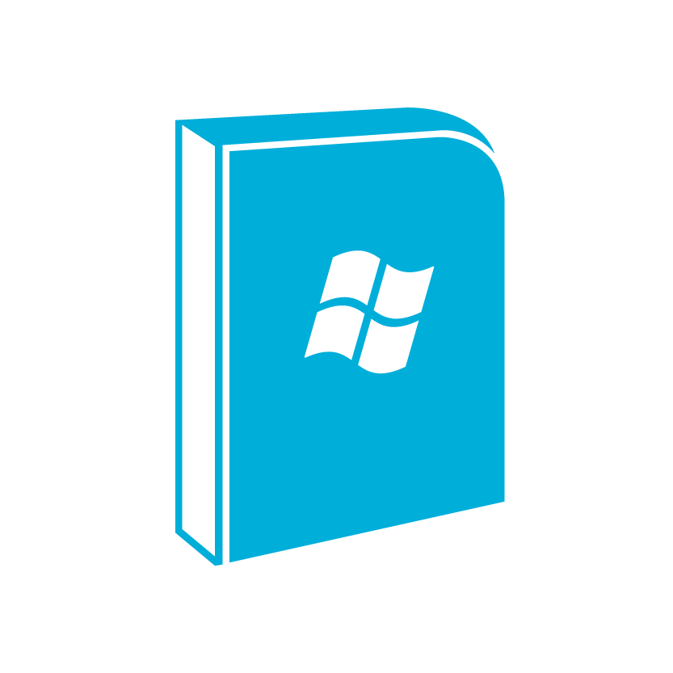
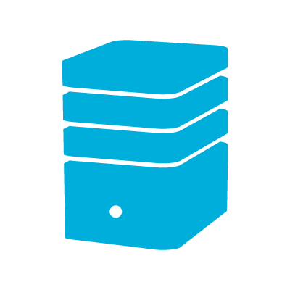
System Requirements
Windows Server 2008 R2 x64
VMM Console
1 GB
.NET 4.0
IIS 7
SQL Server 2008 SP2 / R2 SP1
Dual Core 2.8 GHz
4 GB RAM
Notes:
The System Requirements for App Controller are very minimal so basically you can support Windows Server 2008 R2 or 2012 only one gig of storage and 4 gig of RAM and then we also need SQL Server 2008 SP2 SP1 or 2012, very minimal footprint for App Controller that you can get it up and running very quickly.

Slide 22
Connect To Clouds
Virtual Machine Manager
Administrator for App Controller and VMM
Two way trust between App Controller Server and VMM Server
Hosting provider (SP1)
Management certificate
Service endpoint URL
Windows Azure
Management certificate
Subscription ID
Notes:
Now, you saw all these clouds right, I think then you might be also thinking is how hard is it to connect to these clouds, you know basically we connect to three types of connections you can think about, the cloud to complete connection, one is VMM, the Virtual Machine Manager, here basically the requirement is you need to be able to be the administrator for the VMM, so basically when you connect to the VMM and the cloud there is a two way trust between the App Controller Server and the VMM Server. And when you want to connect to a service provider all you need is a management certificate and service endpoint URL and I’ll show you exactly what that means. And for when you want to connect to Windows Azure all you need is a management certificate and a subscription ID that you’re going to manage.

Slide 23
Control Access to Clouds
VMM
Manage access with VMM Console
Hosting Provider
Manage in App Controller
Use Active Directory users/groups
Windows Azure
Manage in App Controller
Use Active Directory users/groups
Notes:
So now, let’s look at it, once you connect to these clouds, right, you definitely want to give control access to what, and that’s very important, again putting that again in a single pane of glass is also very, very helpful, because now you don’t have to go to three different systems to provide access. Once you have set up these systems appropriately you can control the access on who gets what from App Controller. So for the VMM, for the on premise one we will honor the access, we will basically get the user roles defined on the VMM Virtual Machine Manager on premise, we will just get that into App Controller and honor that completely.
For the hosting provider basically once the host service provider has set you up as a tenant and they will provide you a tenant access and with the tenant access you set up the roles at the hosting provider and then we pull those roles into App Controller so that you can now use your Active Directory groups or user groups within App Controller to actually use that to control access to the clouds and virtual machines that are there at the hosting provider and I’ll show you exactly how we do that and it’s very simple to do that.
Similar with Azure as you know with Azure right now if you log in with a Azure live ID or basically Windows Live ID and you cannot control access to azure, but with App Controller, now what you can do with the subscription that you provide you can provide access to the App Controller using your normal Active Directory user groups that you use day to day that you provide your access to the other resources.

Slide 24
Deploy and Operate
Deployment
Common experience across public and private clouds
Windows Azure virtual machine (SP1)
Operations
Start, stop, scale, remote desktop
Save, resume, shutdown, checkpoint, console, store
Upgrade
Notes:
So now that we are connected to the clouds you have controlled access, you have given access to the folks who need access to, so basically appropriate access now, once you get access you need to do stuff with it, right, you need to deploy virtual machines, you need to deploy services or you need to start and stop services, scale services, remote desktop into some of these virtual machines, you know provide check points, upgrade the services, so you can do all these various operations wouldn’t it be great to have this common experience across these clouds, so you don’t have to worry about how to do it in Azure, or how to do it in a service provider environment or how to do it in VMM environment, App Controller gives you that, one single experience that you can have across these different clouds.

Slide 25
Deploy and Operate
Deployment
Common experience across public and private clouds
Windows Azure virtual machine (SP1)
Operations
Start, stop, scale, remote desktop
Save, resume, shutdown, checkpoint, console, store
Upgrade
Migration (SP1)
VMM to Windows Azure
Notes:
Okay, in addition we’ll also show you how to actually migrate your virtual machines to Windows Azure basically you can copy your virtual machine, the reason I say copy is because it doesn’t actually delete the machine from the VMM so it actually copies the virtual machine that you have on premise into the public cloud and very easy with a click.

Slide 26
Azure VM
Move
Manage
Monitor
App Controller
Library
App Controller
Orchestrator
App Controller
Operations Manager
On-Premise
Azure IP
Azure MP
Windows Azure
Notes:
In this slide I want to show you how easy it is to use System Center 2012 SP1 to take virtual machines that are running on premise and move them to Windows Azure. Using the App Controller component you can actually save to the library a virtual machine that’s running and then using App Controller you can actually take the virtual machine that’s been stored in the library and then move it to Windows Azure. We will do our best attempt to actually fit the VM according the capabilities that exist for Windows Azure VM role, if not we allow you as a customer to modify the settings of the virtual machine as it is moved to Windows Azure.
We also allow the use of Orchestrator and it’s Azure IP to automate tasks against Windows Azure.
And from a monitoring perspective we support or rather System Center SP1 Operations Manager allows you to monitor the virtual machine that is now running inside the data center.

Slide 27
SP1 Features
Partner Extensibility
Protect WS2012 Dedupe volume
Deploy, upgrade, uninistall Unix/Linux hosts
Protect Hyper-V over CSV 2
Service Provider Foundation API
Updated System Center Integration Packs
Protect Hyper-V over remote SMB
Broader Server App-V App Compatibility
Additional Language Support
CentOS
Debian
Ubuntu
Oracle Linux
Move VHD from VMM library to Azure
Deploy Azure VM
Monitor Unix/Linux hosts
IIS App Host
Logical Switch Support
Hyper-V VMs using SMB 3.0
Latest XenServer and vSphere support
Enhanced VMM user role for multi-tenancy
Parallel backup
Migrate VMM VM to Azure VM
Add/Remove Azure VHD to Disks or Images
Console, Powershell on Win7 SP1
Live VM and Storage Migration
Monitor Java Application Servers
Global Service Monitor
Create and Manage Hyper-V Virtualized Networks
Manage and Deploy Hyper-V Switch
Backup Performance
Create VMs using VHDx format
Cross Cluster/Shared nothing migration
Showback / Chargeback
Deploy VMM services in DMZ environment
Manage large scale Hyper-V Clusters
Notes:
As you’ve seen in the last few minutes I’ve given you a brief glimpse of some of the capabilities that exist in System Center 2012 SP1 enabling our customers or partners and customers to be able to build clouds using Windows Server 2012 and the capabilities in System Center 2012 SP1. However that’s a very short glimpse of all the features and this slide tries to at a high level show you all the additional capabilities that are coming as a part of Windows Server 2012 as well as System Center 2012 SP1.
One thing that I’d like to point out here is that we have enhanced the capability of what you can do for Linux virtual machines using Virtual Machine Manager as well. So at a high level I’d like to sort of help customers understand that the SP1 for System Center 2012 contains a large number of features across the spectrum from monitoring to fabric management to Orchestration, to process management which allow customers to manage and deploy their infrastructure and applications using System Center 2012 SP1 and Windows Server 2012.
So with this hopefully I’ve been able to provide you as a brief glimpse into all the capabilities that exist in Windows Server 2012 SP1.

Slide 28
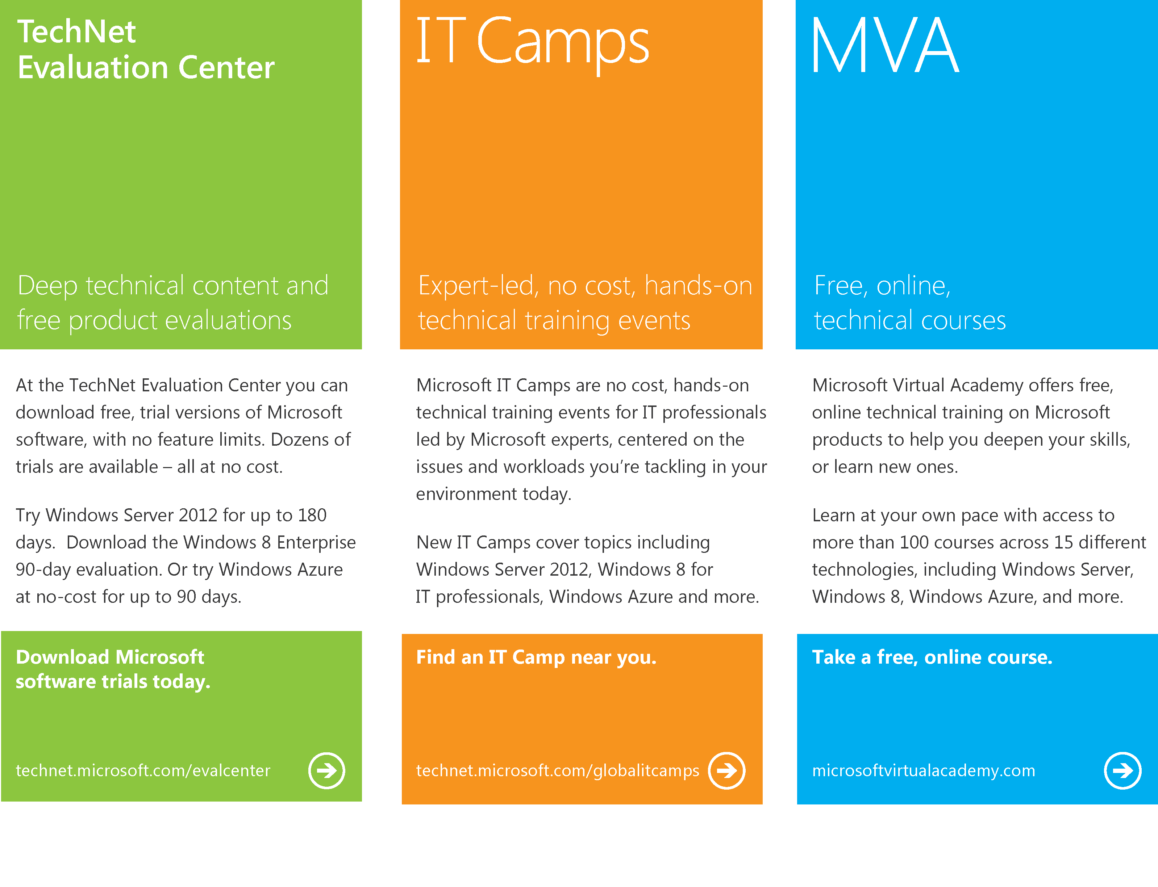
Notes:
And for additional capabilities, please provide feedback to our TechNet evaluation center and you will be able to look at additional sessions that have been developed using the Microsoft Virtual Academy.

Slide 29
© 2012 Microsoft Corporation. All rights reserved. Microsoft, Windows, Windows Vista and other product names are or may be registered trademarks and/or trademarks in the U.S. and/or other countries.
The information herein is for informational purposes only and represents the current view of Microsoft Corporation as of the date of this presentation. Because Microsoft must respond to changing market conditions, it should not be interpreted to be a commitment on the part of Microsoft, and Microsoft cannot guarantee the accuracy of any information provided after the date of this presentation. MICROSOFT MAKES NO WARRANTIES, EXPRESS, IMPLIED OR STATUTORY, AS TO THE INFORMATION IN THIS PRESENTATION.
Notes:
Thank you so much for your time and we really hope you enjoy using System Center 2012 SP1 as much as we have enjoyed developing it.
Thank you.

