Slide 1
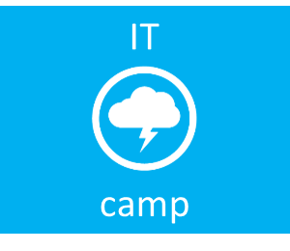
Windows Server 2012 with Hyper-V +++
Virtualization
Cloud
System Center
Management
Infrastructure
Security
Dan Stolts, MCT, MCSA, MCITP, MCSE…
http://ITProGuru.com
http://blogs.technet.com/DanStolts
@itproguru
CT, MA, ME, NH, VT, NY (upstate)
More Jobs ☺
Owner - Bay State Integrated Technology, Inc. (www.BayStateTechnology.com)
President - Boston User Groups (www.BostonUserGroups.org)
Cubmaster – Cub Scouts Pack 14, Lakeville, MA {LakevillePack14.com)
Founder/Chairman - Virtualization Group Boston (www.VirtG.com)
@ITProGuru

Slide 2
Download Process Walkthrough
Windows 2012
Hyper-V Server 2012
System Center 2012
System Center 2012 SP1
Infrastructure As A Service
Windows 8
ITProGuru.com
This Slide Deck http://ITProGuru.com/resources
1.
Go to Download Link
2.
See the Download page
3.
Enter or Establish your Live ID
4.
Download Manager
Begins – then cancel for Credit

Slide 3
Server virtualization
Complete virtualization platform
Increased scalability and performance
Elastic and flexible—from the datacenter to the cloud
TOP FEATURES OF SERVER VIRTUALIZATION TO MEET CUSTOMER CHALLENGES
Hyper-V Network Virtualization
Shared-nothing live migration
Massive scale
Cluster enhancements
Hyper-V Replica
1
2
3
4
5
Hardware offloading
Virtual Fibre Channel
Guest NUMA support
Runtime memory configuration
Hyper-V network switch
6
7
8
9
10

Slide 4
Hyper-V Expanded Processor & Memory Support
System | Resource | Maximum Number |  | Improvement Factor
 |  | Windows Server 2008 R2 | Windows Server 2012
Host | Logical processors on hardware | 64 | 320 | 5x
 | Physical Memory | 1 TB | 4 TB | 4x
 | Virtual processors per host | 512 | 2,048 | 4x
Virtual Machine | Virtual processors per virtual machine | 4 | 64 | 16x
 | Memory per virtual machine | 64 GB | 1 TB | 16x
 | Active virtual machines per server | 384 | 1,024 | 2.7x
Cluster | Nodes | 16 | 64 | 4x
 | Virtual machines | 1,000 | 8,000 | 8x

Slide 5
What is Hyper-V Replica?
A virtual machine level replication solution which efficiently replicates data over a LAN/WAN to a remote (Replica) site without relying on software or hardware technologies outside of the Windows Server 2012 operating system
New in Windows Server 2012 Hyper-V Role
Storage and Workload agnostic
Replica Servers can be standalone or a Failover Cluster
Servers can be members of a workgroup or a domain (same or different); Primary and Replica servers do not need to be in the same domain unless part of a Failover Cluster
Managed locally (Hyper-V Manager) or remotely (Hyper-V Remote Server Administration Tools (RSAT) or System Center Virtual Machine Manager (SCVMM)
4 Deployment Scenarios
Head Office and Branch Office (HO-BO)
Enterprise Datacenter
Hosting Provider Datacenter
Customer Office and Hosting Provider Datacenter (Cross-Premise)

Slide 6
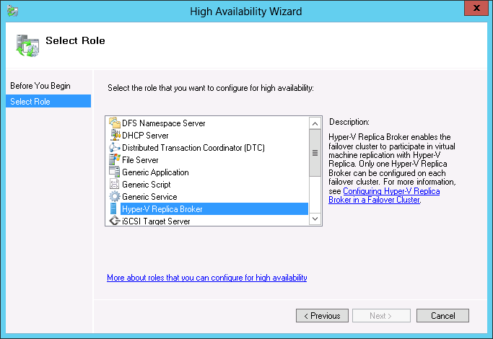
Hyper-V Replica & Failover Clustering
Failover Clusters can participate in replication, but only as a single replication server.
Failover Clusters have a new clustered role, the Hyper-V Replica Broker
Highly-Available role that moves between nodes
One instance per cluster
Changes traditional Hyper-V multi-site (disaster recovery) Failover Clustering. Previously replication across sites was done between nodes within a single cluster.
Primary and Replica servers do not need to be in the same domain unless part of a Failover Cluster
Replication Scenarios
Cluster to Cluster
Cluster to Standalone
Standalone to Cluster
Standalone to Standalone

Slide 7
Hyper-V over SMB
Server Message Block (SMB) protocol…
Is a network file sharing protocol that allows applications on a computer to read and write to files and to request services from server programs in a computer network
Windows Server 2012 introduces the new 3.0 version of the SMB protocol
With Windows Server 2012, Hyper-V…
Can store virtual machine files (configuration, VHD, snapshots) in files shares over the SMB 3.0 protocol
Is supported for both stand-alone and clustered servers that use Hyper-V with shared file storage for the cluster
Can support scale-out file shares and clusters
Can leverage SMB Multi-Channel

Slide 8
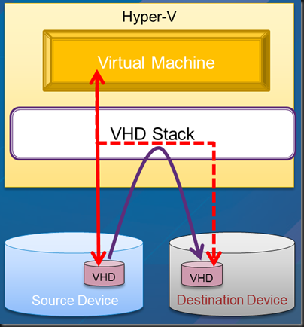
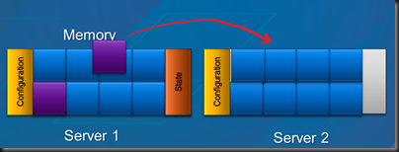
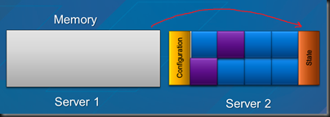
Live Migration – Moving a Running VM without Shared Storage
Live Migration setup occurs
Memory pages are transferred from the source server to the destination server
Modified pages are transferred to destination server
State is transferred to destination server
VM brought online on destination server
Network cleanup occurs
standard Ethernet connection

Slide 9
Windows Server 2012 Hyper-V Scalability Improvements
Expanded processor and memory support
Virtual Non-Uniform Memory Access (NUMA)
Network Adapter Hardware Acceleration
Offload Data Transfer (ODX)
Support for 4 KB sector disks
Virtual Fibre Channel
SMB 3.0
Improved VM Import
VHDX disk format

Slide 10
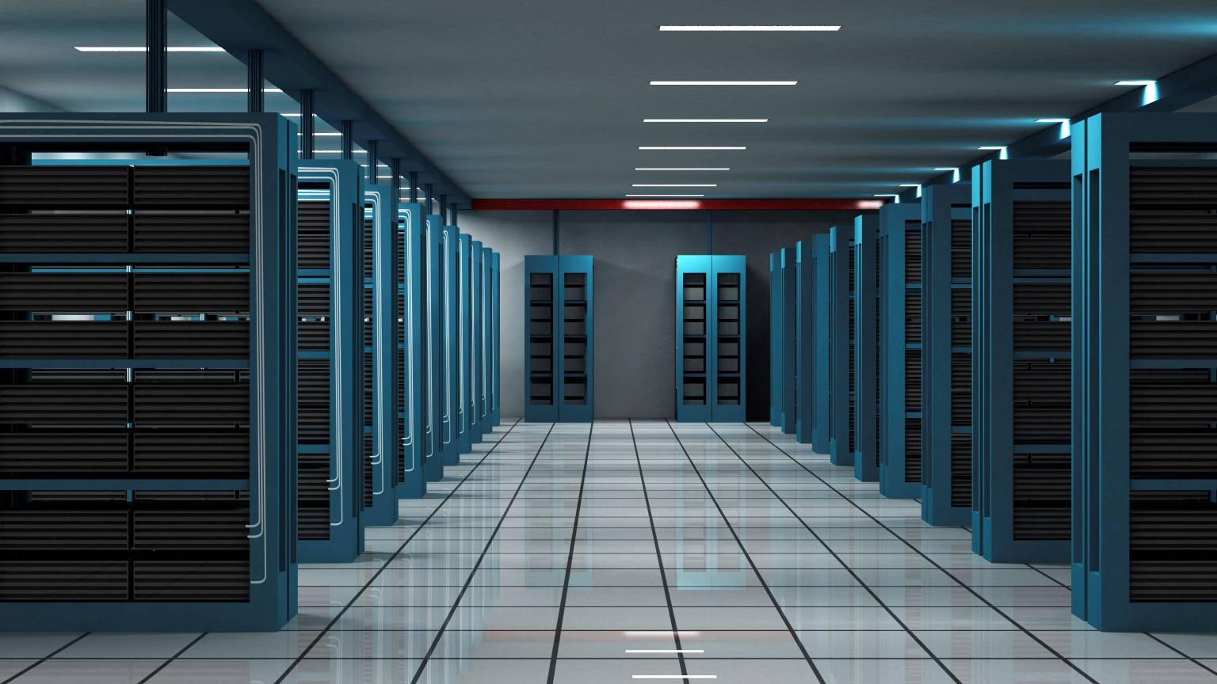
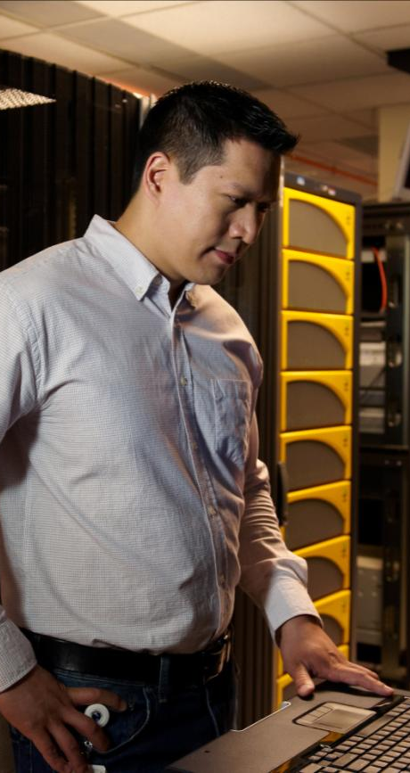
Comparison
System | Resource | Windows Server 2012 RC Hyper-V | VMware ESXi 5.0 | VMware vSphere 5.0 Enterprise Plus
Host | Logical Processors | 320 | 160 | 160
 | Physical Memory | 4TB | 32GB¹ | 2TB
 | Virtual CPUs per Host | 2,048 | 2,048 | 2,048
VM | Virtual CPUs per VM | 64 | 8 | 32²
 | Memory per VM | 1TB | 32GB¹ | 1TB
 | Active VMs per Host | 1,024 | 512 | 512
 | Guest NUMA | Yes | Yes | Yes
Cluster | Maximum Nodes | 64 | N/A³ | 32
 | Maximum VMs | 4,000 | N/A³ | 3,000
VMware ESXi 5.0 is a free download yet has the following restrictions:
Host physical memory is capped at 32GB thus maximum VM memory is also restricted to 32GB usage.
vSphere 5.0 Enterprise Plus is the only edition that supports 32 vCPUs. All others support 8 vCPUs within a virtual machine.
For clustering/high availability, customers must purchase vSphere

Slide 11
Storage
Efficiency, performance, and innovation through diverse storage choices
Continuous availability through new features that preserve uptime
Cost efficiency through storage, management, and other capabilities
TOP FEATURES OF STORAGE TO MEET CUSTOMER CHALLENGES
Storage spaces
File system improvements
Thin provisioning
Cluster Shared Volume
SMB 3.0 for workloads
1
2
3
4
5
Offloaded data transfer
Transparent failover
NFS support
iSCSI target
Storage management
6
7
8
9
10

Slide 12
VHDX Disk Format
New default .VHDX format for VHDs in Hyper-V in Windows Server 2012
Supports virtual disks up to 64 TB
Aligns to megabyte boundaries to support large sector disks (4 KB sector disks)
Uses large block sizes to provide better performance
Includes a new log to protect from corruption due to power failure
Has much greater resiliency
Allows for embedded custom user-defined metadata into VHDX files

Slide 13
Storage Spaces & Thin Provisioning?
Storage Spaces
New in Windows Server 2012
Provides an in-box storage virtualization that can use low-cost commodity storage devices
Aggregates unallocated space on physical disks installed in or connected to servers through a “pooling” model
Can provide a cost-effective platform for business critical storage across a variety of scenarios
Thin Provisioning
“Just-in-Time” allocations of storage with the ability to reclaim storage (“Trim”)
Integrated with Storage Spaces

Slide 14
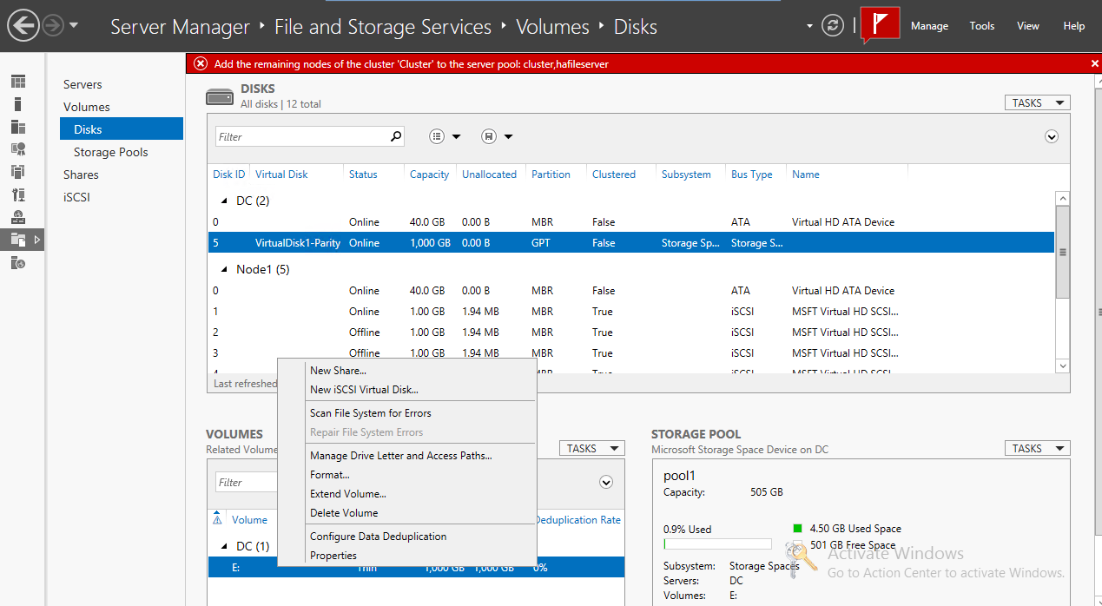
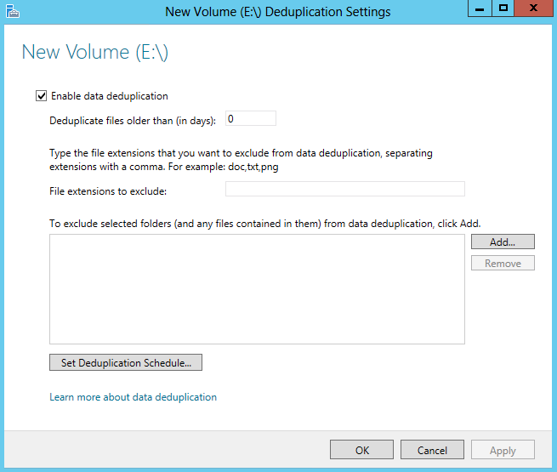
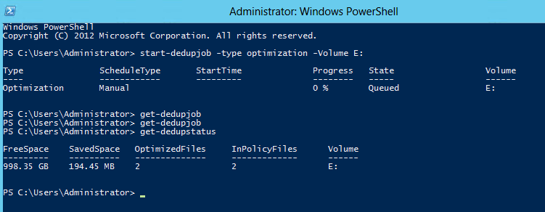
Deduplication
Capacity Optimization
Scale and Performance
Reliability and Data Integrity
Start-DedupJob –type optimization –Volume E:
Enable & Configure Deduplication on volume
Saved Space

Slide 15
Hyper-V Over SMB Workflow
Install the Hyper-V role on a Windows Server 2012 machine
Install the File Services role on a Windows Server 2012 machine
Create an SMB file share
Create a virtual machine and virtual machine hard disk on the file share
Migrate existing virtual machine storage to the file share

Slide 16
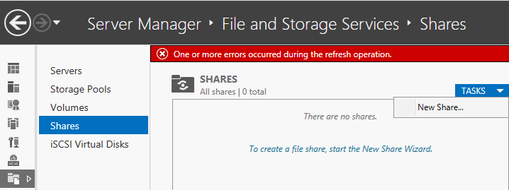
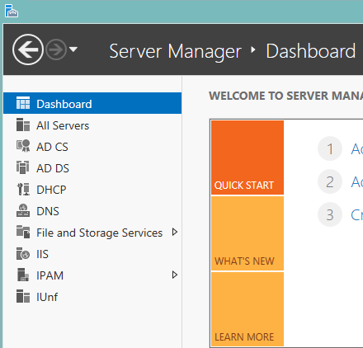
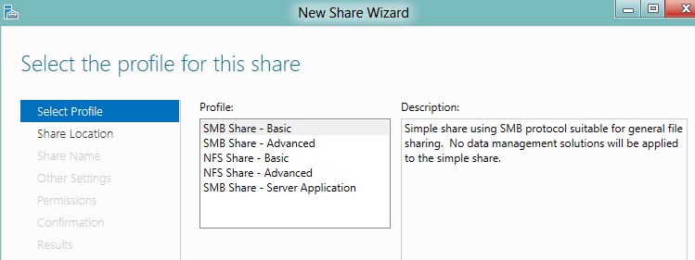
Creating an SMB Share
From Server Manager:
Log on or connect to a Windows Server 2012 computer on which the File and Storage role is installed. Open Server Manager and navigate to File and Storage Services
In Server Manager, start the New Share Wizard
2
1
With PowerShell:
# Create folder MD X:\VMS # Create file share New-SmbShare -Name VMS1
-Path X:\VMS -FullAccess Domain\HVAdmin, Domain\HV1$, Domain\HV2$, Domain\HVC$ # Set NTFS permissions from the file share permissions (Get-SmbShare VMS1).PresetPathAcl | Set-Acl

Slide 17
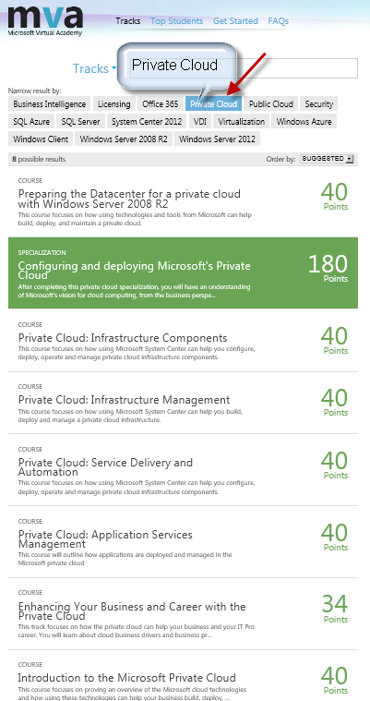
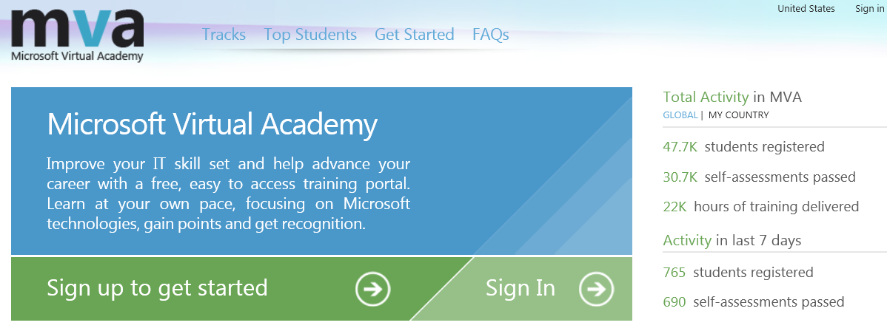
Microsoft Virtual Academy (MVA) http://AKA.MS/GuruMVA Free Online Training
Then Private Cloud

Slide 18
Dan Stolts
Chief Technology Strategist
dstolts@microsoft.com
http://ItProGuru.com
Bob Familiar, my manager, would love your feedback on today’s event.
He wants to know what impact todays event has on you and your business
You can e-mail him at: Bob.Familiar@microsoft.com
Notes:
18

Slide 19
Call To Action
@ITProGuru
Follow Blog ITProGuru.com
Microsoft Virtual Academy: aka.ms/gurumva
Aka.ms/GuruMVA
DOWNLOAD Windows Server 2012 Release Candidate
Aka.ms/getwin2012
DOWNLOAD Microsoft System Center 2012 Evaluation
Aka.ms/getsc2012
Download and Start working with Windows Server 2012 and Hyper-V
Certification
Play with & Learn About Infrastructure As A Service
Microsoft Virtual Academy http://aka.ms/guruMVA

Slide 20
© 2012 Microsoft Corporation. All rights reserved. Microsoft, Windows, Windows Vista and other product names are or may be registered trademarks and/or trademarks in the U.S. and/or other countries.
The information herein is for informational purposes only and represents the current view of Microsoft Corporation as of the date of this presentation. Because Microsoft must respond to changing market conditions, it should not be interpreted to be a commitment on the part of Microsoft, and Microsoft cannot guarantee the accuracy of any information provided after the date of this presentation. MICROSOFT MAKES NO WARRANTIES, EXPRESS, IMPLIED OR STATUTORY, AS TO THE INFORMATION IN THIS PRESENTATION.

