Slide 1
How To…
- Blog for Reach and Influence
- 25,000++ Unique Visitors/Month This FY
@ITProGuru
DanStolts
Cloud
Virtualization
System Center
Management
Infrastructure
Dan Stolts, MCT, MCSA, MCITP, …
CT, MA, ME, NH, VT, NY (upstate)
IT Pro Chief Technology Strategist
Microsoft Corporation
ITProGuru.com
DanStolts

Slide 2
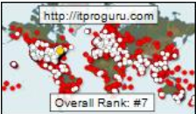

Objectives: How To Deliver RESULTS!
- Understanding Competing Objectives
Action
Incredible Reach
----- VS -----
Scorecard Metrics
Ranking
Give Customers WHAT THEY WANT!
  Go To Them & Inspire Action
Reach – Get The Word Out – Broadly
  SEO – Search Engine Optimization
  Syndication - Broad Distribution (Think Download Links)
  Build Online Persona (Think Ranking/Metrics)
Influence – Onalytica Numbers
  Smart Syndication – Be Smart OR ELSE!
Blogging Limited Capacity – Invest & Optimize Investment
  Relationships – BG, TechNet, MSDN, Influencers, Partners
  Mega Audience – Not just one or two topics
Give
2,000>10,000 in 3 mths
10,000>25,000+ in 9 mths
*Even more is possible
Super Star Status
THIS FY
Reach
Influence

Slide 3
Give Customers WHAT THEY WANT!
Do This or Nothing Else Matters
Deep Technical Content
How To… Step By Step… Video’s
Solve Problems / Complete Solutions / Detailed & Concise
Frequent, Timely, Relevant Information
Bugs & Annoyances, Tips, Tricks, Hints, Secrets
Easy to Find – What will they type in Bing/Google?
Cross Link
Free Stuff
Books
Posters
Training
Answers
Downloads ☺
Information… Where They Want It!
GO TO THEM
Inspire Action
Syndication
Promote Influencers Blogs, Events
Give Others Influence ☺
Reader Questions & Comments
Easy For Them To Syndicate
Cross Post Self and Others

Slide 4
Content That Inspires Action
Without Great Content; You have Nothing
What specific actions do I want to inspire?
  Read my content!
  Download our products!
  Achieve certification!
  Tell their friends!
What does your audience want to do?
  Solve problems!
  Learn quickly!
  Save time!
  Achieve certification!
Ideas: Tie them together …
  Questions at Events
  What do you want to learn about?
  Session Content
  Endless ideas… Use Forum Questions for post ideas ☺
  Thanks to Keith Mayer http://KeithMayer.com and Rachel Appel http://RachelAppel.com
Notes:
Thanks to Keith Mayer http://KeithMayer.com for this slide ☺
Post Ideas:
Write down questions from events you speak at, and look for recurring questions, problems or issues. People will also be searching online looking for the same answers to questions asked at events.
Take a topic from your talks and write about it
Write about something you want to learn
Time:
Make blogging part of your learning and presenting.
While you are creating presentation, makes your notes into fodder for blog posts
While learning a new technology, do the same with notes, code snippets and screen shots

Slide 5
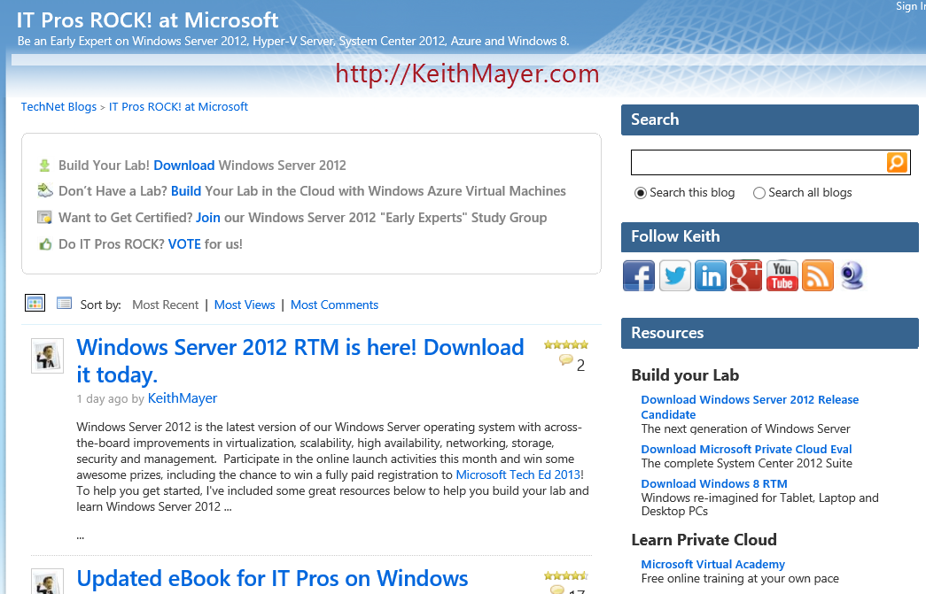
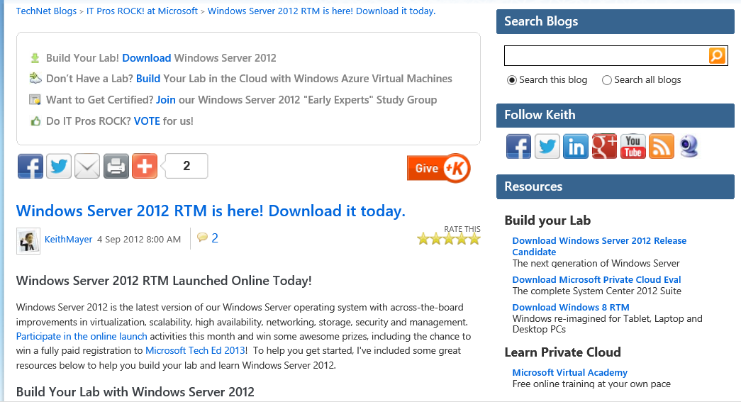
Inspire ACTION!!! - 1/3 visitors Act!

Slide 6

Blogging By The Numbers
Pick a relevant theme, topic and title for your blog and blog posts
  Purpose/Theme – What do you want to be known for? Develop a theme based on that purpose (personal, technology, mix)
  Topic of posts make a huge difference consider today and tomorrow/next year
  Longevity and popularity often determine relevance and ranking
  Use lots of keywords in the title
  Understand what you want – Make a plan
Help Yourself - Cross Post Everything!
Help Other People – Promote others and they will promote you!
Syndicate Cross post and participate on “popular” community sites
  Ulitzer, Petri, Technorati, others…
  Leverage, Don’t Just Copy!
High performance is a must Not everyone has a 20mb x 20mb fiber optic Internet connection. Shrink your pictures before posting, make sure your platform is robust and fast! (Hint: Blogs.TechNet is not known for these traits)
Content really is key
  Audience Value: It should be detailed enough to have value; Full audience, not just one topic
  Keywords more keywords & error codes, what will your audience likely type in google/bing?
  Tell a complete story or completely solve a problem; Don’t assume anything
  Increase the depth of your posts (new technology overview ok)
  Be as concise as possible; but detailed
  Visual appearance does make a difference You got’em there now keep them coming back, if it looks like a marketing site, they won’t come back!
  Don’t stop, consistency counts a post a week minimum, 3 a week is better
Video’s Rock ☺ and can get you pretty incredible numbers – Include transcript or detailed summary of all video’s (so search can find them; see video samples) Also, leverage Technet/Edge for publicity. 10-20 mins max
Other marketing mechanisms to spread the word posts you are particularly proud of use other outlets to spread the word
Choose a good URL / Permalink Structure
Getting Started creating and improving your blog…Just Do It! Start Small, Start Now!
Read This Slide NOTES!!!
Yellow = most important!
Notes:
1) Pick a Theme – Figure out the purpose of your blog and develop a theme based on that purpose. If you are going to be blogging more about personal activities than technical posts you would not want to use a name/theme like “Nothing but Technology” or “All Things Technology”. A more appropriate theme might be “Technology Tips and Random Comments from Dan Stolts”.
Topic of posts make a huge difference. Make sure the topic you choose for a post is of interest to an audience today and tomorrow.
Longevity and popularity often determine relevance. If you want to get really good numbers over time, choose topics that do not expire. When you pick a title, use key words that are likely to be typed into a search engine on the topic. Don’t be bashful, and do not think you need to keep it simple. If you do a long detailed blog post on an event that is going to happen next week (or happened last week) your audience for that content is limited. As time passes the value of that content also declines rapidly. To use a technology example, for me to spend a bunch of time to create a detailed post on Windows XP or Windows Vista would be a waste of time as it is old news. A topic that is of great interest today like “Increasing Productivity by Deploying Windows 7 Phone in Your Company” or “Windows 8 – You have to see the next version of Windows!” are much better topics. There are many reasons whey they are better.
The topic will be of interest for a long time (it will not be old information in a week).
It has several terms that will likely be used when someone is looking for content
It is appealing to a very large audience
Use keywords in the title: The more key words you can use in the title, the higher probability your post will be picked up on a search engine. Don’t make it too complicated but make it relevant.
2) Help Yourself!
When you make a post, cross promote other posts that might be of interest to others that are reading this post. People may have found this particular post from a search engine or someone sending them a link to it directly. If you are doing a post on “How to protect SharePoint with System Center Operations Manager” and you have already done a post on “How to Install System Center Operations Manager Step By Step” make sure you add a cross link to your prior post. Also go back to your prior post and add a link to your new post. Cross promote your own site where possible (and appropriate)
3) If you help enough people get what they want, you will get what you want!
Develop a relationship with other bloggers and influencers. Look for people that blog about topics that are of interest to your audience and watch them. When you create posts, add links to others posts that might be of interest to people that are reading your post. For example: if you are doing a post on “Planning for Office 2010 and SharePoint 2010” and there is another expert that has a post on Business Intelligence (BI) in SharePoint 2010, do a cross post. That is, add a link to the bottom of your post to link to their post. Don’t be bashful, let them know that you posted a link from your post to theirs. Eventually, they will start posting links to your site as well. It is also ok to develop an “agreement” with other specialist to coordinate posts to help each other cross promote. BTW, anybody want to cross post with me? Send me a note at http://blogs.technet.com/b/danstolts/contact.aspx.
4) Cross post and participate on “popular” community sites
There are many public and social sites that want the community to be active. Take advantage of this and post your content to these sites. Some like to post a “preview” of the real post and then provide a link to the entire post. Some sites do not allow previews so make sure you understand the rules. If you do a preview, I recommend you make the preview post a complete and relevant post. It is fine to have your real blog post more detailed but you might upset people if you put a “to be continued” type of post online. It may also get you kicked off the site so be careful and considerate. Also, be active on other community sites. Don’t just make reposts of your content, answer questions and become active on other sites. As people that are on these sites start to recognize you, they will start watching your blog. This could actually make your blog posts go viral so be smart and do not ignore this one! When you repost though, do it smartly. Don’t just copy and paste the content. Give them a teaser on the syndicated site that points back to your blog so you get full credit for the content.
5) High performance is a must.
Not everyone has a 20mb x 20mb fiber optic Internet connection. Make sure that the server you are using to host your blog is responsive. Also, make sure you are not showing so many posts on your home page that it takes too long to load. There are other things to consider when it comes to the server like order your content is displayed, search capabilities, appearance, and many, many more. These are beyond the scope of this post. Setting Up Your New Blog Using IIS 7 on Windows Server 2008 Easily With The Web Platform Installer
6) Content is key Content really is key. Just like the topic and title, the content must be relevant.
Audience Value: It should be detailed enough to have value to the person that is reading the post. Know your audience and know what they want to know. If you have multiple audiences, you may want to have multiple blogs. One blog for each audience is much better than having a blog that targets multiple audiences. If you have a bunch of information that is not relevant to a particular segment of your audience, they will be less likely to subscribe and follow. If you have a post that would be of interest to multiple audiences and you have separate blogs, make sure you post the content to all blogs where it is relevant. Make your content appealing to many audiences. Don’t just post on Virtualization, or any other ONE topic. Mix it up, do some PowerShell, SQL, SharePoint, Windows Server, Deployment, Windows Client, Cloud, Virtualization, Office, Phone, Etc, etc. The more people that find your blog relevant the better!
Keywords: It should include words that might be used to as search keywords. Using keywords multiple (or even many) times increases probability of being found by search engines. If there are particular “error codes” or “error descriptions” that are part of the post make sure you use those and get the text correct. Take some time to do it right.
Tell a complete story: If most (or all of your posts) tell a complete story or COMPLETELY solve a problem, the probability of others linking to your site or subscribing to an RSS feed are much higher.
Increase the depth of your posts. Introductory type posts simply do not get the numbers of deeper content posts. The exception to that rule is for new technology. Technology that is brand new (ie. Windows Phone 7, Internet Explorer 9) is an exception to the rule. Where possible, dive deeper and give people information they do not already have. Supply information that they cannot get somewhere else.
Understand what you want out of your blog. Make sure that you have a plan to get out of your blog what you want. You also need to make sure that your objectives do not conflict with what your audience wants. They must be complimentary.
Be as concise as possible. Do not make your audience read through a 3 page post when you really only have one or two messages to share. Make your post readable. Use bullets and bolding to make your posts easy to skim. Make sure you blog does not read like a book. If it is all long paragraphs of text, people will not spend the time to digest the content.
Visual appearance does make a difference. When people do end up on your blog you want to make sure it is appealing to them. Take advantage of fonts and colors to add appeal to the blog. Pictures, screenshots and logo’s are good but make sure they do not have a significant impact on performance. You also want to make sure that your site does not look too much like a “marketing” site with a bunch of advertisements.
Don’t stop, consistency counts: you need to have a regular cadence. Keep posting. At least a couple times a month is recommended.
7) Video’s Rock and can get you pretty incredible numbers
Video’s have been popular for a pretty long time now. With the economy being in such bad shape, they are even more popular. People are finding it difficult to get away from the office or to get the money to attend live events. They still need to keep up with technology so they turn to the web for this training. Create your video’s using your favorite screencast creation software and post them. Leverage TechNet.com/edge (see #8) Keep your video between 10-20 mins if possible. If you have much more information (like a deployment) break it up into multiple parts see SCOM Part 1 System Center Operations Manager Overview – Managing and Monitoring SharePoint 2010 using System Center Operations Manager 2007 R2
8) Take advantage of other marketing mechanisms to spread the word
Do NOT nag your followers. I do not want to do this for all of your posts but for posts you really want to try to spread or posts you are particularly proud of use other outlets to spread the word. Post a link on Twitter, Facebook and other social media sites. Send emails out to any groups you belong to. Send an email to friends and family (as long as it might be of interest to them) and ask them to help you promote it. Ask fellow bloggers if they would mind helping you promote it. Be careful here. Do not do this too often or you will loose the impact and ability to use this avenue.
9) Choose a good URL / Permalink Structure
The URL of your post is important. Use keywords and avoid characters (like space) that URL encode to multiple characters. I am not a fan of creating posts with words all jumbled up. It is much better to add an underscore character instead of a space. The primary reason for this is it makes it more readable. If you have a bunch of %20′s in your URL it will be hard to read what the post is about if you are looking at just the URL. Often URL’s are forwarded so you want them to be readable. Many blog platforms will automatically generate the URL based on the title. The way around this is just create the post with the words (and underscores) that you want in the URL then go back after the post and change the title if you like to add the spaces or change the words as needed.
10) Getting Started creating and improving your blog…Just Do It!
If you are just getting started creating a blog just do it! If you are uncomfortable getting started. Just start slow with small posts. Instead of doing a 10 steps to success with something do something really small. Perhaps a topic like “Windows 7 Snipping Tool Rocks” how to use this little tool with a screenshot or two can be done in 5 or 10 mins and can build your confidence to continue on. The more you do it the easier it will get. There is no substitute for experience. Another thing you might want to do is look at other bloggers to see how they started. Most blogs have a list of posts by month. Navigate to the first month of their blog to see what they did. This will give you some ideas of how you might get started.
I have found some success in applying these tips and techniques. Be there no mistake about it, I still have a long way to go. I would really like to see 100 times more traffic on my site. However, I can tell you I have found success deploying these techniques and this year I experienced 400% growth in my online reach over the same period last year. Additionally, I have had much feedback from customers thanking me for “saving their butt” by showing them how to solve a big problem they had. One last point… No better time than the present to get started. If you are starting your blog or just want to improve your blogs performance, you have to start. Put a stake in the ground and start building. Good luck!
Leveraged Blog Post: Scale Your Message Online Improving Blog Exposure and Increase Reach of Your Message by Driving Traffic to Your Content By Dan Stolts to create this presentation!

Slide 7
Samples…
Deploy Windows 7 The Easy Way: Using WDS, MDT and AIK - Step-By-Step Video {69,201 3/2010 VIDEO}
Migrate Windows XP to Windows 7 Using USMT (User State Migration Tool) [Upgrade XP or Vista] Step By Step {44,377 9/2009 VIDEO}
How To Install SQL 2008 R2 on Windows Server 2008 R2 SP1 For Use With SCVMM 2008 R2 SP1 {21,487 4/2011} Deep Technical
How to Install PowerShell on Windows Server 2003 and Enable Remote PowerShell Management–All Servers Should Have This Done {51,706 3/2011} Deep Technical
Using PowerShell to Get or Set NetworkAdapterConfiguration-View and Change Network Settings Including DHCP, DNS, IP Address and More (Dynamic AND Static) Step-By-Step {14,269 1/2012} Deep Technical
Part 1 – Build a Windows Server 2008 R2 SP1 Cloud Foundation Test Lab in Less Than an Hour (includes sysprep images) {Series}
How To Modify Timeout, Change Default or Delete Boot Menu Item From Windows 7 or Later Using MSConfig To Modify Boot Configuration Data {Simple}
How To Turn On or Off AutoPlay Features in Windows 7–Change What Programs and Media Are Used In AutoPlay {Simple}
Share Corporate Calendar-Contacts-Email or Whatever With External People Using Outlook and Publish to Office.com Cloud Services {5,431 1/2012}
TIP: Must have Tools of the Blogging Trade: SnagIt! & Camtasia Studio
Notes:
http://support.microsoft.com/kb/325590 =
View related content
Out of Disk Space on Drive C–How To Increase Space on Drive C of ...
How To Expand and Extend To Increase Capacity On A Virtual Hard ...

Slide 8
Syndication
NOT Copy
Leverage
Duplicate content is one of the most widespread SEO problems on the Internet... so much of a problem that the search engines have created a tool (rel=canonical”) to help deal with the problem.
Complete article syndication (copy) is the nemesis of SEO and blog relevance (nemesis: an opponent or rival whom a person cannot best or overcome)
Have others LINK to your content
Summary with LINK to your SOURCE is good
Define
To publish simultaneously, or supply for simultaneous publication, in a number of newspapers or other periodicals in different places
Spread the word to the masses

Slide 9
Syndication: Double-Edge Sword
Action
Incredible Reach
----- VS -----
Lower Relevance
Ranking
Blog
= Relevance
Your Blog is the BEST for Stats for Relevance
  Everything you do should revolve around your blog
  Any content that references your blog adds “Influence”
  Any content that copies your blog reduces “Influence” and reduces “relevance” (10% max)
  Any content not on your blog that YOU Author adds “Influence” to you
    But you do not get credit relevance for the content
    If that content is duplicated on your blog – it reduces “Relevance”
Onalytica Measures Influence
  Influence is: Other Sites Linking to YOU! & Where YOU are the author
  The higher the “relevance” of the site the higher the “influence” you are given
  Smart Syndication: Be Smart OR Risk Declining Relevance!
  Always refer to your blog as the SOURCE and YOU as the AUTHOR (not always possible)
  Broad Distribution (Think Download Links) or otherwise promoting your content
  Always Provide Related Links to your Blog
  DO NOT JUST COPY!!! Complete article syndication is the nemesis of SEO and Blog Relevance
Onalytica
=
Influence
Other
= Influence
Notes:
Thanks to Rachel Appel for her help

Slide 10
Broad Content Syndication & Referral
#1 Referral: Search (Google/Bing) – Learn to Like it!
  More on this Later (SEO)
Cross-post on other Blogs and existing Forum sites
  TechNet, Spiceworks, Technorati, TechRepublic, System Center Central, Ulitzer / Sys-con Media, Many more…
    Embed Blog Stats Engine where possible (more on that later)
Leverage Relationships With Bloggers, Influencers, partners, customers, etc.
  Ok to use Email – Go to the customer!
Microsoft Business Groups are responsible for technical content!!!
    Stephen Rose – Client
    Mitch Ratcliff – TechNet
    Lisa Toftemark – Windows Server
ALWAYS LINK BACK TO YOUR BLOG!!!
    Related Links / More Detail / Ice Cream On Top ☺
    Hold something back (only available on your blog) if you can ☺
Notes:
Lisa Toftemark | Sr. Managing Editor | Identity, Solutions, and Windows Server Information Experience

Slide 11
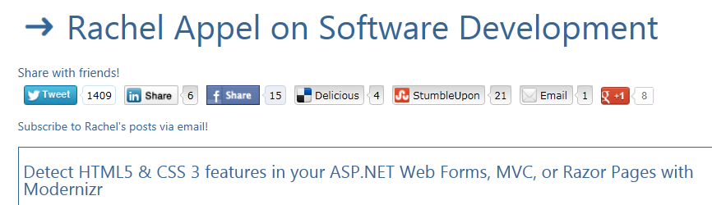
Link, Link, Link & Let Others Link
= Increases Traffic
Frequent, regular, content 3 posts per week or more is best
Link to posts on existing social sites (Not just Twitter)
  TechNet, Del.icio.us, Digg, Slashdot, StumbleUpon, Facebook, LinkedIn Groups
Answer Questions on forums
Social Networking (widgets)
  Make it easy for readers to share content
  ShareThis, AddThis, custom…
Comment on Blogs
Co-author with others
Thank You
Rachel!!!
Notes:
The social networking…
I use the http://sharethis.com/ widget. It’s a snip of HTML you can tell the blog engine to output before or after the content (or both). You can choose the networks you want to use, and there’s a ton of different ones available. You can also choose the look/feel of the button-bar. I thought I’d go with these, but it may be wise to check out the other networks too. Addthis.com is a similar to ShareThis, I just found ShareThis easier to use.
Here’s what mine looks like (also at the bottom)
The cool thing is that if one of the social networks aren’t driving much traffic, you can swap it out for a different one.
Then…I’d say add in site pinning if you don’t have it.
IE Pinned sites….adds a nice flair to the blog.
I had seen some of our stats that say that this drives the return rate of visitors as well as some retention time. I don’t have the numbers on hand though.
This is easy to do, like 5 mins of work. I can show you how or even write up the HTML for you.
Here’s mine, but I want to update it with some “greatest hits” links and links to categories like HTML5 or Windows 8 dev and stuff like that. Also, for some odd reason my favicon isn’t showing up on the taskbar (I probably was messing around and did something).
Also, I thought of this. The writing for the web folks said not to use catchy/pun style titles, make them practical. So I begrudgingly do that (because I know it will hurt SEO if I do, nobody searches on catchy phrases, just practical ones). On the flip side though, I do try to make catchy section titles for each section of the blog post, and I can actually see the posts with the catchy titles don’t get the SEO love.

Slide 12
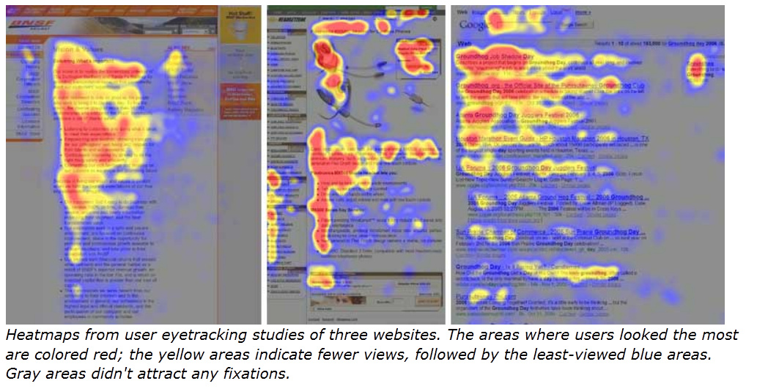
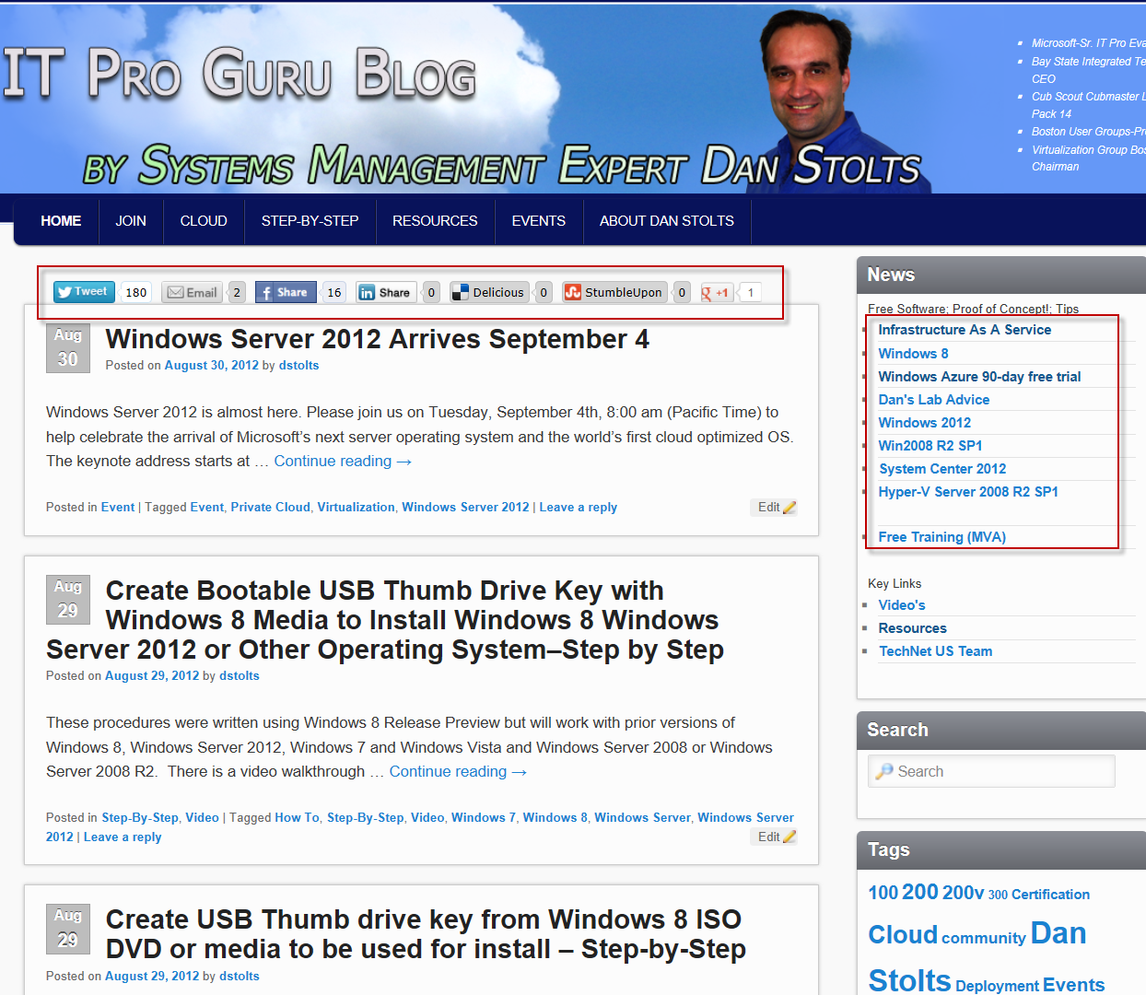
Usability – Eyetracking “F” Pattern
Eyetracking visualizations show that users often read Web pages in an F-shaped pattern: two horizontal stripes followed by a vertical stripe.
Thanks Rachel
http://www.useit.com/alertbox/reading_pattern.html
Notes:
Thanks Rachel Appel
Useit.com shows data from eyetracking studies
The data shows the “F” pattern where users look the most for content
An interesting point is where Google puts its ads on the right – it’s quite the hotspot in the second two images (middle image is not Google though, but the same spot)

Slide 13
Search Engine Optimization
How I got to 10,000 Unique Visitors
Large Part of how I got to 30,000 Unique Visitors per month!
Notes:
inbody:itproguru AND NOT site:itproguru.com AND NOT site:technet.com

Slide 14
Search Engine Optimization (SEO)
Tags
  Heading Tags
    Content within <H1> … <H6> prioritized
  Author Tags
    <a rel=“author” … > or <a rel=“me” … >
  META tags still useful, but not a silver bullet
    Title - <title></title> and <meta name=“title” … >
    Description – Display in Search Results Lists
    Keywords – too many can de-prioritize or blacklist
Post Titles - Capture essence in 5 or 6 words then add expected search terms
    World’s Best Headlines at BBC http://www.useit.com/alertbox/headlines-bbc.html
Monitor Your Site and Learn as you go
  Register with Major Search Engines and submit Sitemap / RSSWeb
  Analytics Bing Webmaster, Google Webmaster, Get Clicky, Other…
  Consistency matters – blog at least weekly – Monitor success and tweak as needed
  Search Syntax, Read a good book, Search the web for tips
Notes:
Thanks to Rachel Appel and Keith Mayer for contributions
Monitor
http://www.useit.com/papers/webwriting/
http://styleguide.yahoo.com/writing
http://www.amazon.com/ELEMENTS-All-Time-Bestselling-Elements-ebook/dp/B0058I7TFI/ref=sr_1_1?ie=UTF8&qid=1315597724&sr=8-1 (tiny but helpful book on writing styles. 2.99 on kindle. Also helps w/PPT structure too)
Your Site and Learn as you go

Slide 15


Broad Content Syndication via Ulitzer
Thanks to John Weston & Keith Mayer

Slide 16
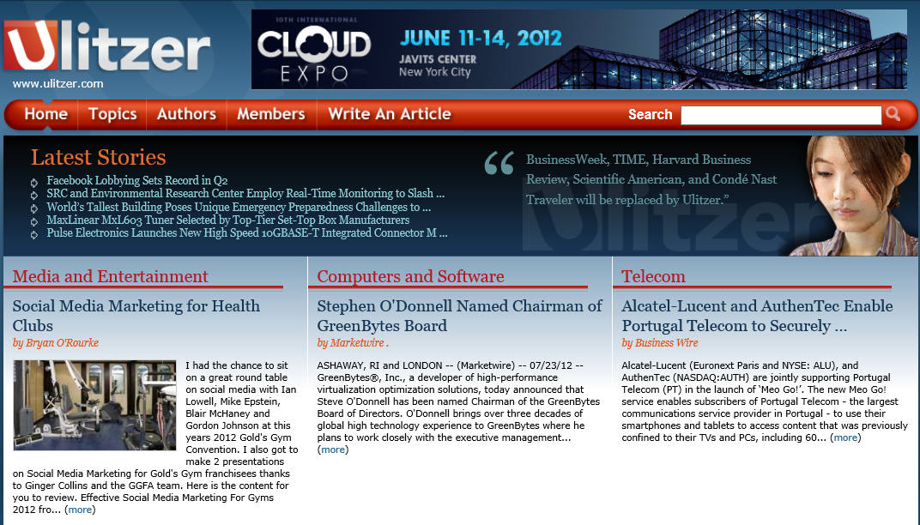
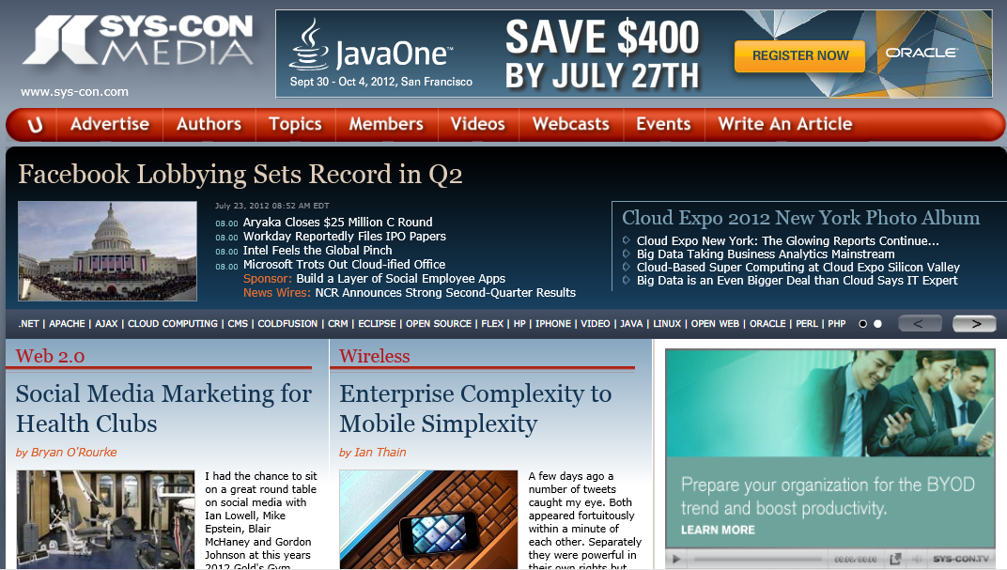
Why Blog on Ulitzer?
Increase Onalytica Influencer Scores & Omniture Reach
8 Twitter Accounts with thousands of followers
Syndication via other Sys-con Media publications

Slide 17

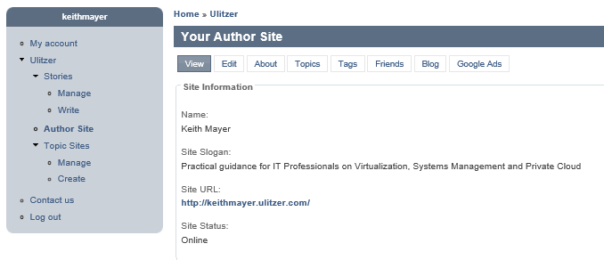
How to Apply for a Ulitzer Blog
Browse to www.ulitzer.com site
Click “Register” and Complete Registration Form
Contact Nancy Valentine @ Sys-Con Media to Approve
  Email: Nancy@Sys-con.com
Setup Your Author Site

Slide 18
Logging In As A Ulitzer Author
Browse to www.ulitzer.com site
Click “Sign-in” and login with your Ulitzer ID
Set IE to Compatibility Mode
Click “Write An Article” to begin a New Blog Post

Slide 19
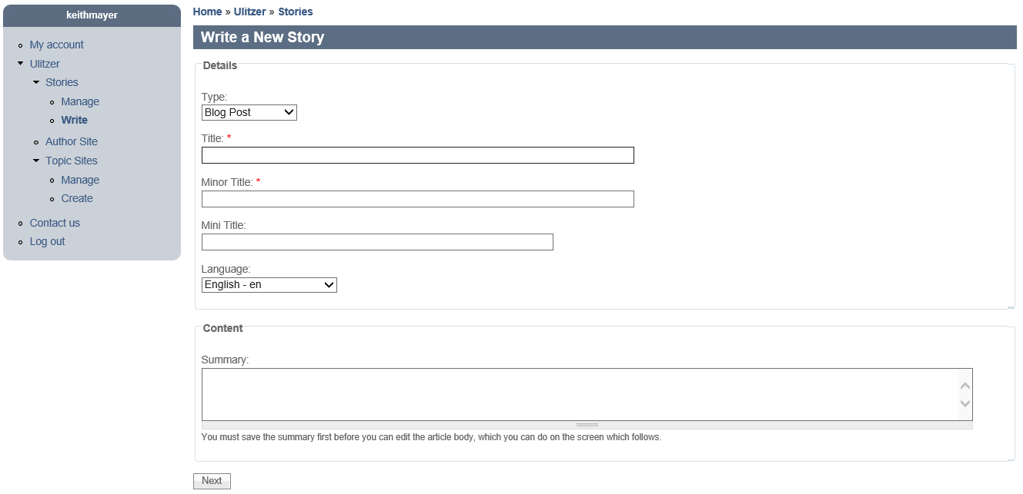
Writing a New Blog Story – Step 1
Select “Blog Post”
Complete Required Fields
Provide a Summary

Slide 20
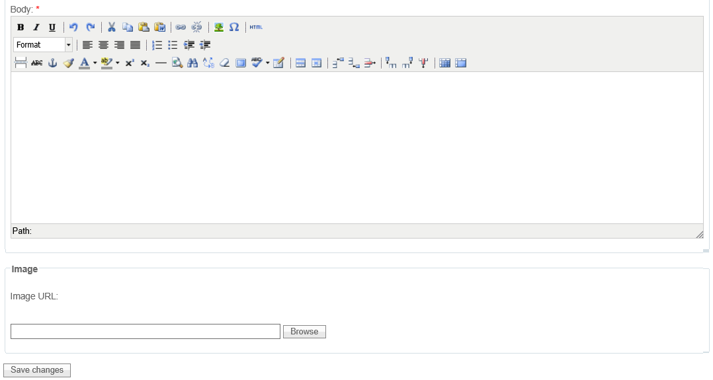
Writing a New Blog Story – Step 2
For Best Results, use “Paste from Word”
Optionally, upload an Image (If you do not one will be provided for you)

Slide 21
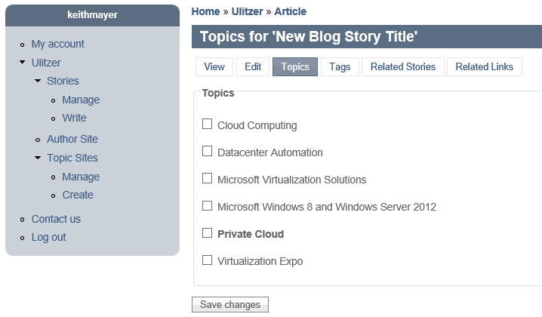
Writing a New Blog Story – Step 3
Select Related Topics for Syndicating on other Topical Ulitzer Sites

Slide 22
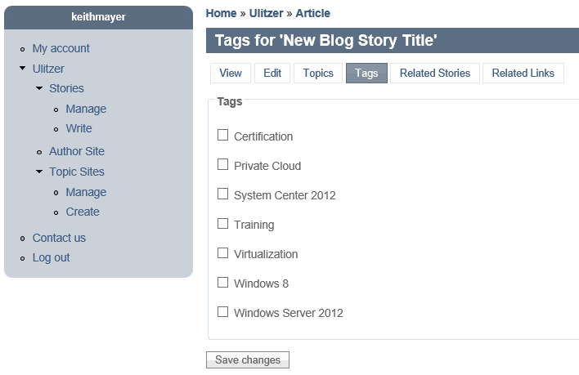
Writing a New Blog Story – Step 4
Select Related Tags to Increase Discoverability

Slide 23
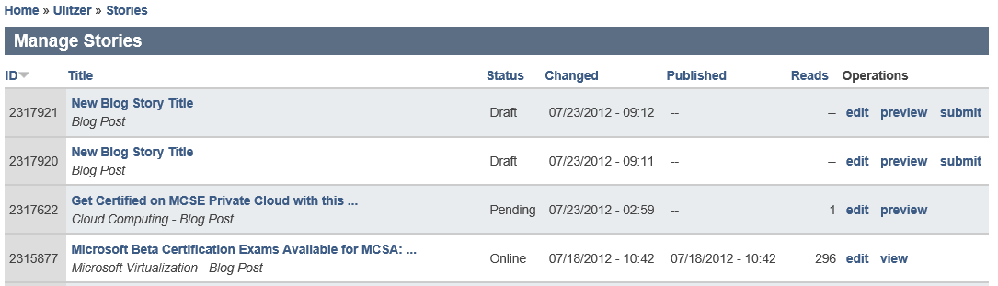
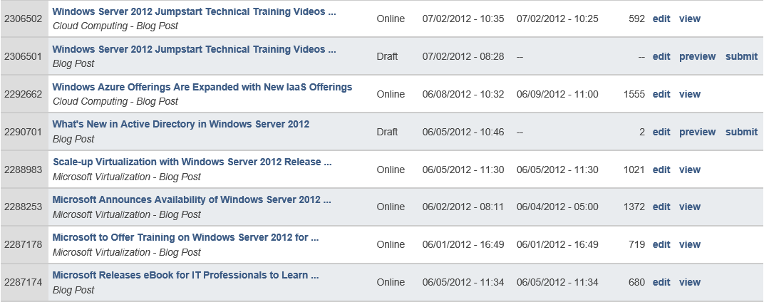
Writing a New Blog Story – Step 5
Select “Preview” to review New Post Prior to Submitting
Click “Submit” to Submit New Post to Ulitzer for Editing & Approval

Slide 24
Integrating Ulitzer with Omniture - Overview
Ulitzer platform strips out HTML script tags, but …
  Embedded IFRAME tags that point to .HTM files allowed
Example:
  <iframe src="http://host.company.com/path/file.htm">
  </iframe>
@ITProGuru
DanStolts
ITProGuru.com
DanStolts

Slide 25
Integrating Ulitzer with Omniture – Step 1
Create .HTM file with Omniture script tags in Notepad
Example:
  <meta name="t_omni_extblogid" content="msstoextblogs2" />
  <meta name="t_omni_blogname" content=“itproguru" />
  <meta name="t_omni_market" content="UNITED STATES" />
  <meta name="t_omni_audience" content="IT PRO" />
  <script type="text/javascript" src="http://www.microsoft.com/feeds/omni_external_blogs.js"></script>
  <noscript><a href='http://www.omniture.com' title='Web Analytics'>
  <img src='http://mssto.112.2o7.net/b/ss/msstoextblogsnojs/1/H.20.2--NS/0' height='1' width='1' border='0' alt='' /></a></noscript>

Slide 26
Integrating Ulitzer with Omniture – Step 2
Publish .HTM file to an HTTP Internet accessible location
I use Windows Azure Blob Storage for this, but you may have a 3rd party Blog that provides this feature.
Resulting URL needs to look “normal” or Ulitzer will strip
  Ie., no embedded special characters, etc
  Technet Blogs platform cannot be used for this due to URL
Example: http://itproguru.com/wp-content/uploads/2012/08/omniture.htm

Slide 27
Integrating Ulitzer with Omniture - Step 3
Create new Blog post on Ulitzer platform as normal
Don’t submit for review/approval yet!
Edit new Blog Post and open raw HTML view
Embed <IFRAME></IFRAME> tags after first <p> tag
Example:
    <iframe
    width="0"
    frameborder="0" src="http://itproguru.com/wp-content/uploads/2012/08/omniture.htm"
    height="0">
    </iframe>

Slide 28
Engaging on LinkedIn

Slide 29
Improving LinkedIn Engagement – Profile Tips
Professional “Headline”
  This gets included everywhere on LinkedIn
  Status Updates, Connection requests, InMail and Messages
  Group posts, Email summaries
  Include your Primary Blog URL for Onalytica
  Include info that will make people want to connect with you
Syndicate your Blog content on your LinkedIn Profile
  BlogLink profile application
  Use Feedburner RSS feed syndication from TechNet blog instead
Notes:
Go where your audience is. Do not assume they are also watching your blog or watching you on twitter

Slide 30
Improving LinkedIn Engagement
LinkedIn no longer pulls Twitter feed
Many LinkedIn Connections don’t use Twitter
LinkedIn Connections are not “always on” unlike Twitter
What I’ve found to work well for me …
  Use TweetDeck for ongoing dialogs via Twitter
  Cross-posting blog post summaries to LinkedIn Groups and LinkedIn Status

Slide 31

Pay-With-A-Tweet
Keith Mayer http://KeithMayer.com
Notes:
http://blogs.technet.com/b/keithmayer/archive/2012/08/22/free-ebook-programming-microsoft-windows-8-apps-windows8-developer-ux.aspx#.UESVQyTn8e0

Slide 32
Viral Content Resyndication “Pay-With-A-Tweet”
Goal: Turn every reader into a resyndication
opportunity
Outcome: Readers are asked to share content on their own social network to receive content themselves
Used for: Longer content works where reader effort can be justified
Alternatives: Need to provide easy alternatives for readers that aren’t “social-aware”
  Thanks to Keith Mayer http://KeithMayer.com
Notes:
Viral Content Resyndication with “Pay-With-A-Tweet”

Slide 33
Pay-With-A-Tweet Overview
Useful for longer content works that are posted to Blogs
  Study Guides
  Lab Guides
  eBooks
Rather than downloading directly, force users to Tweet or Facebook-share to gain access to resource
Creates a “viral” demand that drives broad awareness via 3rd party social networks

Slide 34
Pay-With-A-Tweet: Step 1
Create a new draft Blog post for the content you wish to syndicate.
Upload the resource to a publicly accessible HTTP location
  I usually upload to my Technet Blog using the File Upload feature
Create aka.ms short links
  One link for the resource
  Second link for the blog post
    Keep the blog post in Draft mode until completing this entire process

Slide 35
Pay-With-A-Tweet: Step 2
Browse to http://www.paywithatweet.com
Click the “Create a Pay Button” link
Complete and Submit the form
  Your download URL: aka.ms link to resource
  Tweet to be posted: include your Twitter account tag and relevant hash tags
    Example: Get certified on #SysCtr 2012 with this FREE study guide! Thanks @KeithMayer!
  URL: aka.ms link to your blog post

Slide 36
Pay-With-A-Tweet: Step 3
Edit draft blog post
Open the HTML view in the blog post editor
Paste the “Pay With a Tweet” button code
Save & Publish the blog post
Update the second aka.ms link to point to your post

Slide 37
Q & A
Audience Suggestions
Your Suggestions
What has worked for YOU?

Slide 38
Calls to Action …
Download this deck at: itproguru.com/resources
Search Optimize your Blog
Register for your Ulitzer or other third party Blog
Engage customers on other sites
Leverage suggestions to drive IMPACT!

Slide 39
Rachel’s Resources
http://theoatmeal.com/comics/facebook_likes
Useit.com
http://www.problogger.net/blog
http://www.brentozar.com/archive/2008/12/how-start-blog
eBook: http://pragprog.com/book/actb/technical-blogging
http://jer979.com/files/media/10%20Ways%20to%20Grow%20Your%20Fans.pdf
Notes:
http://www.brentozar.com/archive/2008/12/how-start-blog/
I believe Brent was or is an MVP. Either way, he’s a good influencer in the SQL Community

Slide 40

© 2012 Microsoft Corporation. All rights reserved. Microsoft, Windows, Windows Vista and other product names are or may be registered trademarks and/or trademarks in the U.S. and/or other countries.
The information herein is for informational purposes only and represents the current view of Microsoft Corporation as of the date of this presentation. Because Microsoft must respond to changing market conditions, it should not be interpreted to be a commitment on the
part of Microsoft, and Microsoft cannot guarantee the accuracy of any information provided after the date of this presentation. MICROSOFT MAKES NO WARRANTIES, EXPRESS, IMPLIED OR STATUTORY, AS TO THE INFORMATION IN THIS PRESENTATION.

