Slide 1
Windows Server 2012 or Windows 8 Installation
Notes:
http://channel9.msdn.com/Events/TechEd/NorthAmerica/2012/WSV205

Slide 2
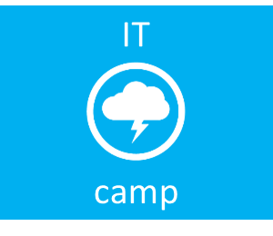

Installing
Windows Server 2012
or
Windows 8
Virtualization
Cloud
System Center
Management
Infrastructure
Dan Stolts, MCT, MCSA, MCITP…
http://ITProGuru.com
http://blogs.technet.com/DanStolts
@itproguru
CT, MA, ME, NH, VT, NY (upstate)

Slide 3
Download Process Walkthrough
Windows 8
Windows Server 2012
System Center 2012
Windows Server 2008 R2 SP1
Hyper-V Server 2008 R2
ITProGuru.com
or
http://aka.ms/labs
1.
Go to Download Link
2.
See the Download page
3.
Enter or Establish your Live ID
4.
Download Manager
Begins – then cancel for Credit

Slide 4
Emergency Exit, Rest Room, Cell
Event Format
Continual Partnership
9 - Yeah, I learned plenty (A-)
8 - Cool event (B-)
7 - Action items to improve (C-)
6 – This is not good (D-)
… You get the picture…
Logistics
Score generously, actionable feedback

Slide 5

Windows Server 2012 Windows 8 Requirements
Windows 8
1 gigahertz (GHz) or faster 32-bit (x86) or 64-bit (x64) processor
1 gigabyte (GB) RAM (32-bit) or 2 GB RAM (64-bit)
16 GB available hard disk space (32-bit) or 20 GB (64-bit)
DirectX 9 graphics device with WDDM 1.0 or higher driver
Taking advantage of touch input requires a screen that supports multi-touch
Windows Server
1.4 GHz 64-bit processor
512 MB RAM
32 GB Disk Space
Super VGA (800 x 600) or higher-resolution monitor
DVD drive, Keyboard, mouse

Slide 6

Hyper-V Requirements
Virtualization Technology
* X64 Architecture with Hardware Assisted Virtualization
Likely found under Configuration then “Virtualization” or “Processor”
Intel: Intel VT
AMD: AMD-V
Execute Disable
* Hardware enabled Data Execution Prevention (DEP)
Likely found under Configuration then “Security”
Intel: XD bit (Execute Disable)
AMD: NX bit (no Execute bit)
Hyper-V on Client MUST have SLAT ****
** Intel: EPT Intel processors whose names start with 'i', e.g. i3, i5, i7, i9
*** AMD: RVI/NPT
**** SLAT is a feature of the CPU = Second Level Address Translation
Samples:
  Lenovo T410, T510, W510, W520, T420s, T520, X201
  Samsung 900x / Dell Precision M4600
  * Bios Requirements for Enabling Hyper-V. Short video to show exactly where you might find these settings. http://aka.ms/BiosHyper-V
** Intel: There may be exceptions Any Intel CPUs based on Nehalem, Westmere, or Sandybridge micro-architectures (there may be exceptions)
*** AMD Support http://support.amd.com/us/kbarticles/Pages/GPU120AMDRVICPUsHyperVWin8.aspx
**** SLAT AKA Extended Page Tables (EPT) AKA Nested Page Tables (NPT) AKA Rapid Virtualization Indexing (RVI) More on TechNet regarding SLAT: http://social.technet.microsoft.com/wiki/contents/articles/1401.hyper-v-list-of-slat-capable-cpus-for-hosts.aspx
Notes:
Understanding SLAT Understanding High-End Video Performance Issues with Hyper-V
capable PC’s http://social.technet.microsoft.com/wiki/contents/articles/1401.hyper-v-list-of-slat-capable-cpus-for-hosts.aspx
Upgrades to this version from Windows Server 2008 and Windows Server 2008 R2 are supported. However, only upgrades from the same server edition are supported. You will not be able to upgrade to subsequent releases from this release

Slide 7
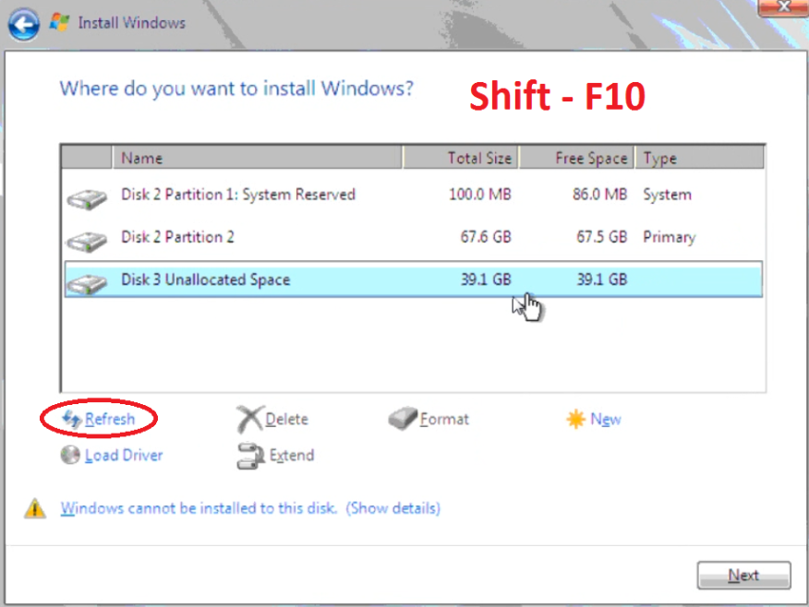
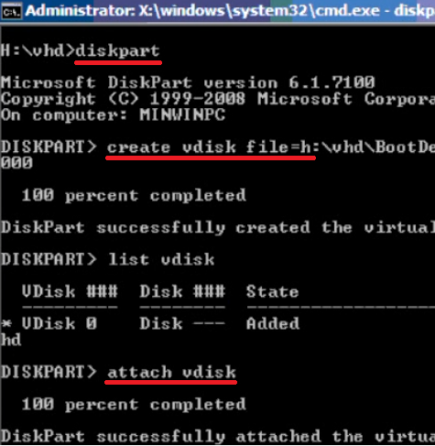
Dual Boot To VHD
Start Installation
Format Media (if doing bare metal install)
  You should be on the “Where do you want to install Windows?” screen of the installation press Shift-F10 to drop to command prompt
Find installation drive (dir c:, dir d:, dir e:, etc)
Diskpart
  Create vdisk file=e:\BootDemo.vhd type=expandable maximum=40000
  Attach vdisk
  Exit
Click “Refresh” button
Select “New Drive” and perform normal installation
Using this method, the BCD will be updated automatically

Slide 8
Demo
Demo
Installing Windows 8 or
Installing Windows Server 2012

Slide 9
Intro to Hyper-V
Notes:
http://blogs.msdn.com/b/b8/archive/2011/09/07/bringing-hyper-v-to-windows-8.aspx
An introduction to Hyper-V
Hyper-V requires a 64-bit system that has Second Level Address Translation (SLAT). SLAT is a feature present in the current generation of 64-bit processors by Intel & AMD. You’ll also need a 64-bit version of Windows 8, and at least 4GB of RAM. Hyper-V does support creation of both 32-bit and 64-bit operating systems in the VMs.
Hyper-V’s dynamic memory allows memory needed by the VM to be allocated and de-allocated dynamically (you specify a minimum and maximum) and share unused memory between VMs. You can run 3 or 4 VMs on a machine that has 4GB of RAM but you will need more RAM for 5 or more VMs. On the other end of the spectrum, you can also create large VMs with 32 processors and 512GB RAM.
As for user experience with VMs, Windows provides two mechanisms to peek into the Virtual Machine: the VM Console and the Remote Desktop Connection.
The VM Console (also known as VMConnect) is a console view of the VM. It provides a single monitor view of the VM with resolution up to 1600x1200 in 32-bit color. This console provides you with the ability to view the VM’s booting process.
For a richer experience, you can connect to the VM using the Remote Desktop Connection (RDC). With RDC, the VM takes advantage of capabilities present on your physical PC. For example, if you have multiple monitors, then the VM can show its graphics on all these monitors. Similarly, if you have a multipoint touch-enabled interface on your PC, then the VM can use this interface to give you a touch experience. The VM also has full multimedia capability by leveraging the physical system’s speakers and microphone. The Root OS (i.e. the main Windows OS that’s managing the VMs) can also share its clipboard and folders with the VMs. And finally, with RDC, you can also attach any USB device directly to the VM.
For storage, you can add multiple hard disks to the IDE or SCSI controllers available in the VM. You can use Virtual Hard Disks (.VHD or .VHDX files) or actual disks that you pass directly through to the virtual machine. VHDs can also reside on a remote file server, making it easy to maintain and share a common set of predefined VHDs across a team.
Hyper-V’s “Live Storage Move” capability helps your VMs to be fairly independent of the underlying storage. With this, you could move the VM’s storage from one local drive to another, to a USB stick, or to a remote file share without needing to stop your VM. I’ve found this feature to be quite handy for fast deployments: when I need a VM quickly, I start one from a VM library maintained on a file share and then move the VM’s storage to my local drive.
Another great feature of Hyper-V is the ability to take snapshots of a virtual machine while it is running. A snapshot saves everything about the virtual machine allowing you to go back to a previous point in time in the life of a VM, and is a great tool when trying to debug tricky problems. At the same time, Hyper-V virtual machines have all of the manageability benefits of Windows. Windows Update can patch Hyper-V components, so you don’t need to set up additional maintenance processes. And Windows has all the same inherent capabilities with Hyper-V installed.
Having said this, using virtualization has its limitations. Features or applications that depend on specific hardware will not work well in a VM. For example, Windows BitLocker and Measured Boot, which rely on TPM (Trusted Platform Module), might not function properly in a VM, and games or applications that require processing with GPUs (without providing software fallback) might not work well either. Also, applications relying on sub 10ms timers, i.e. latency-sensitive high-precision apps such as live music mixing apps, etc. could have issues running in a VM. The root OS is also running on top of the Hyper-V virtualization layer, but it is special in that it has direct access to all the hardware. This is why applications with special hardware requirements continue to work unhindered in the root OS but latency-sensitive, high-precision apps could still have issues running in the root OS.
As a reminder, you will still need to license any operating systems you use in the VMs.

Slide 10
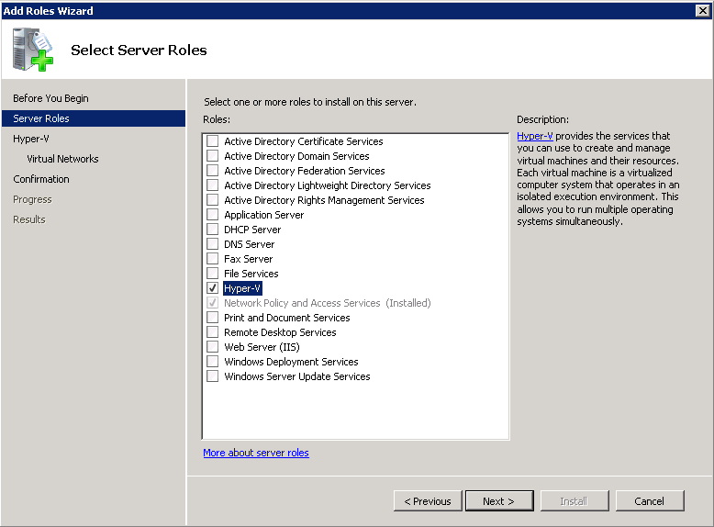
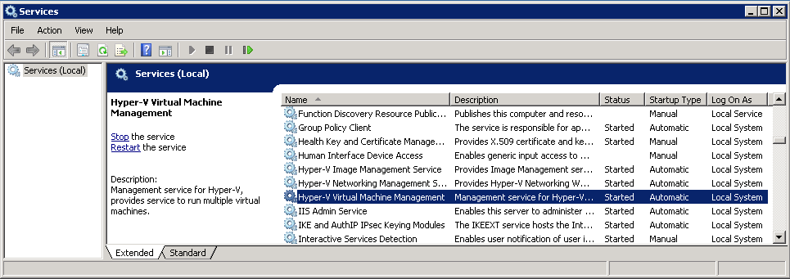
Hyper-V Role
One checkbox followed by two reboots

Slide 11
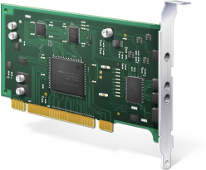
Virtual Network Adapter
Synthetic
Not for PXE boot
High performance
Legacy
PXE bot support
Emulated

Slide 12
Virtual Networks
External
Communicate with other computers on the network
Internal
Communicate with the host computer and only other VMs on the same host,
Private
Communicate only with other VMs on the same host

Slide 13
Virtual Hard Disk (VHD)
Fixed
Storage allocated at creation time
Best performance for production use
Dynamic
Size grows as data are brought in
Small footprint and great for test/dev
Differencing
Linked to a read-only parent disk as
  a base image
Store only the delta

Slide 14
Virtual Machine Operations
Export
Saves snapshots, VHDs, VMs, config XML
Import
Move/Co
Move/Copy/Duplicate
Snapshot
Also known as checkpoint
Backup/Restore
Backup service provider
Migration
One-way process from Virtual Server 2005 R2

Slide 15
Dynamic Memory
Hyper-V memory enhancement in Windows Server 2008 R2 SP1 and beyond
Higher VM consolidation ratios on same hardware with minimal performance impact
Memory is pooled and dynamically distributed across VMs to allow it to easily grow or shrink with no service interruption
  Active Memory addition
    Memory is added immediately when VM needs it
  Passive Memory reclamation
    Unutilized memory is collected every 5 minutes
Supports both server and desktop
VM Guests are enlightened
  Guest Integration Components installed
  Must be updated to latest version
Memory is added and removed via synthetic memory driver (memory VSC) support

Slide 16
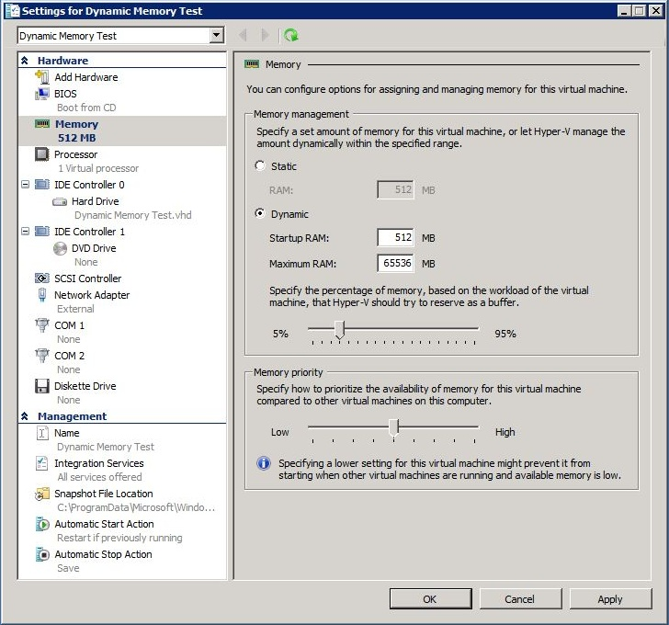
Dynamic Memory Settings
Startup RAM: Memory needed to boot VM
  Guest OS + Apps
  Default: 512MB
Maximum RAM: Memory limit for the VM
  Default: 64GB
Memory Buffer: Free memory to try to
maintain in the VM
  Enables responsiveness for workload bursts
  Allows use for file cache
Memory Priority: Order in which VMs are allocated memory
  Range: 1 (highest) - 10,000
  Default: 5,000

Slide 17
Native Boot To VHD
What is Native Boot?
Benefits and Performance
Inside look at Boot to VHD Partitions
Common Scenarios
Installing … OS Media or Network Boot
  Step By Step – Native Boot to VHD with No underlying OS
  Step By Step – Native Boot to VHD with Underlying OS
An Inside Look at BCDEdit
Limitations
Guidelines, Here is the proof => Next…
http://aka.ms/Boot2VHD

Slide 18
Introduction to Native Boot to VHD
What is a Virtual Hard Disk (VHD)
  Fixed Disks
    Larger (slower to deploy)
    Recommended for production systems
  Dynamic disks
    Grow as data is added
    Smaller (faster to deploy)
  As used with Virtual PC / Virtual Server / Hyper-V
Supported Platforms
  Windows 7 (Enterprise, Ultimate)
  Windows Server 2008 R2 (Full and Core)
    Standard, Enterprise, Datacenter, Web
    Itanium-based systems
  Windows 8, Windows Server 2012
Tools (See Resources for details)
  DiskPart, Disk Management (MMC), BCDEdit, BCDBoot, DISM, Hyper-V Manager, Sysprep, ImageX (AIK)
Notes:
The VHD file format has become the standard for drive images. There can be Fixed or Dynamic. Fixed are larger because they are automatically expanded to take up the full capacity of VHD regardless of how much free space might be available. This makes them a tad faster but much slower to deploy because it takes longer to move such large files. Dynamic disks are much smaller. They are only as big as the actual space used on the disk plus some header and footer data. This makes them much faster to deploy. The VHD’s used for Boot to VHD is the same file format as is used in Virtual PC, Virtual Server and Hyper-V.
Windows 7 not supported: Starter, Home Basic, Home Premium, Professional
Server 2008 R2 not supported: Foundation Edition
There are a number of tools you can use to work with Boot to VHD. Many of them are simply different ways of doing the same thing. We will look a DiskPart, the Disk Management MMC and BCDedit in a bit more detail.
Transition: Before we get into that, let’s take at some of the benefits of Boot to VHD
Tools more details …
DiskPart A command-line tool that you can use to create, attach, and detach VHDs. You can also perform more advanced tasks like compacting, expanding, and merging VHDs. For more information, see DiskPart on Microsoft TechNet (http://go.microsoft.com/fwlink/?LinkId=128458).
Disk Management A Microsoft Management Console (MMC) snap-in that you can use to create, attach, and detach VHDs.
BCDEdit A command-line tool that you use to manage boot configuration data (BCD) stores. For more information, see BCDEdit on Microsoft TechNet (http://go.microsoft.com/fwlink/?LinkId=128459).
BCDBoot A command-line tool that you can use to manage and create new BCD stores and BCD boot entries. BCDBoot can be used to create a new boot entry when configuring a system to boot from a new VHD. For more information, see BCDBoot Command-Line Options on Microsoft TechNet (http://go.microsoft.com/fwlink/?LinkID=155166).
Deployment Image Servicing and Management (DISM) A command-line tool that you use to apply updates, drivers, and language packs to a Windows image. For more information, see Deployment Image Servicing and Management Technical Reference on Microsoft TechNet (http://go.microsoft.com/fwlink/?LinkId=155029).
Windows Hyper-V Manager An MMC snap-in that supports VHD image creation. You can specify the type and size of VHD and install Windows from a CD or DVD, or from an ISO Image file. The Hyper-V Manager is only available on computers that are running Windows Server 2008 or Windows Server 2008 R2 with the Hyper-V role installed.
Sysprep A tool that enables you to remove user and computer-specific data from the operating system image. This enables you to capture the image and deploy it to other computers. For more information, see Sysprep Technical Reference on Microsoft TechNet (http://go.microsoft.com/fwlink/?LinkId=155027).

Slide 19
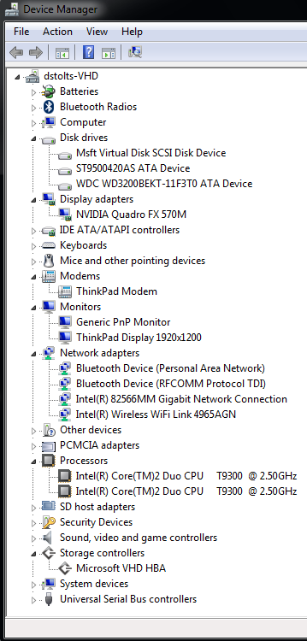
Benefits
Possible to boot a VHD directly on hardware using Hardware Manufacturer Drivers!
Can run Windows Virtualization Platform
Deploy either as physical or virtual using same file
Use the same management tools
Support multiple boot scenarios
Fast deployment for re-usable environments
    Parent of a differencing disk can be a fixed, dynamic, or differencing disk (differencing chain)
    Negligible performance difference from Native
Notes:
With Boot to VHD you are NOT running on a virtualization platform, you are running directly on the hardware using native drivers for devices. The only synthetic driver will be for the VHD storage.
Since you are running on native hardware, you CAN run a Windows Virtualization Platform inside your VHD. You can run Virtual PC or Hyper-V under a Native Boot VHD. From a performance standpoint, you are better off running the VHD’s in your virtualization platform on a physical disk instead of a virtual disk.
You can deploy exactly the same VHD file to either physical or virtual hardware. Boot to bare metal or on a Hyper-V host and go between the two if you need to.
You can use the tools we all know and understand to manage VHD‘s
Multiple boot typically means separate partitions which can result in waisted disk space as well as confusion. Boot to VHD gives us ISOLATION between partitions without wasted space. Plus if you store your data on the physical disk instead of the VHD, you can easily share data between machines.
Re-uasbale environments are typically used for things like development or testing, they can be very quickly deployed and they are very easy to reset to their original state.
Your disks can be Fixed, dynamic and even differencing. The parents can also be differencing disk which means it supports differencing chains.
You will be pleasantly surprised at the incredible performance we get out of Boot to VHD. In fact, let‘s drill down a bit more on performance.

Slide 20
System and VHD Partitions
System Partition
Primary Partition
Bootmgr
D:
C:\Windows
BCD
D:
C:\Pagefile.sys
D:
C:\Vhd\Windows7Dynamic.vhd
Phy
Physical Disk
Virtual
VHD
VHD Boot
C:\Windows
Parent volume of the VHD is available after boot with a different volume letter
LOOK: Watch your disk space go to maximum VHD Capacity + Physical Used
Notes:
Your physical (non-VHD) installation of windows will show up as the physical C: drive. Also, the pagefile will be on this physical volume.
Build 1: When you Boot to VHD the Physical drive will be changed to the D: drive and the VHD drive will become the C: drive
Build 2: Make note though that the physical D: drive will show available space as if the VHD is fully expanded even though it may not be. If you try to boot a dynamically expanding VHD on a physical disk that does not have the capacity, they system will blue screen when it tries to load the disk driver!
Build 3: These different disks are shown in Disk manager as different disks. The Blue icon shows that it is a VHD. The fact that it is the Boot and C: Drive, tells you it is a Boot to VHD. Also notice the System and Page File are on the F: drive. These are on the Physical Disk, not the VHD.

Slide 21
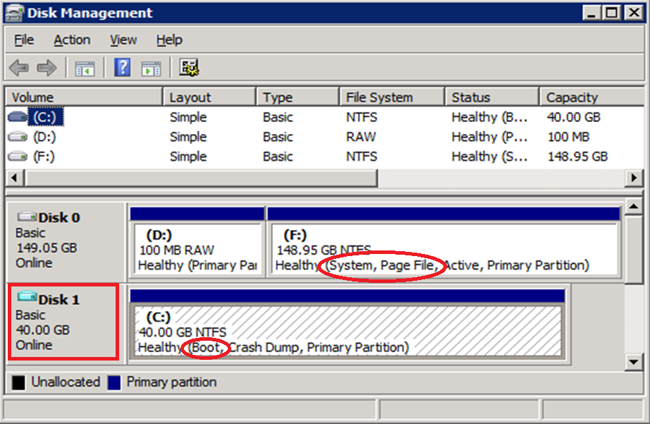
System and VHD Partitions
System Partition
Primary Partition
Bootmgr
D:
C:\Windows
BCD
D:
C:\Pagefile.sys
D:
C:\Vhd\Windows7Dynamic.vhd
Phy
Physical Disk
Virtual
VHD
VHD Boot
C:\Windows
Parent volume of the VHD is available after boot with a different volume letter
LOOK: Watch your disk space go to maximum VHD Capacity + Physical Used
Notes:
Your physical (non-VHD) installation of windows will show up as the physical C: drive. Also, the pagefile will be on this physical volume.
Build 1: When you Boot to VHD the Physical drive will be changed to the D: drive and the VHD drive will become the C: drive
Build 2: Make note though that the physical D: drive will show available space as if the VHD is fully expanded even though it may not be. If you try to boot a dynamically expanding VHD on a physical disk that does not have the capacity, they system will blue screen when it tries to load the disk driver!
Build 3: These different disks are shown in Disk manager as different disks. The Blue icon shows that it is a VHD. The fact that it is the Boot and C: Drive, tells you it is a Boot to VHD. Also notice the System and Page File are on the F: drive. These are on the Physical Disk, not the VHD.

Slide 22
Common Scenarios
  Native boot hardware with no installed OS
  Image management
    ‘Attach’ a VHD and access as a drive letter
    DISM (Deployment Image Management & Servicing)
  Common VHD image for both physical and virtual environments
  One or multiple local VHDs within a single partition
    E.g. for kiosk machines, early adopters
    Developers, Trainers
    Demo, Field Sales
    Proof of Concept
    Virtual Appliances
  Centrally stored VHDs for network deployment
    Copy locally and then start
  Network boot to VHD using WDS
Notes:
Offline Image Management or Disk Manager – to activate the VHD file and access it via a drive letter rather than as a –VHD file.
As mentioned previously the same VHD can be used in both physcal an virtual environments – may be more useful for server images in data centers where it is not always known where a server will be installed.
Boot new hardware without installing an OS
Support multiple local images (for different tasks or workloads) - Demo Environments, Training Environments, etc.
Host images centrally for copying where required.
Use Windows Deployment Services (WDS) to deploy VHD images via network boot (PF12).

Slide 23
Install From Media Or Network Boot
Start Installation
Format Media (if doing bare metal intsall)
  You should be on the “Where do you want to install Windows?” screen of the installation press Shift-F10 to drop to command prompt
Find installation drive (dir c:, dir d:, dir e:, etc)
Diskpart
  Create vdisk file=e:\BootDemo.vhd type=expandable maximum=40000
  Attach vdisk
  Exit
Click “Refresh” button
Select “New Drive” and perform normal installation
Using this method, the BCD will be updated automatically

Slide 24
Preparing for Native Boot and BCDEdit
If host system is Vista SP1:
  Replace Bootmgr and BcdEdit.exe with Windows 7 versions (BCDBoot)
Create bootable VHD file
  Disk Manager, Hyper-V Manager, ImageX, SCVMM, DiskPart,Etc
Copy bootable VHD to a directory on the host system
  (e.g. ‘c:\vhd\BootWin.vhd’)
Use BcdEdit to copy the existing boot entry (from administrative cmd prompt)
  bcdedit /copy {current} /d “Windows VHD Boot”
Look at the new entry
  bcdedit /v
Use BcdEdit to Edit the VHD system
  bcdedit /set {GUID} device vhd=[c:]\vhd\BootWin.vhd
  bcdedit /set {GUID} osdevice vhd=[c:]\vhd\BootWin.vhd
  bcdedit /set {GUID} detecthal on
Use BCDEdit to change the description, default start item, menu order, timeout, etc.
  bcdedit /set {GUID} description “New Menu Description Goes Here!”
  bcdedit /default {GUID}
  bcdedit /displayorder {GUID_1} {GUID_2}
  bcdedit /timeout 10
If using virtualization on the system… (Make sure you cold boot after making changes)
  Enable Virtualization in BIOS
  bcdedit /set {GUID} hypervisorlaunchtype auto
Notes:
Now that we have looked at installing windows to a VHD let‘s look at how to tweak the boot configuration and/or go through manually adding existing VHD‘s to a machine.
You need to make a note of the GUID when you copy. If you do not, you can obtain it by doing a BCDEDIT alone. If no GUID value is entered for the {current} is assumed and you may just mess up your boot menu all together. So... Please be careful with this very poerful tool.
In order to use Boot to VHD you have to have the Windows 7, Windows Server 2008 R2 Boot Manager running on the machine. If you are running Windows Vista and want to use Boot to VHD to run a Windows 7 vhd on the same machine, you can simply install the boot manager by copying it over from a valid windows 7 installation.
You can create a vhd using any number of different tools that perform that function
BCDEdit is a tool that allows you to change the Boot Configuration Data on a Windows 7 boot managed machine. You can do things like Copy existing entries, edit entries, change the display order, change the timeout, change the default entry, turn on HAL detaction, etc. I have a bunch of examples of proper syntax here to make it easier for you to get up to speed quickly. Let‘s take a closer look at BCDEdit by running through a demo.

Slide 25
Limitations
Native Boot is only for Windows 7 and 2008 R2
Native Boot does not support Hibernation
  Sleep mode is supported
Native Boot does not support BitLocker
No Over Allocation of Disk Space *
No “Nested” boot to VHD
Maximum size of dynamic VHD = 2TB (2048 GB)
Parent of Differencing disk must be on same volume

Slide 26
VHD Boot Guidelines
Native VHD boot requires Windows 7 Boot Manager (Bootmgr) and BCDEdit utility
  Use BCDboot.exe from attached VHD
Pagefile and boot manager are outside Virtual Hard Disk (VHD)
  Dynamic VHD expanded during boot
  Plan physical disk free space accordingly
Store user data outside of the OS VHD

Slide 27
Creating Differencing Disks
Create the VHD’s
diskpart
create vdisk file="D:\WIN7_Diff0.vhd" parent="D:\WIN7.vhd“
exit
This takes care of creating the VHD’s and setting up the parent – child relationship. To be able to boot to the differencing disk, the BCD store will need to be updated to reflect our intended changes.
Update the BCD store.
BCDEdit.exe /set {GUID} device VHD=[D:]\Win7_Diff0.vhd
BCDEdit.exe /set {GUID} osdevice VHD=[D:]\Win7_Diff0.vhd
Notes:
Wouldn’t it be a great feature if you could restore an operating system to its default configuration
within a couple of minutes? This can easily be achieved with the help of VHD differencing disks.
Differencing disk in Hyper-V or Microsoft Virtual PC are in essence the same as with Windows Native
VHD boot. The disk has a parent – child relationship where all new blocks are written to the child disk,
leaving the parent disk to its preconfigured state. This enables the possibility of a quick restore by
replacing the differencing disk and re-enabling the parent – child relationship.
Essentially we will use the same steps as before, create VHD’s, and setup the parent – child relationship. As the final step we will need to alter the
boot configuration data store to be able to boot off the differencing disks. Use the following
steps to create the VHD’s and setup the relationship.

Slide 28
Thin Provisioning – Be Very Careful
Disk expansion happens when driver is loaded
  Cannot suppress expansion during Installation
  Stop Error if not enough physical space (Blue Screen)
Registry entry will prevent the disk from expanding to its full size. Open the registry editor, browse to
  The location that’s displayed below and alter the value to “4”.
    [HKEY_LOCAL_MACHINE\SYSTEM\CurrentControlSet\services\FsDepends\Parameters]
    "VirtualDiskExpandOnMount"=dword:00000004
Strongly Recommend You NOT do this!!!!
  IF you run out of disk space, you will likely corrupt your VHD!
Notes:
Thin Provisioning allows you to not have the vhd auto-expand. However, if the underlying disk runs out of space you risk VHD corruption which could destroy your entire VHD.

Slide 29
Resources
How to Perform Common Tasks
http://technet.microsoft.com/en-us/library/dd979534(WS.10).aspx
What's New for IT Pros in Windows 7
http://technet.microsoft.com/en-us/library/dd349334(WS.10).aspx
What's New in Virtual Hard Disks
http://technet.microsoft.com/en-us/library/dd440864(WS.10).aspx
What's New in Deployment Tools
http://technet.microsoft.com/en-us/library/dd744386(WS.10).aspx
Windows(R) Image to Virtual Hard Disk (WIM2VHD) Converter
http://code.msdn.microsoft.com/wim2vhd

Slide 30
Tools Resources
Appendix: Tools, Scripts, and APIs.
The following tools are included in Windows 7 and Windows Server 2008 R2:
DiskPart A command-line tool that you can use to create, attach, and detach VHDs. You can also perform more advanced tasks like compacting, expanding, and merging VHDs. For more information, see DiskPart on Microsoft TechNet (http://go.microsoft.com/fwlink/?LinkId=128458).
Disk Management A Microsoft Management Console (MMC) snap-in that you can use to create, attach, and detach VHDs.
BCDEdit A command-line tool that you use to manage boot configuration data (BCD) stores. For more information, see BCDEdit on Microsoft TechNet (http://go.microsoft.com/fwlink/?LinkId=128459).
BCDBoot A command-line tool that you can use to manage and create new BCD stores and BCD boot entries. BCDBoot can be used to create a new boot entry when configuring a system to boot from a new VHD. For more information, see BCDBoot Command-Line Options on Microsoft TechNet (http://go.microsoft.com/fwlink/?LinkID=155166).
Deployment Image Servicing and Management (DISM) A command-line tool that you use to apply updates, drivers, and language packs to a Windows image. For more information, see Deployment Image Servicing and Management Technical Reference on Microsoft TechNet (http://go.microsoft.com/fwlink/?LinkId=155029).
Windows Hyper-V Manager An MMC snap-in that supports VHD image creation. You can specify the type and size of VHD and install Windows from a CD or DVD, or from an ISO Image file. The Hyper-V Manager is only available on computers that are running Windows Server 2008 or Windows Server 2008 R2 with the Hyper-V role installed.
Sysprep A tool that enables you to remove user and computer-specific data from the operating system image. This enables you to capture the image and deploy it to other computers. For more information, see Sysprep Technical Reference on Microsoft TechNet (http://go.microsoft.com/fwlink/?LinkId=155027).
The following tool are included in the Windows Automated Installation Kit (Windows AIK):
ImageX A command line tool that enables you to capture, create, modify, and apply Windows images. For more information, see ImageX Technical Reference on Microsoft TechNet (http://go.microsoft.com/fwlink/?LinkId=155340).

Slide 31


Windows Server capabilities
Infrastructure
Application
Client
Scenario capabilities
Technical capabilities
Virtualization
Storage
Web and application platform
Networking
Management
and automation
VDI
Identity and access

Slide 32


Call To Action
@ITProGuru
Follow Blog ITProGuru.com
Microsoft Virtual Academy: aka.ms/mva
Hands-On Labs
DOWNLOAD Windows Server 2012 Release Candidate
Aka.ms/getwin2012
DOWNLOAD Microsoft System Center 2012 Evaluation
Aka.ms/getsc2012

Slide 33
Emergency Exit, Rest Room, Cell
Event Format
Continual Partnership
9 - Yeah, I learned plenty (A-)
8 - Cool event (B-)
7 - Action items to improve (C-)
6 – This is not good (D-)
… You get the picture…
Logistics
Score generously, actionable feedback

Slide 34




Resources
Learning
  Connect. Share. Discuss.
  Microsoft Certification & Training Resources
http://northamerica.msteched.com
www.microsoft.com/learning
TechNet
  Resources for IT Professionals
  Resources for Developers
http://microsoft.com/technet
http://microsoft.com/msdn

Slide 35
© 2012 Microsoft Corporation. All rights reserved. Microsoft, Windows, Windows Vista and other product names are or may be registered trademarks and/or trademarks in the U.S. and/or other countries.
The information herein is for informational purposes only and represents the current view of Microsoft Corporation as of the date of this presentation. Because Microsoft must respond to changing market conditions, it should not be interpreted to be a commitment on the
part of Microsoft, and Microsoft cannot guarantee the accuracy of any information provided after the date of this presentation. MICROSOFT MAKES NO WARRANTIES, EXPRESS, IMPLIED OR STATUTORY, AS TO THE INFORMATION IN THIS PRESENTATION.

