Slide 1
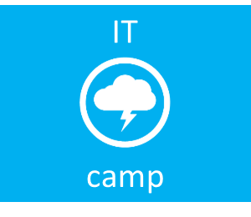
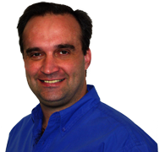
Career Success in the IT Field
Virtualization
Cloud
System Center
Management
Infrastructure
Security
Dan Stolts, MCT, MCSA, MCITP, MCSE…
http://ITProGuru.com
http://blogs.technet.com/DanStolts
@itproguru
CT, MA, ME, NH, VT, NY (upstate)
More Jobs ☺
  Owner - Bay State Integrated Technology, Inc. (www.BayStateTechnology.com)
  President - Boston User Groups (www.BostonUserGroups.org)
  Cubmaster – Cub Scouts Pack 14, Lakeville, MA {LakevillePack14.com)
  Founder/Chairman - Virtualization Group Boston (www.VirtG.com)
@ITProGuru
Notes:
Board - Boston Windows Server User Group - www.WindowsBoston.com
Den Leader – Cub Scouts Pack 14, Lakeville, MA
Author – Build Your Career While You Build Your Community
Student … and Future Professor
Most Important… Father, Husband, Friend & Neighbor ☺

Slide 2
IT Jobs Are Everywhere!
Accounting - Finance | Employment - Recruiting - Staffing | Insurance | Pharmaceutical
Advertising | Energy - Utilities - Gas - Electric | Internet - ECommerce | Polymer / Plastic / Rubber
Agriculture | Engineering - Machinery | Jewelry | Printing - Publishing
Airline - Aviation | Engineering - Precision | Landscaping | Public Relations
Appliance & Electronics | Engineering - Services | Law Enforcement | Quick Service or Fast Food Restaurant
Architecture - Building | Entertainment | Legal | Real Estate - Property Mgt
Art - Photography - Journalism | Environmental | Library Science | Recreation
Automotive - Motor Vehicles - Parts | Exercise - Fitness | Managed Care | Repair / Maintenance Services
Banking - Financial Services | Exhibitions / Event Management / MICE | Manufacturing | Research & Development
Beauty / Wellness / Grooming | Eye Care | Marine / Maritime | Restaurant
Biotechnology | Fashion - Apparel - Textile | Maritime - Offshore & Marine Engineering | Retail
Broadcasting - Radio - TV | Food | Maritime - Port | Retail Bank
Building Materials | Full Service Restaurant | Maritime - Shipping | Sales - Marketing
Call Center / SSO / BPO | Funeral - Cemetery | Mass Merchandiser | Science & Technology
Chemical | Furniture | Medical Equipment | Securities
Coffee Shop | Gas / Convenience Store | Merchandising | Security
Computer Hardware | Government - Civil Service | Military | Semiconductor
Computer Software | Grocery & Pharmacy | Mining / Drilling / Resources | Services - Corporate B2B
Construction | Hardware / Home Improvement | Mortgage | Social Services
Consulting | Healthcare - Health Services | Newspaper | Sporting Goods
Consumer Products | Home Décor and Kitchen | Not for Profit - Charitable | Telecommunications
Cosmetics & Beauty | Homebuilding | Office Supplies - Equipment | Training
Credit - Loan - Collections | Hospitality | Oil Refining - Petroleum - Drilling | Transportation
Defense - Aerospace | Hotel - Resort | Other | Travel
Department Store | HVAC | Other Great Industries | Wireless
Education - Teaching - Administration | Import - Export | Packaging | Wood / Fibre / Paper
Electronics | Industrial | Pet Store

Slide 3

What Does School Give You?
Solid Foundation In Chosen Area of Expertise
Teach You How To Learn
Strong Work Ethic (I Hope)
Contacts
Don’t Wait!
Have Fun ☺
Much, Much, More
Next Step…
Certification

Slide 4
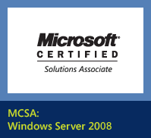
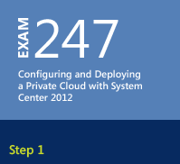
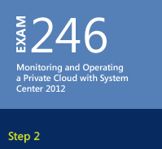
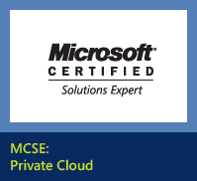
Certification…
Microsoft Private Cloud Certification
Free Online Training:
http://aka.ms/guruMVA

Slide 5
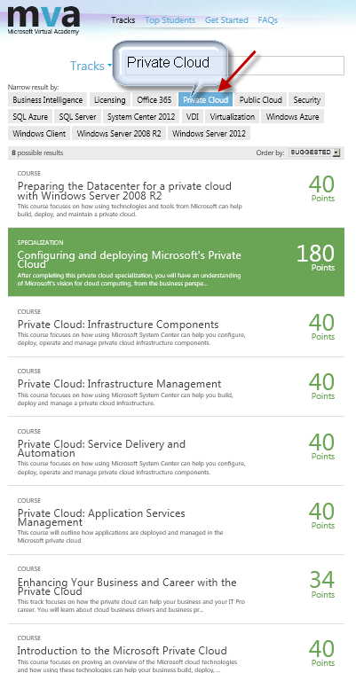
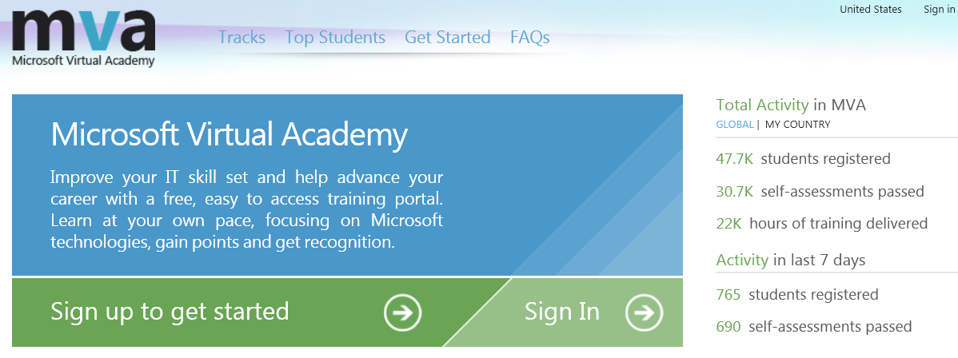

Microsoft Virtual Academy (MVA)
AKA.MS/GuruMVA
Then Private Cloud

Slide 6
What Do Employers Want Most?
Experience!
Go Getter!

Slide 7
Download Process Walkthrough
Windows 8
Windows Server 2012
System Center 2012
Windows Server 2008 R2 SP1
Hyper-V Server 2008 R2
ITProGuru.com
or
http://aka.ms/labs
1.
Go to Download Link
2.
See the Download page
3.
Enter or Establish your Live ID
4.
Download Manager
Begins – then cancel for Credit

Slide 8
How to GET EXPERIENCE… Leverage Community!
What or WHO is the “Community” and How can they help?
Community Leaders
  User Group Leaders (Presidents, Board Members, Leaders, etc.)
  MVP - Most Valuable Professional (Microsoft MVP)
  Speakers – National & Local Shows, User Groups (TechEd, SharePoint Sat, Etc)
  Influential Bloggers and Forum Participants
  Teachers and Trainers (MCT - Microsoft Certified Trainers and other trainers too)
  Writers, Authors – Magazines, Books, White Papers, etc.
  Other people in the industry that help the broader online or in person community
    Meetup.com / LinkedIn.com / Facebook … Many more
Members of the your field (Like Interests)
  All persons that work in the your field or are in some other way closely linked to the field (eg IT Manager, Help Desk, Marketing Dept. of Software company, etc.)
They can give you a bunch of experience and additional training
You will help yourself by helping them!!! Win-Win
Winning is not everything, but the effort to win is
-- Zig Ziglar
Habit 4: Think Win-Win
-- Stephen R. Covey

Slide 9
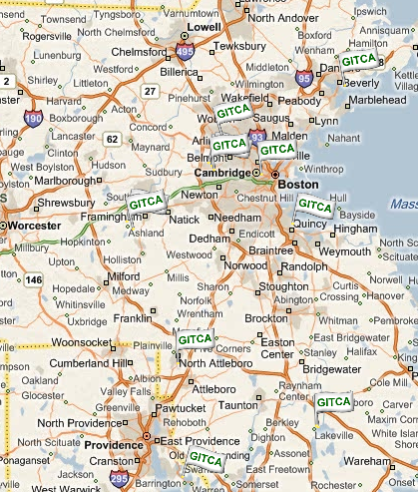
Technology Community Sample
Boston Area / New England
Group Name
Greater Boston Association of Information Technology Professionals
Association of Information Technology Professionals SE
Back Bay Large Installation System Administration
Beantown.NET User Group
Boston .Net Architecture Study Group
Boston .NET Certification Group
Boston .NET User Group
Boston Area Windows Server User Group
Boston AVID User Group
Boston Final Cut Pro User Group
Boston Linux & Unix User Group
Boston Macintosh User Group
Boston Pocket PC - Boston/New England Windows Mobile User/Developer Group
Boston XNA Developers Group
C# User Group of Greater Boston
Cape Cod .NET User Group
Connecticut .Net Developers Group
Connecticut ACCESS User Group ( CtAUG )
Connecticut Java User Group
Connecticut Object Oriented Users Group, Inc.
Greater New Hampshire Linux User Group. GNHLUG
Monadnock Linux User Group. ( Monadnock )
Seacoast Linux Users Group (SLUG)
Merrimack Valley Linux User Group. ( MerriLUG )
Independent Computer Consultants Association. The Greater Boston Chapter
Internet Professionals (IP-495)
National Information Security Group, Inc. Boston Chapter
New England Digital Media User Group
New England Regional SharePoint User Group
New England Small Business Server User Group
New England SQL Server User Group.
New England Visual Basic Professionals User Group
New Hampshire .Net User Group
New Hampshire Seacoast Mac Users
New Hampshire SQL Users Group.
North Shore Computer Society - NSCS
Northeast Autosys User Group
Northeast Oracle User Group
OWASP Boston Chapter ( Focus: Web Application Security)
Sea-Tug
SIBMUG (Seacoast IBM Users Group)
Southern New England Network Users Group. (SneNUG)
Storage Networking user Group. Boston/NE
Adobe Boston Users Group. ( ABUG )
Boston PDA User Group
Exchange Server Boston User Group
Greater Boston Chapter of DAMA International
Greater Boston Network User Group
Agile Boston User Group
Northern Delaware .Net User Group
Central New Yorks .NET Developer Group (CNY .NET Developer Group)
Boston.pm ( Boston Chapter of Perl Mongers, the association of Perl User Groups. )
Agile New England
DLSLUG Dartmouth-Lake Sunapee Linux User Group. DLSLUG
Central New Hampshire Linux User Group ( CentraLUG )
New Hampshire Ruby / Rails Group. ( RubySIG )
Python Special Interest Group. PySIG
Keene State College Linux User Group. KSCLUG
Virtualization Group - Boston. ( VIRTG )
Southern New England SQL Server Users Group
Western Mass Microsoft Technology Users Group
MaineBytes -.net User Group
New England ASP.NET Professionals User Group
International Association of Software Architects (IASA) New England Chapter
New England F# User Group (NEFSUG)
Agile Connecticut User Group
Fairfield / Westchester .NET User Group
Fairfield / Westchester SQL Server User Group
Fairfield County SharePoint User Group
BAND - Bangor Area .NET Developers
Maine Developer Network
New Jersey Microsoft Developer Group ( NY/NJ )
Tech Valley User Group
Visual Developers of Upstate NY (VDUNY)
Western New York .Net User Group (WNY DNUG)
Rochester, NY SharePoint User Group
The Rhode Island .NET User Group
Vermont .NET User Group
Vermont SQL Server User Group
Boston Azure User Group
Nashua Scrum Club
Cape Code XNA User Group
Western New York Professional Association of SQL Server (WNYPASS)
Boston Flex User Group
North-East Open Text User Group
BOSTON BUSINESS INTELLIGENCE User Group
Boston Area SharePoint Users Group
MacTechGroup
DotNetNuke Boston User Group
Joomla! Users Group Boston
BostonCHI
Boston WebsiteSpark Group
Boston Python Meetup
New England Silverlight Guild ( Cambridge, MA )
New England Silverlight Guild ( Farmington, CT
www.BostonUserGroups.org

Slide 10

Why get involved… What Do You Want?
Money? Security? Lifestyle? Experience?
What are your goals?
  Write them down; Look at them daily!
  Break them down into manageable and achievable goals
  Invest in yourself
What Are You Willing To Do To Get It?
Bottom Line… (Magic Tip #1) Live a purpose driven life and PLAN to WIN!
You were born to win, but to be a winner, you must plan to win, prepare to win, and expect to win.
-- Zig Ziglar

Slide 11
Leaders ARE Readers!
Prepare to become a leader in your community in your career and in your life…
The first thing to do is… (Magic Tip #2)
Act like a leader…
Abraham Lincoln
Harry Truman
Ronald Reagan
Bill Clinton
Barack Obama
Pick a president …
Opra Winfrey
Zig Ziglar
Dale Carnegie
Stephen Covey
Where to Start?
One Leadership Development Book every three months
  Dale Carnegie – How To Win Friends and Influence People
  Stephen Covey – 7 Habits of Highly Effective People
  Zig Ziglar – See You At The Top
One Technology book every three months
  Windows, SharePoint, Virtualization, or Whatever
Learn how to read FAST…
Eventually: a book a month then even more ☺
"Not all readers are leaders, but all leaders are readers."
— Harry S. Truman

Slide 12
Presentation
Public Speaking Skills = Interviewing Skills
Online Presence – Blog, Forums, Website
Build and prove your technical acumen, gain technical expertise
Proof of attention to detail, develop online reputation
Presentation Preparation Skills = Resume Skills
Proof of being a go getter, people will find you
“You Learn significantly more from giving a presentation than you do from attending a presentation” – Stephen R. Covey
  Give a person a fine reputation to live up to
  -- Dale Carnegie

Slide 13
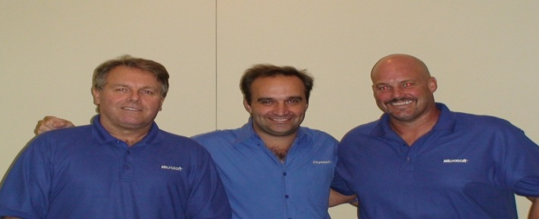

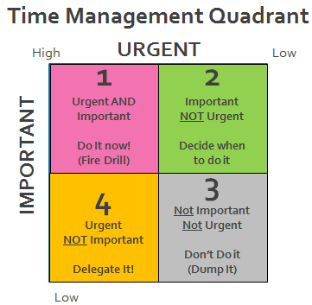
Learn From Your Community Experiences…
Finding Speakers and Sponsors
Negotiating Skills - Humility
Get to know people with different technical backgrounds
Relationships with companies and key people in those companies
Social Networks
Twitter, LinkedIn
Facebook, YouTube
TechNet Forums or Other
Project and Time Management
Build Your Soft Skills
  Organizational Skills
  Time Management Skills
  People Management Skills
  Leadership Skills
Arouse in the other person an eager want:
He Who Can Do This Has the Whole World with Him. He Who Cannot Walks a Lonely Way
-- Dale Carnegie

Slide 14
Links From Dan Stolts “ITProGuru”
Boston User Groups – http://BostonUserGroups.org – North East US User Groups
GITCA – http://www.gitca.org User Groups around the world!
ITProGuru Blog – http://ITProGuru.com – More detailed HOW TO… information
  How To Successfully Deliver Presentations for Community Leaders and Professional Speaker ...
  Scale Your Message Online Improving Blog Exposure and Increase Reach of Your Message by ...
  Online Collaboration - Publishing PowerPoint Slides to Your Blog or Website Using Office ...
Microsoft Technology Community Groups – www.TechnicalCommunity.com
TechEd Online (lots of technical content) – http://msTechEd.com
TechNet – http://TechNet.com
Sign up to be on Dan’s Member List http://ITProGuru.com/join
This Slide Deck http://ITProGuru.com/resources
(Resources Link on Main page)
Free Software; Proof of Concept!; Tips
Infrastructure As A Service
Windows 8
Windows Azure 90-day free trial
Dan's Lab Advice
Windows 2012
Win2008 R2 SP1
System Center 2012
Free Training (MVA)

Slide 15
Start Building Your Community and Your Career Today!
Magic Tip (#5) Start Now!
Write down WHY this is important to you! Read it every day.
Start developing your “Personal Mission Statement”. Follow it every day.
Find Community Groups in your area… Visit many of them and volunteer for the one(s) that interest you. Bing.com:
  Technology + User Group (ex: Windows Server User Group)
  Technology + virtual + community (ex: System Center Virtual Community)
  Geo Area + User Group (ex: Boston User Group)
  Technology + Forum (ex: SharePoint Forum)
  Any combination of above
Start slow.. But start today: Reserve X hours each week to build your plan, yourself, your community and your career. X should start out small so you do not overwhelm yourself. Eventually, you will likely find yourself spending X*2 or more per day ☺
Introduce yourself to someone new daily if possible (start with the person next to you)
  Objective: Learn as much as you can about the other person (be interested in them)
  Need help? Ask BING… “working a room introduce yourself” for tons of tips.
  Want more guidance… Check out Toastmasters
  Practice on me if you like… introduce yourself after the show
    Something like… Hi Dan, just want to take a minute to introduce myself. I am _______ …
Become genuinely “Interested” in other people
-- Dale Carnegie
The future belongs to those who live intensely in the present.
- Anonymous

Slide 16
I Get Networking And Helping Others Is Important… But, That Is Not Me!
That is not you because you have not learned HOW!
You have not learned it well enough to be comfortable doing it!
You Need Conversation Starters… Introduce yourself and ask a question!
What are you studying in school
  How much time do you have left
What do you do for work
  How long have you been doing that?
Where do you work?
How long have you been there?
Are you a football fan? … How do you feel about what is going on with the _Patriots_or whatever
Are you a …. fan?
Have you gotten into social networking?
Where do you live? Where is that?
Kids? People love to talk about their kids!
  What age? Soccer, football, reading, math, driving (what age drives many more conversation continuation topics)
Be a good listener. Encourage others to talk about themselves
-- Dale Carnegie

Slide 17
Networking: What To Avoid
Politics (even if they bring it up)
Religion (even if they bring it up)
Any topic that is controversial (even it they bring it up)
Sex / Love Life / Other Personal Matters
Criticism / Judgement
Their Vacation until you have a relationship (unless they bring it up)
Their health or family health … until you have a relationship (unless they bring it up)
  Be a good listener. Encourage others to talk about themselves
  -- Dale Carnegie

Slide 18
Networking: What to do…
Ask a Question, but Avoid Sounding Like You Are Giving Them The 3rd Degree
Start a conversation… Ask a question…
It really does not matter… what you talk about… You just need to find common interests. Remember, they are likely uncomfortable too.
Make sure you “Offer” information about you during the conversation
Ex. Conversation where you introduce yourself to someone at this conference… Hi, My name is Dan Stolts
Hi Dan, I’m Jim
Hi Jim, nice to meet you. What do you think of the conference so far? …. Or just lead with your opinion of the conference followed by the question
Oh, I guess it is ok
Yeah, I can relate. I have been to 4 sessions and one was great, one was good and the other two were just ok. But even if the rest of the conference is not good, I feel I got enough out of the xyz session to make the whole day worth my investment. Have you gotten the value of your time back out of it yet?
No not really, but I am still hopeful.
What do you do for work? Are you here to get something specific to help you with your job? … asking multiple questions at once is ok … or you could just change the subject. Are you a Celtics Fan? They have been doing great…
Being a people person is not being a good talker… it is being a good listener.
-- Dan Stolts “ITProGuru”

Slide 19
Conversation Starters
These are conversation “Starters” this is not the conversation
Technology Professionals
User Group Leader
What technologies do you work with
Where do you work
  How long…
Unemployed…
  What are you looking for?
  What are your strengths?
  What companies are you targeting?
Where do you live
Do you have any hobbies?
Hobbies…
Vacation – careful here!!
Same as Technology Professional
How long have you been a leader (or on the board) for this group?
How many people are on the board
How much time does it take to run a group … what do you get out of running the group… why do you do it
What are some of the challenges the group faces now
Is the group growing? Have you embraced social networking to grow the group?
How much time does it take to run the group?
Are you involved with other groups
… if you are interested in helping the group… do you need any help? If so, what would I need to do to get started?
Do not overcommit… Instead, under commit and over deliver
-- Dan Stolts “ITProGuru”

Slide 20
More Starters…
Do your homework … No excuses before you go, check out blog, twitter, website, products/services, news, etc. So you can talk about his/her interests.
Speakers
Vendors / Business Owners
How often do you speak at events
What other topics to you speak on
Do you have your schedule posted online
Do you cover the local area do you do a bunch of traveling
It looks like a really cool job, how did you get into the field
Do you have a twitter account
What do you like best about your work
What does your business do
Are you looking for new customers; what kind of companies would make a good referral for you
How long have you been in the business
Do you work with the technology community or leverage their support for prospects
How’s business
Talk in terms of the other persons interests
Make the other person feel important and do it sincerely
-- Dale Carnegie

Slide 21
Time Management Quadrant
URGENT
High
Low
1
Urgent AND Important
Do It now!
(Fire Drill)
2
Important
NOT Urgent
Decide when
to do it
IMPORTANT
4
Urgent
NOT Important
Delegate It!
3
Not Important
Not Urgent
Don’t Do it
(Dump It)
The only way to get the best of an argument is to avoid it
Show respect for the other person’s opinion. Never tell them they are wrong.
-- Dale Carnegie
Low

Slide 22
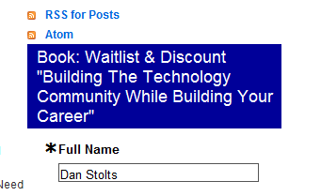
Key Takeaways - 5 Magic Tips
Live a purpose driven life and PLAN to WIN!
Act like a leader – Read a book
Help Others And You Will Become a People Person
Invest in Yourself; Educate Yourself
Start NOW!
Recommended Reading:
  Dale Carnegie – How To Win Friends and Influence People
  Stephen Covey – 7 Habits of Highly Effective People
  Zig Ziglar – See You At The Top
Sign up to be alerted when Dan’s book on building the technology community comes out http://www.ITProGuru.com
"There are two ways to climb an oak tree. You can climb it, or you can sit on an acorn and wait for it to grow.“
-- Zig Ziglar

Slide 24
Emergency Exit, Rest Room, Cell
Event Format
Continual Partnership
9 - Yeah, I learned plenty (A-)
8 - Cool event (B-)
7 - Action items to improve (C-)
6 – This is not good (D-)
… You get the picture…
Logistics
Score generously, actionable feedback

Slide 25

Windows Server 2012 Windows 8 Requirements
Windows 8
1 gigahertz (GHz) or faster 32-bit (x86) or 64-bit (x64) processor
1 gigabyte (GB) RAM (32-bit) or 2 GB RAM (64-bit)
16 GB available hard disk space (32-bit) or 20 GB (64-bit)
DirectX 9 graphics device with WDDM 1.0 or higher driver
Taking advantage of touch input requires a screen that supports multi-touch
Windows Server
1.4 GHz 64-bit processor
512 MB RAM
32 GB Disk Space
Super VGA (800 x 600) or higher-resolution monitor
DVD drive, Keyboard, mouse

Slide 26

Hyper-V Requirements
Virtualization Technology
* X64 Architecture with Hardware Assisted Virtualization
Likely found under Configuration then “Virtualization” or “Processor”
Intel: Intel VT
AMD: AMD-V
Execute Disable
* Hardware enabled Data Execution Prevention (DEP)
Likely found under Configuration then “Security”
Intel: XD bit (Execute Disable)
AMD: NX bit (no Execute bit)
Hyper-V on Client MUST have SLAT ****
** Intel: EPT Intel processors whose names start with 'i', e.g. i3, i5, i7, i9
*** AMD: RVI/NPT
**** SLAT is a feature of the CPU = Second Level Address Translation
Samples:
  Lenovo T410, T510, W510, W520, T420s, T520, X201
  Samsung 900x / Dell Precision M4600
  * Bios Requirements for Enabling Hyper-V. Short video to show exactly where you might find these settings. http://aka.ms/BiosHyper-V
** Intel: There may be exceptions Any Intel CPUs based on Nehalem, Westmere, or Sandybridge micro-architectures (there may be exceptions)
*** AMD Support http://support.amd.com/us/kbarticles/Pages/GPU120AMDRVICPUsHyperVWin8.aspx
**** SLAT AKA Extended Page Tables (EPT) AKA Nested Page Tables (NPT) AKA Rapid Virtualization Indexing (RVI) More on TechNet regarding SLAT: http://social.technet.microsoft.com/wiki/contents/articles/1401.hyper-v-list-of-slat-capable-cpus-for-hosts.aspx
Notes:
Understanding SLAT Understanding High-End Video Performance Issues with Hyper-V
capable PC’s http://social.technet.microsoft.com/wiki/contents/articles/1401.hyper-v-list-of-slat-capable-cpus-for-hosts.aspx
Upgrades to this version from Windows Server 2008 and Windows Server 2008 R2 are supported. However, only upgrades from the same server edition are supported. You will not be able to upgrade to subsequent releases from this release

Slide 27
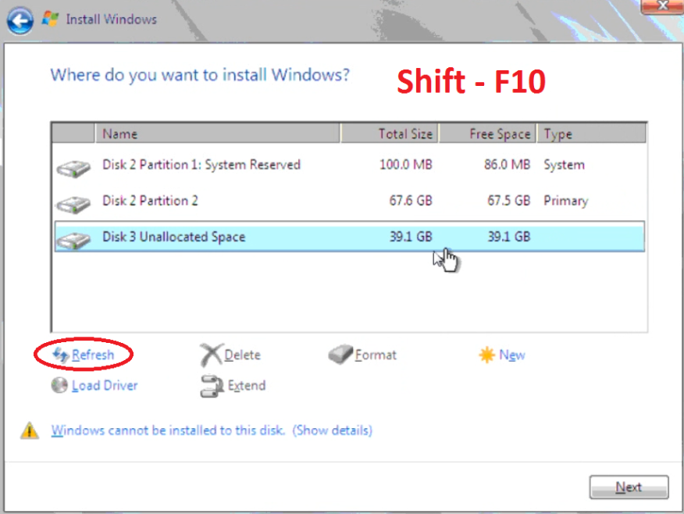
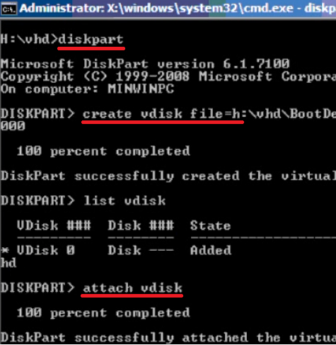
Dual Boot To VHD
Start Installation
Format Media (if doing bare metal install)
  You should be on the “Where do you want to install Windows?” screen of the installation press Shift-F10 to drop to command prompt
Find installation drive (dir c:, dir d:, dir e:, etc)
Diskpart
  Create vdisk file=e:\BootDemo.vhd type=expandable maximum=40000
  Attach vdisk
  Exit
Click “Refresh” button
Select “New Drive” and perform normal installation
Using this method, the BCD will be updated automatically

Slide 28
Demo
Demo
Installing Windows 8 or
Installing Windows Server 2012

Slide 29
Intro to Hyper-V
Notes:
http://blogs.msdn.com/b/b8/archive/2011/09/07/bringing-hyper-v-to-windows-8.aspx
An introduction to Hyper-V
Hyper-V requires a 64-bit system that has Second Level Address Translation (SLAT). SLAT is a feature present in the current generation of 64-bit processors by Intel & AMD. You’ll also need a 64-bit version of Windows 8, and at least 4GB of RAM. Hyper-V does support creation of both 32-bit and 64-bit operating systems in the VMs.
Hyper-V’s dynamic memory allows memory needed by the VM to be allocated and de-allocated dynamically (you specify a minimum and maximum) and share unused memory between VMs. You can run 3 or 4 VMs on a machine that has 4GB of RAM but you will need more RAM for 5 or more VMs. On the other end of the spectrum, you can also create large VMs with 32 processors and 512GB RAM.
As for user experience with VMs, Windows provides two mechanisms to peek into the Virtual Machine: the VM Console and the Remote Desktop Connection.
The VM Console (also known as VMConnect) is a console view of the VM. It provides a single monitor view of the VM with resolution up to 1600x1200 in 32-bit color. This console provides you with the ability to view the VM’s booting process.
For a richer experience, you can connect to the VM using the Remote Desktop Connection (RDC). With RDC, the VM takes advantage of capabilities present on your physical PC. For example, if you have multiple monitors, then the VM can show its graphics on all these monitors. Similarly, if you have a multipoint touch-enabled interface on your PC, then the VM can use this interface to give you a touch experience. The VM also has full multimedia capability by leveraging the physical system’s speakers and microphone. The Root OS (i.e. the main Windows OS that’s managing the VMs) can also share its clipboard and folders with the VMs. And finally, with RDC, you can also attach any USB device directly to the VM.
For storage, you can add multiple hard disks to the IDE or SCSI controllers available in the VM. You can use Virtual Hard Disks (.VHD or .VHDX files) or actual disks that you pass directly through to the virtual machine. VHDs can also reside on a remote file server, making it easy to maintain and share a common set of predefined VHDs across a team.
Hyper-V’s “Live Storage Move” capability helps your VMs to be fairly independent of the underlying storage. With this, you could move the VM’s storage from one local drive to another, to a USB stick, or to a remote file share without needing to stop your VM. I’ve found this feature to be quite handy for fast deployments: when I need a VM quickly, I start one from a VM library maintained on a file share and then move the VM’s storage to my local drive.
Another great feature of Hyper-V is the ability to take snapshots of a virtual machine while it is running. A snapshot saves everything about the virtual machine allowing you to go back to a previous point in time in the life of a VM, and is a great tool when trying to debug tricky problems. At the same time, Hyper-V virtual machines have all of the manageability benefits of Windows. Windows Update can patch Hyper-V components, so you don’t need to set up additional maintenance processes. And Windows has all the same inherent capabilities with Hyper-V installed.
Having said this, using virtualization has its limitations. Features or applications that depend on specific hardware will not work well in a VM. For example, Windows BitLocker and Measured Boot, which rely on TPM (Trusted Platform Module), might not function properly in a VM, and games or applications that require processing with GPUs (without providing software fallback) might not work well either. Also, applications relying on sub 10ms timers, i.e. latency-sensitive high-precision apps such as live music mixing apps, etc. could have issues running in a VM. The root OS is also running on top of the Hyper-V virtualization layer, but it is special in that it has direct access to all the hardware. This is why applications with special hardware requirements continue to work unhindered in the root OS but latency-sensitive, high-precision apps could still have issues running in the root OS.
As a reminder, you will still need to license any operating systems you use in the VMs.

Slide 30
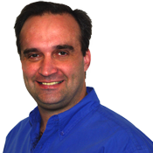

Dan Stolts
Chief Technology Strategist
dstolts@microsoft.com
http://ItProGuru.com
Bob Familiar, my manager, would love your feedback on today’s event.
He wants to know what impact todays event has on you and your business
You can e-mail him at: Bob.Familiar@microsoft.com
Notes:
30

Slide 31
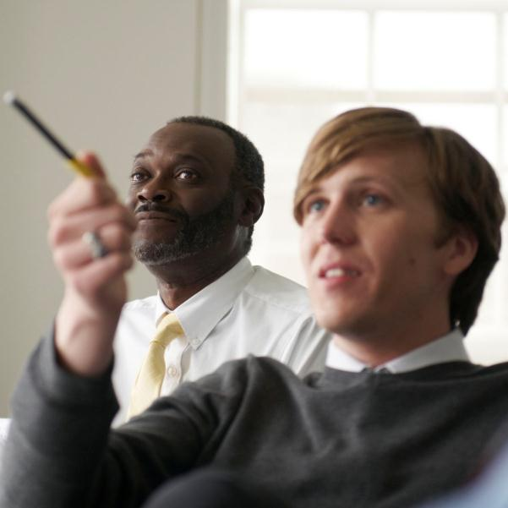

Call To Action
@ITProGuru
Follow Blog ITProGuru.com
Microsoft Virtual Academy: aka.ms/gurumva
Aka.ms/GuruMVA
DOWNLOAD Windows Server 2012 Release Candidate
Aka.ms/getwin2012
DOWNLOAD Microsoft System Center 2012 Evaluation
Aka.ms/getsc2012
Certification
Read!
Get Experience by Helping Community
Create Blog; Frequent Forums
Play with & Learn About Infrastructure As A Service

Slide 32
Emergency Exit, Rest Room, Cell
Event Format
Continual Partnership
9 - Yeah, I learned plenty (A-)
8 - Cool event (B-)
7 - Action items to improve (C-)
6 – This is not good (D-)
… You get the picture…
Logistics
Score generously, actionable feedback

Slide 33




Resources
Learning
  Connect. Share. Discuss.
  Microsoft Certification & Training Resources
http://northamerica.msteched.com
www.microsoft.com/learning
TechNet
  Resources for IT Professionals
  Resources for Developers
http://microsoft.com/technet
http://microsoft.com/msdn

Slide 34
© 2012 Microsoft Corporation. All rights reserved. Microsoft, Windows, Windows Vista and other product names are or may be registered trademarks and/or trademarks in the U.S. and/or other countries.
The information herein is for informational purposes only and represents the current view of Microsoft Corporation as of the date of this presentation. Because Microsoft must respond to changing market conditions, it should not be interpreted to be a commitment on the
part of Microsoft, and Microsoft cannot guarantee the accuracy of any information provided after the date of this presentation. MICROSOFT MAKES NO WARRANTIES, EXPRESS, IMPLIED OR STATUTORY, AS TO THE INFORMATION IN THIS PRESENTATION.

