Slide 1
Microsoft Azure
(Plus a little something on Windows 10)
Dan Stolts
Chief Technology Strategist - Microsoft Corporation
http://ITProGuru.com | @ITProGuru

Slide 2
Story..
A Cab/Taxi Company
Founded 2009
Launch 2010
The cloud and a vision
made it possible!
How was this company’s success possible?
What does this have to do with Cloud?
Notes:
A startup business launched in 2010 that would ultimately change the way we travel the streets of the world when we do not have our cars. This company grew to be a global powerhouse in less than 5 years! I have no doubt everyone in this room has either used them or at least heard of them and understand what they do and how they can help you when in need. This company is now, a mere 5 years after launch, a $50 BILLION business. The company started out as UberCab and shortly thereafter changed their name to simply Uber. That’s an impressive feat for sure. But consider this... Uber is one of the largest Taxi companies in the world but they do not own a single Car! But wait, their’s more. What happens when cars can drive themselves? How many MORE people will want to take advantage of this opportunity to generate revenue with their car.
How was this possible? The cloud and a vision!

Slide 3
A SHORT Story…
A Software Company
Everything can change in a very short period of time and we in the IT and Security business need to be able to change to keep up with it.
Notes:
A not so small software company who had a reputation for being a bully, slow and stale. A company that lost it’s ability to “innovate”. With some 190,000 employees many thought the company had become irrelevant and many more expected that this would be the inevitable outcome for the companies long term outlook. Just over 5 years ago, on February 1, 2010 the company launched a new product that would not only change the fate of the organization but change the way the world thinks about cloud computing. The product was then called Windows Azure. Others were already in the cloud business but focusing on Virtual Machines in the sky. Microsoft started out with a new and very different model and 5 years later is the biggest cloud provider in the world. This technology so fundamentally changed the company that it is no longer a software company. It is now a Services and Devices company and if you reach any trade magazine or newspaper today you will read about them being considered the leading innovator of our time.
What does this have to do with security? Everything. Everything can change in a very short period of time and we in the IT and security business need to be able to change with it.

Slide 4
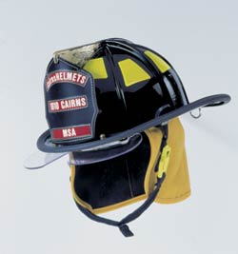

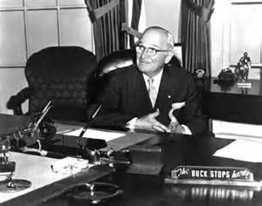


The way it is…
YOU Are Needed
Starts
@ITProGuru

Slide 5

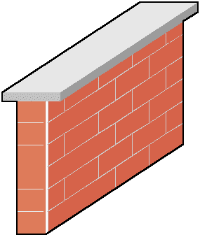

Provide Business Units The Service(s) and Solutions They Need
Or…
Your Business Unit Will…
You WILL …
Lose Money
Not Hit Their Numbers
Go Around You!
Find a Solution
Host it in the cloud
Stray from policy and procedures
Miss Opportunity
Lose Control
Lose Visibility
Lose Management
Still be RESPONSIBLE if the $%^&* hits the fan!!!
Lose your SANITY? Your JOB?
AKA: Shadow IT
@ITProGuru

Slide 6
The Talent Problem
CIO Survey + Conversation Evidence
Get Smart on the business!
Get Smart on Technology!
  Cloud
  Datacenter
  Security
  Data

Slide 7

Translating Business Problem to Technology Solution
Often Really HARD!!!
Two trains leave different cities heading toward each other at different speeds. When and where do they meet?
Train A, traveling 70 miles per hour (mph), leaves Westford heading toward Eastford, 260 miles away.
At the same time Train B, traveling 60 mph, leaves Eastford heading toward Westford.
When do the two trains meet?
How far from each city do they meet?
Business Problem
http://mathforum.org/dr.math/faq/faq.two.trains.html
Technology Solution
AKA: Functional Requirements
Addresses a business need or opportunity
Language: Business (vision, strategic mission, objectives, processes)
Often many problems are manifests so root problem often difficult to identify
People who understand the business typically not smart about technology
Perspective: Business climate, emerging industry issues, culture, business aim
What are the usability implications
AKA: Technical Requirements
Addresses a technology challenge
Language: Technology (Programming, Infrastructure, Cloud, IoT)
Often many solutions are required to solve one business problem
Solve for y = ((x + 2) * (x + 7) )/ 127
People who understand technology often do not understand business challenges
Perspective: Technology Available, technical skills, technical resources
What are the Security Implications
@ITProGuru

Slide 8


Translate Business Objectives Into Actions
Identify Problems (especially root problems)
Determine the requirements to solve each problem
Determine technology available to help solve the problem
Identify strategic partners
Determine likely barriers
Determine additional value (if any)
Get Started
@ITProGuru

Slide 9
Complicating The Situation…
Business Units are accustomed to …
  IT coming up with objections
  IT not understanding needs
  IT Not delivering in a timely fashion
  IT as a barrier to progress
  ….
Why?
  Poorly formulated plan
  Does not follow procedures
  Not enough time
  Don’t have the right skills
  ….
We Need to get their confidence back
Get them to engage you early
then OVER DELIVER for a few years!
@ITProGuru

Slide 10
New Pulse of IT
Get Smart, Be Strategic; Solve Business Problems
How can you deliver services faster?
How can you help the company continue expansion?
How can you increase customer satisfaction or retention?
What are current pain points for…
  Customers? Partners? Employees?
What new services (cloud, mobile) might your company be able to benefit from?
Projects on a shelf for lack of infrastructure or money?
Your Vision + New Cloud Solution = Success!
@ITProGuru

Slide 11

Example: Azure Certification Jump Start
70-534 Architecting Microsoft Azure Solutions
Brought to you By:
@ITProGuru
Microsoft
8:00 Registration, Breakfast and Networking
8:30 Sharp: 70-534 Introduction
Exam Tips and Tricks
Design Microsoft Azure infrastructure and networking (15–20%)
Secure resources (15–20%)
Design an advanced application (15–20%)
Lunch & Labs
Design websites (15–20%)
Design an application storage and data access strategy (15–20%)
Design a management, monitoring, and business continuity strategy (15–20%)
Field Experiences
5:00pm Book Signing – Authors Dan Stolts (some locations)
5:00pm Social Hour w/ Speakers and Friends
Registration Required
Coming Soon…
Join EVENTS Mailing List NOW!
http://www.amazon.com/dp/0735697442/ref=rdr_ext_tmb
ITProGuru.com/Join
Text Book for Attendees
Notes:
http://aka.ms/70-534 – Once it goes live..
Learn what you need to know to become a certified Azure Solutions Architect. We will go through the lessons found in the book 70-534 Architecting Microsoft Azure Solutions. We will wrap things up with our speakers (and authors of the book) doing a book signing so bring your copy of the book.
70-534 Introduction
Exam Tips and Tricks
Design an advanced application (15–20%)
Design websites (15–20%)
Design a management, monitoring, and business continuity strategy (15–20%)
Design Microsoft Azure infrastructure and networking (15–20%)
Secure resources (15–20%)
Design an application storage and data access strategy (15–20%)
Field Experiences
Book Signing – Authors Dan Stolts, Steve Maier

Slide 12
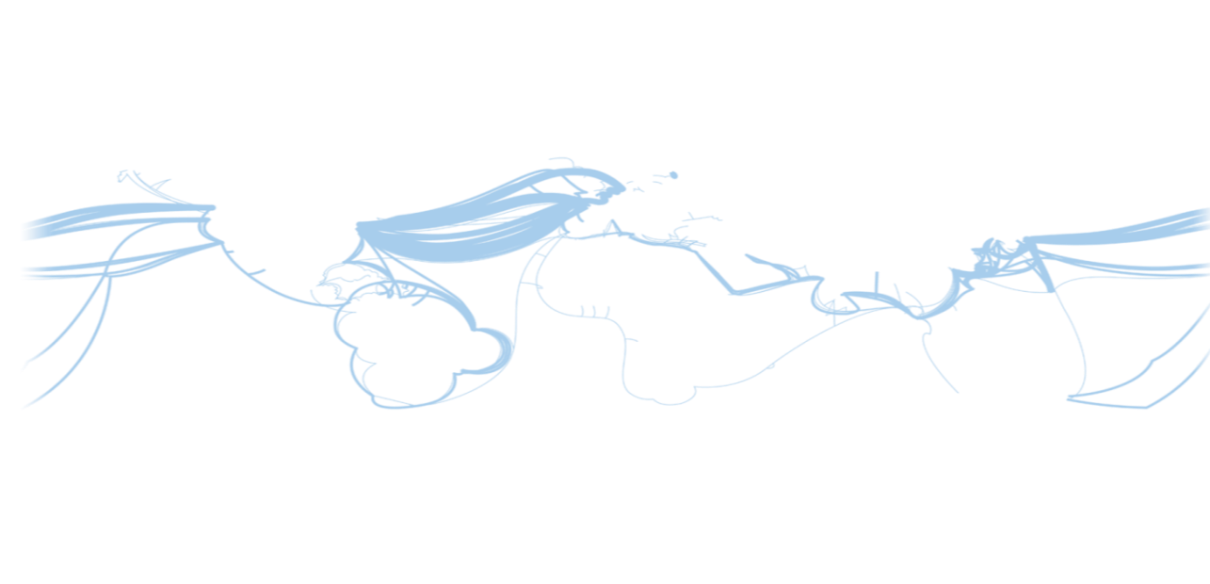
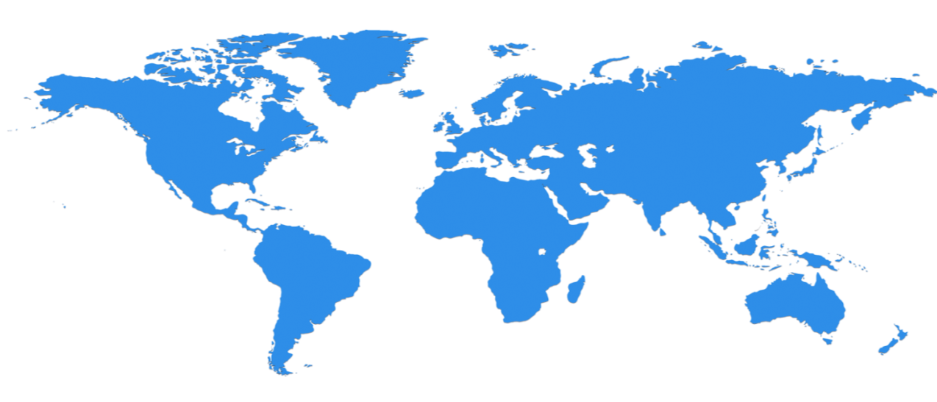

Microsoft Azure Infrastructure
23 Regions ONLINE…huge datacenter capacity around the world…and we’re growing
North Europe
Ireland
West Europe
Netherlands
Central US
Iowa
North Central US
Illinois
US Gov
Iowa
China North *
Beijing
East US
Virginia
Japan East
Saitama
West US
California
China South *
Shanghai
East US 2
Virginia
Japan West
Osaka
India West
TBD
India East
TBD
South Central US
Texas
US Gov
Virginia
East Asia
Hong Kong
SE Asia
Singapore
Australia East
Sydney
Brazil South
Sao Paulo
  100+ datacenters
  One of the top 3 networks in the world (coverage, speed, connections)
  2 x AWS and 6x Google number of offered regions
  G Series – Largest VM available in the market – 32 cores, 448GB Ram, SSD…
Australia West
Melbourne
Operational
Announced
  * Operated by 21Vianet

Slide 13
Datacenter buildings are about one football field in size
@ITProGuru

Slide 14
…large enough to hold two jumbo jets
@ITProGuru

Slide 15
That’s up to 600,000 servers in each Azure region
And there are 16 building per region…
@ITProGuru

Slide 16

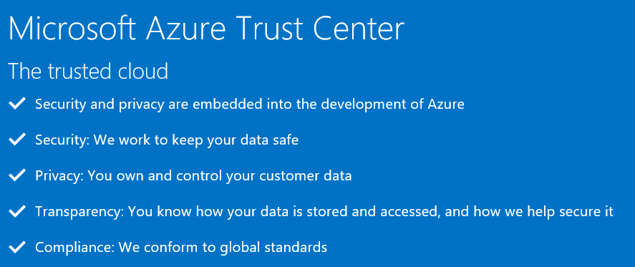
Azure Trust Center
http://azure.microsoft.com/en-us/support/trust-center/
@ITProGuru

Slide 17
Your cloud provider is your partner
Responsibility
On-Prem
IaaS
PaaS
SaaS
Customer management of risk
Data Classification | End Point Devices
Data classification
and accountability
Client & end-point
protection
Identity & access
management
Shared management of risk
Identity & access management
Application
level controls
Network controls
Provider management of risk
Physical | Networking
Host Security
Physical Security
@ITProGuru
Cloud Customer
Cloud Provider

Slide 18





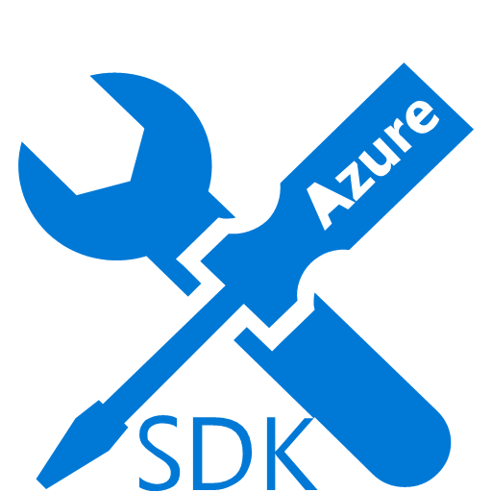
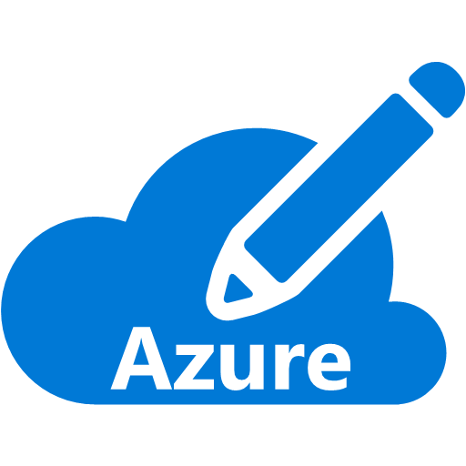

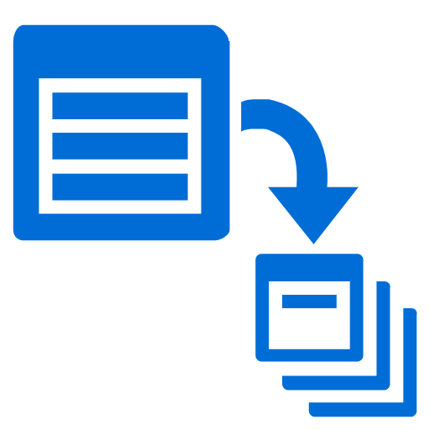

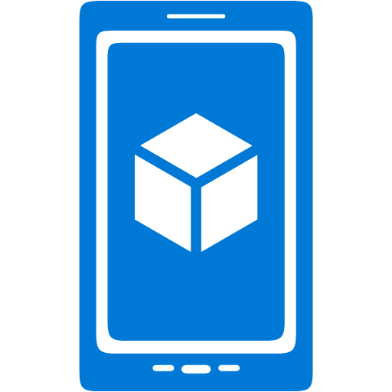











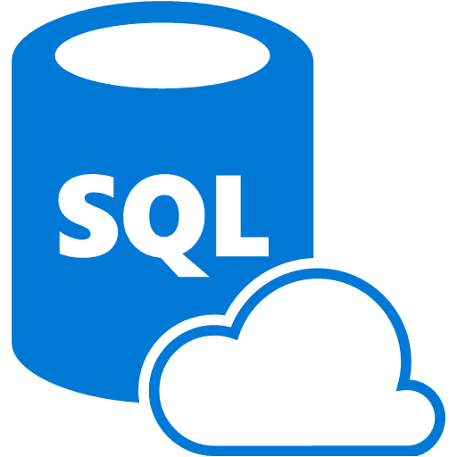









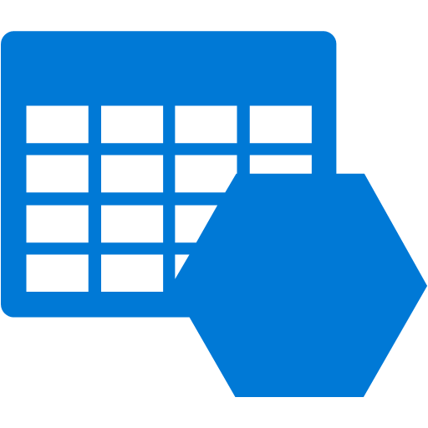










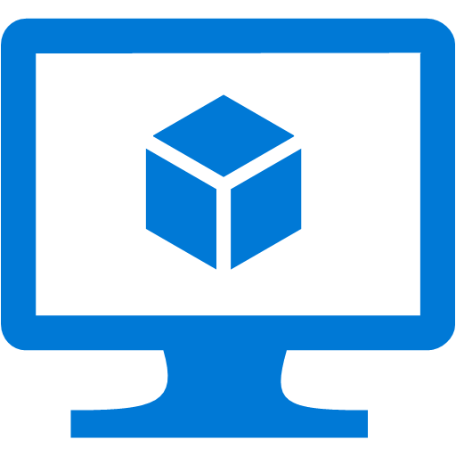








Azure = Building Blocks to Technology Solutions … Platform Services
Security & Management
Compute
Web and Mobile
Developer Services
Hybrid
Operations
Cloud
Services
Service
Fabric
Web Apps
API
Apps
API
Management
Visual Studio
Azure SDK
Portal
Azure AD
Connect Health
Batch
Remote App
Mobile
Apps
Logic
Apps
Notification
Hubs
Team Project
Application
Insights
Active
Directory
AD Privileged
Identity
Management
Multi-Factor
Authentication
Integration
Analytics & IoT
Data
Backup
Storage
Queues
Biztalk
Services
Automation
HDInsight
Machine
Learning
SQL
Database
SQL Data
Warehouse
Operational
Insights
Hybrid
Connections
Service
Bus
Key Vault
Data
Factory
Event
Hubs
Redis
Cache
Search
Import/Export
Store /
Marketplace
Media & CDN
Site
Recovery
Stream
Analytics
Mobile
Engagement
DocumentDB
Tables
VM Image Gallery
& VM Depot
Media
Services
Content Delivery
Network (CDN)
StorSimple
Infrastructure Services
Compute
Storage
Networking
Virtual Machines
Containers
BLOB Storage
Azure Files
Premium Storage
Virtual Network
Load Balancer
DNS
Express
Route
Traffic Manager
VPN Gateway
Application Gateway
Datacenter Infrastructure (24 Regions, 23 Online)
@ITProGuru

Slide 19
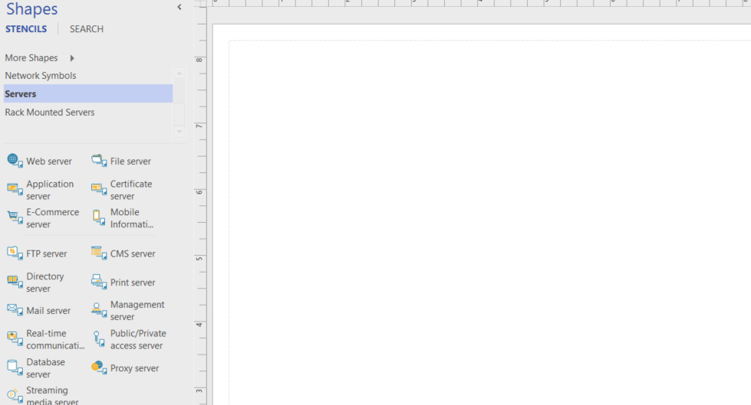
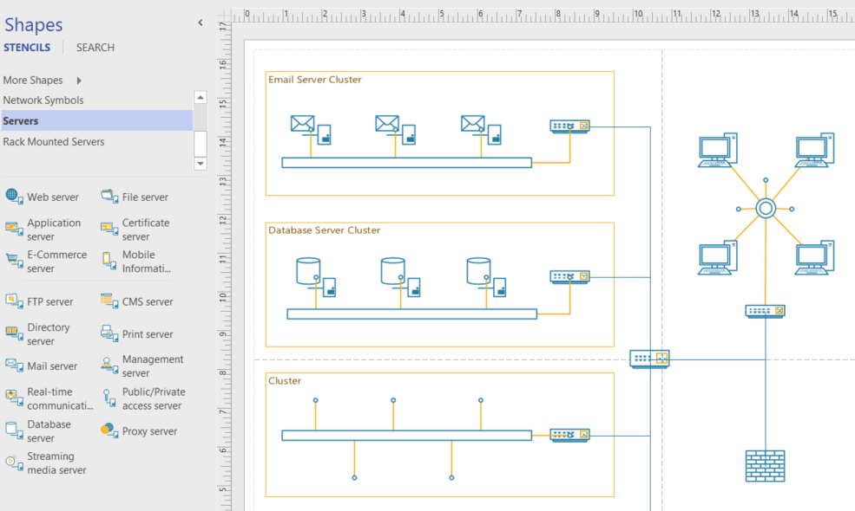
Like Visio, you start with a blank canvas…
Architect what is possible for your company. Solve Your Business Challenges with the Azure Cloud
@ITProGuru

Slide 20























Microsoft Azure
^{app}
^{services}
cloud services
caching
identity
service bus
media
mobile services
web sites
integration
hpc
analytics
^{data}
^{services}
SQL database
HDInsight
table
blob storage
^{infrastructure}
^{services}
virtual machines
virtual network
vpn
traffic manager
cdn
@ITProGuru
Notes:
Windows Azure is a broad stack of services that runs in our datacenters globally.
Think of the different services as building blocks. These services can be categorized into three classes –
Infrastructure services which are lower level building blocks,
Data services that provide storage and data management capabilities to apps, and
App services which provide different capabilities to rapidly develop apps, scale and run apps at a global scale.

Slide 21
Microsoft Azure
^{app}
^{services}
cloud services
caching
identity
service bus
media
Apps
mobile services
web sites
integration
hpc
analytics
^{data}
^{services}
SQL database
HDInsight
table
blob storage
caching
identity
cloud
services
table
^{infrastructure}
^{services}
virtual
network
virtual machines
virtual network
vpn
traffic manager
cdn
@ITProGuru
Notes:
You can use these blocks or puzzle pieces to rapidly build apps, and then choose an Azure datacenter to run the app. Windows Azure takes care of the underlying management, and provides your app the scale it needs.
This approach is what industry experts call a Platform as a Service.

Slide 22

Microsoft Azure
Azure datacenters,
your datacenters.
^{app}
^{services}
cloud services
caching
identity
service bus
media
web sites
integration
hpc
analytics
virtual machines
virtual network
mobile services
vpn
^{data}
^{services}
SQL database
HDInsight
table
blob storage
^{infrastructure}
^{services}
virtual
network
virtual machines
virtual network
vpn
traffic manager
cdn
vpn
@ITProGuru
Notes:
But that is not all that you can do with Azure. Windows Azure also provides infrastructure services which allow for more hands on configuration and management similar the servers you have today. However, they’re hosted in Microsoft datacenters letting you use Azure as if you were operating your own datacenter in the Cloud. For example, you can provision VMs, give them private IP addresses, and connect to them using a VPN from your on-premises environment. Most importantly, this lets Windows Azure mimic your on-premises datacenter and run your current apps with little or no change without the expense of having to own servers of racks, cooling and building costs. Furthermore, you can connect the “datacenter” you build in the Cloud to your on-premises datacenter so the datacenter in the Cloud becomes an extension to your on-premises infrastructure.
These “building blocks” lets Windows Azure to be used as an Infrastructure-a- a-service.
So, you see Windows Azure offers IaaS +PaaS in one platform. IaaS provides flexibility, PaaS eliminates complexity. Use PaaS where you can, use IaaS where you need. With Azure, you can use both together or independently, and build apps of the future. That uniquely differentiates us.

Slide 23







Virtual Machines
Virtual
Machines
Scalable, on-demand infrastructure for your apps and VMs
Apps with public web front ends, variable traffic sitting in demilitarized zone
Existing custom apps, specialty servers with batch processing patterns
No app changes – same VHD format
Manage with tools you know
Virtual
Network
Business Application
Windows Server
Active Directory
SQL Server
Internet
Windows Server
Active Directory
System Center
Operations Manager
Windows Server
Business Users
On-premises
Microsoft Azure
Business Users
@ITProGuru

Slide 24
Storage Scale
Microsoft Azure Storage
50+ Trillion Objects
“Microsoft consistently performed better than Amazon. It delivered the best speeds across small and medium-sized files and, in some cases, beat Amazon by nearly 2x.”
– Nasuni 2015 State of the Cloud Storage Report
@ITProGuru
Notes:
Let us now understand the Windows Azure storage system and some of its salient features.
Treat Windows Azure as a giant “hard drive”. Why do we call it a giant? Windows Azure Storage has over 4 trillion objects, processes an average of 270,000 requests per second, and reaches peaks of 880k requests per second!
Windows Azure Blob storage is actually the top most rated by Nasuni Cloud storage report. This ranking is based on a number of factors like read/write speeds, availability and performance metrics.

Slide 25
Azure Storage Options – Today
Platform as a Service
SQL Server running on the new D/G-Series
Azure Storage
Tables
Blobs
Queues
Azure SQL Database Basic/Standard/ Premium
Infrastructure as a Service
Document DB
Optimized for density
Cheap storage
No relational
Azure Search
Linux VMs
Integrate Chef or Puppet
Azure Cache
……many more
…more to come!
HD Insight
Premium Storage *
Windows Server 2012 R2
IaaS: increased capability allows you to run more
PaaS: evolving the managed offerings
@ITProGuru
Notes:
IaaS more of a complete offering

Slide 26




Hybrid Cloud Connectivity
OnPremNet
Microsoft Azure
CloudNet
On-Premises Network
Subnet 10.2.1.0 / 24 - Web
Site-to-Site
IPSec VPN tunnel
System Center
SQL
IIS
IIS
SharePoint
IPv4 Public Address
Subnet 10.2.0.0 / 24 - Gateway
Highly Available
Active / Passive
AD / DNS
VPN Gateway
VPN Gateways
Site-to-Site
ExpressRoute tunnel
Subnet 10.2.2.0 / 24 - Core
Exchange
BranchCache
File
AD / DNS
SQL
IP Address Space: 10.1.0.0/16
IP Address Space: 10.2.0.0/16
@ITProGuru

Slide 27
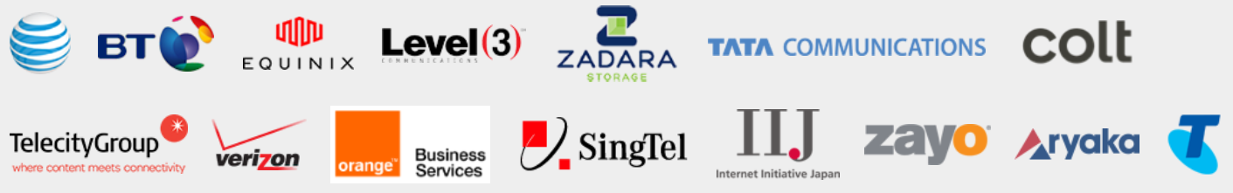
ExpressRoute
Site-to-Site VPN
ExpressRoute:
Exchange Provider
ExpressRoute:
MPLS Network Provider
Public
internet
Public
internet
Customer site 3
Microsoft Azure
Microsoft Azure
Customer site 2
WAN
Customer DC
Microsoft Azure
Customer site
ExpressRoute
partner location
Customer site 1
Public
internet
Connect via an encrypted link over public internet
Peer at an ExpressRoute location, an Exchange Provider facility
Connection from a WAN provided by Network Service Provider (e.g. telco).
Azure becomes another site on the customer’s WAN network.
Virtual Network - Compute only.
ExpressRoute - Provides customer choice and include access to
compute, storage, and other Azure services.
@ITProGuru

Slide 28

Azure Site Recovery
One migration solution for heterogeneous infrastructure
Microsoft Azure
Site Recovery
Microsoft Azure
Site Recovery
Microsoft Azure
Site Recovery
Orchestration and Replication
Orchestration and Replication
NEW
Orchestration and Replication
NEW
vCenter
Primary Site
Primary Site
Primary Site
Physical, Azure, or AWS
Hyper-V
VMware
Key features include:
Automated VM protection and replication
Remote health monitoring
Near zero RPO
No-impact migration testing
Customizable recovery plans
Minimal RTO – few minutes to hours
Orchestrated migration when needed
Replicate to – and recover in – Azure
Heterogeneous physical and virtual support
@ITProGuru

Slide 29




Hybrid Identity
Virtual
Machines
Virtual
Network
Connect hybrid infrastructure services with a single identity
Authenticate apps in virtual machines using
on-premises identities
Bring mature, enterprise adopted AD to apps in cloud
Enable hybrid scenarios through Virtual Network private secure connection to on-premises
Connect Office 365 and other SaaS Apps to on-premises identities
Windows Server
Active Directory DS
Windows Server
Active Directory ADFS
Microsoft Azure
Active Directory
LOB & custom apps
Windows Server
Active Directory
Internet
End Users
On-premises
Microsoft Azure
SaaS Apps
@ITProGuru

Slide 30
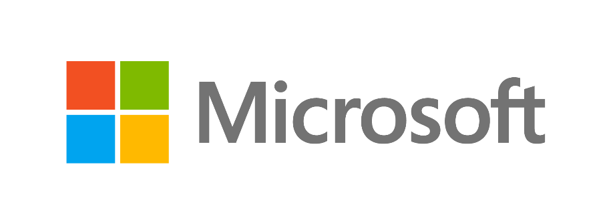
Azure Certification Jump Start
70-534 Architecting Microsoft Azure Solutions
All Attendees Go Home With The Book & Autograph!!!
8:00 Registration, Breakfast, Networking and say thanks to our sponsors
8:30 Sharp: 70-534 Introduction & Exam Tips and Tricks (Don’t be late!!!!)
9:15 Design Microsoft Azure infrastructure and networking (15–20%)
10:15 Secure resources (15–20%)
11:15 Design websites (15–20%)
12:00 Lunch & Meet Sponsors & Networking
1:00 Labs & Special Tribute (Hands-On-Labs - Bring your laptops & Power)
1:45 Design an application storage and data access strategy (15–20%)
2:45 Design an advanced application (15–20%)
3:45 Design a management, monitoring, and business continuity strategy (15–20%) – hardest module plan on staying
5:15 Evaluations, Book Signing and Social
Registration $25 Fee covers materials and food.
Registration Opening Soon:
Email itproguru@Microsoft.com to get an invite
http://www.amazon.com/dp/0735697442/ref=rdr_ext_tmb
Brought to you By:
@ITProGuru
Dec 7th 2015 – Microsoft – 11 Times Square NYC
Notes:
Learn what you need to know to become a certified Azure Solutions Architect. We will go through the lessons found in the book 70-534 Architecting Microsoft Azure Solutions. We will wrap things up with our speakers (and authors of the book) doing a book signing so bring your copy of the book.
70-534 Introduction
Exam Tips and Tricks
Design an advanced application (15–20%)
Design websites (15–20%)
Design a management, monitoring, and business continuity strategy (15–20%)
Design Microsoft Azure infrastructure and networking (15–20%)
Secure resources (15–20%)
Design an application storage and data access strategy (15–20%)
Field Experiences
Book Signing – Authors Dan Stolts, Steve Maier

Slide 31
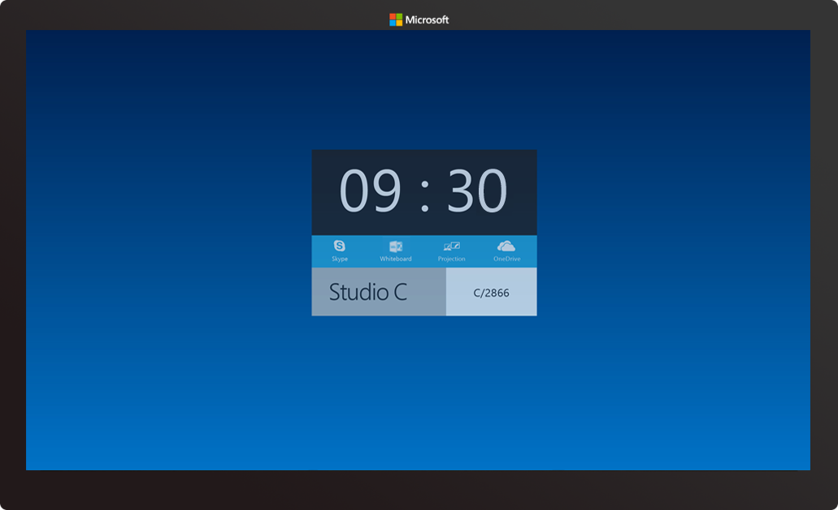
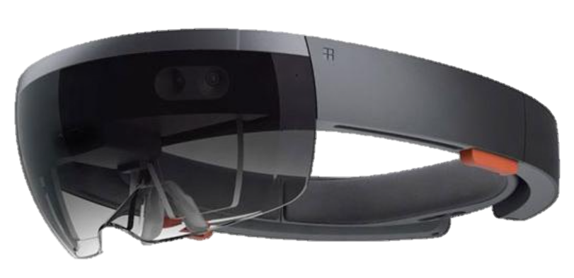

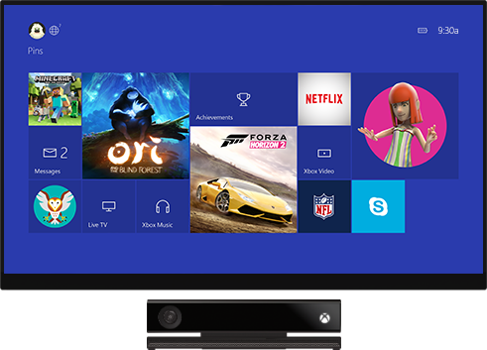
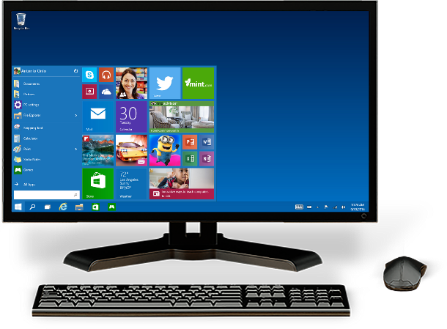
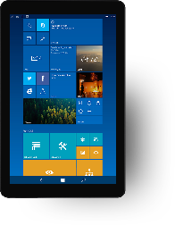
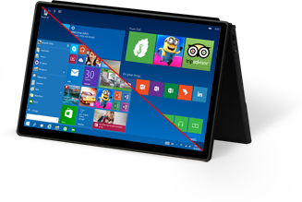
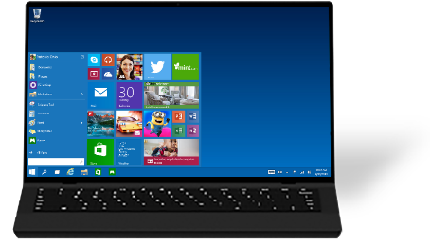

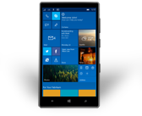
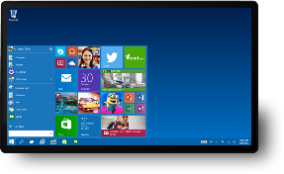

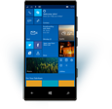
One product family
One platform
One store
@ITProGuru

Slide 32
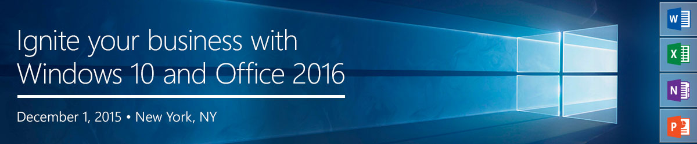
Dec 1st, NYC, Pier Sixty, Chelsea Piers 23rd Street and West Side Highway
Multi-Track: ITPro, Dev, Hands On Lab Tracks
Overview + Deeper content on:
  Apps, Browser (Edge and IE)
  Security
  Deployment / Configuration
  Update/Upgrade/Continuous Innovation
  More
@ITProGuru
https://www.microsoftevents.com/profile/web/index.cfm?PKwebID=0x743028cc

Slide 33

http://ITProGuru.com/Join
Keep Informed!!!
  Future Event Notifications
  Special Promotions
  Special Events / Advance Notice
  Member Benefits
@ITProGuru

Slide 34
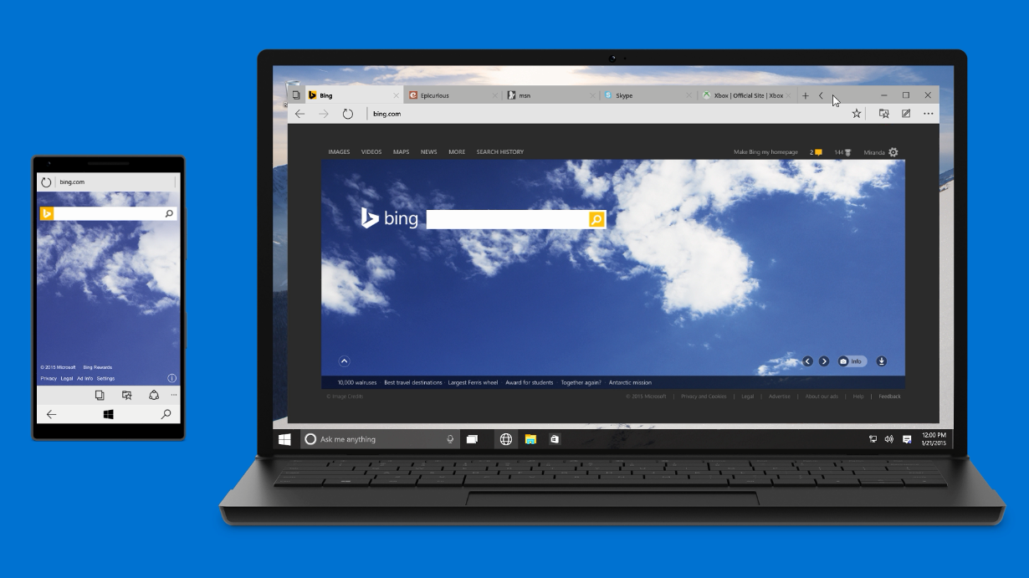
Microsoft Edge
Only browser with Cortana,
to get more done on the web
Distraction-free, offline reading
Built-in note-taking & sharing
@ITProGuru
Notes:
And that’s where Microsoft Edge comes in:
The new, default browser
Has unique experiences around Cortana, reading and note-taking – but rather than talk about these, I’d rather show them.

Slide 35
Microsoft Edge is…
Built for Windows 10
    Built on the Universal Windows Platform
    Updated frequently, along with Windows 10
    Manageable through Group Policy, Mobile Device Management
Ready for the future
    Free from legacy Internet Explorer extensibility points
    Built on top of modern security protections
    Able to launch Internet Explorer 11 when needed
@ITProGuru
Notes:
But Microsoft Edge is about more than just enabling new experiences. It’s also about important engineering decisions that help set us up for the future.
First is really betting on the Windows 10 platform – using the UAP, using XAML/C# which is the same platform as our Store app developers. This allows us to be updated frequently like other Universal Windows apps.
Also allowed us to make a break from the past. This starts with deciding that Microsoft Edge would not support some legacy extensibility points that IE has added over the past 20 years. like toolbars and BHOs. Once we did this, we could apply more strict security boundaries like AppContainer (app-level sandbox) or Enhanced Protected Mode (tab level sandbox).
Even though we feel good about Microsoft Edge compatibility with modern web, we also don’t want to leave users behind… think about Enterprises, or Korea.

Slide 36
Windows 10 Security Approach
Identity Protection
Information Protection
Device Protection
@ITProGuru

Slide 37
Accessing credentials
PIN
Biometrics
Simplest implementation option
Works on existing devices
User familiarity
Enables multi-factor
Ease of use
Impossible to forget
Identity Protection

Slide 38
Device-based multi-factor
USER CREDENTIAL
Utilize familiar devices
Secured by hardware
An asymmetrical key pair
Provisioned via PKI or created locally via Windows 10
Identity Protection
@ITProGuru

Slide 39

Enterprise data protection
Provides user friendly data separation and containment (corporate versus personal)
Enables data protection wherever your data is
Ensures only trusted apps can access your data
Delivers protection for mobile and the desktop
@ITProGuru
Notes:
BitLocker is a great solution for protecting data when a device is lost or stolen but how can you protect your data from your users who may accidentally or even intentionally leak data. This is where a brand new Windows 10 features comes to play. The feature is internally called Enterprise Data Protection and it provide persistent file level encryption and basic rights management to corporate files.
Unlike data protection solutions, particularly on mobile devices like Samsung Knox, Good Technologies, and the many other container solutions, we’ve come up with a solution that doesn’t get in the way of the user experience. Our solutions is fully integrated within the experience you already familiar with and you can continue to use the apps that you, or IT, chooses to access protected content. We don’t require users to sue special folders, change mode, move into secure zones or partitions, etc. Instead our solution works completely behind the scenes and protects data where ever it lives on the device. Windows acts a broker that gates user and app access to protected data based on the policies that you define.
Because our solution is integrated into the platform you can use the same apps (e.g.: Office, Notepad, Adobe) to interact with protected data whether it’s on the desktop or on mobile. This is a big differentiator for us as in most cases you’re going to be forced to use completely different apps on mobile vs your desktop devices. For example your users will use Outlook on the desktop and then on their phone they’ll need to use a knock-off email client that is very likely limited comparative speaking.
EDP is great at identifying, separating, and protecting corporate data and in most cases it can do so without the need for app wrapping, reengineering, etc. EDP fully integrates with Azure Active Directory and Rights Management services to provide secure sharing B2B and even B2C.

Slide 40

Introducing
Windows Update for Business
Roll-out rings
Maintenance windows
Peer to peer delivery
Integration with your existing tools like System Center
@ITProGuru

Slide 41



Windows as a Service
Consumer devices
Business users
Special systems
Updates installed via Windows Update as they arrive
Keeping hundreds of millions
of consumers up to date
Large and diverse user base helps drive quality of the OS updates
BYOD devices are up to date & secure
Update their devices
after features are validated
in the market
Examples: Air Traffic Control,
Emergency Rooms
No new functionality on
long term servicing branch
Regular security updates
Control with WSUS
@ITProGuru

Slide 42
Market Driven Quality: External and Internal
Users
10’s of thousands
Several Million
Hundreds of millions
Over 1 billion Windows users
Windows
Insider Preview Branch
Engineering Builds
Broad Microsoft Internal Validation
Current Branch
Current Branch for Business
Contoso Internal Ring 1
Contoso Internal Ring 2
Contoso Internal Ring 3
Contoso Internal Ring 4
Time
Device protection
@ITProGuru

Slide 43
Next steps
Download the Windows 10 Tech Preview
Test in place upgrade in your lab
Test your LOB apps for compatibility
Sign up for the Windows Insider Program
BUILD
Ignite
@ITProGuru
Notes:
[Purpose of this slide: CTA]
(Do we want to go here?)
If you are deploying Windows 8 today, our ask of you is not to stop doing that. Upgrading to Threshold from Windows 8 is the best option.
For your devices running Windows 7, our advise is to look at Windows 8 for your touch devices now with and eye towards upgrading them in the future – and begin to plan for Threshold for your non-touch devices.

Slide 44
Questions… Answered at Events
?
?
?
?
?
?
?
?
?
?
?
?
?
?
?
?
?
?
?
?
?
ITProGuru.com/Join

Slide 45

©2015 Microsoft Corporation. All rights reserved. Microsoft, Windows, Windows Vista and other product names are or may be registered trademarks and/or trademarks in the U.S. and/or other countries.
The information herein is for informational purposes only and represents the current view of Microsoft Corporation as of the date of this presentation. Because Microsoft must respond to changing market conditions, it should not be interpreted to be a commitment on the part of Microsoft, and Microsoft cannot guarantee the accuracy of any information provided after the date of this presentation. MICROSOFT MAKES NO WARRANTIES, EXPRESS, IMPLIED OR STATUTORY, AS TO THE INFORMATION IN THIS PRESENTATION.
@ITProGuru

